Slide 1
VPAT® 101 Introduction to the Voluntary Product Accessibility Template
Brian Elton
Training Practice Manager, TPGi

Slide 2
Agenda
What is the VPAT?
Why should I use a VPAT?
A short history of the VPAT
VPAT parts
How do I get a VPAT report?
When should we get a VPAT report?

Slide 3
What is the VPAT?

Slide 4

VPAT® – the Voluntary Product Accessibility Template®
=
the accessibility resumé for a digital product
VPAT Template
Accessibility Conformance Report
“Voluntary Product Accessibility Template” and “VPAT” are registered service marks of the Information Technology Industry Council (ITI).

Slide 5
Types of digital products in the VPAT
Web sites and web applications
Software including mobile apps
Hardware such as kiosks, PCs, phones, office machines
Content and functionality such as communication platforms, video, email, training content, documents, and content creation tools

Slide 6
Why should I use a VPAT?

Slide 7
Standardized reporting
Customers and buyers can make preliminary assessments of ICT products and services in a known format
It makes it easier to compare products from different sellers
For sellers it saves time - prepare the standard format once and use it for multiple buyers
Helps you compete for business, especially for public sector customers

Slide 8
Other benefits
Shows transparency and a demonstration of commitment to accessibility
Can be used as a baseline for your internal accessibility policy

Slide 9
A short history of the VPAT

Slide 10
Beginnings
1998: US Section 508 requires agencies to buy accessible
2001: VPAT ® is developed by the Information Technology Industry Council (ITI) in collaboration with the US federal government
2017: The U.S. Section 508 Refresh is harmonized with Web Content Accessibility Guidelines (WCAG) 2.0
2023: VPAT ® is updated to version 2.5, which includes WCAG 2.2

Slide 11



VPAT now offers a choice of standards
VPAT edition | Target customers | WCAG* | Section 508 | EN 301 549
508 Edition | United States public sector | ✓ 2.0 | ✓
EU Edition | European Union & Australia | ✓ 2.1 |  | ✓
WCAG Edition | Common denominator | ✓ 2.2
International Edition | All in one | ✓ 2.2 | ✓ | ✓
*WCAG 2.2 includes all WCAG 2.1 and WCAG 2.0 success criteria.

Slide 12
VPAT parts

Slide 13
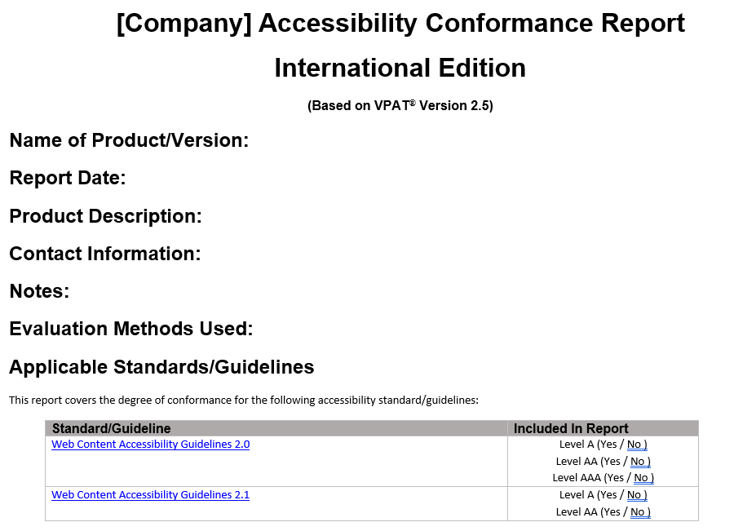
Product information

Slide 14
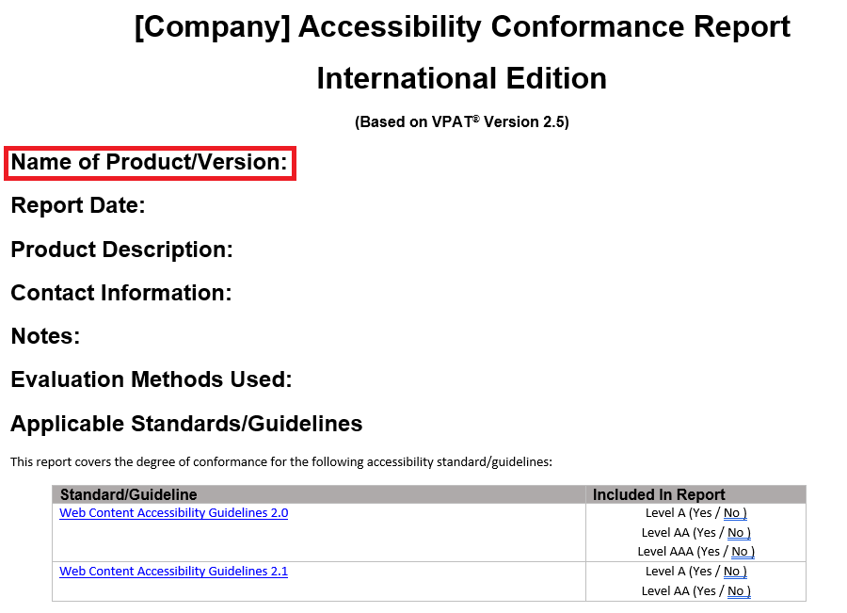
Product information – Name/Version

Slide 15
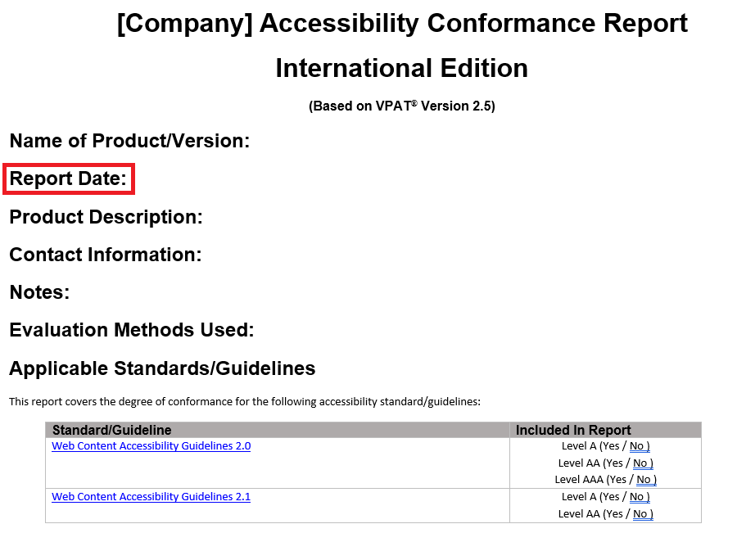
Product information - Date

Slide 16
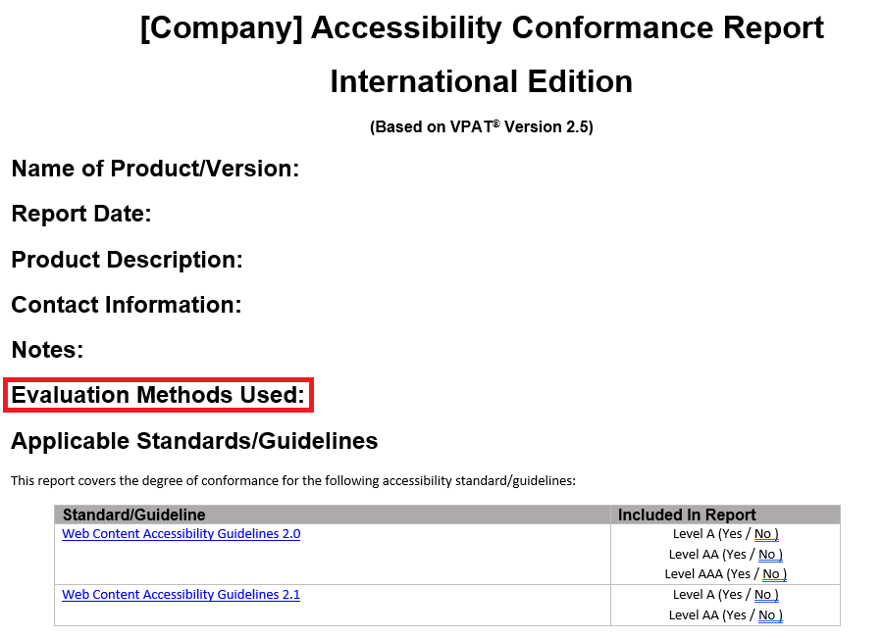
Product information - Methods

Slide 17
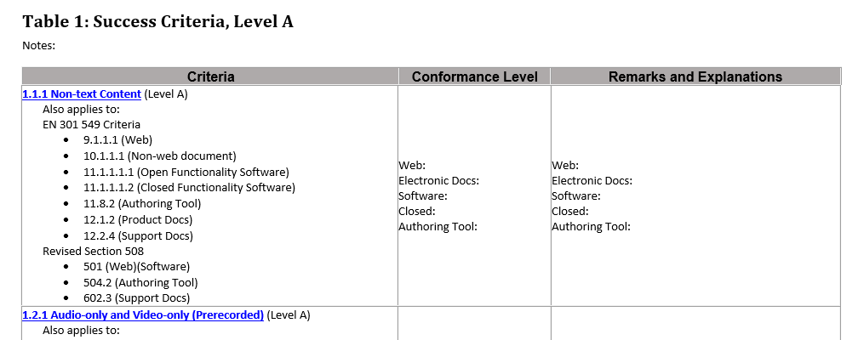
WCAG Success Criteria

Slide 18
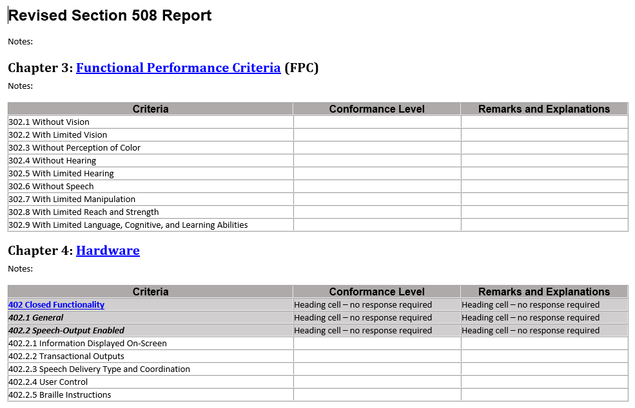
Revised Section 508 Report

Slide 19
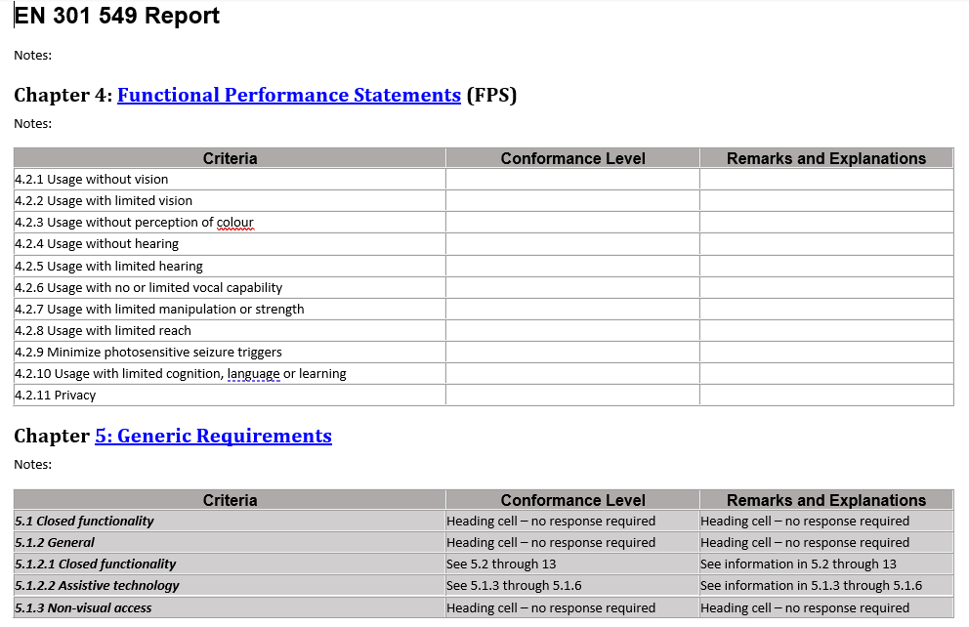
EN 301 549 Report

Slide 20
VPAT rating values
Supports: “The functionality of the product has at least one method that meets the criterion without known defects or meets with equivalent facilitation.”
Partially Supports: “Some functionality of the product does not meet the criterion.”
Does Not Support: “The majority of product functionality does not meet the criterion.”
Not Applicable: “The criterion is not relevant to the product.”
Not Evaluated: “The product has not been evaluated against the criterion. This can only be used in WCAG 2.x Level AAA.”

Slide 21
Ratings and remarks
“Partially Supports” and “Does Not Support” are both a “fail” rating. The remarks are crucial for understanding impact on users and for comparing products.
“Supports” ratings should also have remarks when necessary to qualify why it got this rating.
If you see a “Not Applicable” rating, it means the product does not have content relevant to this criterion

Slide 22
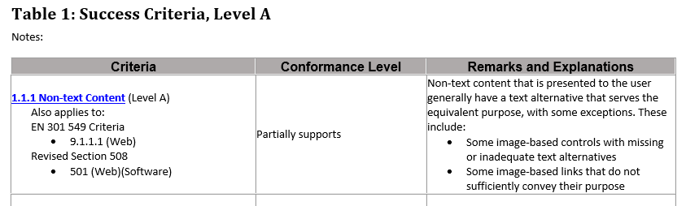
Example

Slide 23
How do I get a VPAT report?

Slide 24
First get an accessibility audit
An auditor evaluates the content and functionality of your product
The VPAT report lists the results of the audit

Slide 25
Choose your accessibility standards
Easiest: choose all standards – WCAG, Section 508, and EN 301 549
Always include WCAG level A and AA
WCAG 2.2 includes all WCAG 2.1 and WCAG 2.0 success criteria
Include Section 508 for potential US public sector
Include EN 301 549 for potential EU or Australia public sector

Slide 26
Identify a sufficient sample for testing
Must represent all the types of pages and functionality in your product
Product documentation
Support services
Authoring tool – such as a rich text editor
Third-party content integrated into your product

Slide 27
Accessibility audit testing procedures
Type of testing | Example of tool or technique
Automated testing | ARC Toolkit (by TPGi)
Manual testing | Using a keyboard only
Markup examination (Web) | Chrome developer tools
Assistive Technology | Screen reader (JAWS, NVDA, VoiceOver)

Slide 28
A good quality VPAT report that your customers can trust
Disclose the testing methodology
Provide clear remarks to justify the ratings
Work with a reputable third-party auditor
Keep up with the current version of your product

Slide 29
What if the VPAT report lists accessibility problems?
Offer a plan and timeline for improvements.
Focus on users with disabilities.
US government buyers can select a product which “best meets” requirements.

Slide 30
Risks of a Poorly Created VPAT
Cost you valuable contracts
Lead to compliance risks
Damage trust with buyers
Whenever possible, work with a reputable 3rd party like TPGi to create your VPAT!

Slide 31
When should we get a VPAT report?

Slide 32
Does the “V” still stand for “voluntary?”
Accessibility of your product is a legal requirement; a specific report on that level of accessibility is not
US public sector buyers require VPAT reports with Section 508
Reports can be available on your website or on request

Slide 33
When to prepare a VPAT report
You could wait until a customer asks you for one
Risk: an audit takes time
Risk: you don’t know your accessibility status
or audit first, then start on a VPAT report when asked
or report proactively

Slide 34
Be proactive
Get an accessibility audit.
Improve your product accessibility.
Prepare a VPAT report and update it regularly.
Inform current users of your accessibility progress.
Gain a competitive advantage.

Slide 35

Questions

