Slide 1
Understanding ADA Title II: Accessibility Auditing, Compliance, and Prioritization
David Sloan,
Chief Accessibility Officer and User Experience Practice Manager
October 28th 2025

Slide 2
Overview
Overview of the ADA Title II digital accessibility rule
How does it support public entities meet Title II obligations?
What requirements does it place on covered organizations?
Strategy for responding to the rule
Self evaluation
Corrective action planning and planning for new content
Accessibility audits: their tactical and strategic value

Slide 3
Prologue
This webinar does not offer legal advice!
Decisions made by the current administration have created some uncertainty over the direction of disability rights legislation and regulation in the United States
Regardless, people with disabilities need accessible and usable digital resources

Slide 4
Overview of the ADA Title II Rule on digital accessibility

Slide 5
Title II of the ADA
The original text of Title II of the ADA (1990) says:
“Subject to the provisions of this subchapter, no qualified individual with a disability shall, by reason of such disability, be excluded from participation in or be denied the benefits of the services, programs, or activities of a public entity, or be subjected to discrimination by any such entity.”
“Public entities” covered by Title II mean state and local governments and organizations and agencies funded by state and local governments
Includes public schools, colleges and universities, hospitals and healthcare clinics, transit agencies, utilities, libraries, election facilities, courtrooms and detention facilities,

Slide 6
The intent of the new rule
The Department of Justice has always maintained that ADA Title II applies to programs, services, and activities provided through websites and mobile apps
In 2024 a new rule placing accessibility requirements on web content and mobile app accessibility reinforced this position
It adds language to the ADA Title II regulation to provide clarity to covered organizations on how they can meet their ADA responsibilities of non-discrimination and effective communication when providing services and programs through websites and mobile apps
The rule’s intention is not to reduce protection for people with disabilities where other applicable laws or regulations may provide a higher level of protection
So an applicable state law with more stringent accessibility requirements would take precedence

Slide 7
What technologies are covered by the rule?
Web content:
HTML webpages, including embedded audio and video
Digital documents (e.g. Word, PowerPoint, PDF) made available through the web
Mobile apps

Slide 8
What is the technical accessibility requirement?
Covered web content and mobile apps must meet Web Content Accessibility Guidelines (WCAG) 2.1 Level AA
Although this is one version older than the latest version of WCAG, there’s nothing in the rule to stop organizations adopting WCAG 2.2
The Department of Justice could not issue a rule that refers to the “latest version” of a standard

Slide 9
Deadlines for compliance
Deadlines are based on the size of the covered organization:
April 24, 2026 for state and local government entities with populations of 50,000 people or more
April 26, 2027 for state and local government entities of less than 50,000 people, and also for special district governments

Slide 10
Exceptions on rule’s applicability
The presence of exceptions from the rule is intended to help covered organizations prioritize efforts on highest impact areas:
Exceptions are specific to the rule, not to the ADA
So covered organizations still need to be ready to address accessibility to meet ADA requirements to ensure effective communication and provide reasonable accommodations
Exceptions apply to certain types of content based on its age, format, purpose, and who provided it:
The rule has very specific definitions of content included in exception—if a piece of content doesn’t meet the definition, the exception doesn’t apply

Slide 11
Types of exceptions
Archived web content
Preexisting “conventional electronic documents” that are not currently used to provide programs, activities, or services
Content posted by a third party that is not engaged by a covered organization to provide content
Individualized, password-protected content
Pre-existing social media content posted by a covered organization

Slide 12
Other potential exceptions
When not meeting technical accessibility requirements:
Would cause undue burden and/or require fundamental alteration (“if it would cost too much” or “if it would change the resource too much”)
Can be mitigated by providing a “conforming alternative version” instead of a single version that meets WCAG 2.1 Level AA
Does not materially affect access to content, functionality, or participation for people with disabilities

Slide 13
Strategy for meeting rule requirements

Slide 14
ADA Compliance Strategy
Understand current state (Self Evaluation)
Take action to address shortcomings in current state (Action Plan)
Fix issues in current digital resources (Corrective Action Plan)
Implement a strategy for ensuring new resources meet accessibility requirements (Plan for New Content)

Slide 15
1 Self Evaluation

Slide 16
Inventory existing resources
Goal: find out what web content and mobile apps are subject to the ADA Title II rule
Find and document all covered digital resources
Prioritize these resources for order of testing based on factors such as:
Purpose
Frequency and criticality of use
Planned lifetime
Ownership

Slide 17
Test existing resources
Goal: find out where the barriers are
In priority order, test or audit each resource for conformance with the technical requirements
Use a mix of methods:
Automated testing against (parts of) WCAG 2.1 AA
Manual testing against WCAG 2.1 AA
Usability testing with people with disabilities
Investigate issues that have already been reported

Slide 18
Automated testing
Accessibility platform tools can scan pages, components, user flows, or whole websites against a subset of WCAG and report:
WCAG failures
Issues of concern requiring manual checks
Benefits: very quick, can test at scale, gather data for benchmarking and performance over time
Limitations: Don’t test against all possible issues, results require manual verification

Slide 19
Manual testing
Manual testing allows comprehensive testing against all of WCAG (auditing)
Efforts can be speeded up with the use of tools for specific
Combine testing with compatibility testing with different browsers, assistive technologies etc
Benefits: Fuller coverage, allows remediation advice that’s specific to the resource in question, can test digital resources for which there may be limited automation opportunities, can identify how to help users affected by barriers while they still exist
Limitations: Takes a long time, requires expertise to ensure accuracy and consistency

Slide 20
2.1 Corrective Action Plan

Slide 21
Remediate existing resources
Goal: fix the barriers identified in testing
For each resource, take a prioritized approach to remediation, considering
Severity of a barrier on affected groups
Effort to fix
Availability of workarounds for users affected by barriers
Validate remediation efforts through further testing
Include usability testing with people with disabilities

Slide 22
Record remediation efforts
Goal: provide evidence of remediation
Record for each resource:
Methodology for evaluation and remediation
Progress in remediation
Support for people affected by barriers not yet fixed – and make this information easily available
Justification for non-remediation (e.g. invoking exemptions)

Slide 23
2.2 Planning for new content

Slide 24
Analyzing audit results
Goal: use audit data on accessibility barriers to identify source of issues
Use analysis to discover:
Patterns of issues – where did they occur, what were the characteristics?
What was the root cause of the issue?
How could the issue be prevented from reoccurring in the future?
Use as input for the Plan for New Content

Slide 25
Acting strategically on audit results
Goal: use audit data on accessibility barriers to identify process improvements
Use analysis results to discover where improvements could be made through:
Training – where improved knowledge and skills can help reduce issue occurrence
Fixing reusable components – where one fix could have positive impact in multiple pages
Improved documentation – where guidance on how to use components or implement designs could reduce accessibility issues
Rethinking use of third-party content – where selecting an alternative third-party solution could reduce the number of issues present
Better user experience – where selecting the right design or component could improve usability and enhance user experience for people with disabilities

Slide 26
Example audit issue
Issue: The “address lookup” button is not focusable or operable using the keyboard
Location: Sign-up form in Sign up for Parking Permit page
Impact: People who use the keyboard can’t activate the button to select their address from a list and have to manually enter their address
Severity: High
WCAG SC: 2.1.1
Remediation advice: Use a button element in place of the current <div> element. Make sure that scripts controlling the button functionality respond to keystrokes (Enter and Spacebar).
How did this issue occur?
What can we do to stop it occurring again?

Slide 27
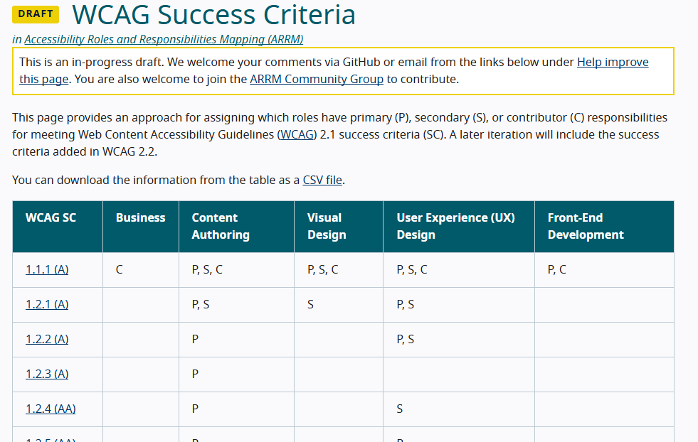
W3C Accessibility Roles Responsibilities Matrix (ARRM)
https://www.w3.org/WAI/planning/arrm/

Slide 28
Other key components of a sustainable accessibility strategy
Leadership support for accessibility as an organizational priority
An accessibility policy communicates accessibility as a core value of the organization and how it will commit to that value
A governance framework communicates how accessibility efforts will be monitored
Accessibility responsibilities for every role involved in creating, managing, procuring, or maintaining digital resources.
Recruitment and staff development plan that prioritizes accessibility skills
Vendor management policy and procedures that manage accessibility risk with third party ICTs

Slide 29
Useful official resources
The official text of the Final Rule published in the Federal Register: https://www.federalregister.gov/documents/2024/04/24/2024-07758/nondiscrimination-on-the-basis-of-disability-accessibility-of-web-information-and-services-of-state
Supporting resources from the Department of Justice
Fact sheet on the rule: https://www.ada.gov/resources/2024-03-08-web-rule/
Small Entity Compliance Guide : https://www.ada.gov/resources/small-entity-compliance-guide/
ADA Coordinator training: https://www.adacoordinator.org/

Slide 30

Turn Today’s Insights Into Action!
ADA Deadline Reminder:
Public entities must meet Title II requirements by:
April 24, 2026 (≥50k Population)
April 26, 2027 (Smaller and Special Entities)
Schedule a free ADA consultation by using the url: https://bit.ly/FreeADACall
How TPGi Can Support Your Next Steps
Comprehensive Digital Accessibility Audits
VPAT creation
UX and Accessibility Strategy Consultancy
Automated Testing with ARC Platform
Accessibility Training
Self-Service Kiosk & Testing Solutions
Download your ADA Title II Blueprint by using the url: https://bit.ly/ADABlueprint
Your Accessibility Partner

Slide 31

Questions

