Slide 1

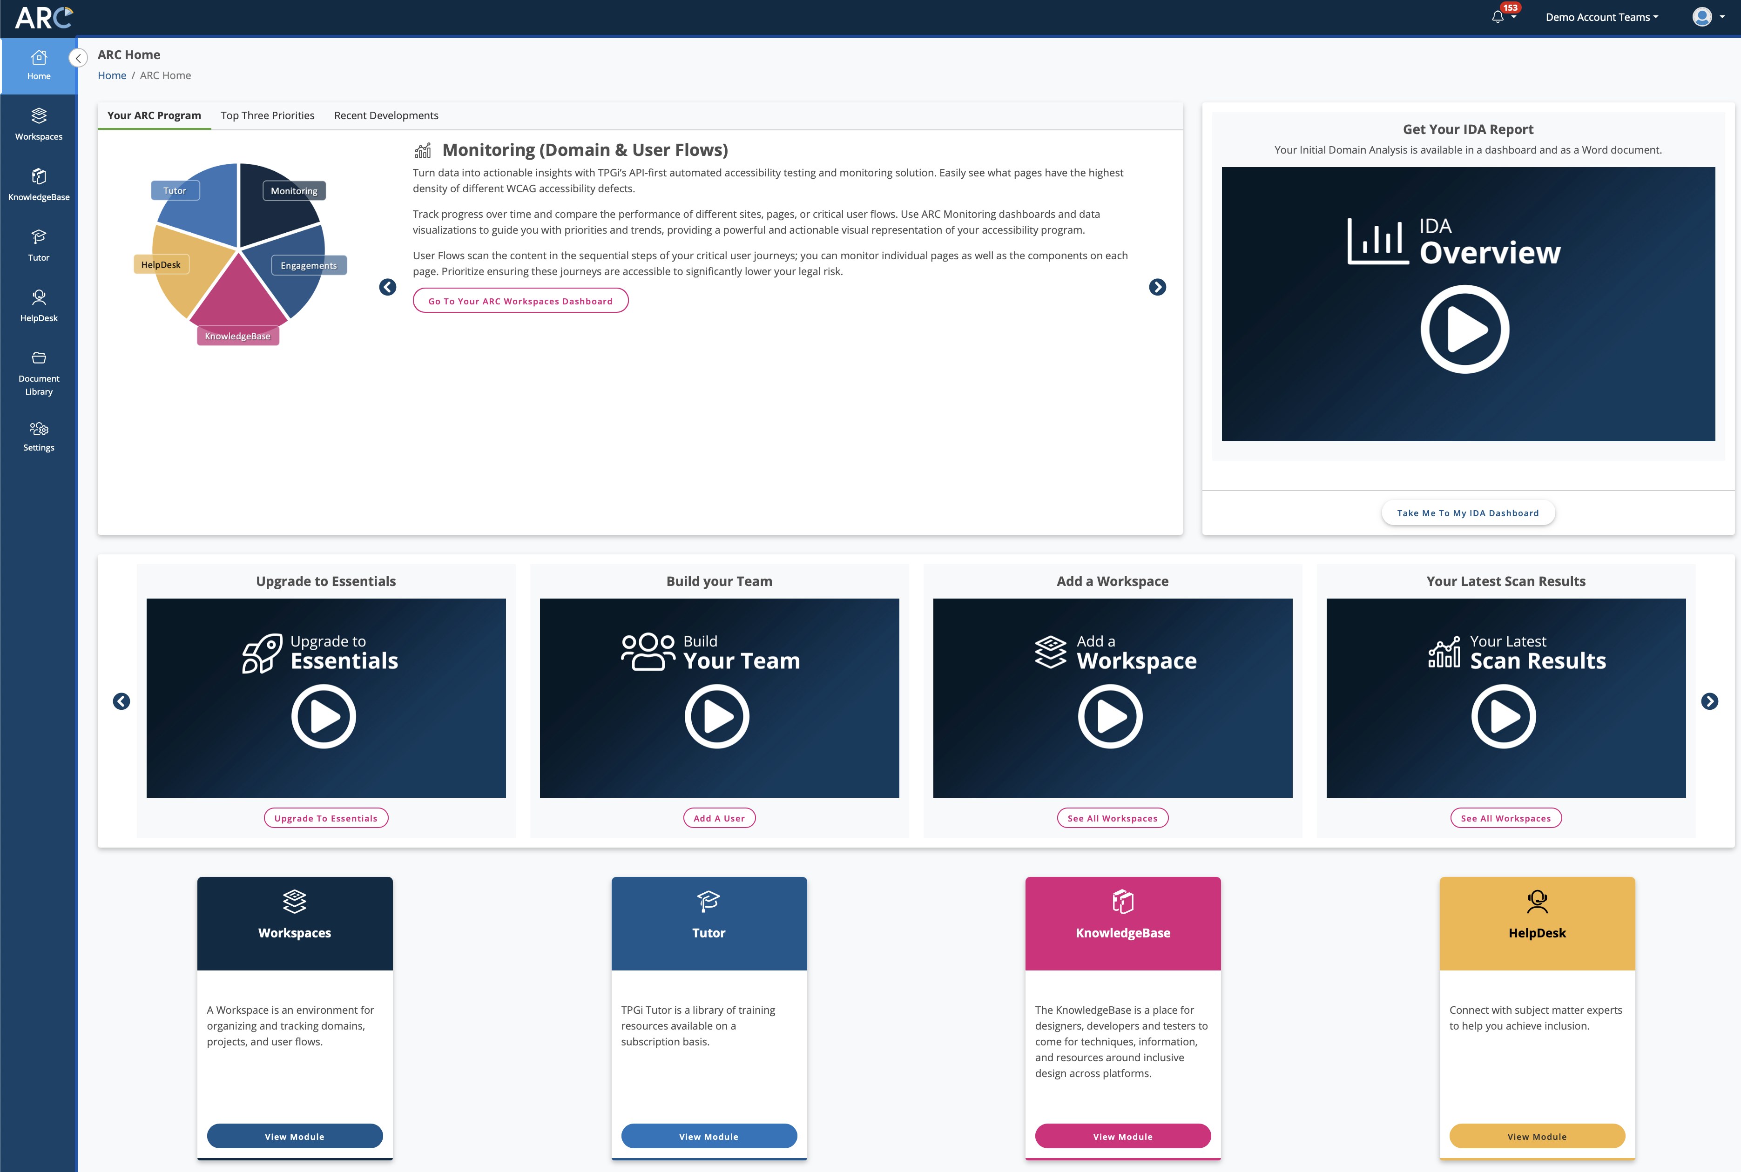

Advance Your Return on Accessibility (ROA) with Testing
Charlie Pike
Director, Platform Success
cpike@tpgi.com

Slide 2
Agenda
Introduction
Discovery
Rollout
Maturity
Q&A

Slide 3
The Analysis Onion
Domain Scans
User Flows
AT Testing
User Feedback
User Research
Manual Expert Audits

Slide 4
1. Discovery

Slide 5
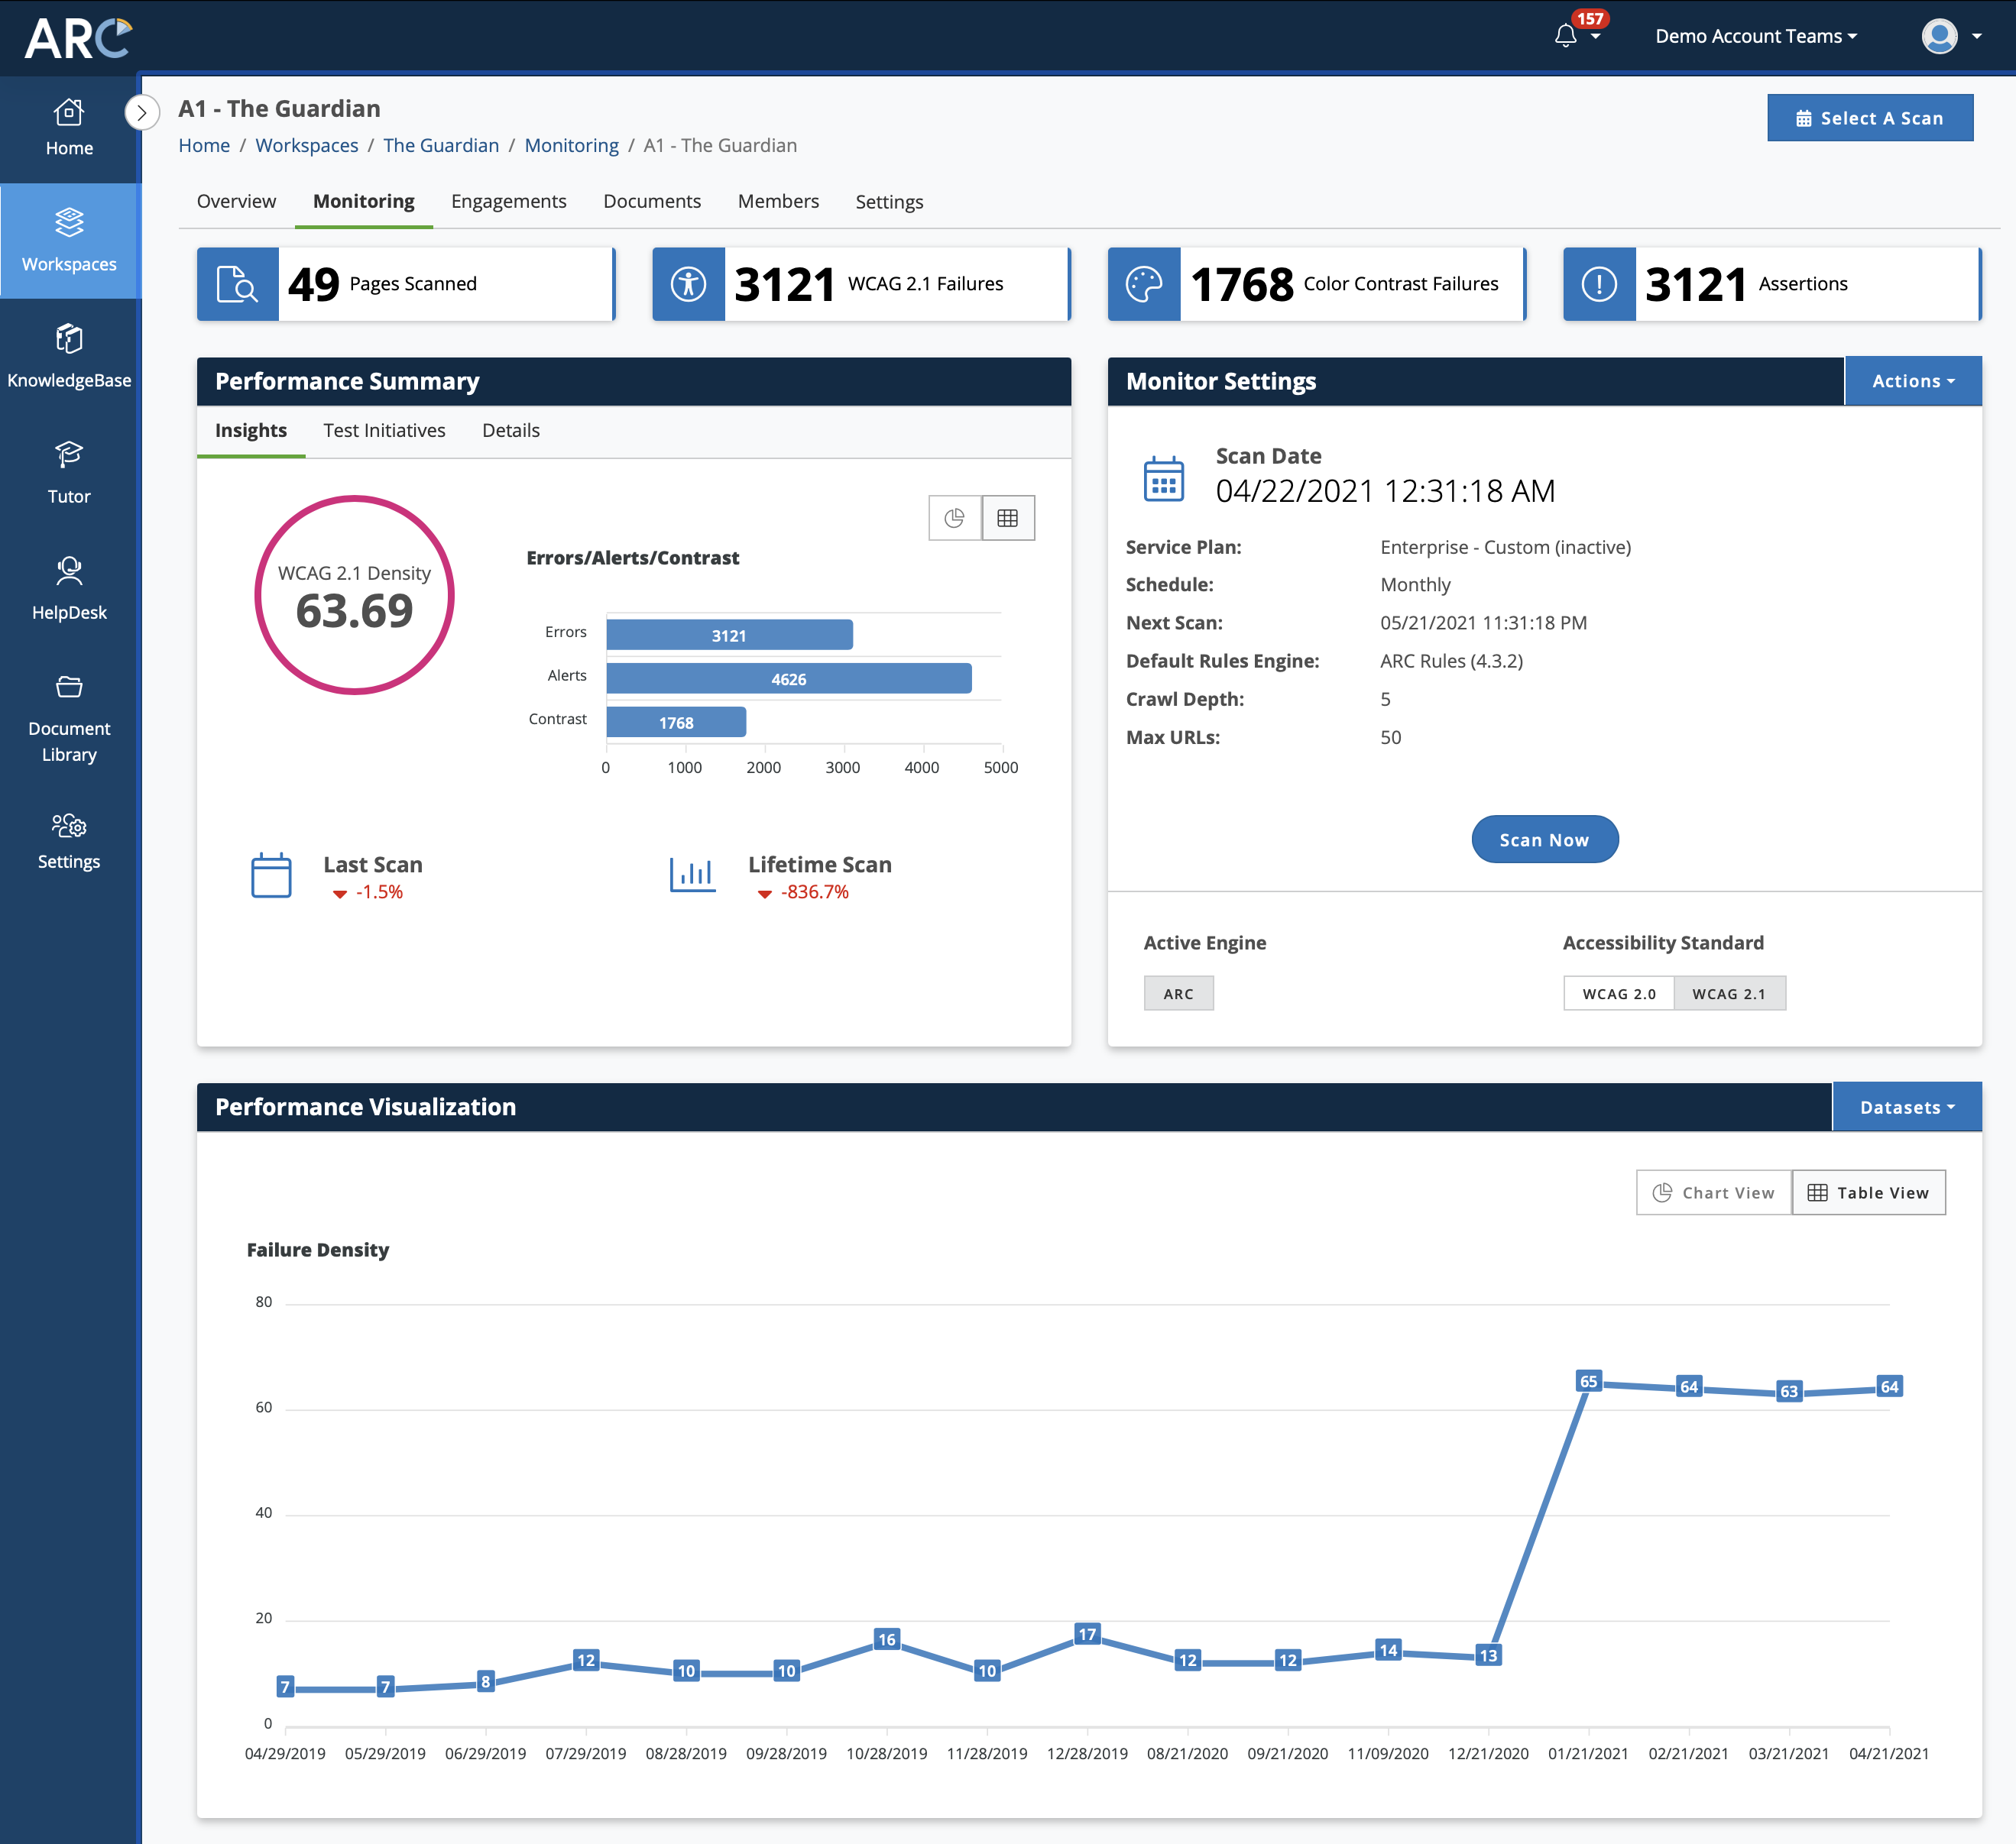
Discovery: Domain Monitoring
Accessibility scanning:
  Websites
  Web applications

Slide 6
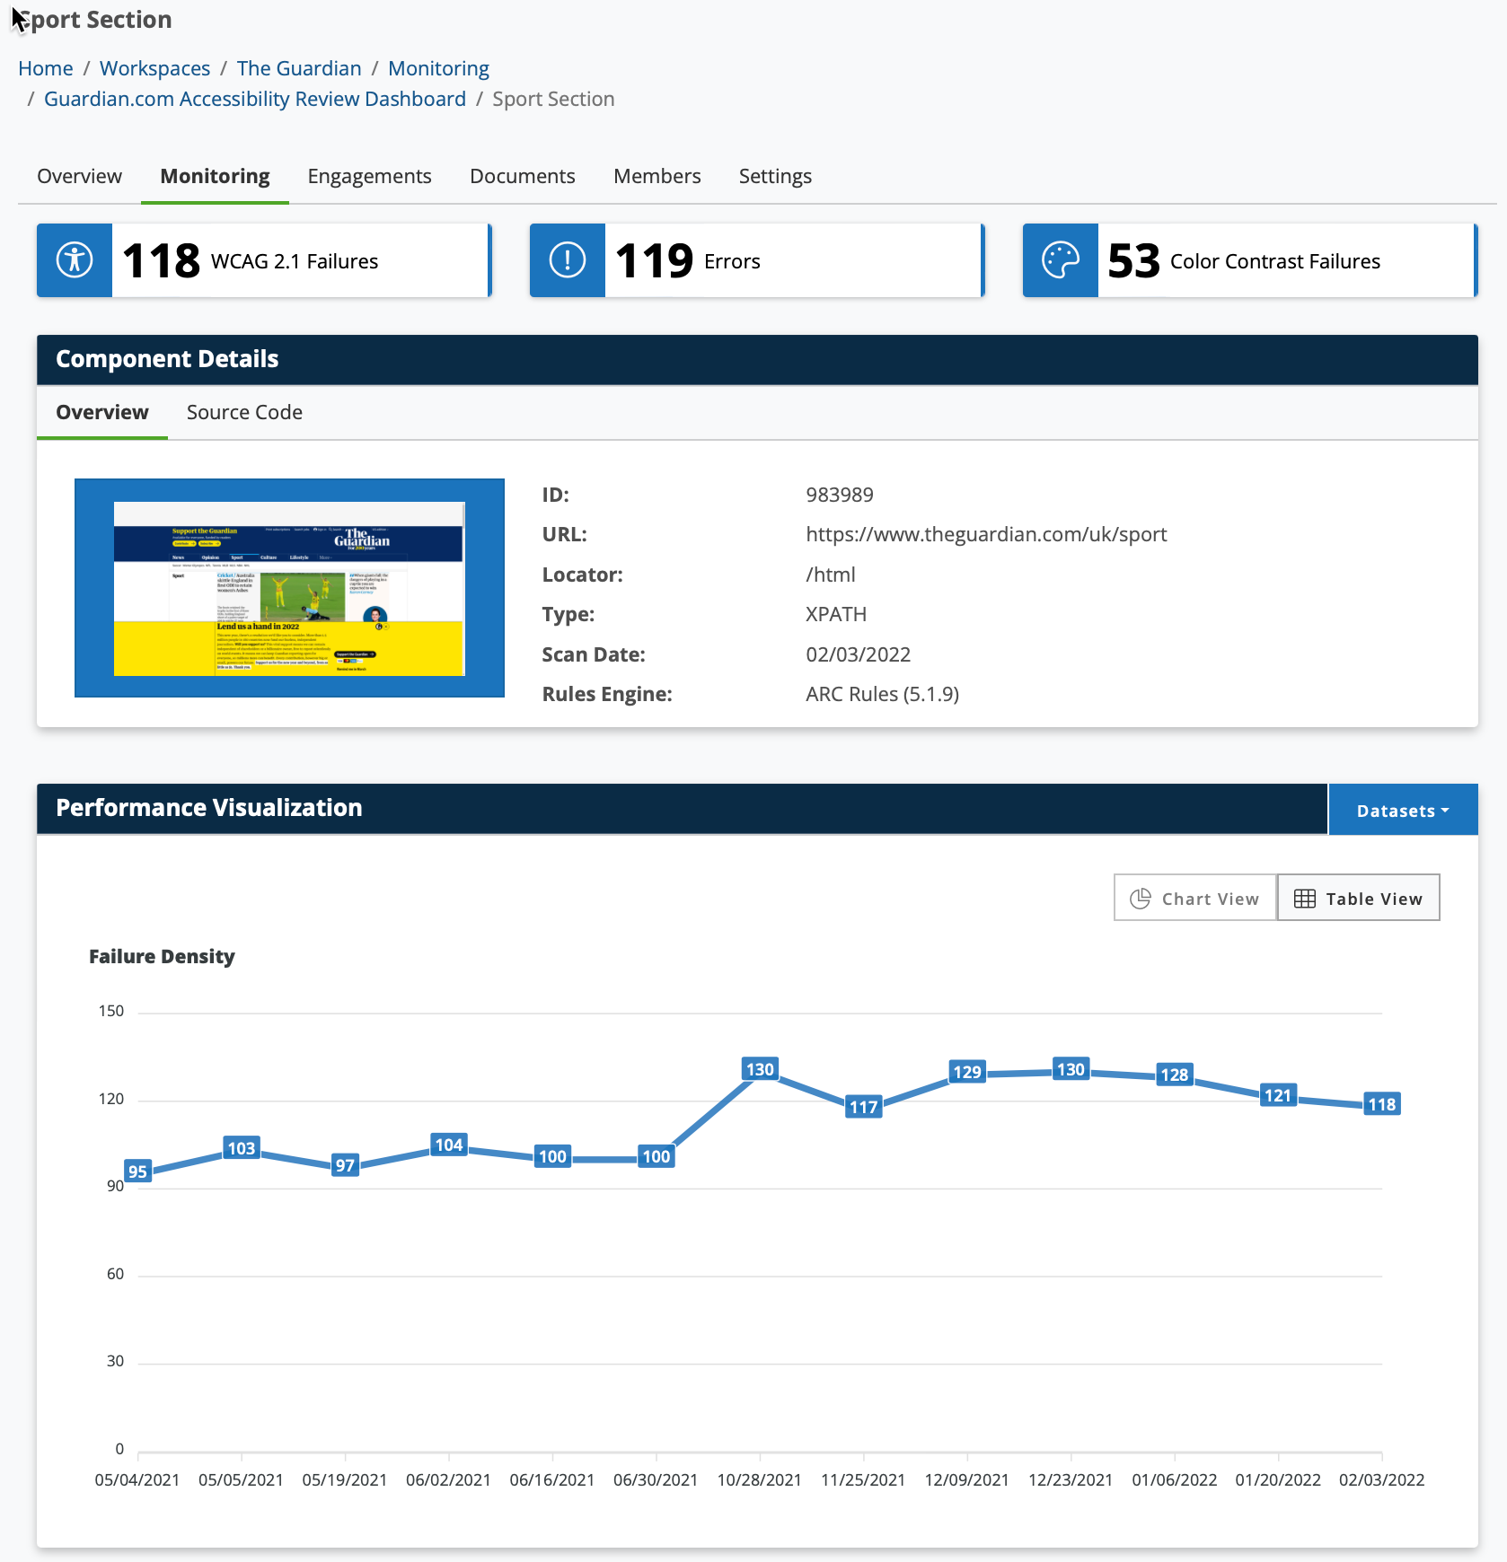
Discovery: User Flow Monitoring
Accessibility scanning:
  Interactive tasks
  Components

Slide 7
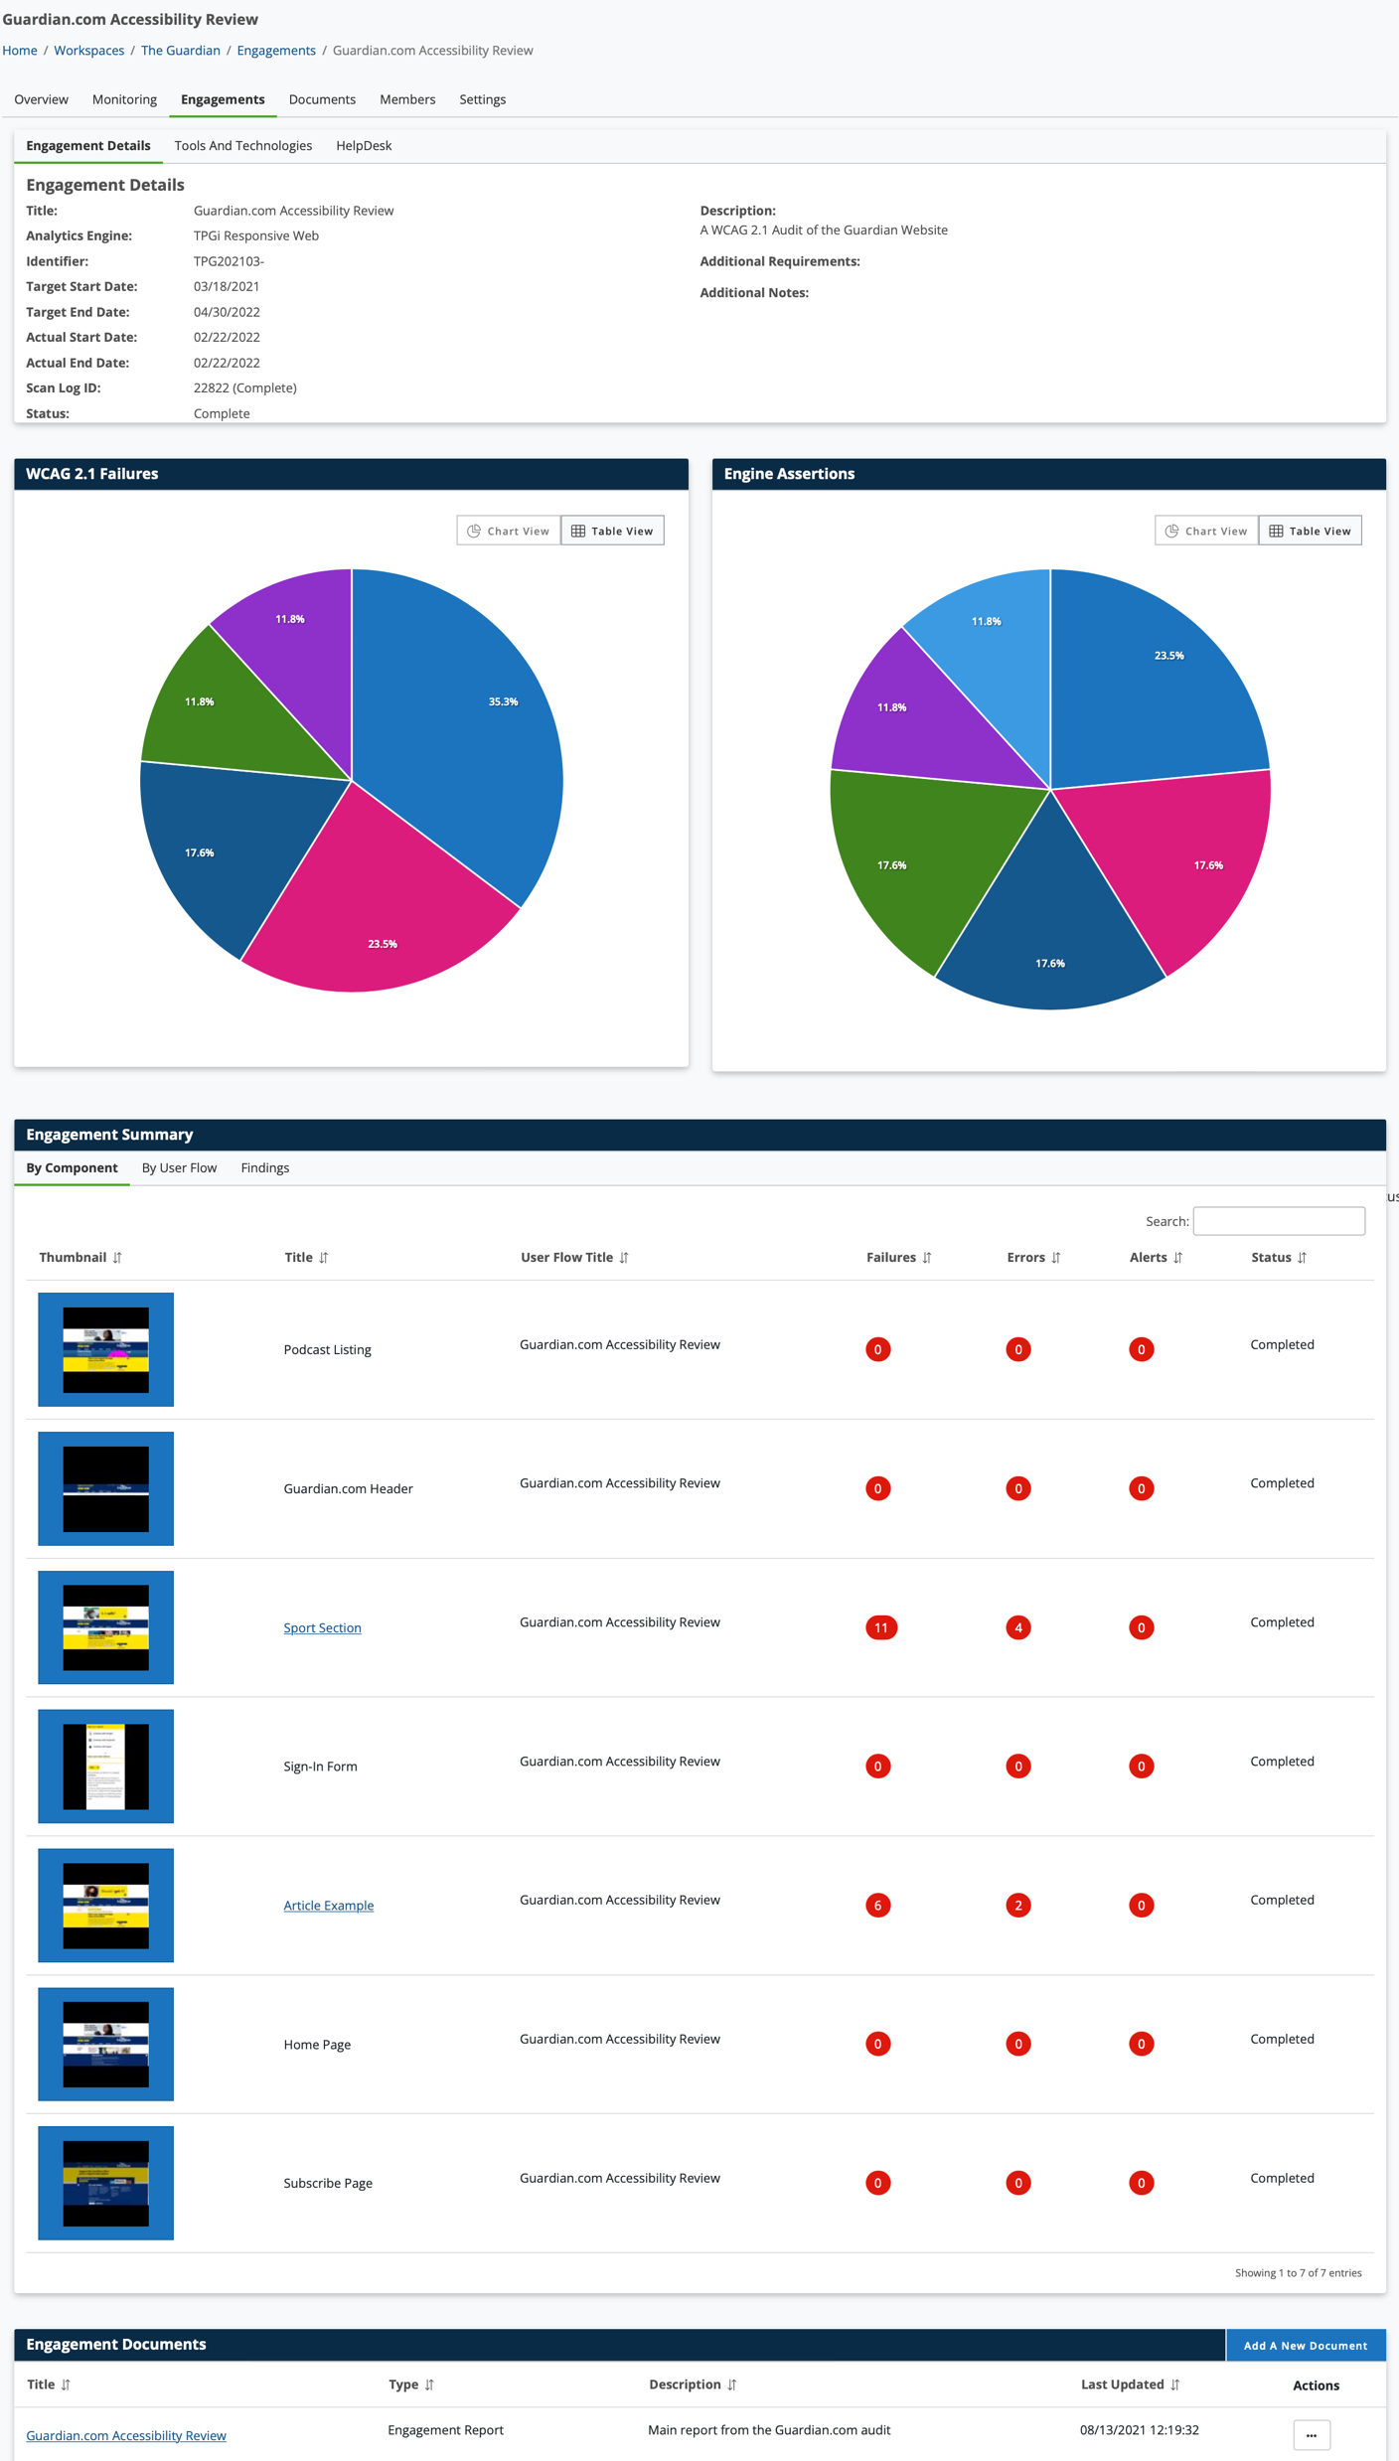
Discovery: Engagements
Manual Expert Testing
Full WCAG and Section 508 compliance testing

Slide 8
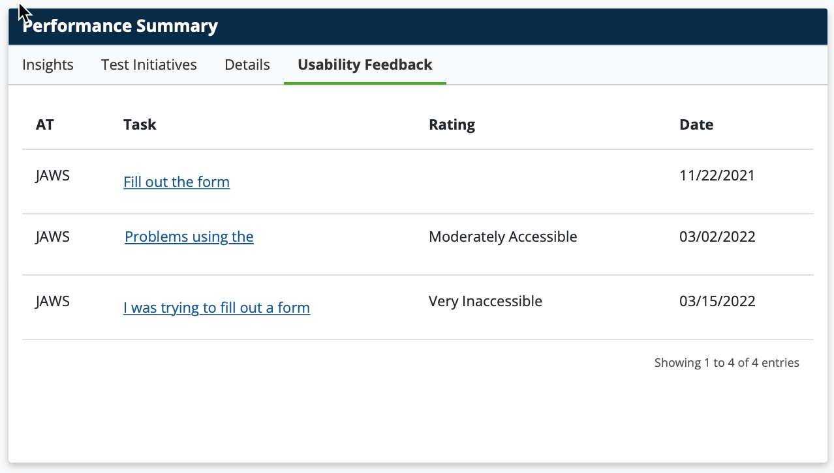
Discovery: JAWS Connect
Feedback direct from users
Collect feedback in monitoring dashboard
Combine with scan data for complete picture

Slide 9
2. Rollout

Slide 10
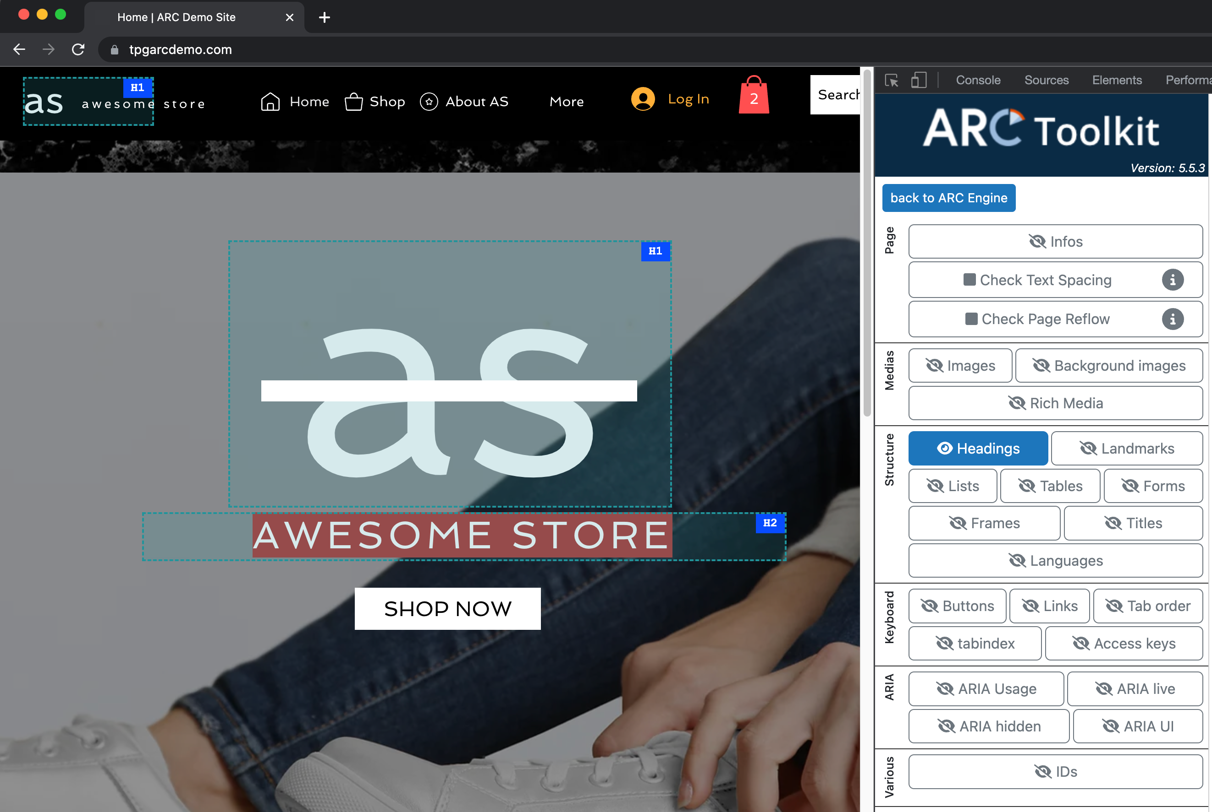
Rollout Testing
API integrated testing
ARC Toolkit
  On-demand
  Desktop installation
Node Package
  Deep environments

Slide 11
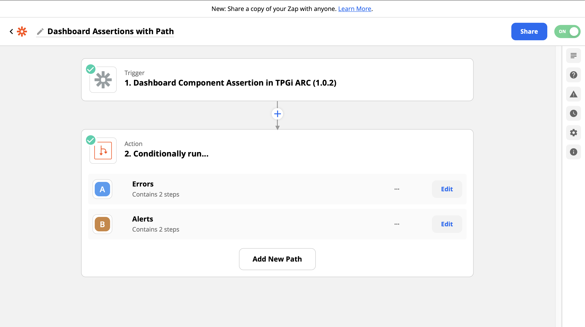
Reporting and Workflow
Use Zapier to raise bugs and build reports
API to integrate tests and reports into development and test environments

Slide 12
3. Maturity

Slide 13
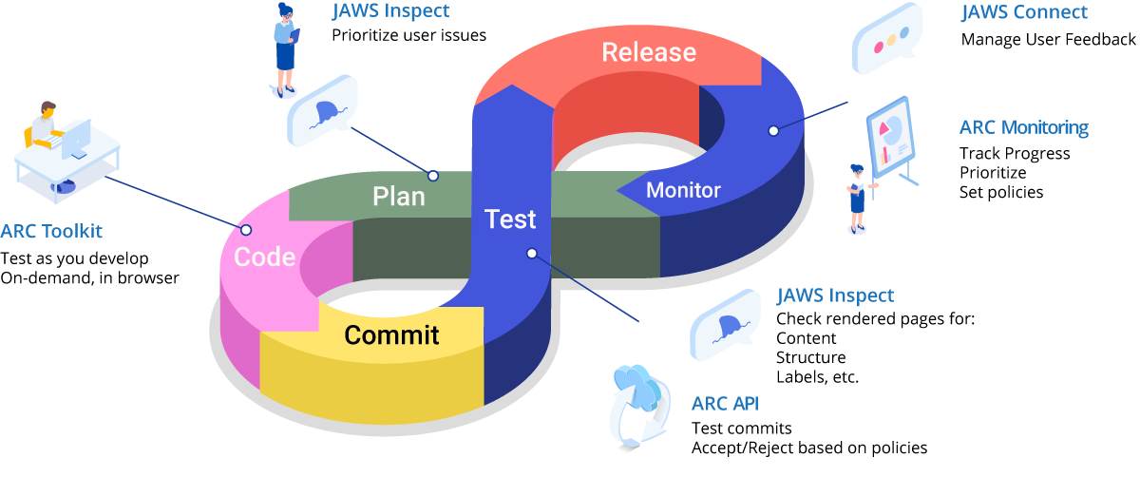
“Mature” Accessibility Assembly Line

Slide 14
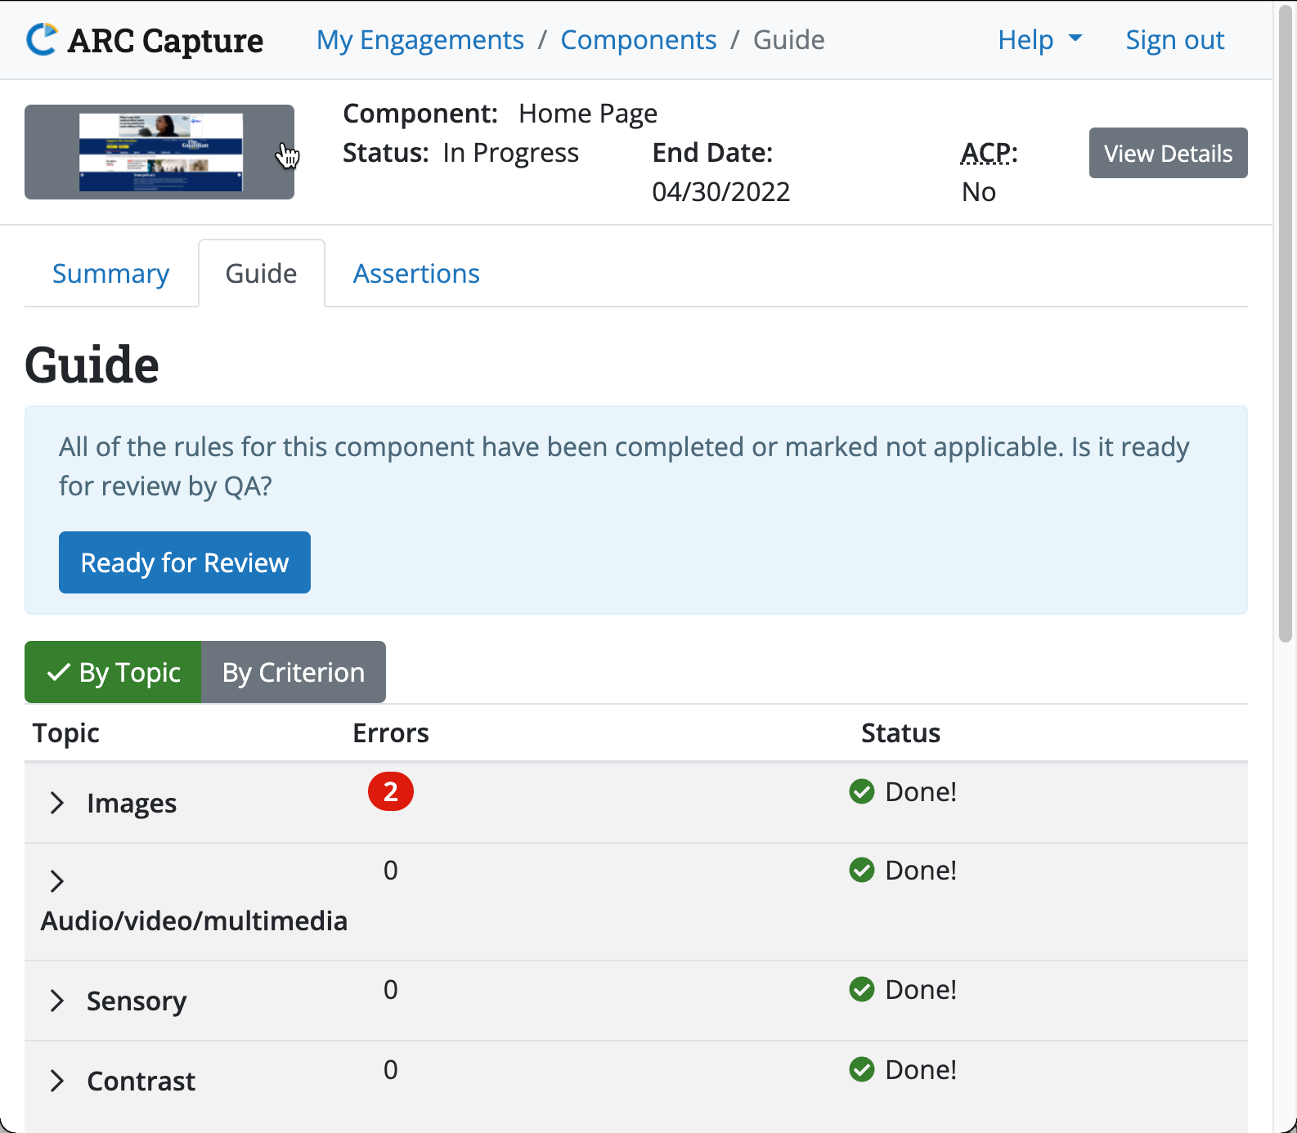
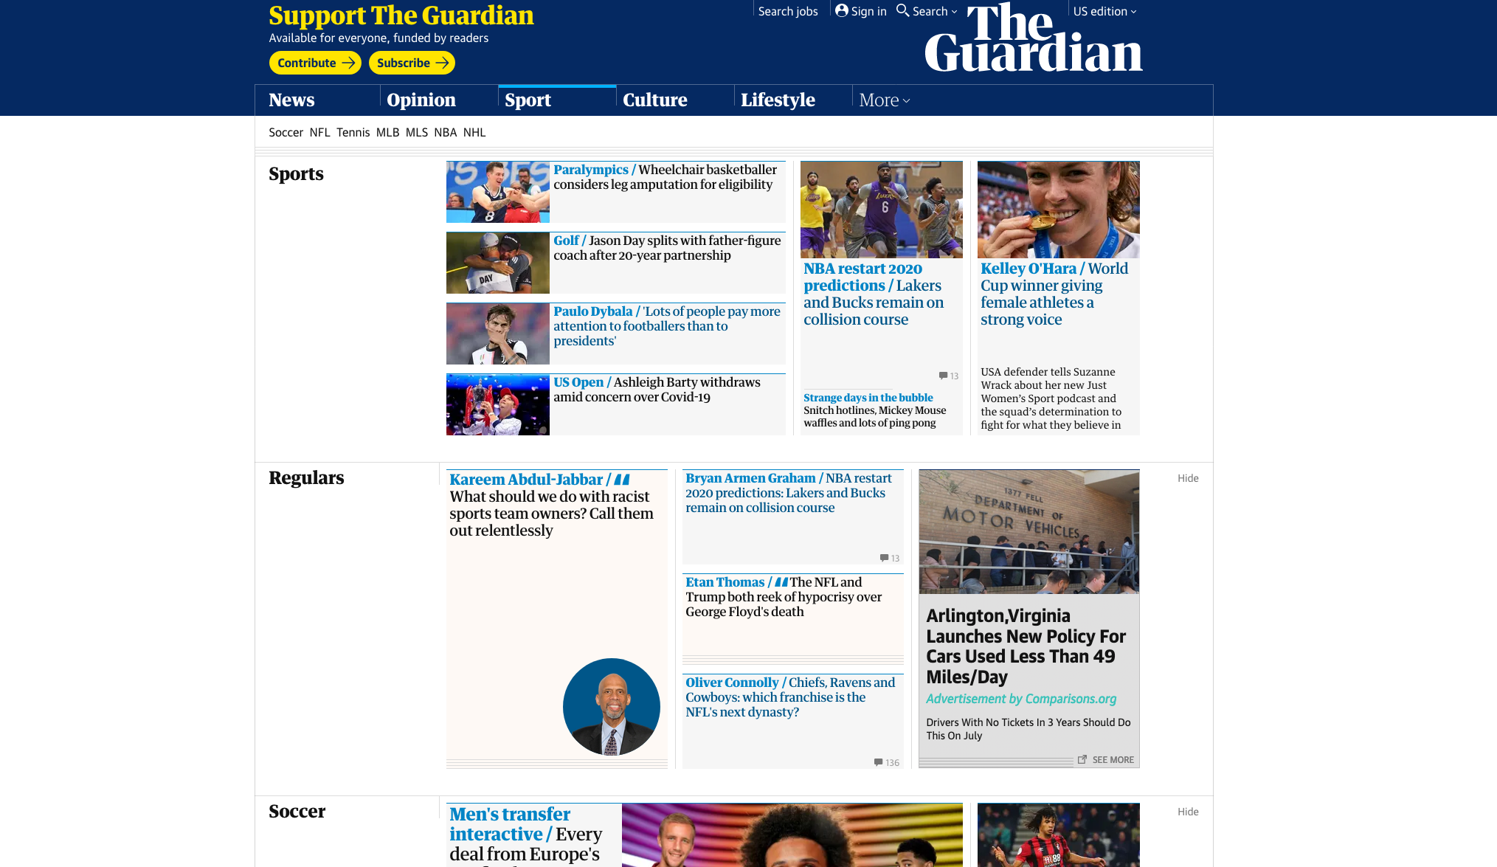
Provider
Manage your own manual testing projects and services

Slide 15

Questions

Slide 16

Thank You
Thank You!
Charlie Pike
cpike@tpgi.com

