Slide 1
Assessing the European Accessibility Act: What is the Impact Several Months Later?
David Swallow
Principal UX Consultant

Slide 2




Cast your minds back to 28 June 2025…

Slide 3
Where We Are Now: The Post-Deadline Reality
Readiness varies widely — from mature programmes to organisations still working out if they’re even in scope.
The EAA covers specific consumer-facing products and services — not everything — and that’s creating confusion.
End-user reporting and complaints appear to be increasing.
Awareness is uneven across the EU, though AccessibleEU, EDF and some national bodies are helping close the gap.
Member states are progressing at different speeds, so guidance and enforcement aren’t yet consistent.

Slide 4
The Missing Piece: EN 301 549 and Standards Lag
EN 301 549 v4 Timeline:
Under review by market surveillance authorities in the EU countries (as of Nov 2025)
Publication expected May 2026; legal adoption Sept 2026
Organisations expected to comply before the updated standard is finalized
The delay creates uncertainty and momentum risk: “Why act if nothing’s final?”
Most guidance points to WCAG 2.2 AA + EN 301 549 v3.2 for now.

Slide 5
Highlights in EN 301 549 version 4
 | Version 3 | Version 4
WCAG applied to web, documents, and software: | WCAG version 2.1 | WCAG version 2.2; Aligned with WCAG2ICT
Functional performance criteria: | Advisory only | Required
Real-time communications: | Clause 6 | Rewritten; see new standards
Video players: | Clause 7 | Revised
Stationary ICT (kiosks): | Clause 8.3 | Revised
Software user preferences: | Clause 11.7 | Revised
Product and service information: | Clause 12 | Revised; see new standards
Media programme guides: | - | New clauses 12.4-12.5
Communication relay services: | Clause 13 | Rewritten; see new standards

Slide 6
Other New and Revised EU Standards
New: Non-digital information - accessibility for printed materials, packaging, instructions, and physical formats
New: Support services - customer support, help desks, repairs, and installation services made accessible
New EN 303 919: Emergency communications - ensuring people with disabilities can contact emergency services and receive alerts
Revised EN 17161 (Design for All) - updated framework for embedding accessibility into organisational processes
Revised EN 17210 (Built Environment) - refreshed guidance for accessible buildings and physical spaces

Slide 7
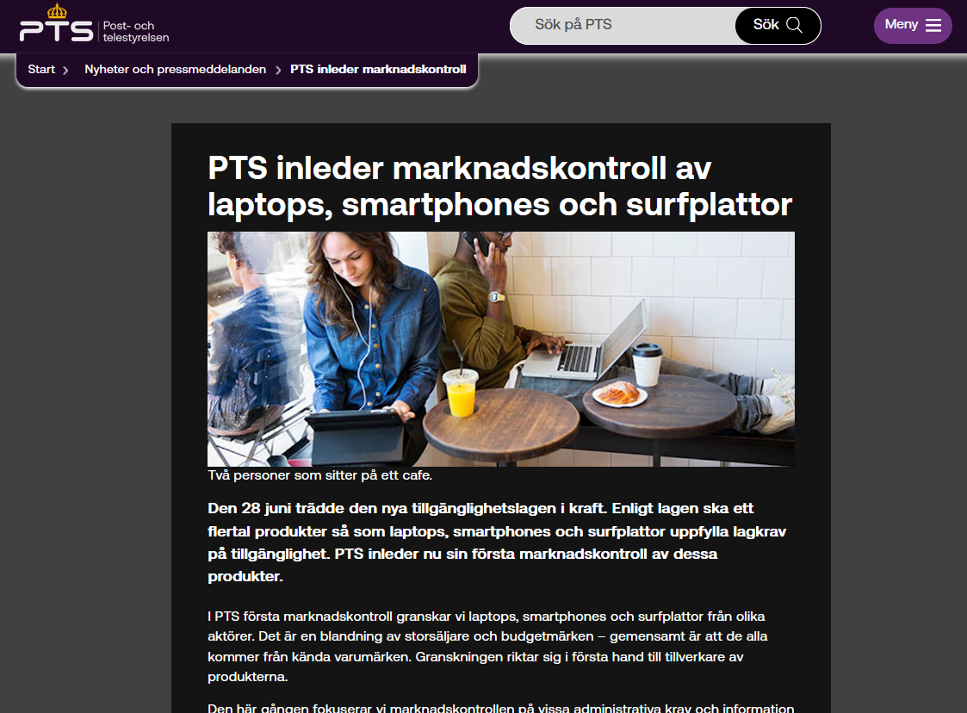
Monitoring Approaches across Europe
Wide variation in national monitoring strategies
Some rely mainly on automated testing
Others combine automation, manual testing, and input from people with disabilities
Early focus on monitoring economic operators
Real enforcement underway (e.g., Sweden’s PTS inspecting devices)
Dedicated bodies emerging: MLBF (DE), DGCCRF (FR)
Public education and complaint channels developing unevenly

Slide 8




Enforcement – Early Signals
Legal action initiated in France against Auchan, Carrefour, E. Leclerc & Picard
July 2025: formal notice (mise en demeure) issued by ApiDV, Droit Pluriel & Intérêt à Agir
Alleged barriers: missing alt text, poor keyboard navigation, semantic structure flaws
Deadline given to comply by 1 Sept 2025; associations pressing for systemic change
November 2025: urgent court referral filed for “digital discrimination”
National-level enforcement risk: major brands aren’t exempt
Accessibility failure framed as discrimination, not just a technical issue

Slide 9
Procurement and Compliance
EN 301 549 now central to public-sector ICT procurement:
ETSI TR 101 551: guidance for buyers embedding accessibility into tenders
ETSI TR 101 552: guidance for suppliers on demonstrating conformance
Soon to be merged into one TR
Leading organisations:
Specify key user journeys
Define expected accessibility outcomes
Set clear evidence requirements (often with user involvement)

Slide 10

Emerging Friction Points
Divergent interpretations across member states
Lack of plain-language guidance
Participation barriers in standards development
Expanding accessibility scope is stretching organisations
Coordination across Europe is still developing

Slide 11

AI and the EAA
AI has the potential to enhance accessibility:
Automatic captioning and transcription
Real-time translation
Personalised assistive experiences
Smart content summarization
Risks and concerns if disabled people are not involved:
Unpredictable outputs
Biased or incomplete information
Interfaces that are technically accessible but fail in practice
The EU AI Act emphasises transparency and risk management — complementing, not replacing, accessibility.

Slide 12
Practical Guidance and Next Steps
Don’t wait for EN 301 549 v4; align with WCAG 2.2 AA
Engage early with competent authorities
Document accessibility efforts
Collaborate with people with disabilities
Internal coordination: procurement, training, product development
Factor in enforcement risk proactively

Slide 13

No fireworks, but real momentum…

Slide 14

Questions

