Slide 1
How Beginners Can Easily Test for JAWS Screen Reader Accessibility
Charlie Pike
Director, Platform Success

Slide 2
Agenda
Introduction
JAWS Inspect
When and how to test with JAWS
5 Accessiblity Checks
Demonstration
Q&A

Slide 3
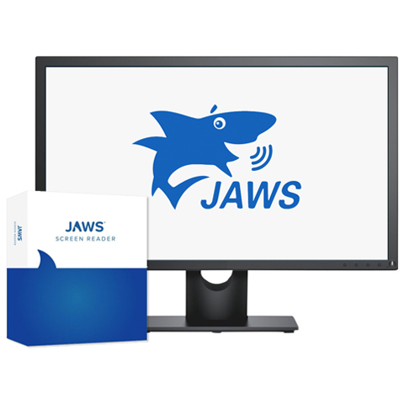
What is JAWS?
Job Access with Speech
World’s most popular Windows screen reader
Enables a blind or visually impaired user to read the text that is displayed on the computer screen with a speech synthesizer or braille display

Slide 4
Why test with JAWS?
Test compatibility with screen readers
Evaluate the user experience
Go past guidelines to grasp accessibility
User challenges are easy to understand
It may be technically accessible, but is it usable?
Notes:
Pinellas is a Loss converted the last 2 years of the ARC subscription to services. Will move to Free Tier.

Slide 5

JAWS Inspect
JAWS Inspect vastly simplifies accessibility and JAWS compatibility testing. Without the distraction of speech or the complex feature set of the end-user product, Inspect uses transcripts of JAWS output to help diagnose issues and share them easily across quality control and compliance systems.

Slide 6
Benefits
Simplifies JAWS use for testers
Text transcript of JAWS output for use in bug tracking and compliance programs
Helps with the identification of issues
Rapid rollout with limited training required
Demonstrates impact of accessibility on users

Slide 7
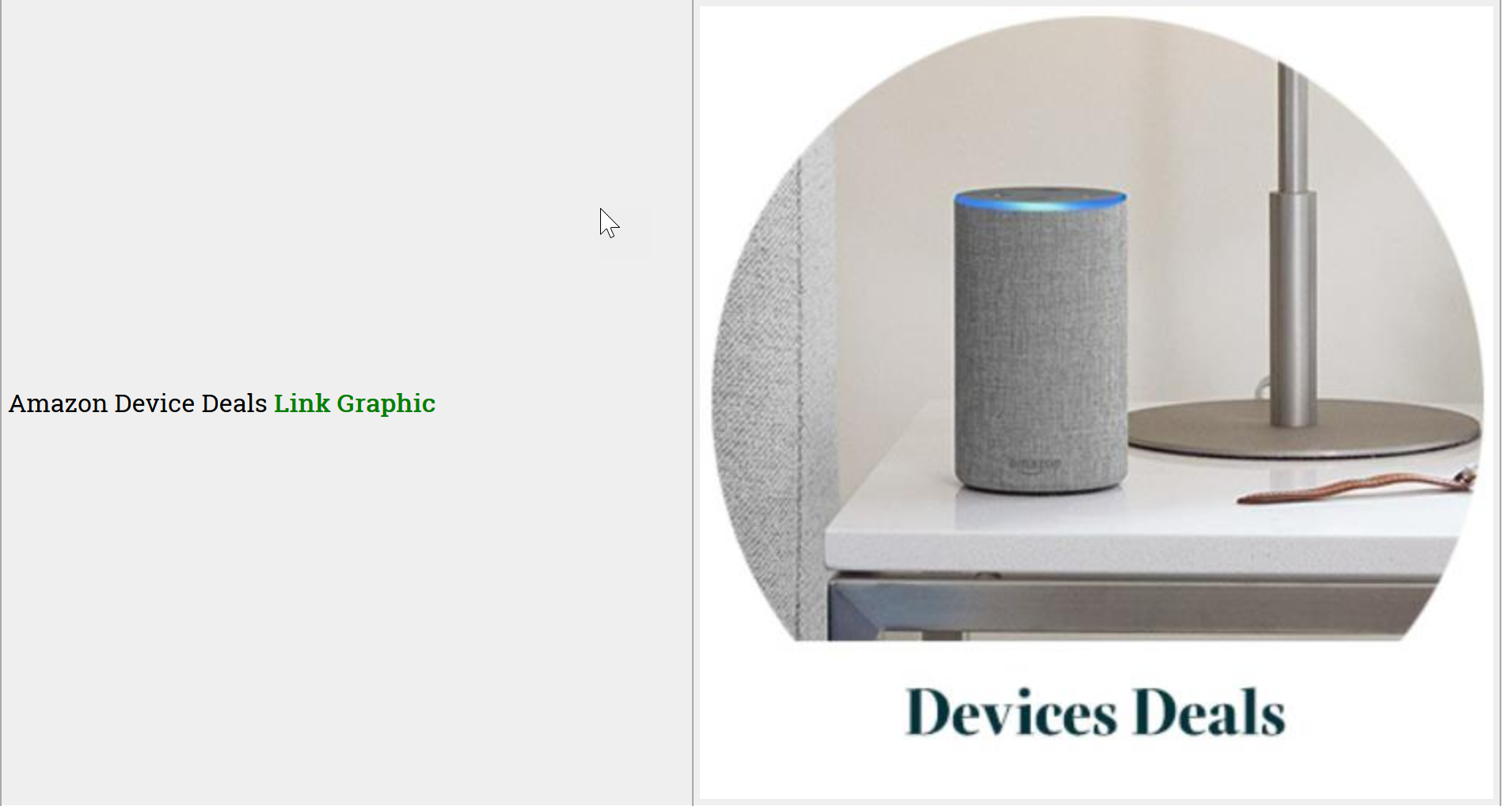
Top Features
A clear visual illustration of what JAWS users experience on your site
No need for accessibility expertise to read and understand reports

Slide 8
When and How to Test with JAWS

Slide 9
Peeling the Onion
Domain Scans
AT Testing
User Feedback
User Research
User Flows
Manual Expert Audits

Slide 10
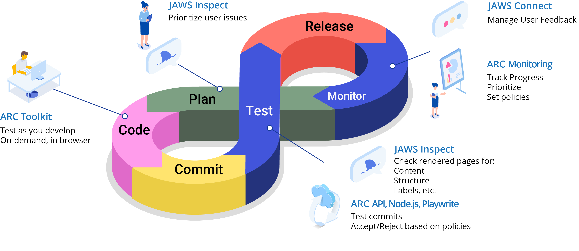
Accessibility Assembly Line

Slide 11
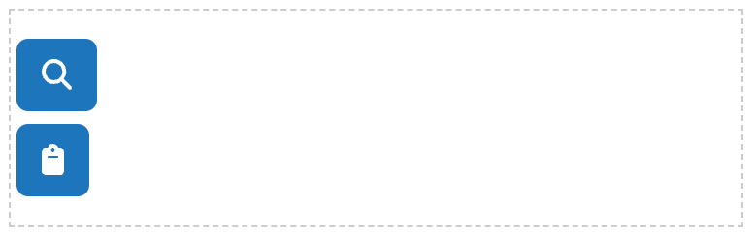
JAWS with other Tools
JAWS Inspect
Check images have alternate text
ARC Toolkit
Check alternate text is correctly coded and not duplicated
<img src = “https://www.amazon.com/media/” alt=“Amazon Device Deals></img>

Slide 12
JAWS and Technical Testing
JAWS Inspect
Check fields are labelled
ARC Toolkit
Check labels are programmatically connected to fields
<label for = “firstname”>
First Name
<input type =“text” id=“firstname”>
</label>

Slide 13
Benefits of 5 Simple Tests
Easy to perform using JI
Anyone can do them, little technical knowledge needed
Good indicators of overall accessibility
High impact for users

Slide 14
Accessibility Tests
Test 1: Non-text content
Test 2: Headings and structure
Test 3: Form labels
Test 4. Links and link text
Test 5. Keyboard and interaction

Slide 15
Questions?

