Slide 1
Countdown to Compliance:
The European Accessibility Act and Self-Service Kiosks 101
David Sloan, TPGi/Vispero
Roxana Fischer, Vispero
Matthijs Verhagen, Storm Interface
January 29th, 2025

Slide 2
Overview
Introduction to the European Accessibility Act
EAA requirements for self-service terminals and kiosk
Making self-service terminals accessible – hardware and software
Strategy for meeting and maintaining EAA compliance

Slide 3
Prologue
  This webinar does not offer legal advice!
  We’ll provide an interpretation of the EAA’s requirements from a kiosk/self-service terminal perspective and advice on strategy for meeting these requirements
  Please seek legal advice to establish your responsibilities for each EU country in which you do business

Slide 4
Introducing the EAA

Slide 5
European Accessibility Act - key points
  A European Directive, to be adopted into national law by each member state
  Focuses on specific consumer products (devices) and services available to EU consumers
  Defines:
    Accessibility requirements to be met by covered products and services
    Requirements for reporting conformance and providing feedback channels
  Also places responsibilities on member states for market surveillance

Slide 6
Covered products and services
Digital TV equipment
Computers and operating systems
Smartphones
Self-service devices such as ATMs and ticketing machines
e-Books and e-Readers
e-Commerce websites and mobile apps
Communication technology and equipment
Banking services
Passenger transport services
Audiovisual media services

Slide 7
General accessibility requirements for products and services
  Products and services must be designed and produced to “maximise their foreseeable use by persons with disabilities”
  This includes:
    Providing instructions for using a product in an accessible way
    Designing user interface and functionality in an accessible way, including providing alternative modes of interaction and supporting adjustment of input and output
    Protecting user privacy when using accessibility features
    Providing alternatives to biometric identification
    Providing accessible customer support services

Slide 8
EAA and other accessibility standards
EAA does not directly reference other accessibility standards. But it:
  References “perceivable, operable, understandable, and robust” – the four principles of the W3C Web Content Accessibility Guidelines
  Specifies functional performance criteria to be met, similar to Section 508 in the US.
  Has a provision (in Article 15) for “presumption of conformity” based on conforming to relevant harmonized EU standards
EN 301 549 Accessibility requirements for ICT products and services is a harmonized standard for EAA’s companion, the EU public sector Web Accessibility Directive:
  Integrates by reference technical accessibility requirements from WCAG 2.1 and closely aligns with the US Section 508 Standards
  Is being updated to become a harmonized standard for EAA, expected early 2026
  Following the current version of EN 301 549 can help demonstrate conformance with EAA accessibility requirements

Slide 9
Conformance declaration
  Product manufacturers and service providers have obligations to assess and declare conformance with accessibility requirements, including:
    Communicating conformance to relevant audiences
    Establishing processes for maintaining conformance and taking corrective action when a product or service is found not to conform
    Maintaining and providing information to demonstrate efforts to maintain conformance over time
    Declaring (with evidence) non-conformance due to applying EAA’s fundamental alteration or disproportionate burden exemptions
  Member States have obligations to establish mechanisms to monitor conformance (“market surveillance”) and take appropriate steps when a product or service is not in conformance

Slide 10
Deadlines for conformance
  The deadline for conformance for covered products and services is June 28, 2025:
  Exceptions to this deadline include:
    Services provided through non-conformant products can continue to be provided using those products until June 28, 2030
    Self-service terminals that were in use as of June 28 2025 can remain in use to provide services for up to 20 years after they were first made available for use

Slide 11
Making self-service terminals accessible

Slide 12
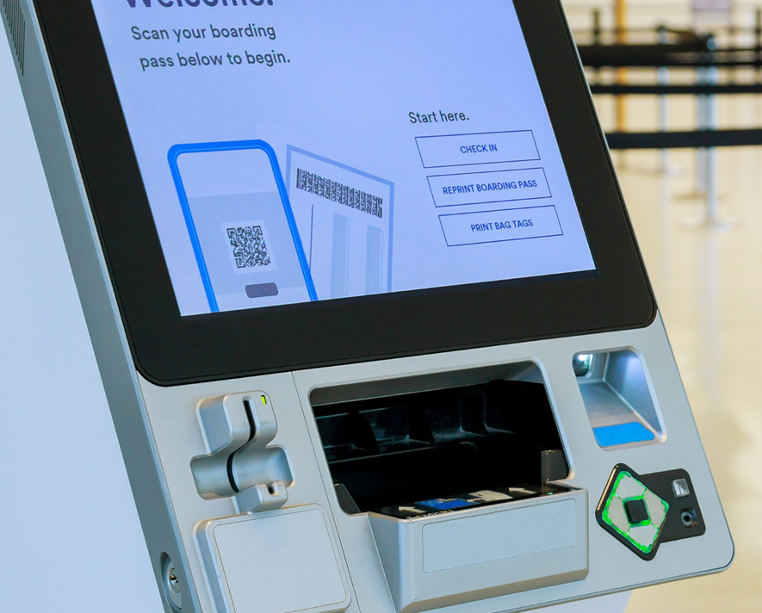

Providing accessible alternatives
Visual information
Instruction video -> audio description
Auditory information
Warning sound -> on-screen warning
Physical usage
Touchscreen -> physical buttons
Interaction
Timeout -> option to extend

Slide 13
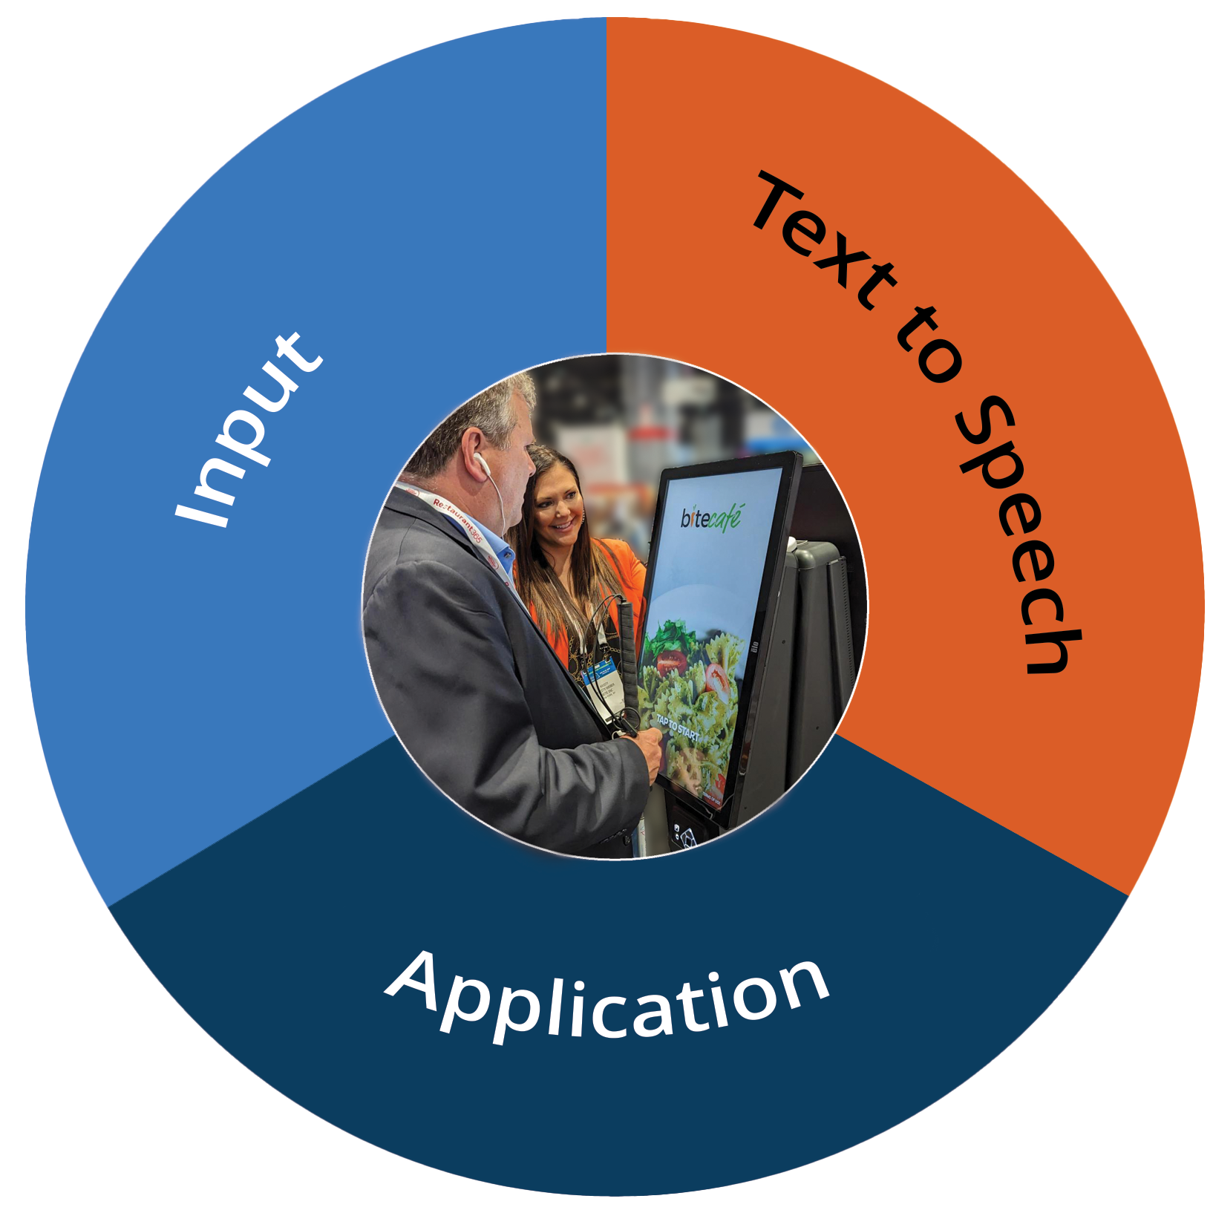
Components of an accessible kiosk
Input: Providing input methods that can be operated by people with disabilities
Output: Providing alternatives such as text-to-speech output
Application: Ensuring the kiosk application is designed to be accessible and usable

Slide 14
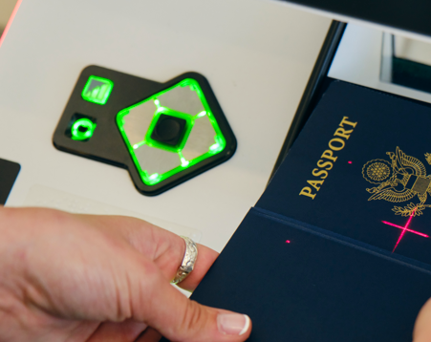
Supporting accessible input (hardware)
  Physical dimensions (Reach)
  Force of operation
  Input Methods
  Support accessible alternatives
  Automatic accessibility activation

Slide 15


Supporting accessible output (software)
Text to Speech
Audio Files
Self Voicing
Screen Reader (JAWS for Kiosk)

Slide 16
Supporting accessible output (software) – cont.
Things to Consider:
Language Support
Touch Support
Support for Alternative Inputs
Support for headphone jack Start and Stop
Support Pronunciation Dictionary
Support Context Information, Instructions and Hints
Support Voice Rate, Pitch and Volume Change
Support Privacy Mode
Operating system
Technical Support
Customization
Updates

Slide 17
Designing accessible kiosk applications
  Make sure that all functionality and content is keyboard focusable
  Provide just enough information about a control to support speech output
  Ensure sufficient contrast between colors; don’t rely on color to communicate information
  Support adjustment of display to make content easier to perceive
  Provide functionality and content in a consistent way
  Avoid flickering and flashing content
  Provide notifications for timeouts and allow timeouts to be extended

Slide 18
Strategic advice for meeting EAA requirements

Slide 19
Strategies for maintaining conformance
  Secure leadership support, establish internal accessibility policy and an owner for accessibility
  Include accessibility from the beginning – it’s cheaper and more effective than retrofitting
  Provide role-based accessibility training to staff involved
  Include people with disabilities in research, design and evaluation
  Collect feedback on conformance and have a process for responding to reports of barriers
  Gather, maintain, and make available documentation on conformance
  Address accessibility responsibilities of your partners in the supply chain

Slide 20

Questions

