Slide 1
How to Deter and Win Web Accessibility Lawsuits
Aaron Farber
Platform Consultant

Slide 2
State of Web Accessibility Litigation
4,600 digital accessibility lawsuits filed in 2023
The top ten plaintiff-side firms represent around 25 plaintiffs, but account for 84% of all claims
Notes:
Source: UsableNet, Kristina Launey Seyfarth Shaw LLP

Slide 3
Most Lawsuits Based in Florida, New York, and California
U.S. Court of Appeals – 2nd District:
Plaintiff has to show concrete and particularized harm
Plaintiffs must put forth more effort to establish standing – their right to bring suit.
Legal activity is increasingly moving to state courts with more favorable state-based accessibility laws:
New York State Human Rights Law
California Jesse Unruh Civil Rights Law
Notes:
Source: UsableNet, Kristina Launey Seyfarth Shaw LLP

Slide 4
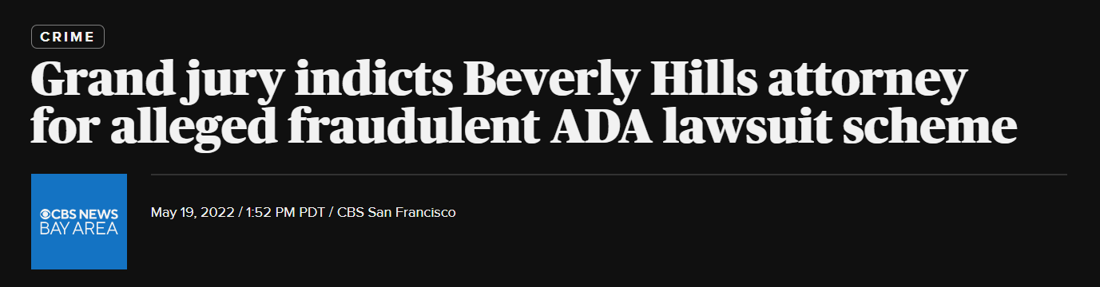
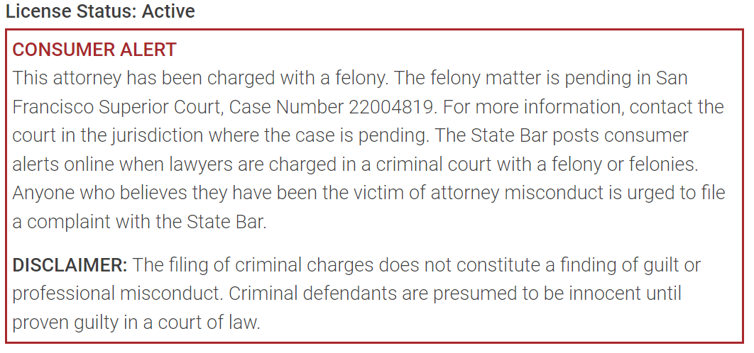
Fewer Drive-By Web Accessibility Lawsuits?
High-Profile Instances of Unscrupulous Lawyers Facing Consequences.
San Francisco DA charges attorney who sent letters demanding settlements and falsely claiming to file suit.
California State Bar displays the scarlet letter.
If you feel you’ve been unfairly targeted, consider letting law enforcement know.

Slide 5
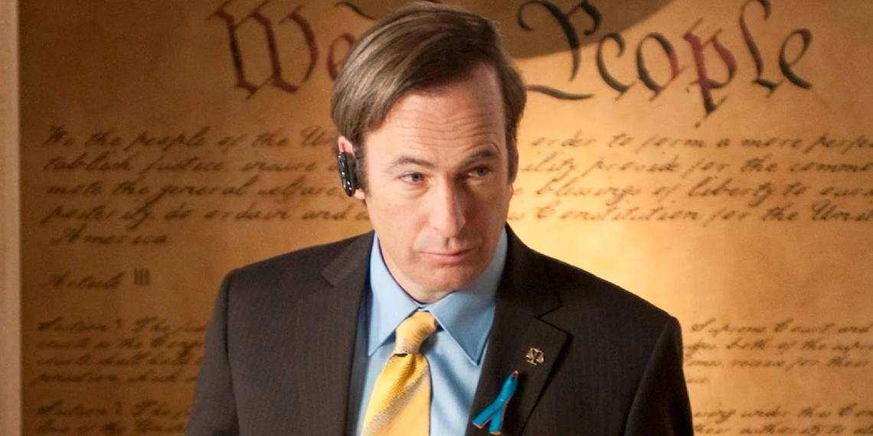
Saul Goodman

Slide 6
Industry Breakdown
Ecommerce
Restaurants, Food Services
Education
Notes:
Source: UsableNet, Kristina Launey Seyfarth Shaw LLP

Slide 7
Fewer than 10% of these suits ever reach a jury
Going to court is expensive and unpredictable.
Most businesses reason that it’s less expensive to settle.
Settlement does not stop receiving future lawsuits.
25% of lawsuits were against companies with previous lawsuits
Notes:
Source: UsableNet, Kristina Launey Seyfarth Shaw LLP

Slide 8
Lawsuit Origins
The lawsuits range in quality and level of effort expended by plaintiff firms.
However, there’s two clear aspects which draw the attention of plaintiff firms:
Accessibility Overlays
Automated Scans

Slide 9
Accessibility Overlays
These widgets recreate browser-based or assistive technology features and some change HTML markup after the page loads rather than change the underlying source code.
20% of lawsuits against websites using widgets (predominantly Accessibe).
449 suits in 2023 and over 500 already in 2024.
Notes:
Source: UsableNet, Kristina Launey Seyfarth Shaw LLP

Slide 10
Signals Sent By An Accessibility Overlay
Accessibility in a single line of code is not possible and demonstrably false.
Plaintiff firm and accessibility subject matter experts’ perception is that these businesses took a shortcut and did not consider accessibility in the design and development of their website.
The overlay indicates the business may be unable to remediate their website in a timely basis.

Slide 11
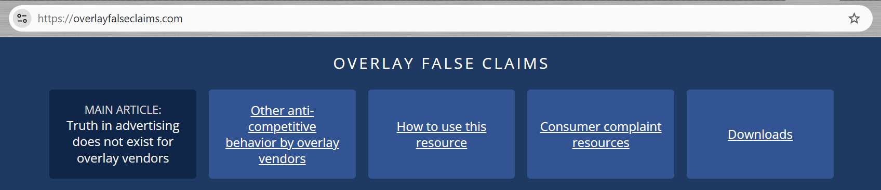
Most Importantly, Overlays May Not Improve User Experience
Web accessibility community has painstakingly documented that these tools do not improve the user experience for people that use assistive technologies. (overlayfalseclaims.com)
Notes:
Source: UsableNet, Kristina Launey Seyfarth Shaw LLP

Slide 12
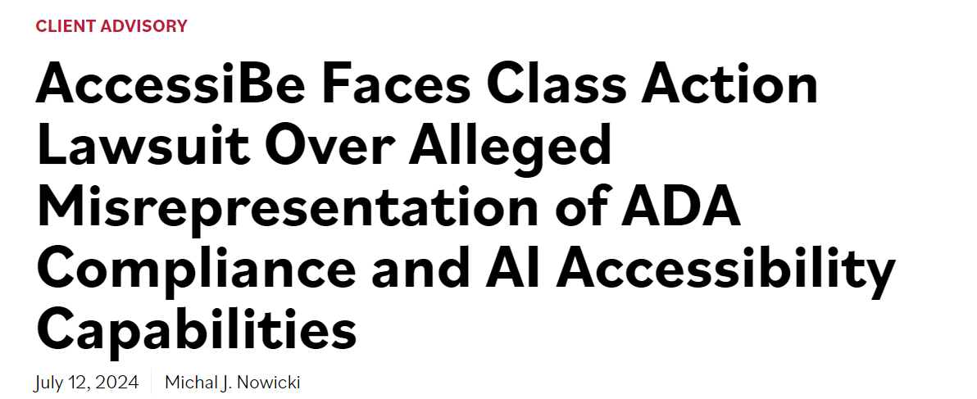
Businesses Rebel Against Overlays
NYC-based dermatology practice filed class action lawsuit against Accessibe alleging false advertising and ineffectiveness
Notes:
Source: UsableNet, Kristina Launey Seyfarth Shaw LLP

Slide 13
Automated Scans Are The Most Common Trigger for a Drive-By Lawsuit
Plaintiff firms can easily run scans on websites. They have limited accessibility expertise, but…
When a site contains a large number of issues, the plaintiff firm then delves deeper on the site, perhaps instructing a screen reader user to go to the site.
One does not receive a lawsuit because of WCAG violations. One receives a lawsuit because someone cannot use the site as they normally use the web.

Slide 14
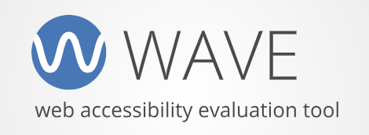
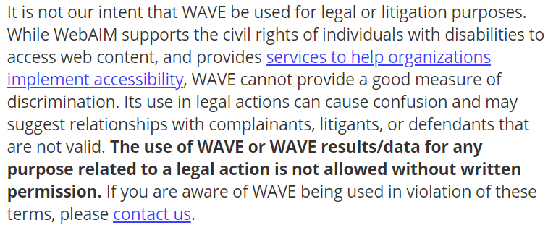
Automated Scans Are Improperly Used By Plaintiff Firms
Using an automated scan in litigation without express consent violates Terms of Service.
Let the automated scan vendor know!
Nevertheless, automated scans are the #1 trigger.

Slide 15
Evaluating Automated Scan Results
First of all, check whether the results are testing applicable accessibility standards.
The prevailing online accessibility standard is the Web Content Accessibility Guidelines (WCAG) Level AA.
Let’s look at why.

Slide 16
Accessibility Standard - WCAG
2.0 – Published in December 2008.
2.1 – Published in June 2018.
2.2 – Published in October 2023
Some states have signaled that they will shift to 2.2 as the standard.
WCAG Version | Level A | Level AA | Total Success Criteria
2.0 | 25 | 13 | 38
2.1 | 30 | 20 | 50
2.2 | 32 | 25 | 57

Slide 17
WCAG Conformance Level
Level A – Ensures the most basic level of access for disabled people; it does not provide an equivalent user experience.
Level AA – Ensures disabled people do not encounter significant barriers; it provides a mostly equivalent user experience.
Level AAA – Enhances the user experience for disabled people; it ensures accommodation for people who have multiple disabilities.

Slide 18
WCAG Conformance Level (cont.)
To make an application accessible could require:
(1) Significant changes to a site’s codebase
(2) Changes to a site’s visual appearance
A = Does not require 1 OR 2
AA = Requires 1 OR 2
AAA = Requires 1 AND 2

Slide 19

WCAG Level AA is the Established Legal Remedy
Level AA is thought to be achievable and an equitable remedy.
Level AAA is never set as the standard – promotes high-quality user experience that is difficult to achieve.
Some organizations receive scan results containing Level AAA issues, or best practices. These are inherently low-priority.

Slide 20
Run Your Automated Scans
Do not wait for litigation.
Run automated scans on your website to understand your level of risk.
But which automated scan?

Slide 21
Comparing ARC and Axe-core
There are multiple vendors. Automated rules engine overlap in the results they return. Limited value in running scans with the different engines. Pick one!
Axe-core is driven by its marketing pitch and philosophy – “No false positives”.
ARC is concerned with the different permutations of browser and assistive technology. Casts a wider net.

Slide 22

How ARC and Most Vendors Reports Scan Results
Error – an element automatically identified as a WCAG violation
Alert – an element which requires further manual inspection to confirm as a WCAG violation
Best Practice – an element which may not represent a WCAG violation but impacts the user experience

Slide 23
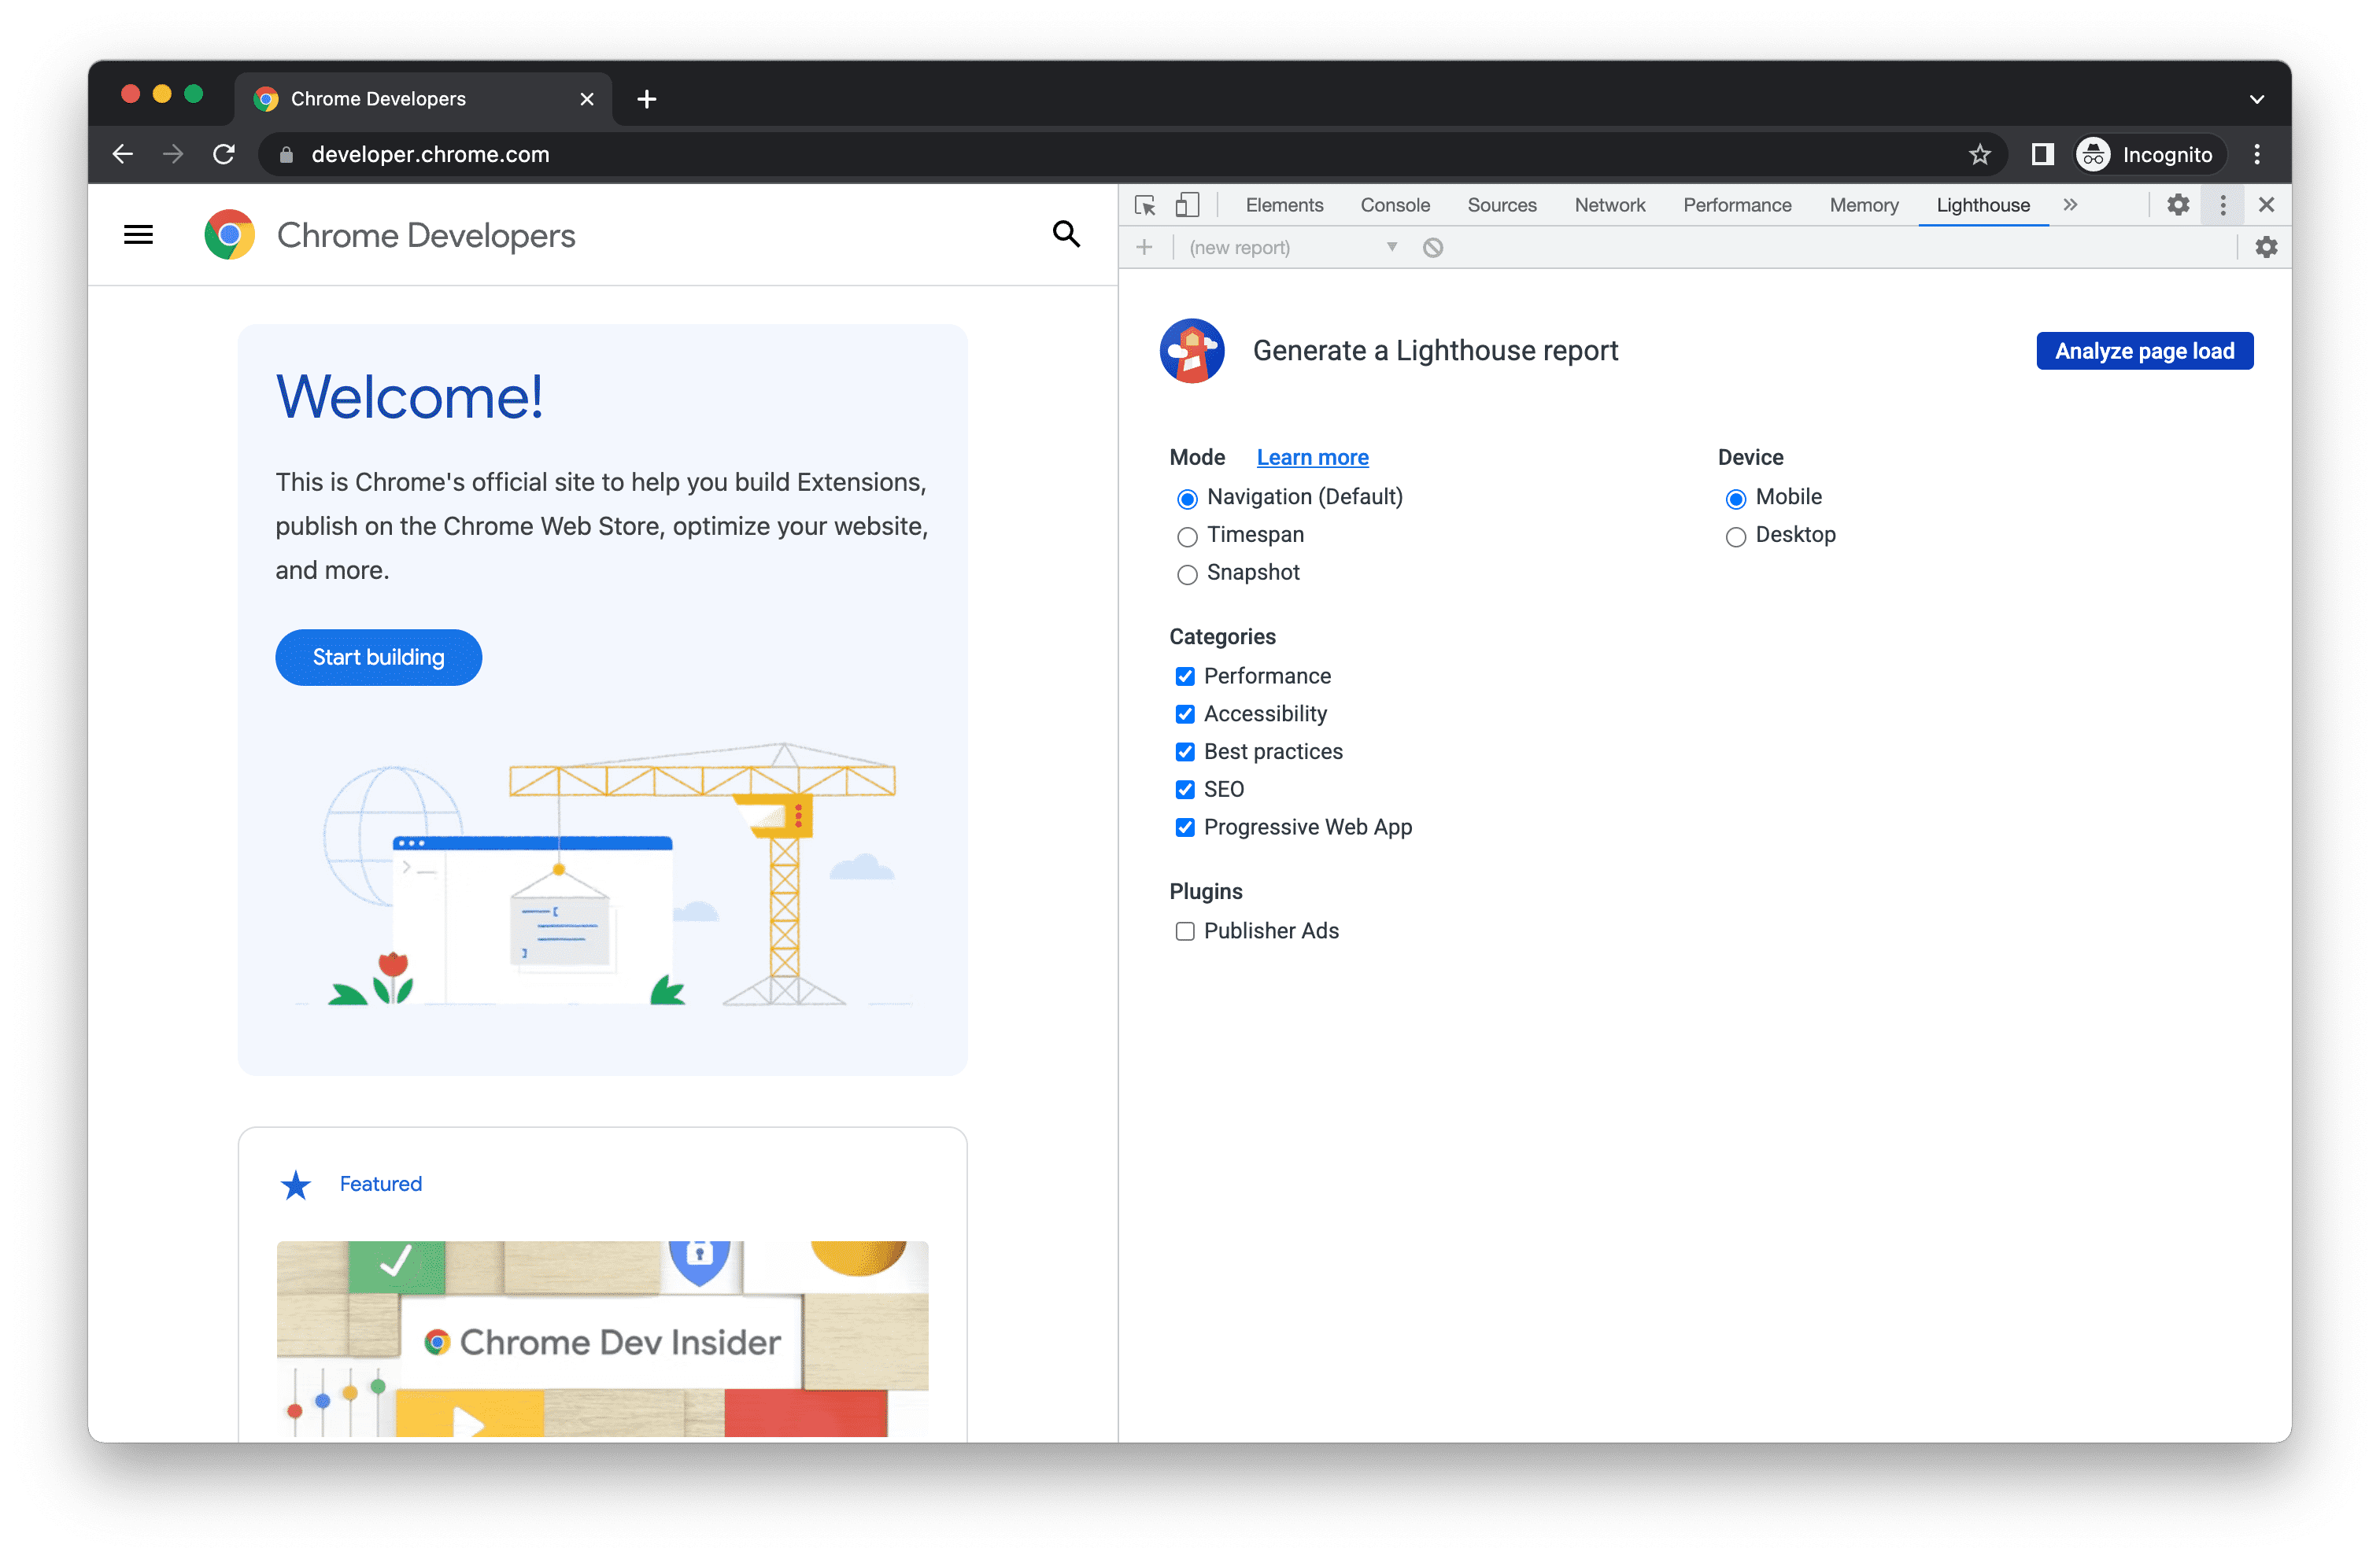
A note on Google Lighthouse
Google Lighthouse is an automated testing suite built into the Chrome browser.
Uses a subset of the Axe-core. Applies WCAG 2.2.
In other words, using Axe will report more issues than Lighthouse.

Slide 24
Automated Scan Best Practices
With ARC Monitoring (talk to us!), you can provide a homepage URL and let ARC crawl and analyze your entire domain.
Most vendors have a similar product/approach.
However, these scans evaluate pages as they appear on page load.
Use the ARC Toolkit Chrome extension to test deeper into user journeys.

Slide 25
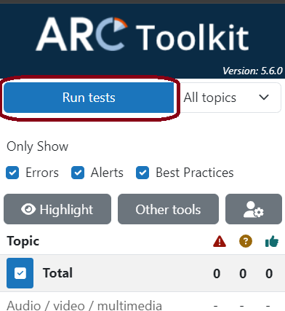
Run a scan whenever, wherever
ARC Toolkit makes it easy to scan pages
Pages which require authentication
Pages behind a firewall or other security policies
Specific points deeper in user journeys
Local file URLs

Slide 26
Advantage of Chrome extensions
In short, you can get a page into your preferred state, e.g. open the shopping cart or scan the page after you’ve added an item.

Slide 27
Most Common Automated Errors Cited In Lawsuits
The lack of a text alternative (traditional <img>, image-based links, SVG-based controls) is at the heart of nearly 50% of automated errors detected in a broad-based scan of eCommerce site.
WCAG Success Criteria 1.1.1 Non-text Content and 2.4.4 Link Purpose (in Context) are the most common violations.
Images missing alternative text and links lacking any text.

Slide 28
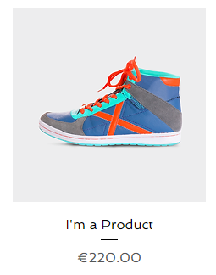
Source for the Most Common Assertions #1
Image-based links and controls represent multiple WCAG violations.
Solving image-based links, controls is the most straightforward and impactful way to improve one’s WCAG Density Score.
Solution: Enclose the image and product text in a single link.
Product label text is located outside the product image-based link.

Slide 29
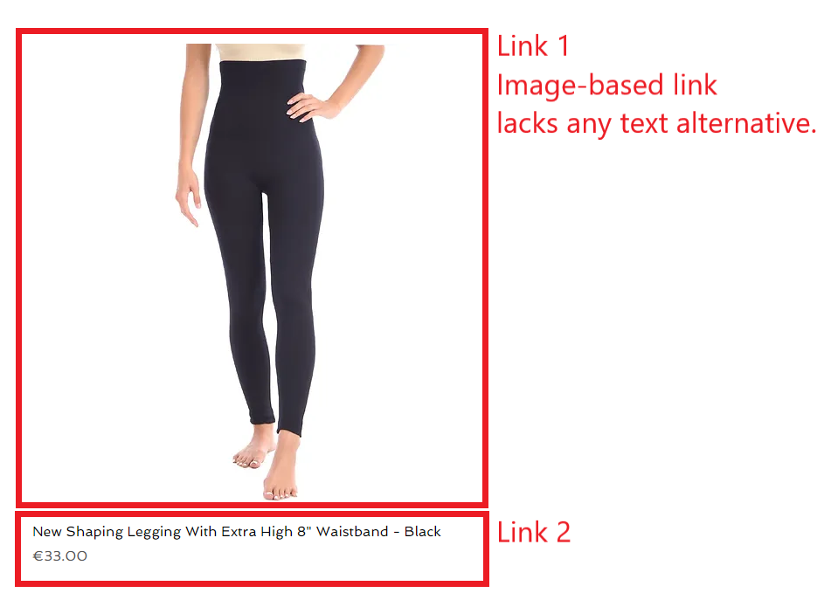
Issue: Product image-based links with product title text link

Slide 30
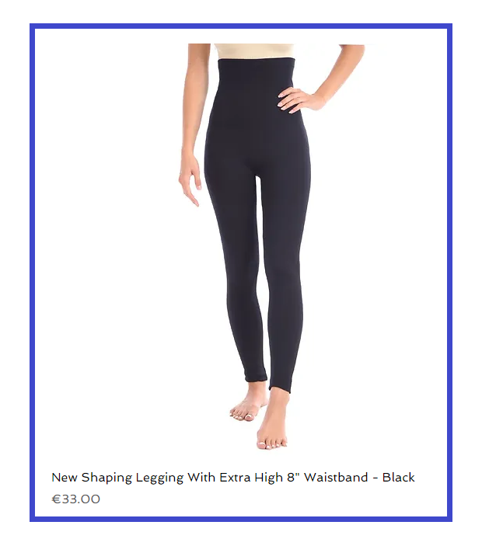
Solution: Make the product image and product title text into a single link
The image can be considered decorative as the product title text serves as the text alternative.
Fewer links equals more efficient navigation.
In-depth guide: Block Links, Cards, Clickable Regions, Rows, Etc. – Adrian Roselli

Slide 31




Source for the Most Common Assertions #2
Icon-based navigation menu buttons may lack text alternatives or proper semantics.
Hamburger menus are a gateway to navigating the site. Critical issue.

Slide 32
Source for the Most Common Assertions #3
Sites which use ARIA have more automated errors.
ARIA is used for modern UI patterns which cannot be achieved in native HTML alone e.g. tab panels, expandable/collapsible widgets.
How to recognize ARIA widgets? They are JavaScript powered interactions – click on something and it changes page content without reloading the page.
ARIA carries precise specifications. Easy to misconfigure.

Slide 33
Steps to Overcome ARIA-based issues
Simplify the interface.
For example, shift from a tooltip to having visible, permanent text.

Slide 34
PDFs Can Be a Target
It’s difficult to make accessible PDFs without specialized training. Automated scans may flag PDFs. They almost always contain errors.
Using a PDF assumes that user has requisite software.
Instead, create an accessible HTML form or use Google Forms (external or can be embedded).

Slide 35
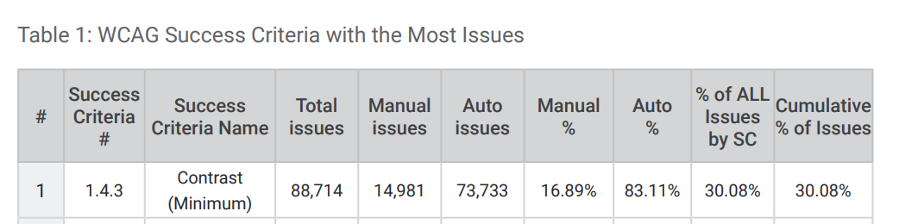
Color Contrast In Context of Lawsuits
A single line of CSS can result in hundreds of errors.
However, Aaron does not know of any case predicated on color contrast.
Axe-core states color contrast is most common issue.

Slide 36
Evaluate Automated Scan Results
Your job is to gauge the impact on user experience of each automated scan results.
Typically, that is the first thing teams do in reaction to a complaint/demand letter, especially if it contains automated scan results.

Slide 37
Quality of a Complaint
Consider the two claims:
Buttons do not have accessible names
It is not possible to determine what color is selected
We can tell which is a more valid, meaningful, and genuine claim.

Slide 38
Does Having a Phone Number Protect You?
Stating that you can provide accessibility support is helpful to users but does not exempt you from having to solve website issues.
A phone number does not provide an equivalent user experience to having a site that can be used at any time of day.

Slide 39
Accessibility Statement
Some complaints cite the lack of an accessibility statement.
Have one!
It’s a setting to document your substantive efforts on accessibility.
It’s a top deterrent to plaintiff firms.
State if you are working with a respected accessibility vendor.

Slide 40
Accessibility Statement (cont.)
Some complaints cite the lack of an accessibility statement.
Have one! Post in the site’s footer.
It’s a setting to document your substantive efforts on accessibility.
It’s a top deterrent to plaintiff firms.
State if you are working with a respected accessibility vendor.

Slide 41
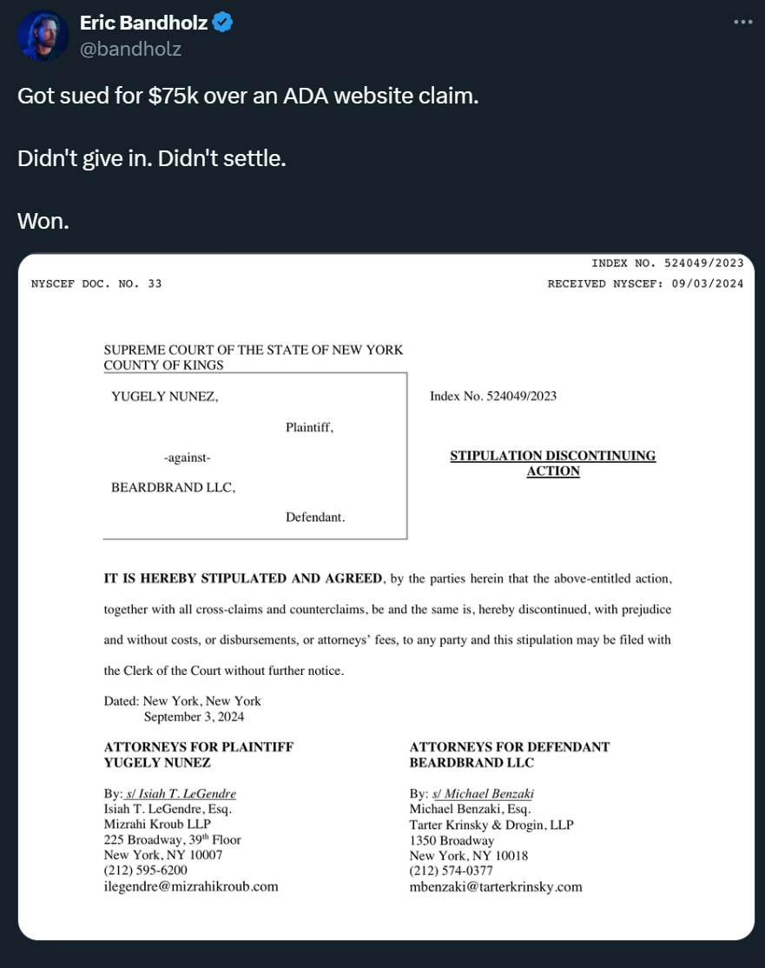
Some Don’t Settle!
Beardbrand categorically denied the claims.
The plaintiff firm simply dropped the case.
No, you don’t get them to pay your attorney fees. Most likely at least not.

Slide 42
What to Ask For If You Must Settle?
Remediation timelines – extend them.
Be strong in arguing against claims.
Fix these things while complaint is in motion.

Slide 43
TPGi Plan In One Year
Run automated scans – understand your current state of accessibility
Manually test key user journeys
Have batches of issues for each dev cycle.
Regularly scheduled check-ins – build momentum, keep momentum

Slide 44

Let’s Make It Accessible
Achieve your digital accessibility goals with TPGi. We can help you find the right solutions for your organization.
Contact us:
+1 (877) 775-9474
info@tpgi.com
Schedule a demo

