Slide 1
How to Prepare for Accessibility Testing
Aaron Farber
Platform Consultant

Slide 2
Agenda
Overview
Accessibility Standard
Environment
Group Guidelines
Select a Representative Sample
Instructions for Testers

Slide 3
Accessibility Resource Center (ARC)
Contains the tools and resources for every aspect of managing an accessibility program
Don’t focus on the product, focus on the vision
Let’s go!

Slide 4
ARC
Provider: Plan, create, and manage accessibility reviews
Capture: Perform manual/automated accessibility reviews
Monitoring: Run automated scans between manual reviews

Slide 5
Time presents a real challenge
Enterprise organizations must focus on increasing efficiency in manual accessibility testing and reducing barriers to entry.
Testing infrastructure grows over time and requires significant initial investment.
Accessibility programs MUST demonstrate their value to internal stakeholders.

Slide 6
WCAG presents a challenge
WCAG Success Criteria have nuance and evolving interpretations.
WCAG is used in legal and governmental settings. It must be precise but that leads to significant use of jargon.
WCAG is not something someone sits down and reads end-to-end.

Slide 7
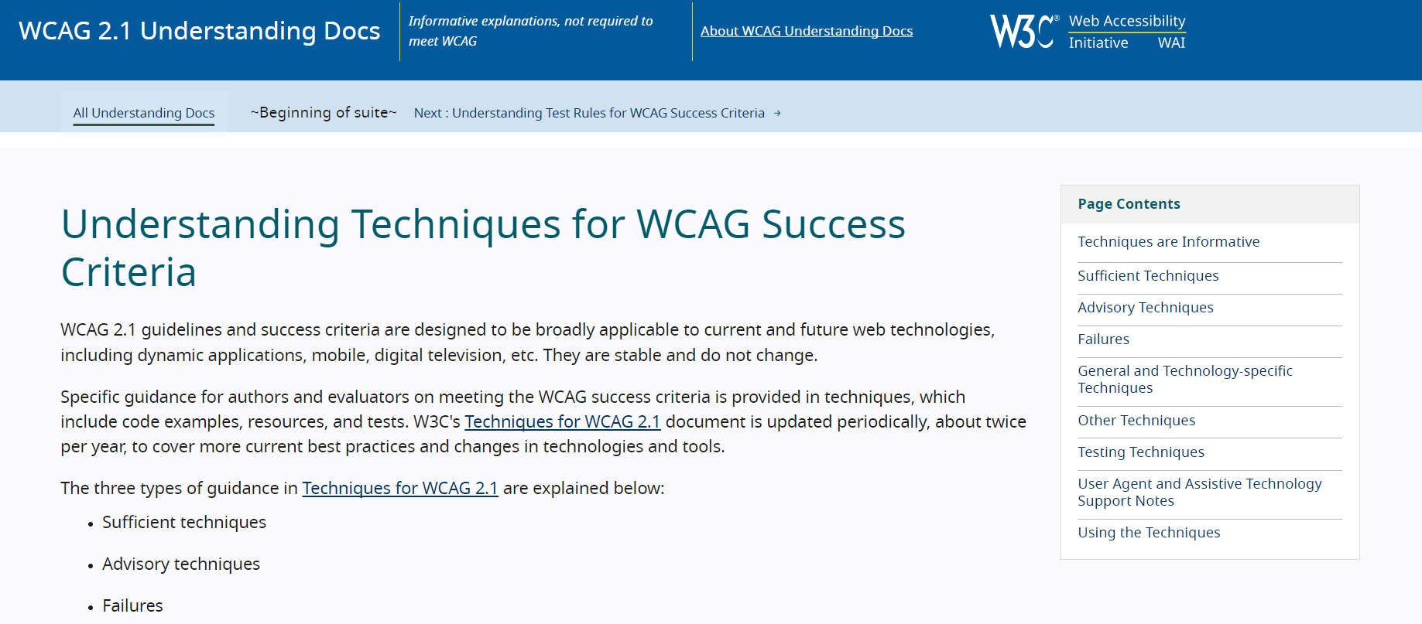
Test using WCAG’s official docs?
WCAG’s “Understanding Techniques” for 2.1.1 Keyboard is 5,000 words

Slide 8
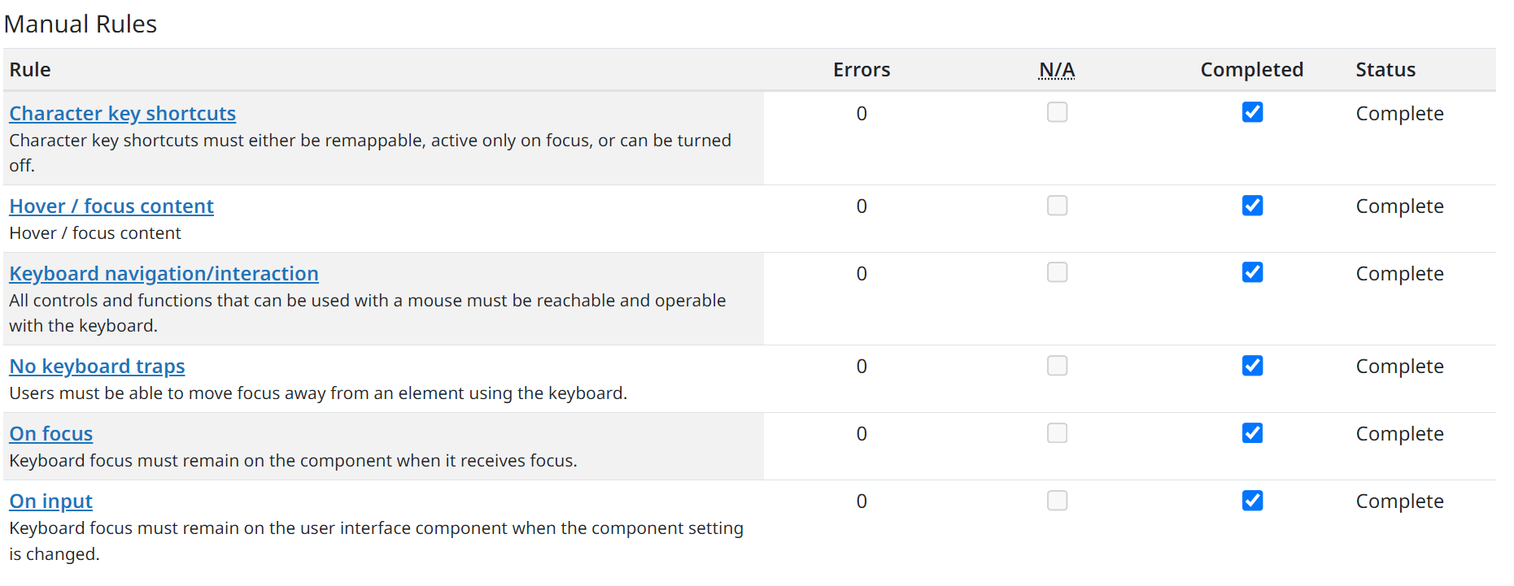
Test by Rule Rather Than Guideline
ARC Capture breaks down WCAG Success Criteria into smaller, easily repeatable manual tests.
2.1.1 Keyboard (Level A)
Equals
A sample of 2.1.1 manual tests

Slide 9
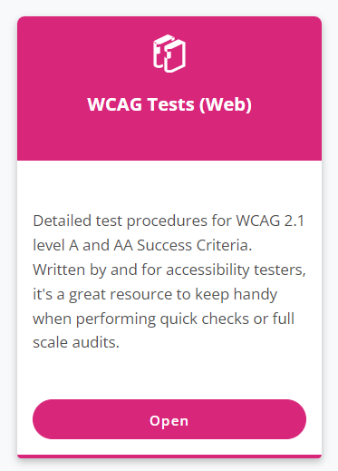
Test by Guideline
Alternatively, ARC provides manual testing procedures for every WCAG Success Criteria.
Easy to understand.
Helpful for custom elements which don’t fit neatly into established design patterns

Slide 10
ARC Capture Test by Rule approach
Easier to apply individual, guided tests than test interfaces against the entire guideline.
Enables testers with minimal accessibility experience to reliably carry out full-scale WCAG audits. Reduces nuance.
The largest companies, with significant internal accessibility programs, audit using this approach.

Slide 11
Group Related Accessibility Guidelines
Group the guidelines by topic
Allows testing to be divided among team members and their skillsets
Delegate accessibility to more individuals
Empowers team to start accessibility testing on their own

Slide 12
Core Groups of Related Guidelines
Keyboard and Focus
Color Contrast and Use of Color
Images and Graphical Elements
Page Structure and Navigation
Interactive Elements and ARIA
Responsive Design

Slide 13
Keyboard and Focus
1.4.13 Content On Hover or Focus
2.1.1 Keyboard
2.1.2 No Keyboard Trap
2.1.4 Character Key Shortcuts
2.4.1 Bypass Blocks
2.4.3 Focus Order
2.4.7 Focus Visible

Slide 14
Color Contrast
1.3.3 Sensory Characteristics
1.4.1 Use of Color
1.4.3 Contrast (Minimum)
1.4.11 Non-text Contrast

Slide 15
Images and Graphical Elements
1.1.1 Non-text Content
1.4.5 Images of Text
1.2.1 Audio-only and Video-only
1.2.2 Captions
1.2.4 Captions (Live)
1.2.5 Audio Description (Prerecorded)
2.2.2 Pause, Stop, Hide

Slide 16
Page Structure and Navigation
1.3.1 Info and Relationships
1.3.2 Meaningful Sequence
2.4.4 Link Purpose (In Context)

Slide 17
Interactive elements and ARIA
4.1.2 Name, Role, Value
4.1.3 Status Messages

Slide 18
Responsive Design
1.3.4 – Orientation
1.4.10 Reflow
1.4.4 Resize Text

Slide 19
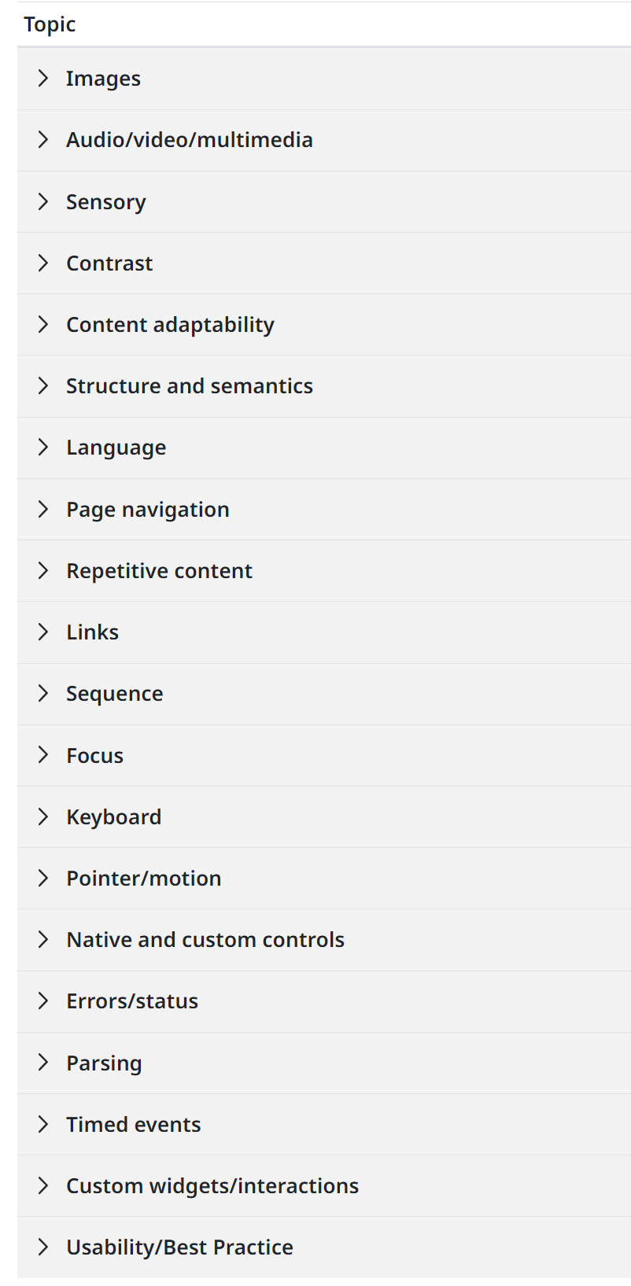
ARC’s Grouping
ARC Capture divides WCAG Success Criteria even further - into 20 Topics

Slide 20
Manual and/or automated testing?
Clearly distinguish what can be tested via manual and automated means.
Automated testing enables teams to rapidly get an aerial understanding of accessibility for an application.

Slide 21
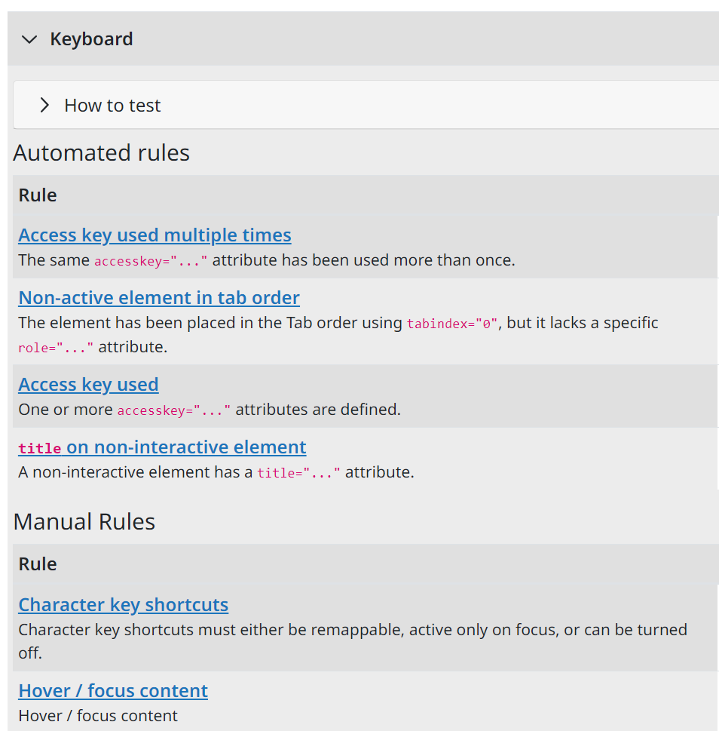
Combine manual and automated testing
ARC Capture separates each WCAG Success Criteria into a set of automated and manual rules.
Automated rules flag issues which can be hard to find during manual testing e.g. a site using the access key attribute

Slide 22
First run automated scans
ARC Capture scans whatever is open in your browser viewport, making it easy to scan pages which require authentication or at a specific point in a user journey.
Automated testing does have a level of noise. Manual testing/verification of automated results is necessary.

Slide 23
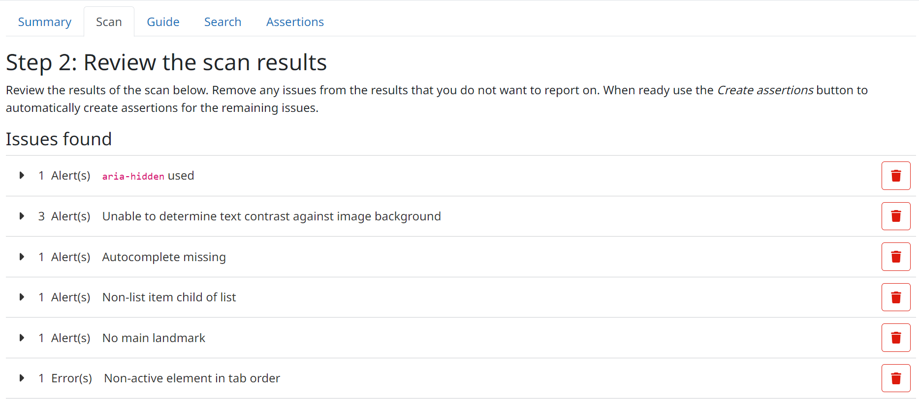
Curate the results from an initial scan
Capture enables teams to dismiss automated findings which don’t violate WCAG or have an impact on user experience.

Slide 24
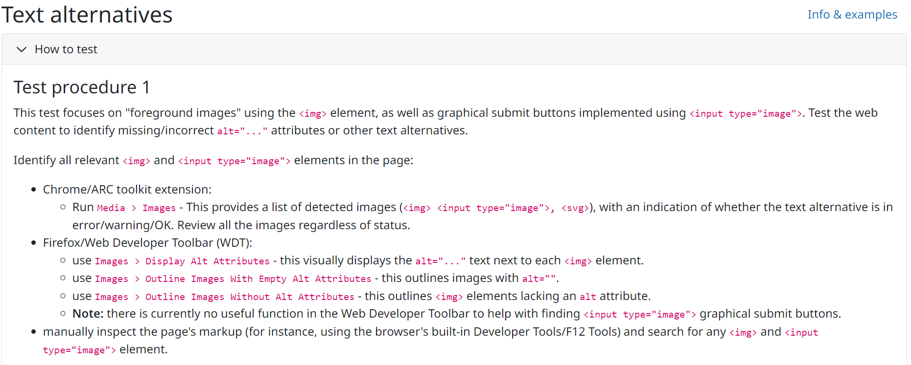
Manual testing procedures
Capture provides steps for manual testing which are focused on the tools and interface testers are actually using e.g. DevTools

Slide 25
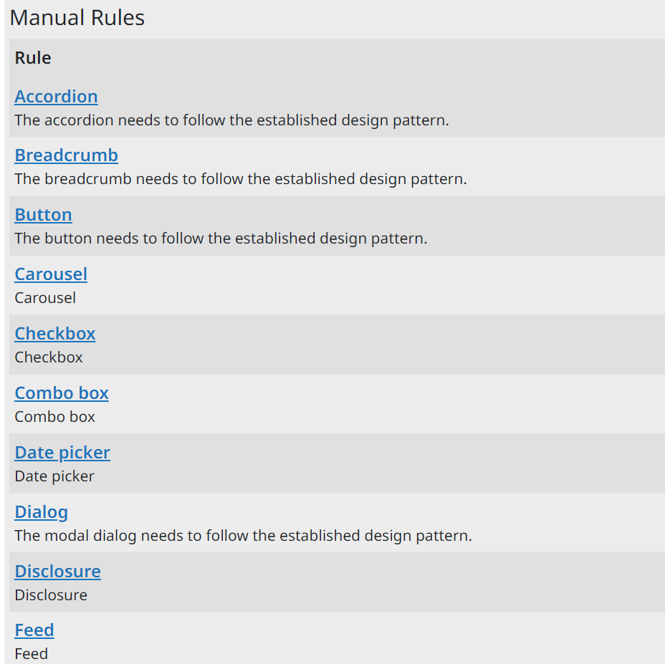
How to test custom UI elements?
Capture provides testers with resources on the specific accessibility expectations for design patterns which go beyond what is available in native HTML.

Slide 26
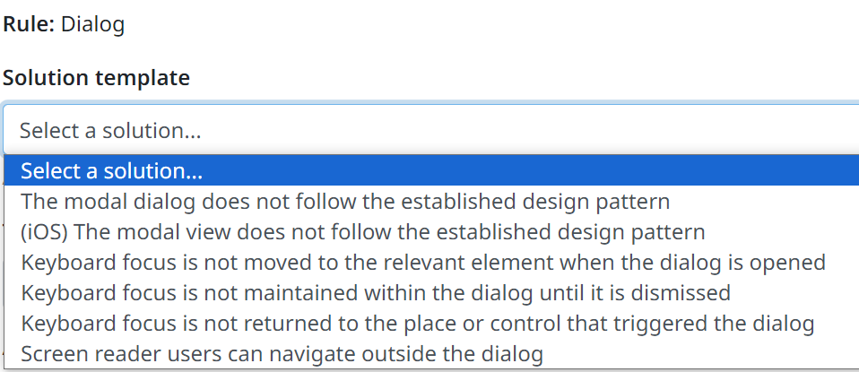
Solution templates
Saves QA from having to reinvent the wheel.
Adds guardrails to manual audit findings.
Testers add/subtract from the template.

Slide 27
Technology industry is about growth, mentorship!
ARC Capture provides a built-in QA system, enabling senior accessibility engineers to review the work of junior members of the team.
Facilitates collaboration, and encourages junior members to clearly state which issues they have questions about.

Slide 28
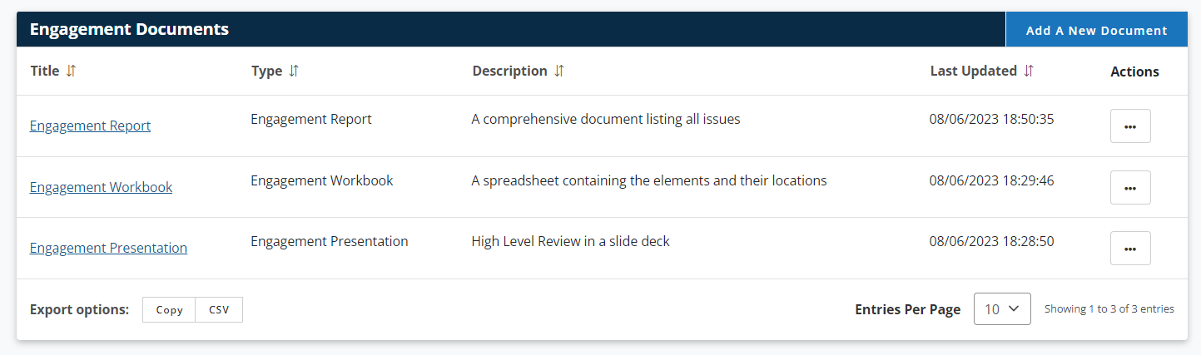
Provide findings in different formats
Capture auto-generates:
Report: A comprehensive Word document
Workbook: A comprehensive spreadsheet ideal for importing into JIRA
Presentation: A high-level report for executives

Slide 29
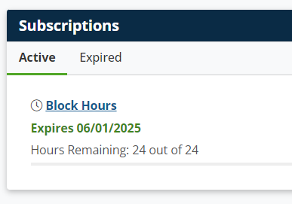
HelpDesk is a must for extended support
ARC provides a HelpDesk for teams to get continued support on issues.
Helps accessibility programs track their work, and demonstrate their value, expertise.

Slide 30

Let’s Make It Accessible
Achieve your digital accessibility goals with TPGi. We can help you find the right solutions for your organization.
Contact us:
+1 (877) 775-9474
info@tpgi.com
Schedule a demo

