Slide 1
How to Prepare for Accessibility Testing
Aaron Farber
Platform Consultant

Slide 2
Agenda
Overview
Accessibility Standard
Environment
Group Guidelines
Select a Representative Sample
Instructions for Testers

Slide 3
Accessibility Resource Center (ARC)
Contains the tools and resources for every aspect of managing an accessibility program
Don’t focus on the product, focus on the vision
Let’s go!

Slide 4
ARC
Provider: Plan, create, and manage accessibility reviews
Capture: Perform manual/automated accessibility reviews
Monitoring: Run automated scans between manual reviews

Slide 5
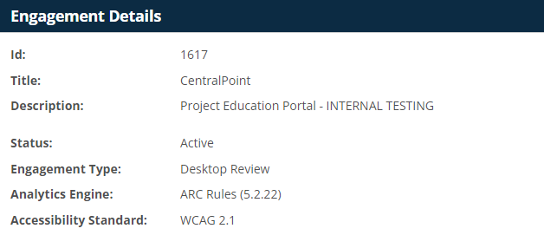
Audit Details
Set a status and expected delivery date.
Calculate number of hours needed for the audit and consider a schedule for performing the audit.
You’ll get better at estimating timelines as your conduct more manual testing.

Slide 6
Accessibility Standard - WCAG
2.0 – Published in December 2008.
2.1 – Published in June 2018.
2.2 – Published in October 2023
WCAG Version | Level A | Level AA | Total Success Criteria
2.0 | 25 | 13 | 38
2.1 | 30 | 20 | 50
2.2 | 32 | 25 | 57

Slide 7
WCAG Conformance Level
To make an application accessible could require:
(1) Significant changes to a site’s codebase
(2) Changes to a site’s visual appearance
A = Does not require 1 OR 2
AA = Requires 1 OR 2
AAA = Requires 1 AND 2

Slide 8
WCAG Conformance Level
Level A – Ensures the most basic level of access for disabled people; it does not provide an equivalent user experience.
Level AA – Ensures disabled people do not encounter significant barriers; it provides a mostly equivalent user experience.
Level AAA – Enhances the user experience for disabled people; it ensures accommodation for people who have multiple disabilities.

Slide 9
Select a Conformance Level
Level AA is the established accessibility standard for manual testing.
Level AAA is never set as the standard – promotes high-quality user experience that is difficult to achieve.

Slide 10
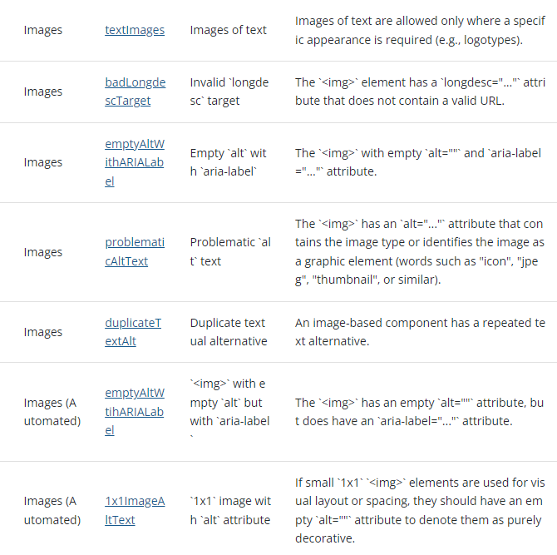
Test by Rule
ARC Rules breaks down WCAG Success into smaller, easily repeatable manual tests.
A sample of 1.1.1 manual and automated tests
1.1.1 Non-text Content (Level A)
Equals

Slide 11
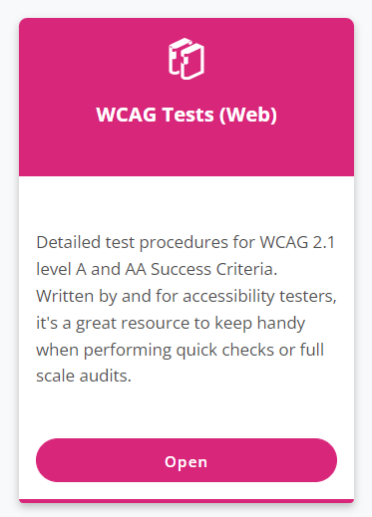
Test by Guideline
Alternatively, ARC provides manual testing procedures for every WCAG Success Criteria.

Slide 12
ARC Capture Test by Rule approach
Easier to apply individual, guided tests than test interfaces against the entire guideline.
Enables testers with minimal accessibility experience to reliably carry out full-scale WCAG audits.
The largest companies, with significant internal accessibility programs, audit using this approach.
Rules have template remediation solutions ready for your use by your team.

Slide 13
Select your environment
JAWS/Chrome is the most popular browser/assistive technology combination, followed by NVDA/Chrome is next.
NVDA is free and an option for Windows. Has similar behavior to JAWS.
MacOS / VoiceOver is the primary desktop screen reader for only 6.5%.
According to WebAIM Screen Reader Survey 2021

Slide 14
Select your environment
Screen Reader/Browser | % of Respondents
JAWS with Chrome | 32.5%
NVDA with Chrome | 16.0%
JAWS with Edge | 12.6%
NVDA with Firefox | 9.7%
JAWS with Firefox | 4.8%
VoiceOver with Safari | 4.7%
NVDA with Edge | 3.6%
ZoomText/Fusion with Chrome | 2.1%
JAWS with Internet Explorer | 1.9%
VoiceOver with Chrome | 1.6%
ZoomText/Fusion with Edge | 1.2%
Other combinations | 9.4%

Slide 15
Group Related Accessibility Guidelines
Group the guidelines by topic
Allows testing to be divided among team members and their skillsets
Delegate accessibility to more individuals
Empowers team to start accessibility testing on their own

Slide 16
Core Groups of Related Guidelines
Keyboard and Focus
Color Contrast and Use of Color
Images and Graphical Elements
Page Structure and Navigation
Interactive Elements and ARIA
Responsive Design

Slide 17
Keyboard and Focus
1.4.13 Content On Hover or Focus
2.1.1 Keyboard
2.1.2 No Keyboard Trap
2.1.4 Character Key Shortcuts
2.4.1 Bypass Blocks
2.4.3 Focus Order
2.4.7 Focus Visible

Slide 18
Color Contrast
1.3.3 Sensory Characteristics
1.4.1 Use of Color
1.4.3 Contrast (Minimum)
1.4.11 Non-text Contrast

Slide 19
Images and Graphical Elements
1.1.1 Non-text Content
1.4.5 Images of Text
1.2.1 Audio-only and Video-only
1.2.2 Captions
1.2.4 Captions (Live)
1.2.5 Audio Description (Prerecorded)
2.2.2 Pause, Stop, Hide

Slide 20
Page Structure and Navigation
1.3.1 Info and Relationships
1.3.2 Meaningful Sequence
2.4.4 Link Purpose (In Context)

Slide 21
Interactive elements and ARIA
4.1.2 Name, Role, Value
4.1.3 Status Messages

Slide 22
Responsive Design
1.3.4 – Orientation
1.4.10 Reflow
1.4.4 Resize Text

Slide 23
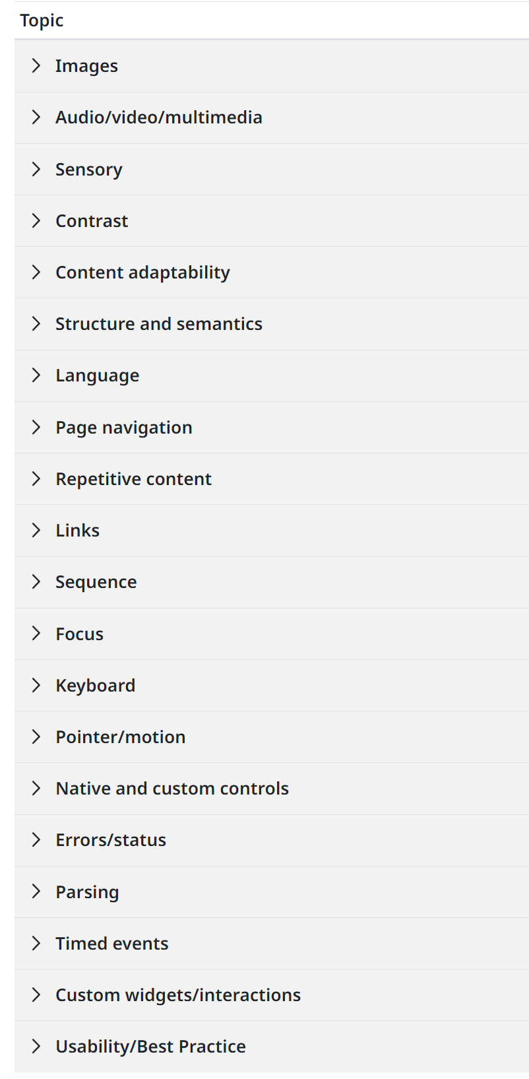
ARC’s Grouping
ARC Capture divides WCAG Success Criteria even further - into 20 Topics

Slide 24
Why select a representative sample
It’s rarely feasible or logical to evaluate every page/widget
Therefore, select a representative sample
Consider the component library used on your site

Slide 25
How to select a representative sample
  Consider website structure and purpose
  Include a range of content types – videos, forms, etc.
  Select template components and page-specific content
  Cover high-visibility, high-traffic user journeys
  Each sample should be around the same size, level of effort to test

Slide 26
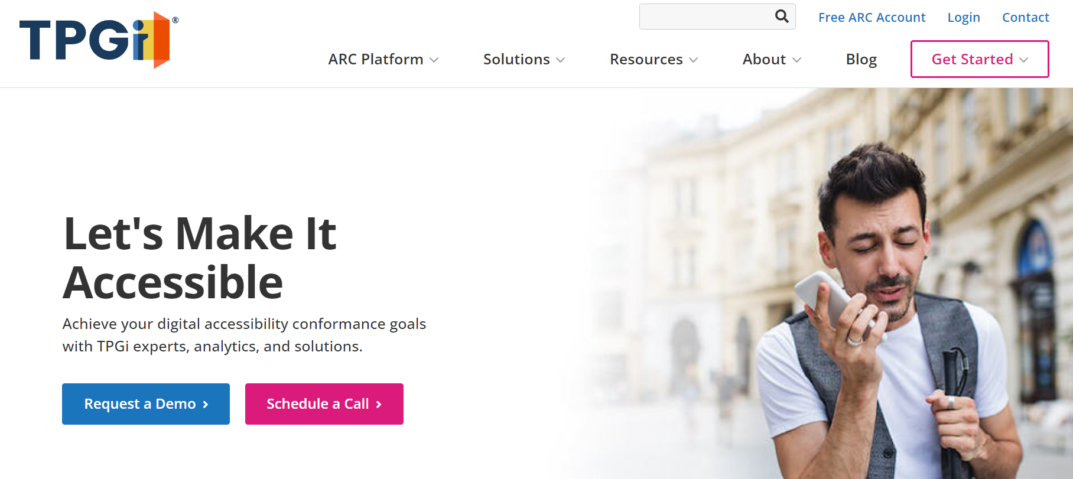

The application

Slide 27
Break application into a set of samples

Slide 28
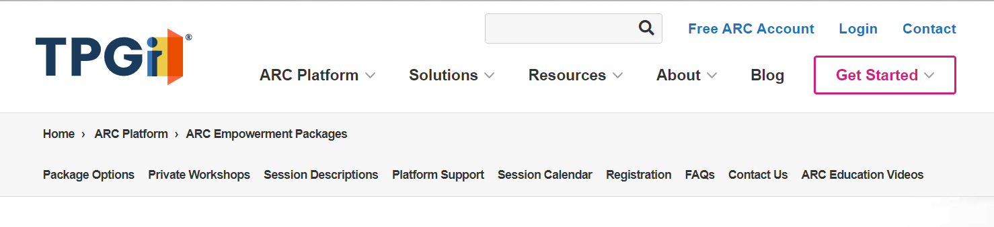
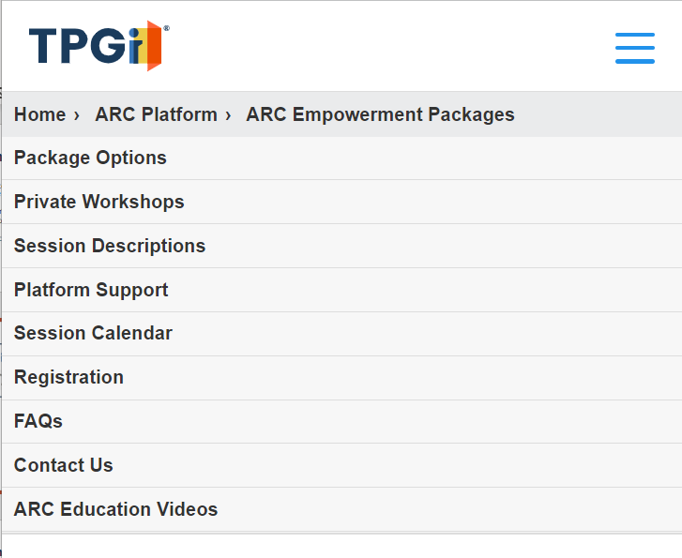
Scope of a componet
01 Navigation - Desktop layout
  For each component, it’s implied that it is to be tested at all responsive break points.
  If the component is large or its mobile layout is significantly different, break the component into multiple components.
02 Navigation - Mobile layout

Slide 29
Define a component
For each component, provide:
  a name
  an id (a # for the component)
  a screenshot
  steps to reach the component (important for testing deeper into user journeys)
  what’s included, not included in the component
  estimated level of effort
  a user flow
  Use common sense. Provide the information is necessary/helpful for testers.

Slide 30
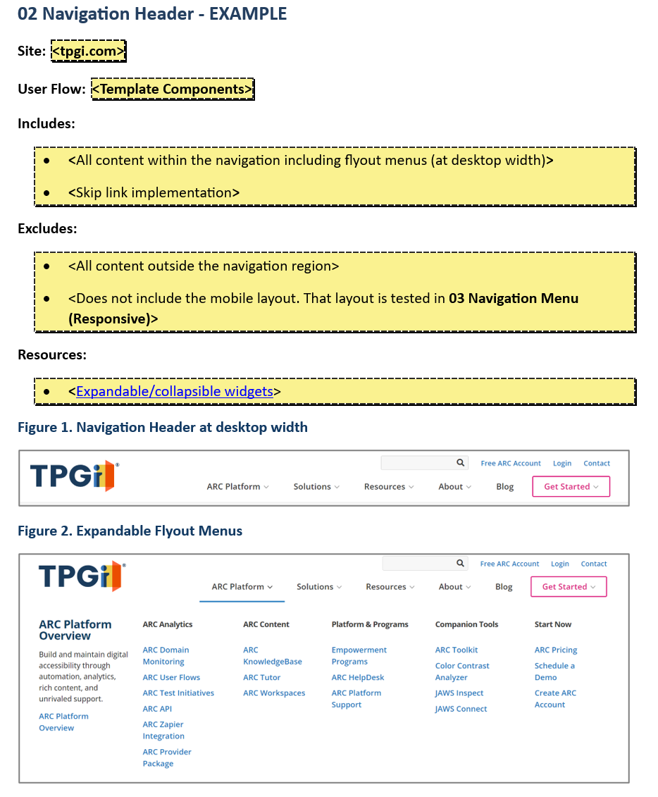
Components

Slide 31
Common Issues
Common Issues is the first component (#01). Common Issues or Global Issues apply to the entire site.
A Common Issues component saves time. You don’t have to flag the same issues multiple times.
While it’s not always possible, the components should be organized based on their importance to the application.

Slide 32
Pro-Tips
Select Components which are the same size. Makes it easier to track work.
When a component contains a particular design pattern, provide a reference

Slide 33
Handouts
Online Product Accessibility Test Plan template
Manual Accessibility Review workbook

Slide 34

Let’s Make It Accessible
Achieve your digital accessibility goals with TPGi. We can help you find the right solutions for your organization.
Contact us:
+1 (877) 775-9474
info@tpgi.com
Schedule a demo

