Slide 1
Intro to
Mobile Accessibility Testing Tools
Laurie Pagano
Principal Accessibility Engineer

Slide 2
Agenda
Introduction
Device Settings and Assistive Technologies
Additional Testing Tools

Slide 3
Introduction

Slide 4
Some Important Points
This is not an exhaustive list of accessibility settings or available assistive technologies
Regular software updates may introduce changes
Today's focus is on iOS (Apple) and Android (Google)
Google Pixel is recommended for testing—other Android devices may have differences in user interface, features, and functionality

Slide 5
Compatibility Testing
Some concepts are the same across web and mobile
Source code is unlikely to be readily available for native mobile applications
Compatibility testing checks for compatibility with the available settings and assistive technologies

Slide 6
Device Settings and Assistive Technologies

Slide 7
Accessibility Settings

Slide 8
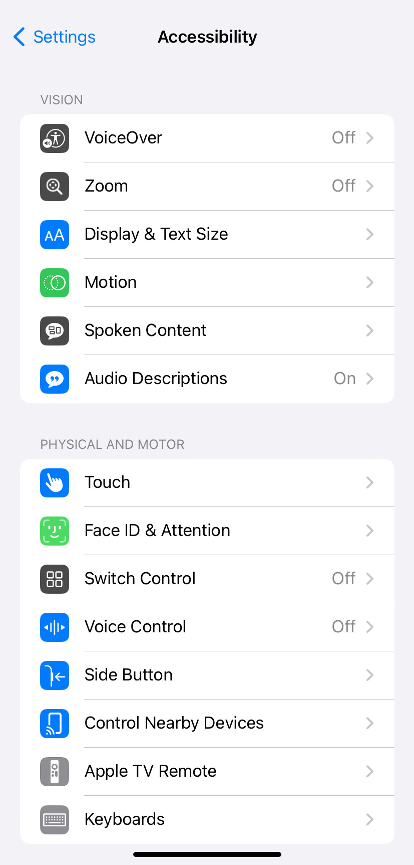
Accessibility Settings: iOS
Settings > Accessibility
as of iOS 13
Set changes globally or app-by-app
as of iOS 15

Slide 9
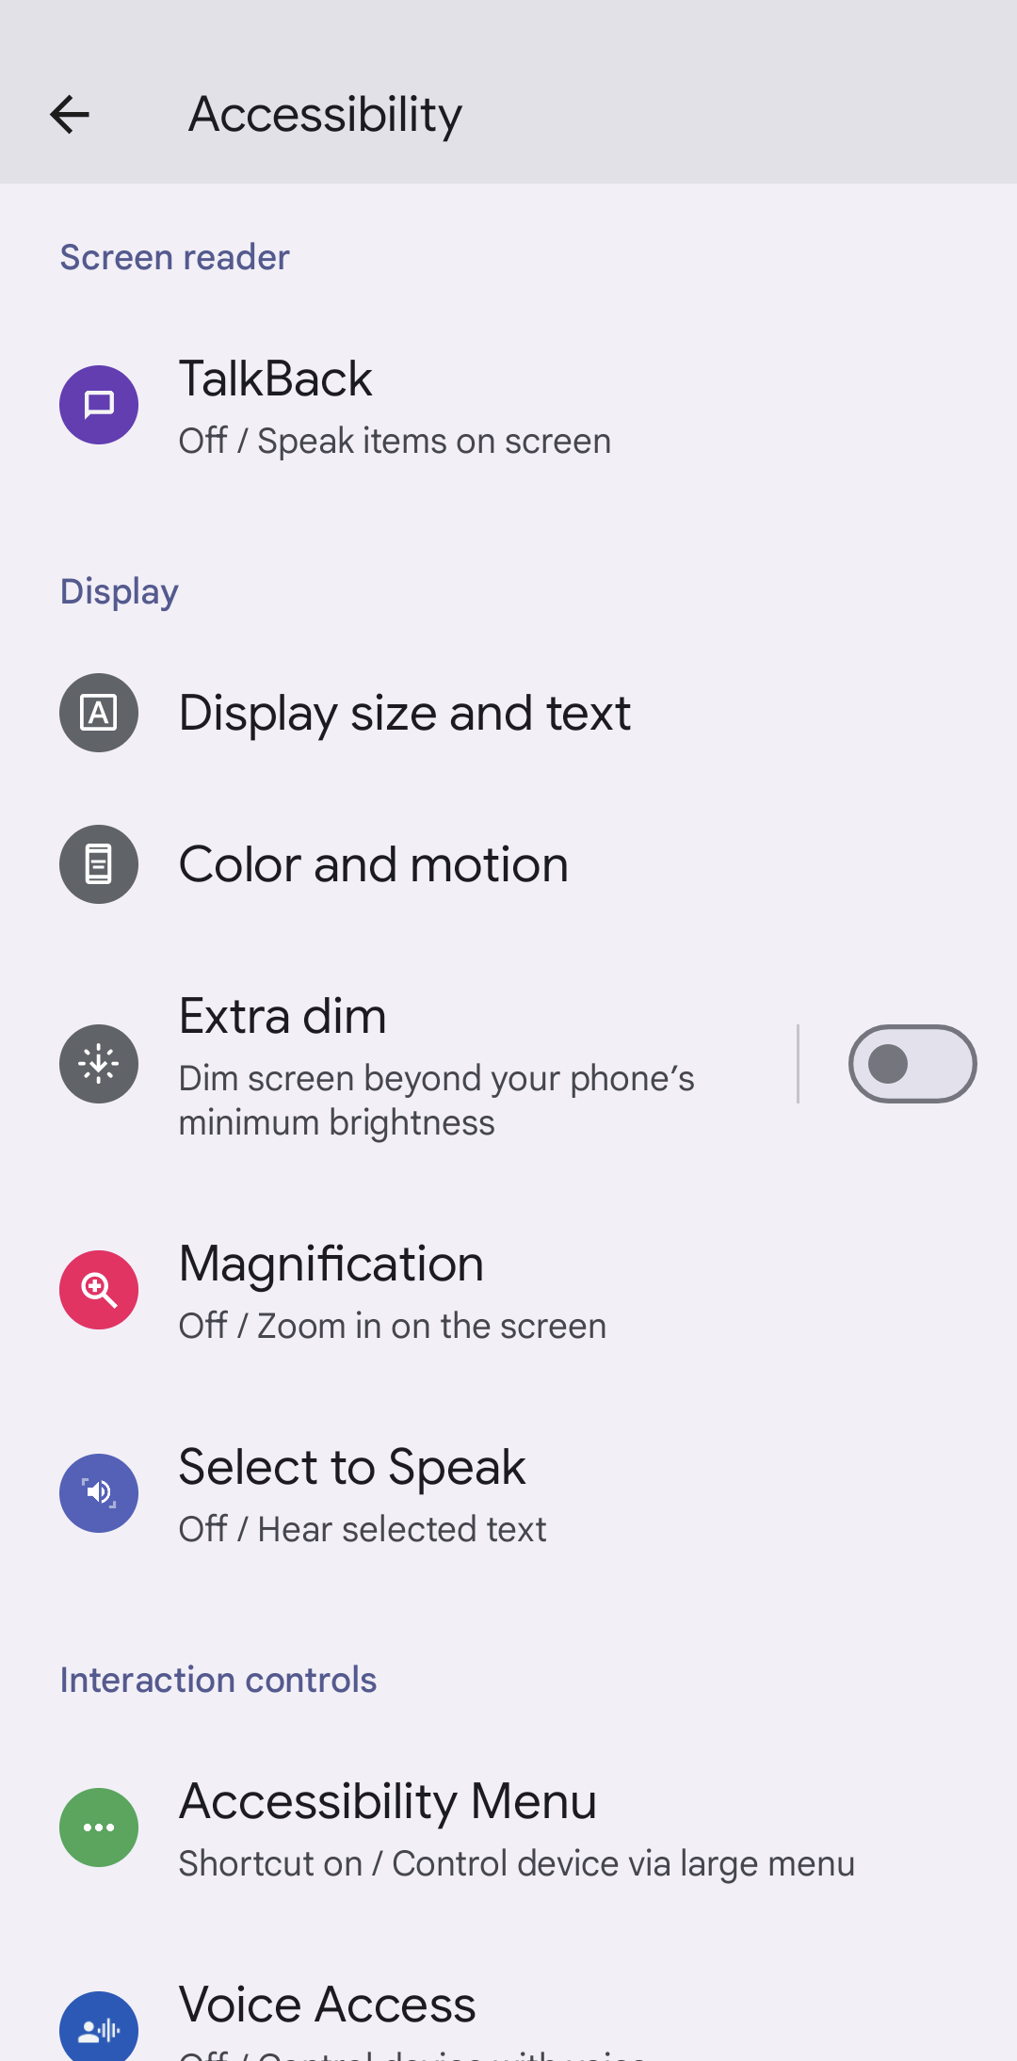
Accessibility Settings:
Android
Settings > Accessibility
Pixel

Slide 10
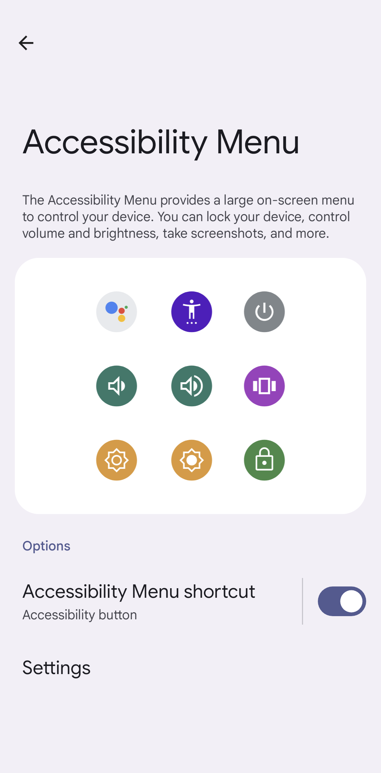
Accessibility Settings:
Android, cont.
Settings > Accessibility > Accessibility Menu
Provides shortcut access to common device features
Android Accessibility Suite
Accessibility Menu, TalkBack, and Select to Speak
No longer includes Switch Access
as of early 2023
Available for free in the Play Store (if not preinstalled)

Slide 11
Accessibility Settings: Common Issues
Application does not respond to accessibility settings

Slide 12
Resize Text

Slide 13
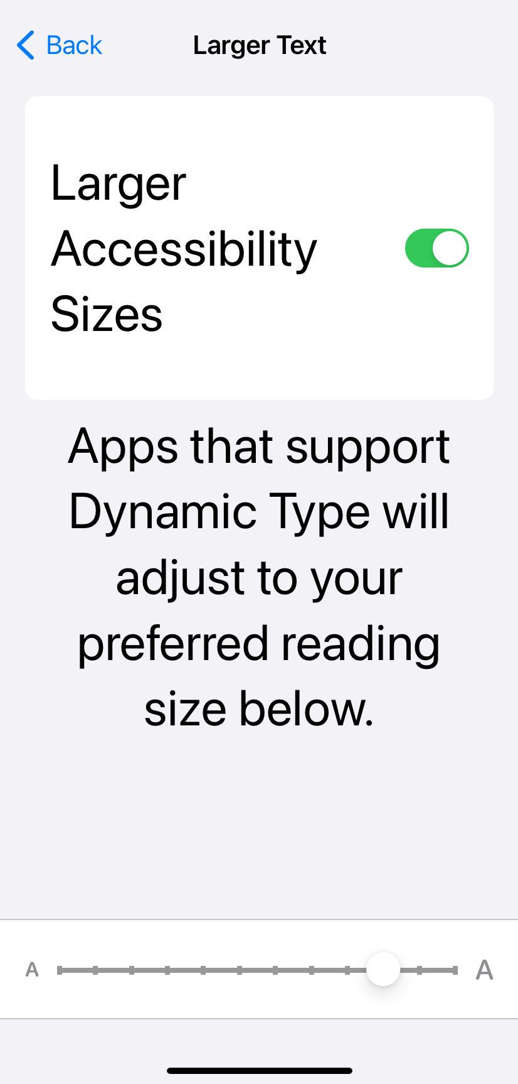
Resize Text: iOS
Settings > Display & Brightness > Text Size
Accessibility > Display & Text Size >
Larger Text
Larger accessibility sizes provides five additional text size options
Apple's text styles offer built-in support for
Dynamic Type/text resizing

Slide 14
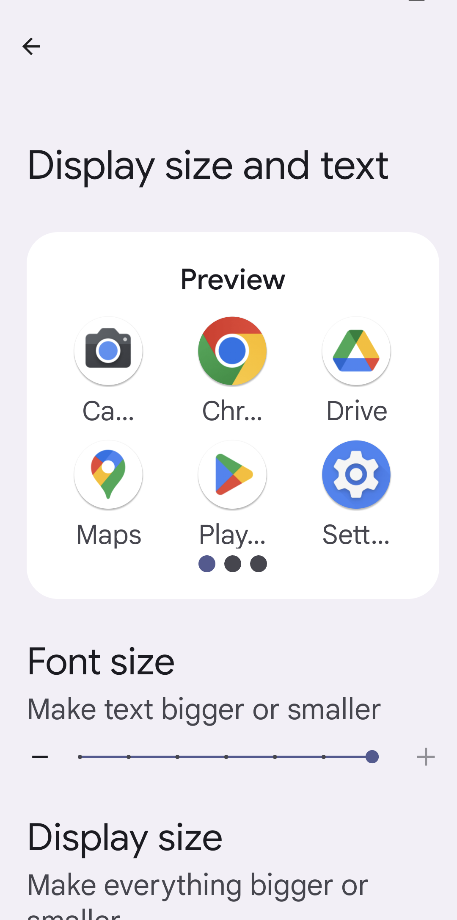
Resize Text:
Android
Accessibility > Display size and text
Android 13+
Font size affects only text, resizing up to 200%
Android 14+
Display size affects text as well as layout, controls, icons, etc.
Scalable units support text resizing

Slide 15
Resize Text: Common Issues
Portions of text do not resize
Text is cut off with ellipses (…)
Text is cut off by the boundary of its container
Text does not respond to text resize settings
Note: Safari and Chrome web browsers each have text resize settings independent of system text resize settings.

Slide 16
Color and Contrast

Slide 17
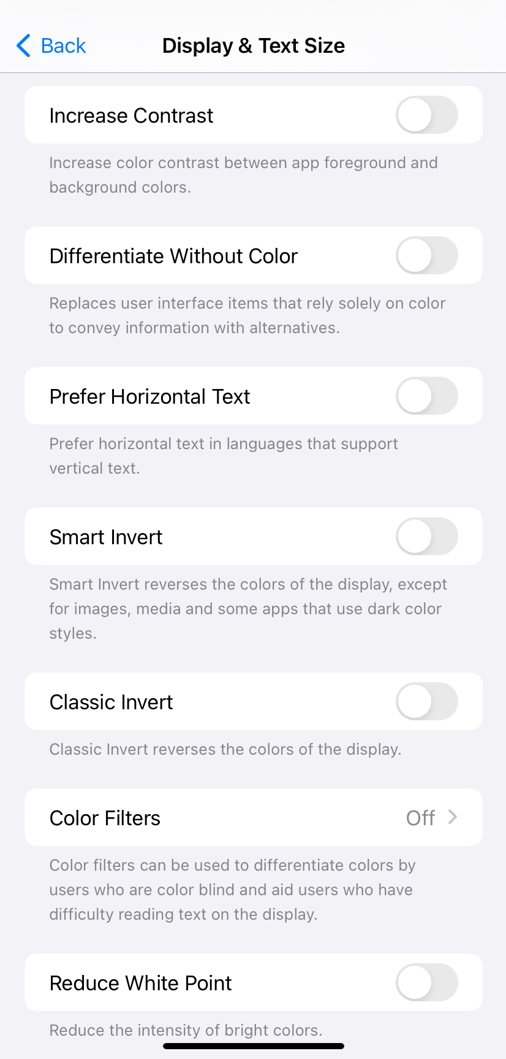
Color and Contrast: iOS
Accessibility > Display & Text Size
Classic Invert inverts all displayed colors
Smart Invert inverts all displayed colors except for media (e.g., graphics, video) and select user interface elements
Increase contrast must not be relied upon but must not be suppressed!

Slide 18
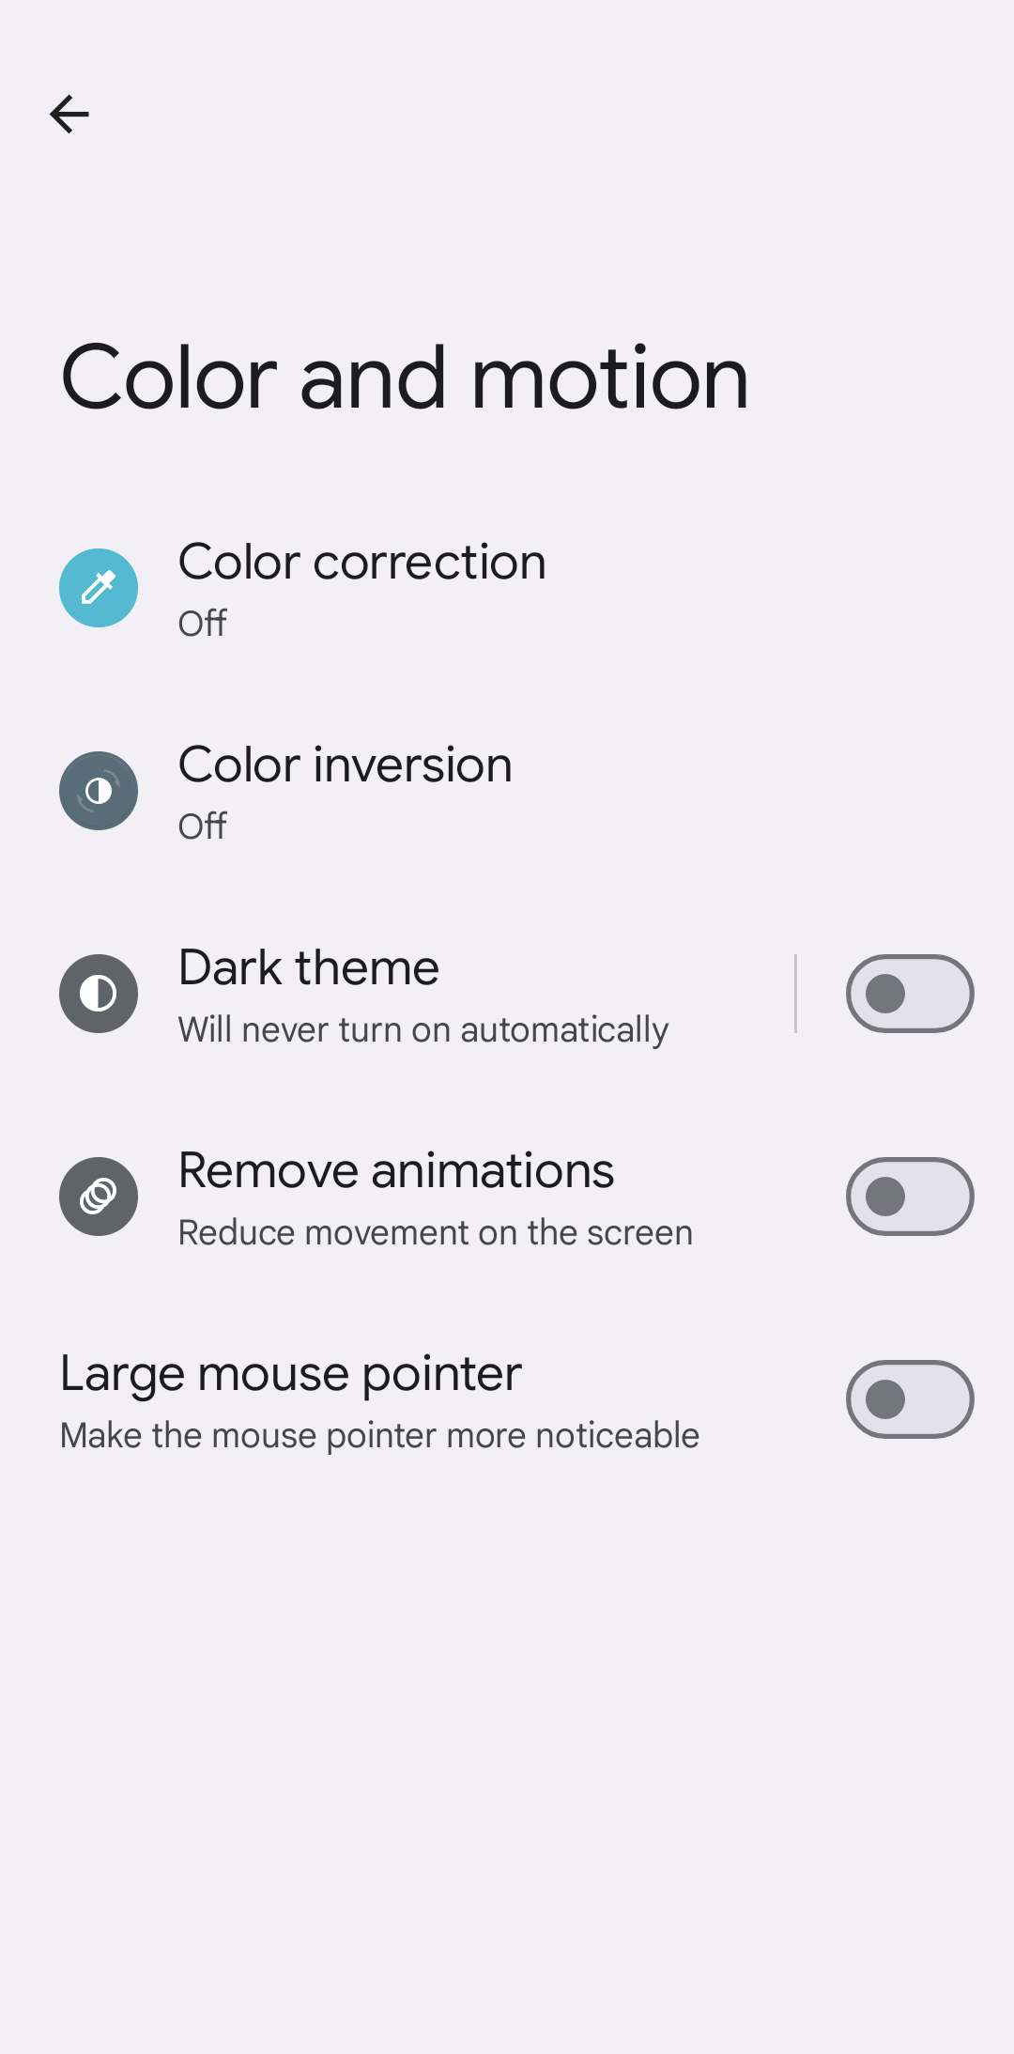
Color and Contrast:
Android
Accessibility > Color and motion
as of Android 13
Color inversion inverts all displayed colors

Slide 19
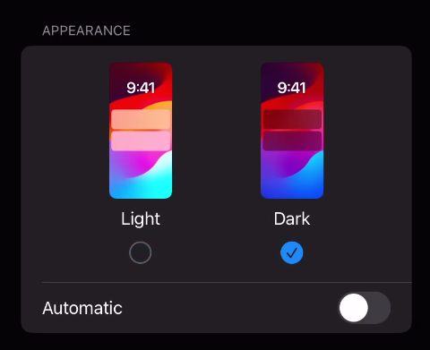

Color and Contrast:
Dark
Dark Mode or Dark theme uses darker backgrounds and colors to decrease brightness and reduce eye strain
May introduce color or contrast issues
Settings > Display & Brightness
iOS
Accessibility > Color and motion > Dark theme
Android

Slide 20
Color and Contrast: Common Issues
Insufficient contrast for text elements
Insufficient contrast for user interface elements and states
Insufficient contrast for images and icons that convey information
Content does not respond to color and contrast settings

Slide 21
Screen Readers

Slide 22
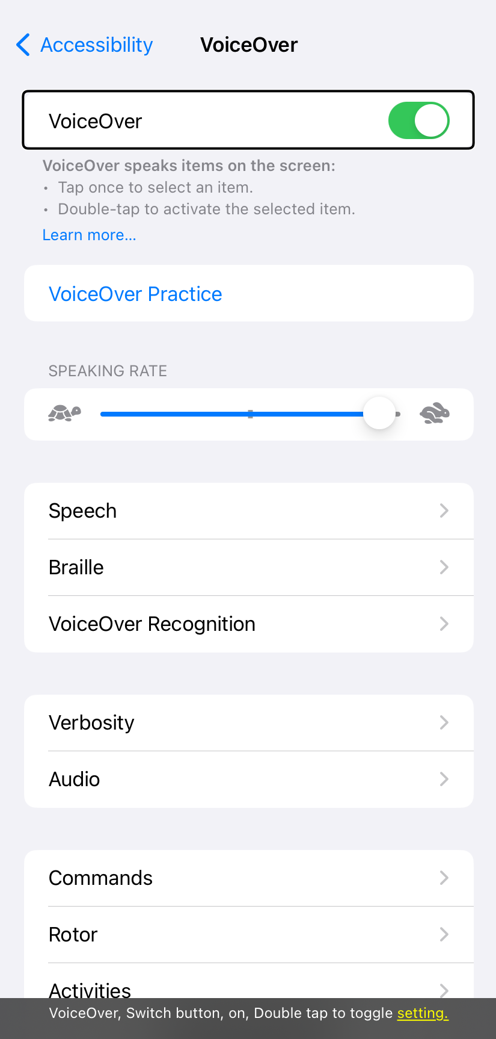
Screen Readers: iOS (VoiceOver)
Accessibility > VoiceOver
In iOS 13+, Caption Panel can display VoiceOver speech output as text at the bottom of the screen

Slide 23
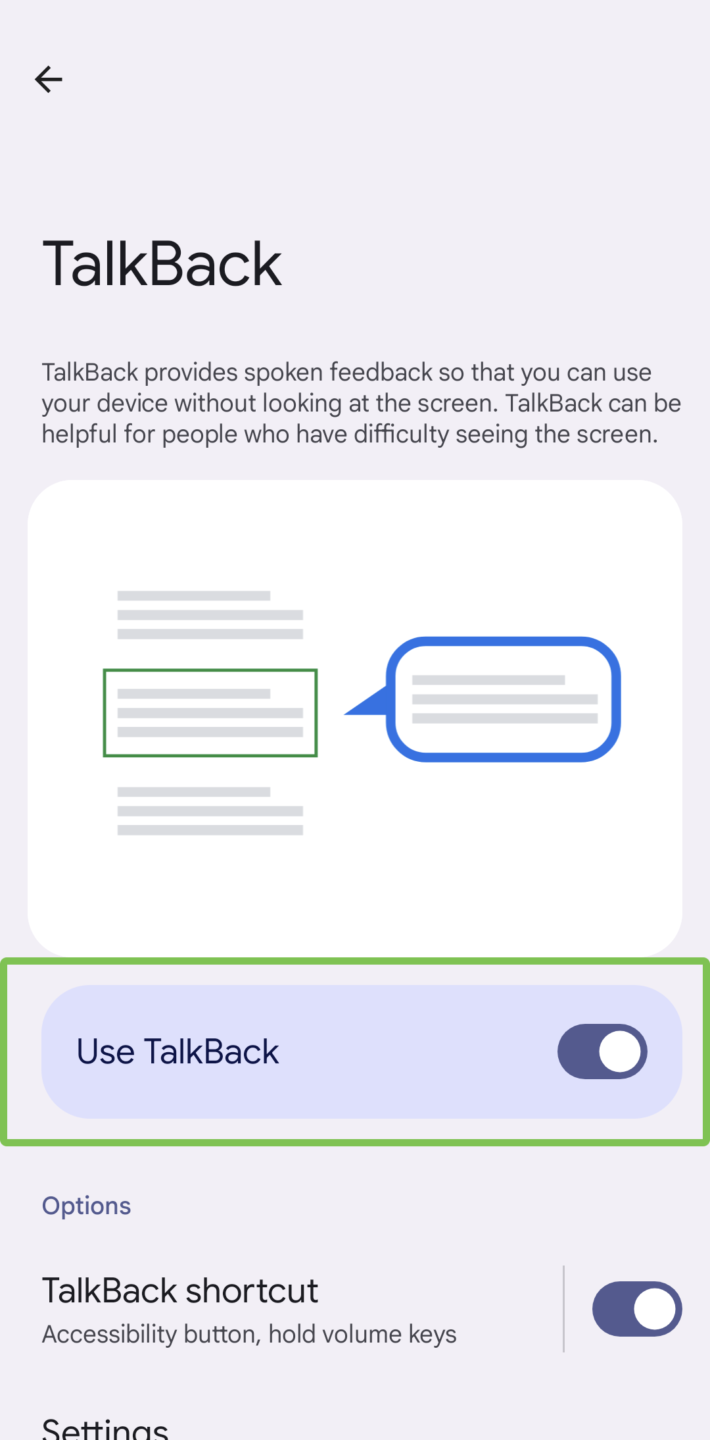
Screen Readers:
Android (TalkBack)
Accessibility > TalkBack
Part of Android Accessibility Suite, which integrates with device settings
TalkBack speech output displays as text at the bottom of the screen
If needed: TalkBack > Settings >
Advanced settings > Developer settings >
Display speech output

Slide 24


Screen Reader Navigation:
The Basics
Explore – drag with one finger
Select item – one-finger single tap
Move sequentially – one-finger swipe
right (forward) / left (backward)
Activate – one-finger double tap

Slide 25
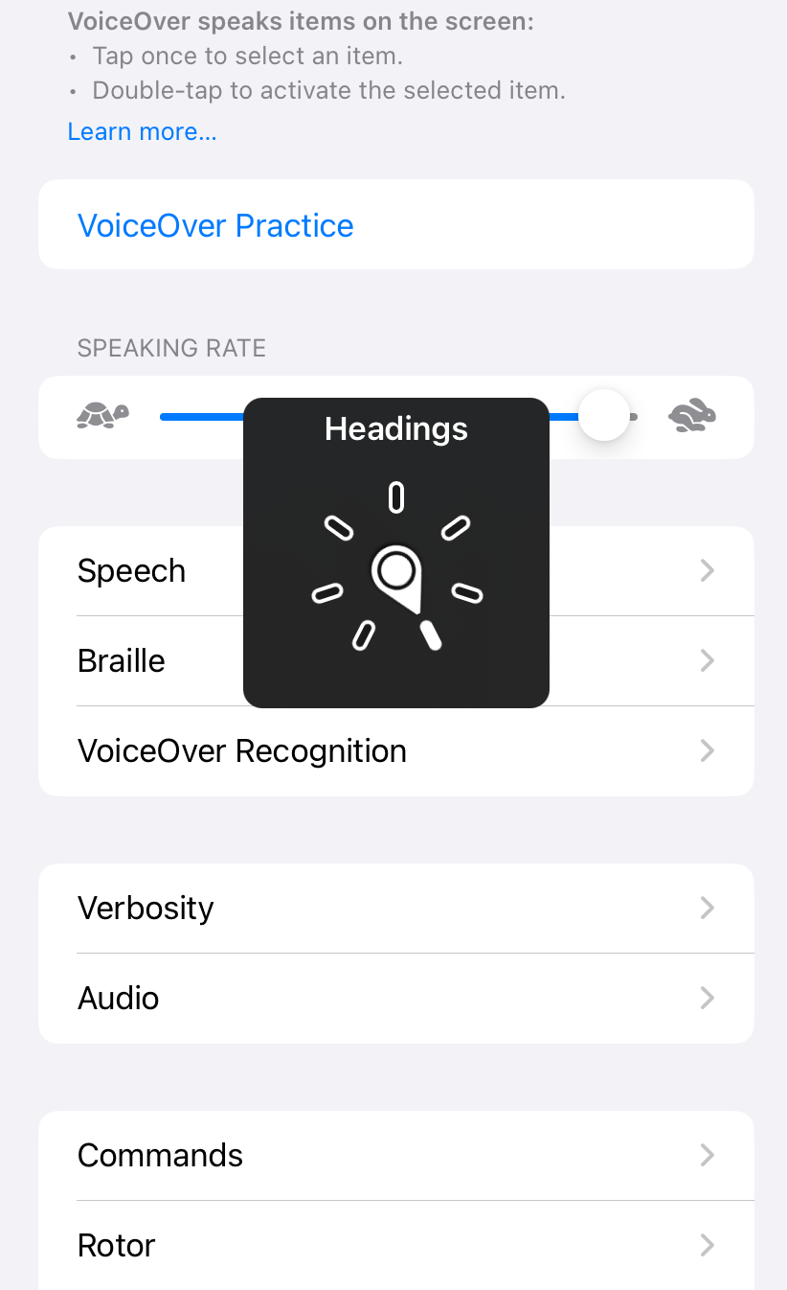
Screen Reader Navigation: iOS
Rotor – two-finger twist gesture to select
Navigate by all items of a particular type
(headings, images, words, etc.)
Move sequentially – one-finger swipe down (forward) / up (backward) to navigate
Can also adjust settings
(speaking rate, volume, enable hints, etc.)
Quick Settings – two-finger quadruple tap

Slide 26
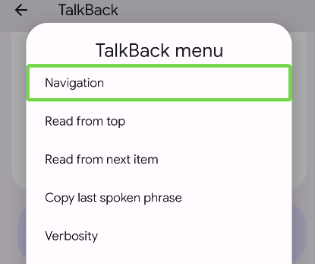
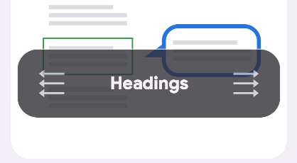
Screen Reader Navigation:
Android
TalkBack menu – one-finger swipe down then right or three-finger tap
Reading controls
  one-finger swipe down then up / up then down or three-finger swipe to select
  one-finger swipe down (forward) / up (backward) to navigate

Slide 27
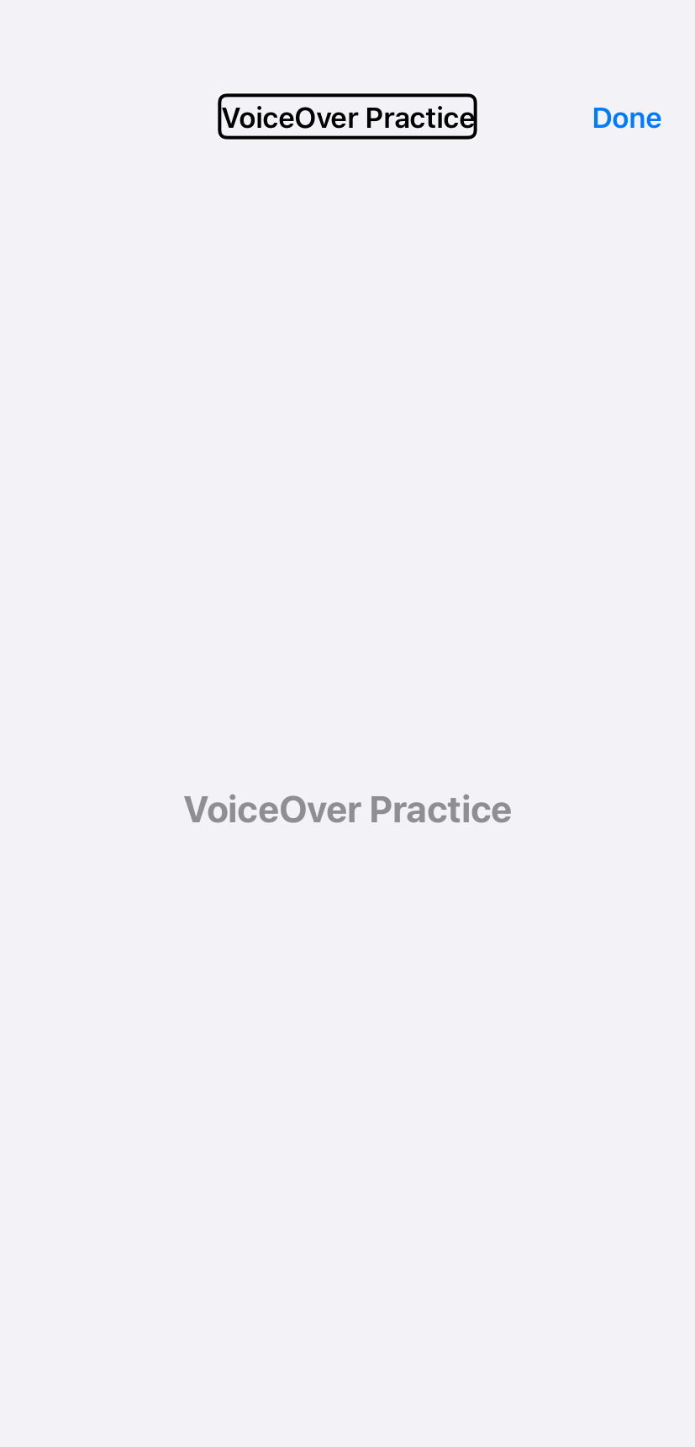
Practice Area: iOS (VoiceOver)
Accessibility > VoiceOver (on) > VoiceOver Practice
Make gestures on the screen to
learn more

Slide 28
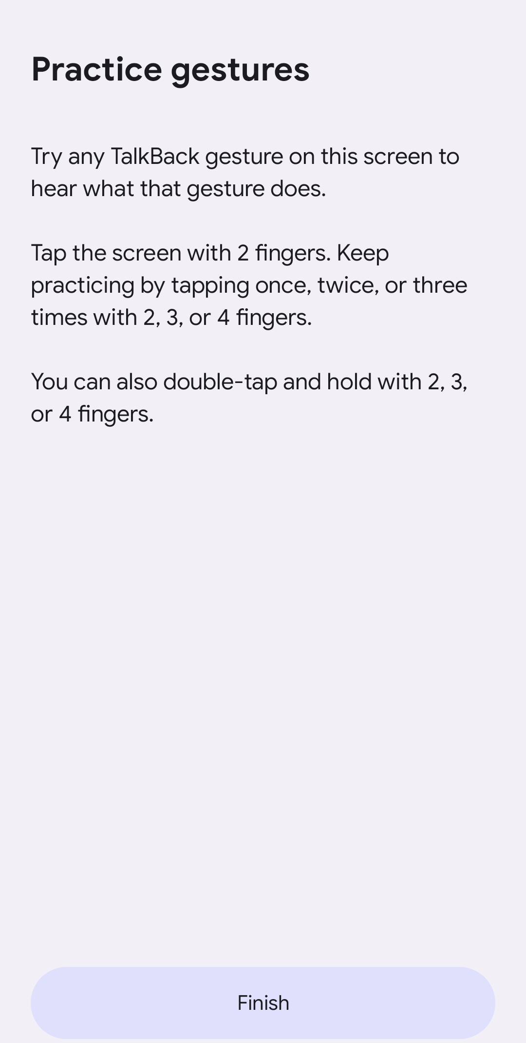
Practice Area:
Android (TalkBack)
Accessibility > TalkBack > Settings > Tutorial and help > Practice gestures
Make gestures on the screen to
learn more
Accessibility > TalkBack > Settings >
Tutorial and help > Tutorial

Slide 29
Screen Readers: Common Issues
Images with missing or incorrect text alternatives
Visible information, structure, and relationships not communicated
Hidden content announced
Illogical reading order
Interactive elements not operable while the screen reader is enabled
Content updates not communicated
Interactive elements with missing or incorrect names, roles, states, or values

Slide 30
Accessibility Shortcut

Slide 31
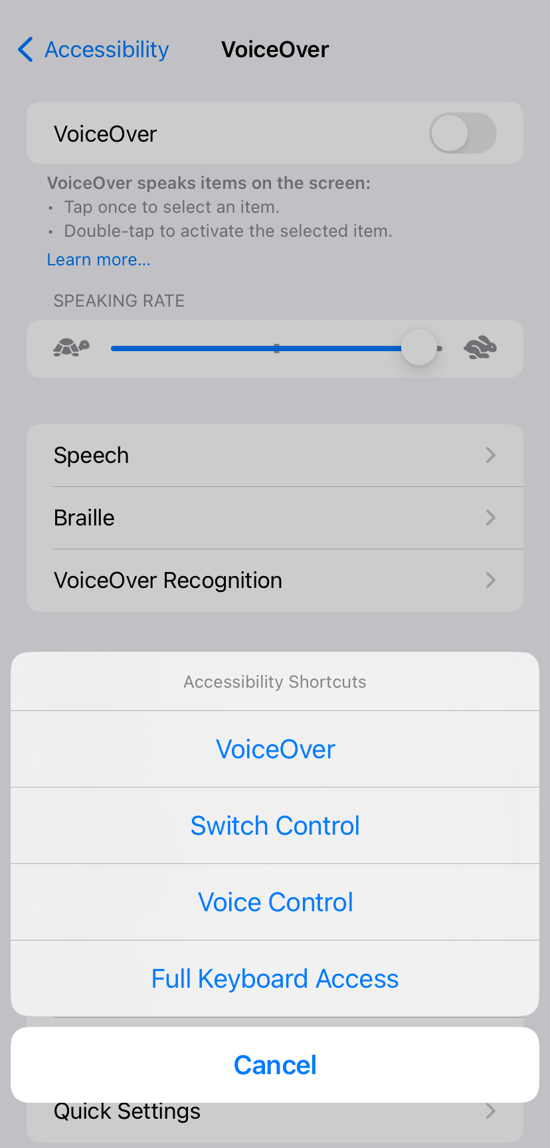
Accessibility Shortcut: iOS
Triple-click the side button or the
home button
Add a button to the Control Center
Toggle one accessibility setting or choose from multiple
Accessibility > Accessibility Shortcut

Slide 32
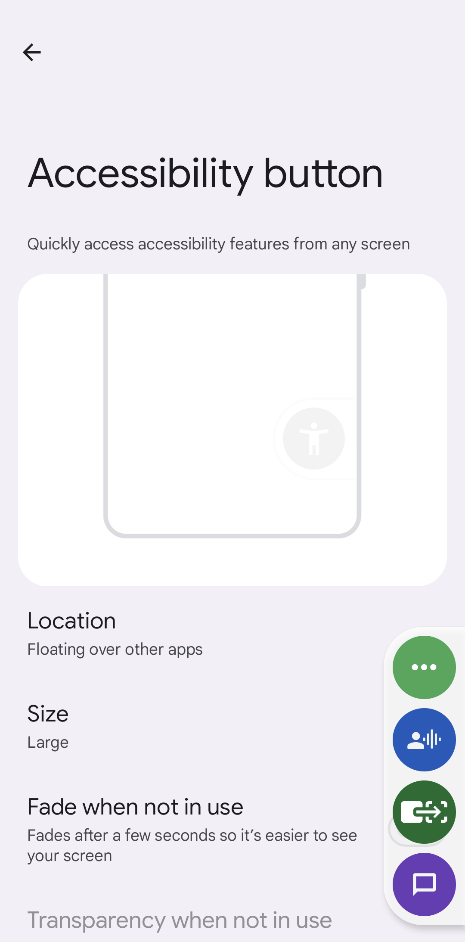
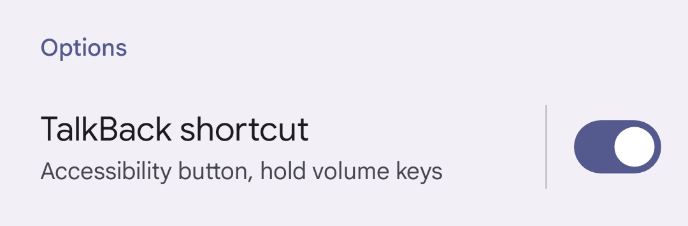
Accessibility Shortcut:
Android
Hold both volume keys together
Add accessibility shortcut button
Toggle one accessibility setting or choose
from multiple
Available as an option to enable for most accessibility settings

Slide 33
More Device Settings

Slide 34
More Device Settings: Color and Contrast
iOS | Android
Reduce Transparency | Color correction
Differentiate Without Color | High contrast text
Color Filters | Extra dim (Android 12+)
Reduce White Point | Contrast (Developer options, Android 14)

Slide 35
More Device Settings: Vision and Sight
iOS | Android
Zoom | Magnification (updated in Android 14)
Magnifier (updated in iOS 17) | Select to Speak
Spoken Content (Speak Selection, Speak Screen) | Remove animations
Bold Text | Large mouse pointer
Button Shapes | Bold text
On/Off Labels | Audio description (Android 13+)
Reduce Motion (updated in iOS 17)

Slide 36
More Device Settings: Mobility and Touch
iOS | Android
Voice Control | Voice Access
Switch Control | Switch Access
Assistive Touch | Autoclick (dwell timing)
Reachability | Touch & hold delay
Haptic Touch/Touch Accommodations | Time to take action (Accessibility timeout)
Back Tap (iOS 14+) | Vibration & haptics

Slide 37
More Device Settings: Hearing and Audio
iOS | Android
Hearing Devices | Sound Amplifier
Hearing Control Center (iOS 17+) | Live Transcribe
Sound Recognition | Sound Notifications
LED Flash for Alerts | Live Caption
Subtitles & Captioning | Hearing devices (updated in Android 14)
Live Captions (iOS 16+) | Flash notifications (Android 14)

Slide 38
More Device Settings: Speech and Voice
iOS
Live Speech (iOS 17+)
Personal Voice (iOS 17+)

Slide 39
More Device Settings: Cognition
iOS
Assistive Access (iOS 17+)

Slide 40
Resources
iOS
Accessibility Support
https://support.apple.com/accessibility
Android
Accessibility Help
https://support.google.com/accessibility/android

Slide 41
Additional Testing Tools

Slide 42
Physical Keyboard
Bluetooth or wired, but likely Bluetooth
Input method for screen reader users or for users
with limited mobility or dexterity

Slide 43
Physical Keyboard: The Basics
iOS | Android
Accessibility > Keyboards > Full Keyboard Access (FKA) | Settings > System > Keyboard > Physical Keyboard (large screens)
Note: Turn FKA off when not in use to avoid issues with VoiceOver focus | OS + / to view list of shortcuts
Helpful tip! Make it a point to find a multi-device or easy-switch Bluetooth keyboard.

Slide 44
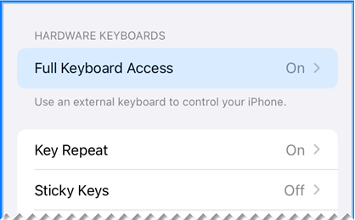
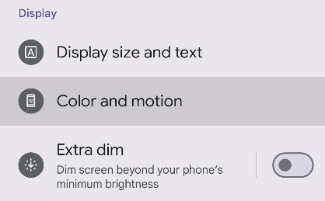
Physical Keyboard: Common Issues
Interactive elements not operable
Illogical focus order
Unable to see where focus is
(e.g., focused element is obscured or focus indicator is missing)

Slide 45
Automated Testing
Note: No automated testing tool is perfect! Automated tools can only ever supplement—never replace—manual testing.

Slide 46
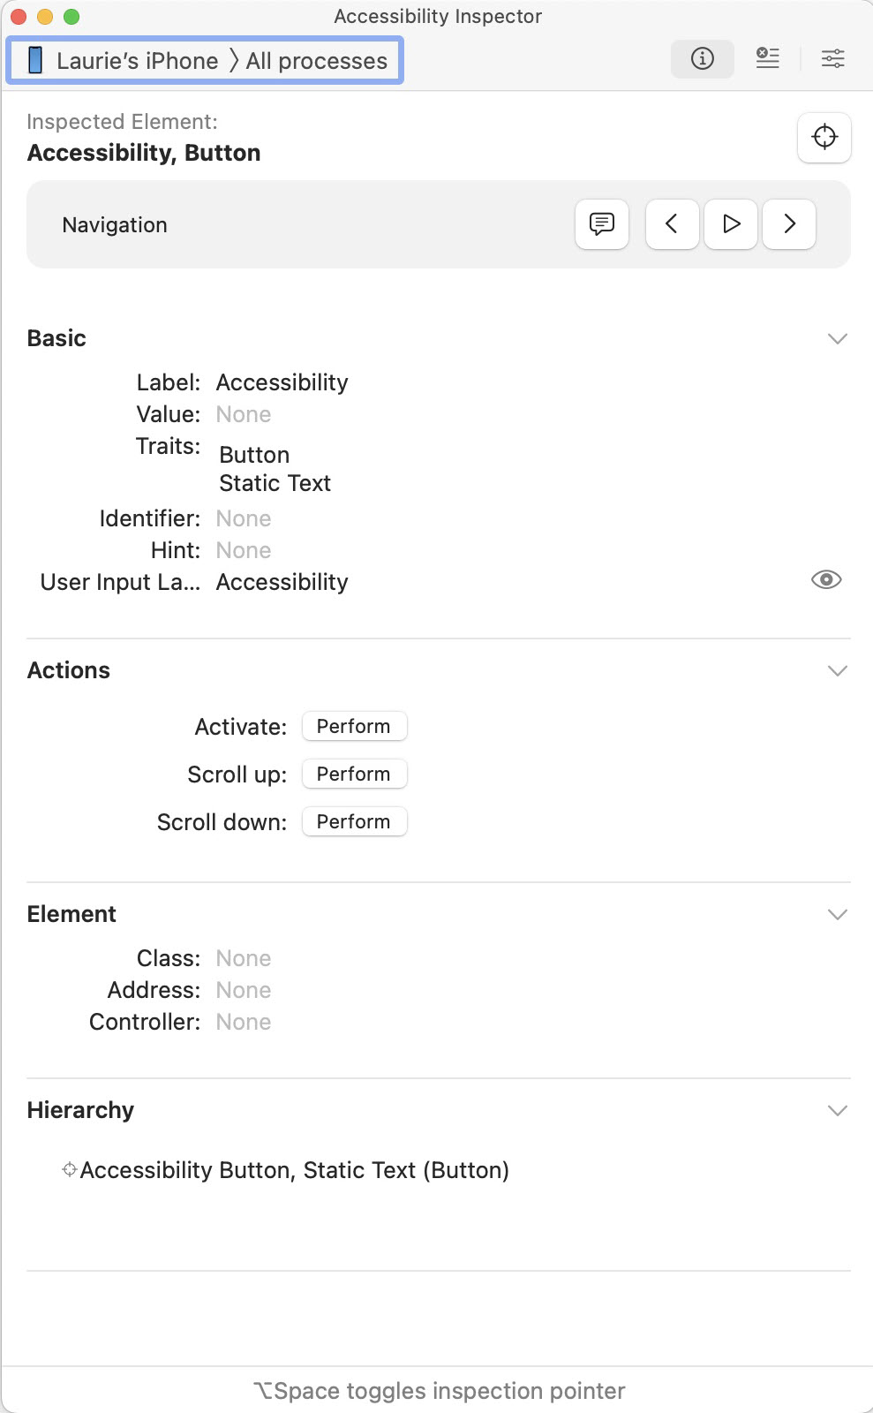
Automated Testing: iOS
Accessibility Inspector
Available in Xcode
Xcode > Open Developer Tool > Accessibility Inspector
Must connect testing device to a computer
with Xcode
Inspect by element to show basic information

Slide 47
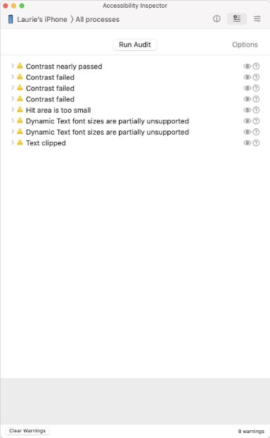
Automated Testing: iOS, cont.
Run Audit to show potential issues for all visible screen content
Includes issues relating to color contrast, target size, missing labels, text resize, and more

Slide 48
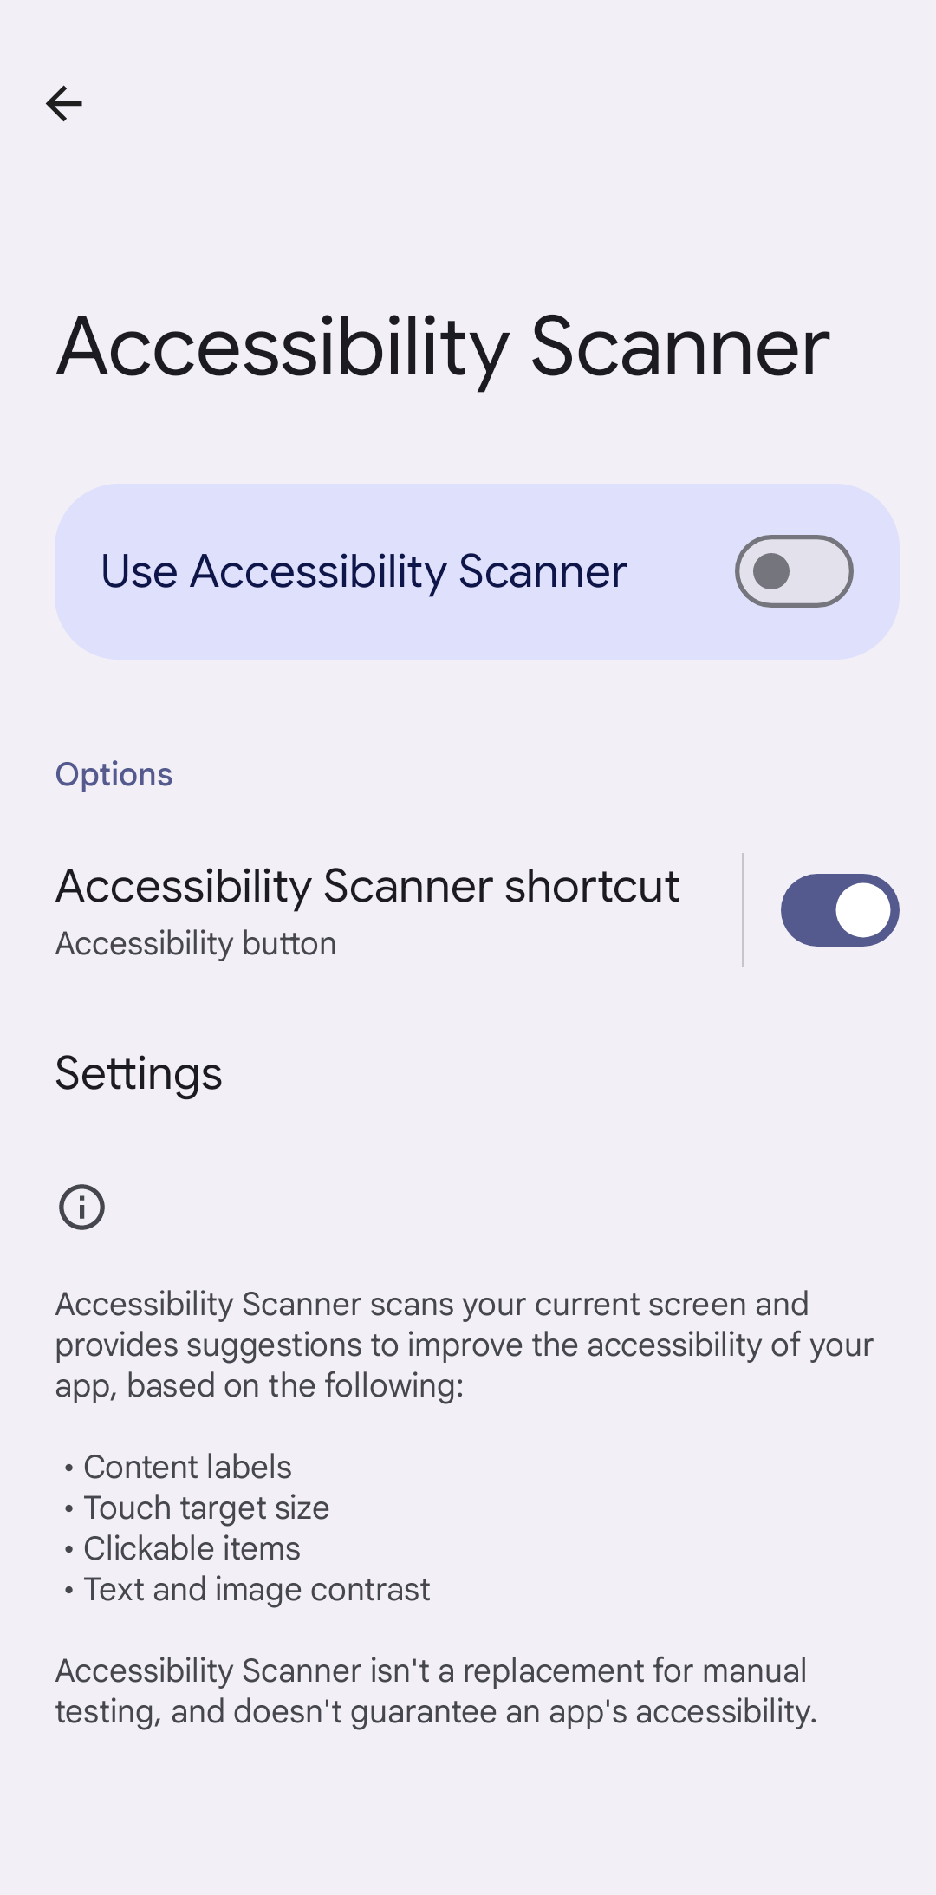
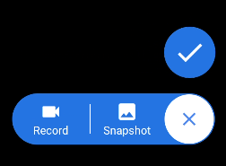
Automated Testing:
Android
Google Accessibility Scanner
Available for free in the Play Store
Operates directly on testing device
Provides a floating button to scan content for potential issues

Slide 49
Automated Testing: Common Issues
Insufficient color contrast for text and images
Interactive elements with insufficient target sizes
Interactive elements with missing names and labels

Slide 50
More Testing Tools

Slide 51
Screen Mirroring
iOS | Android
LonelyScreen | SCRCPY
Display your testing device on your desktop screen
May be helpful for:
  Capturing information to share with others
  Testing color contrast using the Colour Contrast Analyser

Slide 52
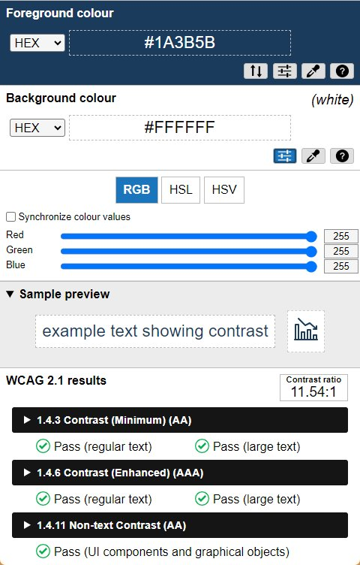
Colour Contrast Analyzer
(CCA)
Free tool for easily determining the contrast ratio of two colors
Select colors using an eyedropper tool, an RGB slider, or by manually entering color formats
Download available from TPGi
https://www.tpgi.com/color-contrast-checker

Slide 53

Questions

