Slide 1

Modernize & Improve the Patient Experience with Self Check-in
Moderator: Laura Boniello Miller
October 10, 2023

Slide 2
Agenda
Introductions
Project Overview
Panel Discussion
Listener Q & A

Slide 3
Introductions
Mike Raudenbush, Senior Director of Sales, KIOSK Information Systems
  13 Years in the Kiosk Industry
  Specialized in working with clients and partners to develop and deploy complex kiosk solutions, involving: Hardware, Software and Services
  Experienced in meeting various hardware requirements, including accessibility within self service implementations

Slide 4
Introductions (cont.)
Patrick Smith, Catholic Health (healthcare system, kiosk deployer)
  Senior Systems Analyst Patient Access Systems.
  25 years of healthcare experience. 8 ½ years in IT. Worked to implement Epic Revenue Cycle for six facilities within the Catholic Health Services health network.
  Successful implementation of Welcome tablets to over 140 departments. Currently transitioning from tablets to Kiosks. Have rolled out over 40 kiosks with plans to roll out as many as 300 into 2024.
  EPIC Certifications include Welcome, Grand Central & Prelude.

Slide 5
Introductions (cont.)
Balaji Raman, Director Patient Financial Systems Catholic Health
  25+ years of healthcare experience
  18+ years in Revenue Cycle both in Operations and Information Technology
  Have lead multiple Electronic Medical Record Implementations
  In-depth experience in Revenue Cycle Consulting specifically focusing on transformation and optimization

Slide 6
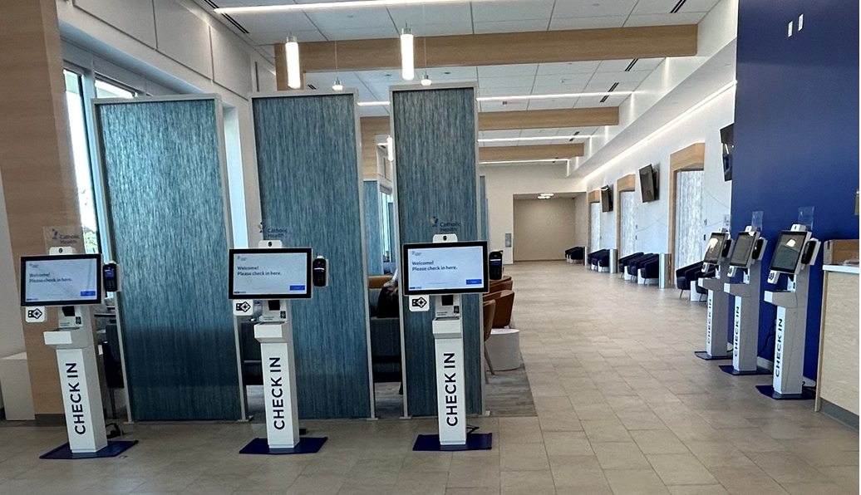
Case Study – Catholic Health
Notes:
So this is one of our main hubs in Centereach NY and as six kiosks, multiple providers that use this building, an urgent care and you know it's it's a newly renovated and and just went live a few months ago so.
Laura Miller
I'll try to uh
Settings

Slide 7
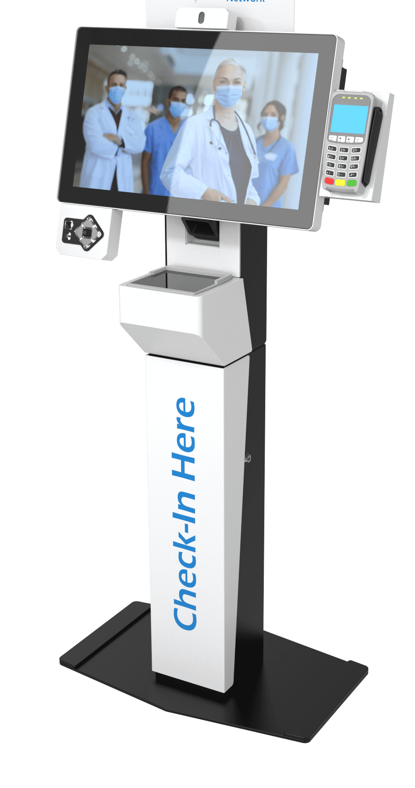
QA

Slide 8
Traci Murray - tmurray@vispero.com
Mike Raudenbush - nraudenbush@kiosk.com

Slide 9

Modernizing the Patient Experience with Self-Service Kiosks

Slide 10








KIOSK Information Systems
Global presence and corporate organization
Louisville, Colorado USA
Seefeld, Germany
New Taipei City, Taiwan
New Taipei City, Taiwan HQ
Hayward, California USA
+ more global offices
KIOSK Information Systems
  Leading supplier of self-service solutions
  > 250,000 Kiosks deployed world-wide
Posiflex
  Parent Company
  Integrated KIOSK Information Systems supplier and manufacturer
  5th Largest POS, terminal, component & display manufacturer globally
Portwell
  Sister Company
  5th Largest embedded PC, board & display manufacturer globally
New Taipei City, Taiwan HQ
Fremont, California USA HQ
+ more global offices

Slide 11
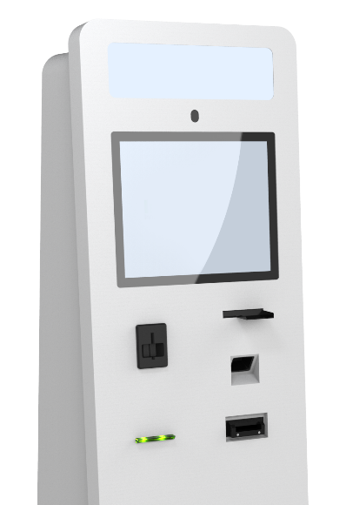
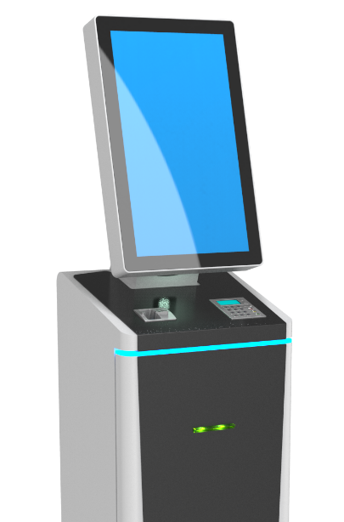
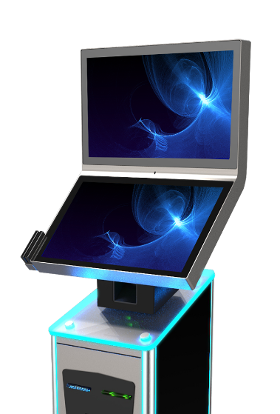
KIOSK Differentiators
What we do best
Reliable network of global deployment
300,000+
units in the field
Innovative product portfolio
30 years
Niche solution experts
all key disciplines
Expanded business opportunities
Self-service
solutions
End-to-end
product life cycle management
since 1993
Stringent, mission-critical SLA capability
Turnkey cradle to grave hardware support

Slide 12
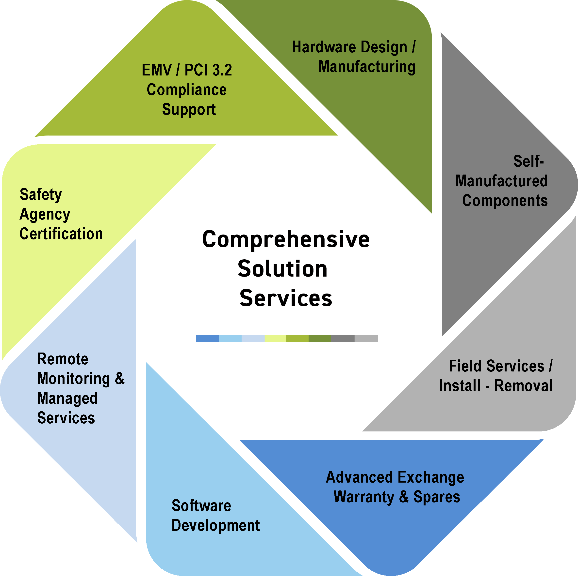
Complete kiosk Solution Ecosystem
End-game benefits:
Simpler – expert access for all project deliverables
One-stop shop
Vastly improved project success
Notes:
we have evolved to - Industry leading experts on all solution points
Hardware design, EMV/PCI Compliance Support, Remote monitoring, Hosting, Managed Services, Advanced parts and on-site services, along with fully custom software development all providing the ability to ensure a successful kiosk deployment

Slide 13

Common Healthcare industry challenges
Labor shortages continue to impact the healthcare industry, and self-service kiosks offer an opportunity to streamline the check-in process and improve accuracy.
Administration Efficiency: With check-in kiosks handling day-to-day check-in transactions, administrators have more time to focus on higher-level tasks
Information Accuracy: Moving pre-screening forms from paper to kiosks eliminates human error in copying handwritten forms into EHR
Identity and Insurance Fraud: Check-in kiosks validate patient identity and insurance information upon arrival, reducing opportunity for fraud

Slide 14


Opportunities for growth
An efficient check-in process sets up healthcare systems for success and benefits care providers, administrators and patients.
Improve Profitability: Check-in kiosks collect payment at time of service, streamlining payments and reducing receivables
Convenience for Patients: Beyond check-in, kiosks aid in wayfinding, enable patients to request medical records, manage upcoming appointments, and even arrange transportation with Uber/Lyft integration
Improved Staff Morale: Redeploying basic customer service to kiosks removes the burden of repetitive tasks from front desk staff

Slide 15






Software solutions
KIOSK-authored software
KIOSK in-house developers provide turnkey services in personalized software.
Software licensing for KIOSK’s Hardware Integration Module (HIM)
KIOSK’s proprietary remote monitoring platform, KNECT IoT ®
Partner-authored software
KIOSK’s partners provide a wide selection of easily applicable software solutions.
Market-ready digital solutions for faster deployment
Ability to fully integrate with legacy software systems in a wide variety of verticals
Customer-authored software
KIOSK’s licensable Hardware Integration API library for custom solutions.
Easy-to-use, well-defined abstraction layer of development assets
Provides developers a quick integration of software with hardware and reduced time to market.

Slide 16
Healthcare KIOSK Solutions
Overview of Solutions

Slide 17



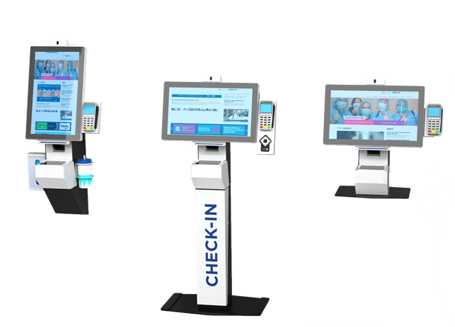
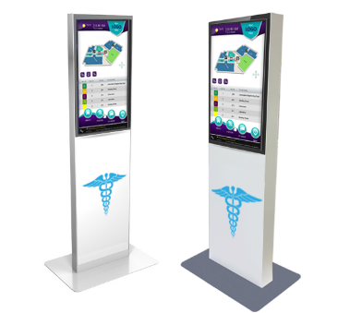
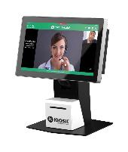
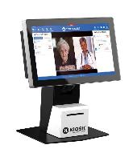
Patient journey
GUIDE: HOSPITAL WAYFINDING
CONVENIENCE: PATIENT CHECK-IN
SUPPORT: PATIENT SERVICES

Slide 18
PRIMARY FOCUS:
PATIENT CHEcK-IN
Solution Capabilities:
Patient check-in kiosk hardware with software integration capabilities (i.e. Epic Welcome)
Digital appointment check-in to streamline operations
Secure patient identification and registration, ensuring full HIPAA compliance
Real-time demographics verification and eligibility check to ensure records and collection accuracy

Slide 19
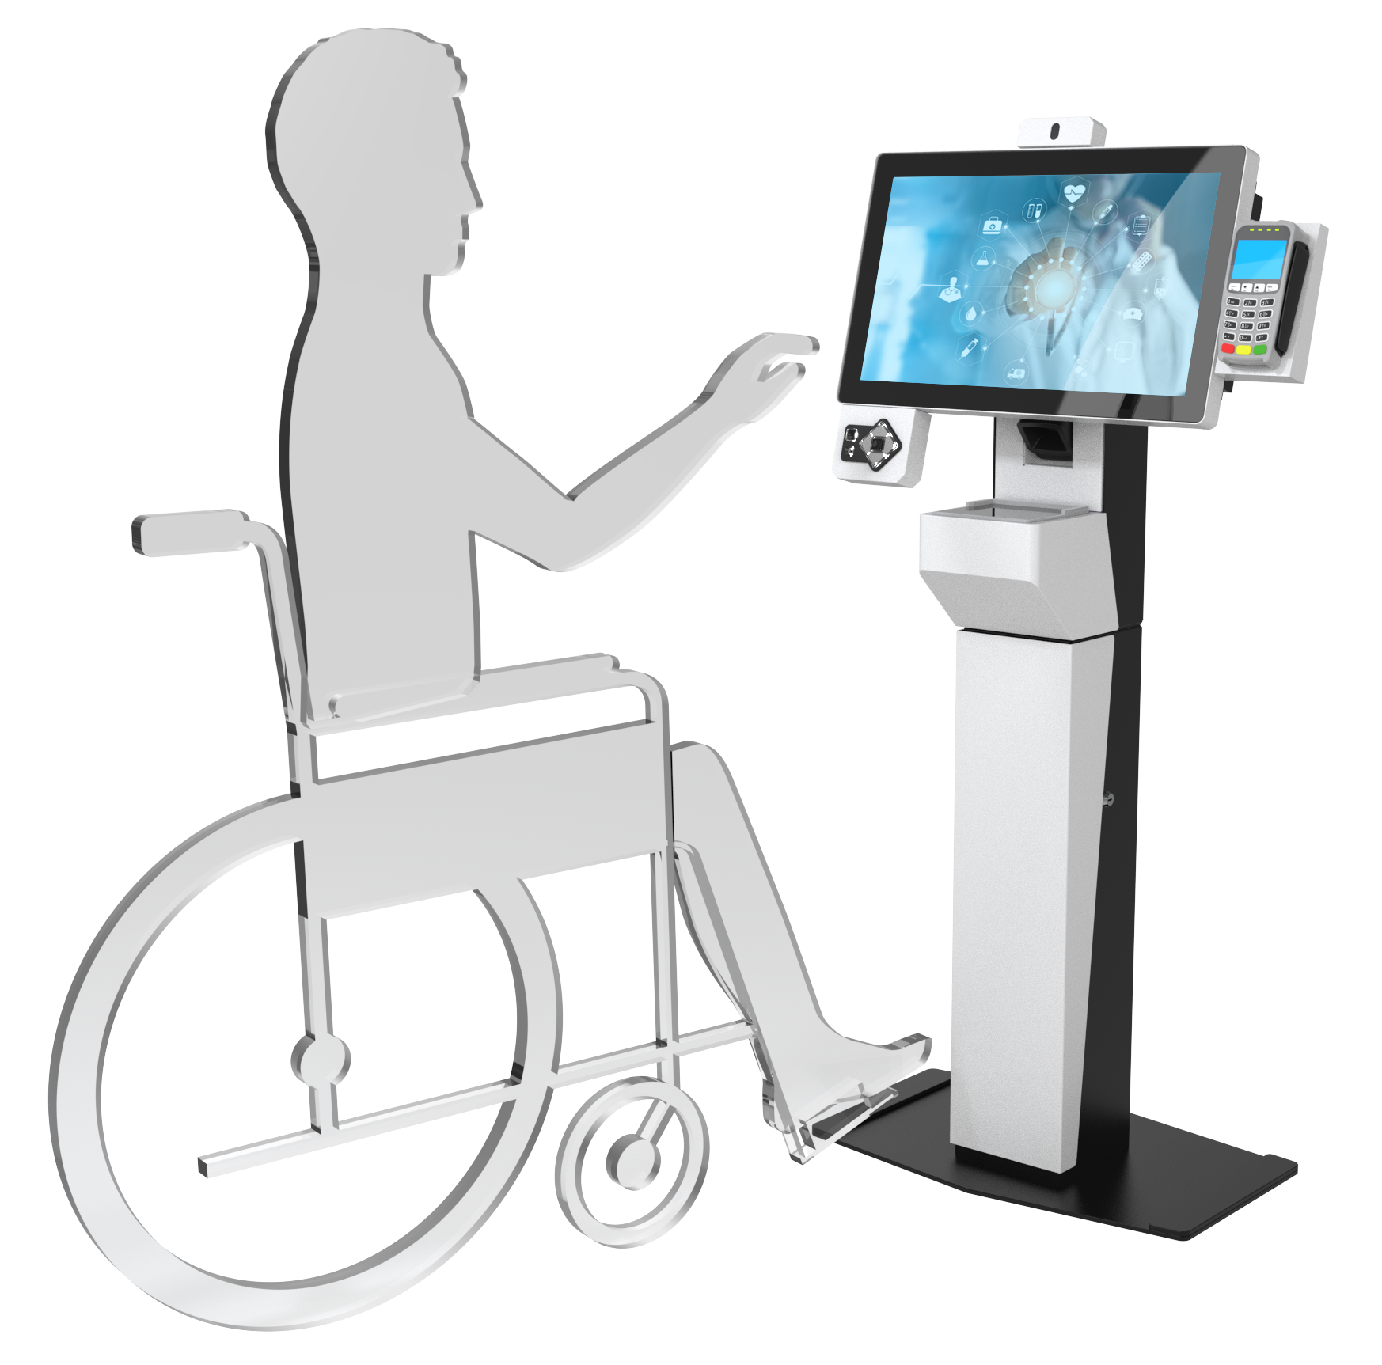
considerations for ada compliancE
48” ADA Reach Limit
Know the standards around kiosk accessibility
  ADA Height / Reach specifications
Work with an experienced hardware provider
  Make sure they know what is needed to support specific functions of the kiosk (i.e. data input and output devices, etc)
Kiosk software applications matter
  Developer techniques for accessibility include digital content like contrast, font size, video captions, etc. (i.e. Assistive Technology Software such as the JAWS for kiosk screen reader)
Kiosk placement
  Environmental factors such as approach, placement, and glare can impact the accessibility of a kiosk

Slide 20
The Challenge
Keeping up with rapidly growing technology and making sure it’s used in a meaningful way.
Ensuring that patients are comfortable and engaged in using the tools we are providing.
Educate staff of the importance of scheduling & pre-registration.
Assisting staff with modified workflows to increase patient satisfaction.
Reducing the collection of bad data.
Increasing the collection of POS collections.

Slide 21
The Goals
Transform our workflows into enhanced digital experience.
Decrease door to door times for patient satisfaction.
Reduced data entry mistakes improving accuracy of patient data.
Increased POS collections.
Provide updated and ongoing training for all staff.
Reduce workload for front end staff, allowing more time for staff to perform other activities.

Slide 22
The Solution
Implement Epic Welcome Kiosks throughout our health organization.

Slide 23
The Results
Increased accuracy of patient data
Average reduction in patient wait time
Decrease average patient door to door times
POS collections
Surveying patients utilizing the kiosks - 90% positive feedback

