Slide 1
Navigating the
European Accessibility Act:
Your Roadmap to Compliance

Slide 2


Presented by:
Mark Miller
Director of Sales, TPGi
David Sloan
Chief Accessibility Officer, Vispero
UX Practice Manager, TPGi

Slide 3
Agenda
Introducing the European Accessibility Act
What products and services are covered?
EAA Requirements Summarized
EAA’s relation to technical accessibility standards
Implications for Business
Your EAA Trail Map – a strategy for meeting and maintaining conformance
Takeaways

Slide 4
Introducing the European Accessibility Act
An attempt to harmonize accessibility requirements across the European Union
  Divergent rulesets have made it difficult to understand and meet accessibility laws and regulations
  Harmonization helps reduce market fragmentation and provide consistency in accessibility requirements
When?
  EAA was due to be transposed into member state law by June 2022
  Covered products and services provided to the EU market must meet EAA requirements by June 28, 2025
Notes:
Harmonization means a common set of requirements across EU member states, making it easier for product and service providers to understand what to do to meet accessibility requirements across Europe. Also makes it easier for customers to know what to expect
Why – civil rights for people with disabilities not to encounter discrimination when accessing digital products and services. Building on UN Convention on the Rights of Persons with Disabilities (UN CRPD)
Business logic – people with disabilities have spending power, and the population of disabled people in Europe is growing. 101 million (1 in 4) people aged over 16 in the European Union (2022) https://www.consilium.europa.eu/en/infographics/disability-eu-facts-figures/
Exceptions exist for certain legacy technology and for micro-enterprises, but conformance is still recommended
How long? – 15 months & 28 days or 69 Weeks & 2 days or 485 days

Slide 5
What is covered by the EAA?
Digital TV equipment
Computers and operating systems
Smartphones
Self-service devices such as ATMs and ticketing machines
e-Books and e-Readers
e-Commerce websites and mobile apps
Communication technology and equipment
Banking services
Passenger transport services
Audiovisual media services
Notes:
Categories:
- Commonly used hardware and software, including kiosks
- Various services related to communication, commerce, finance, education, and transportation
Websites and apps providing ecommerce, banking, transport services

Slide 6
EAA Requirements Summarized
Product manufacturers and service providers must meet accessibility requirements for covered products and services:
  Meet functional requirements associated with disability profiles
  Provide documentation of accessibility features
EU member states must meet requirements for monitoring compliance with requirements:
  Transpose EAA into national legislation and regulations
  Assign an organization responsible for monitoring
  Implement a mechanism for dealing with non-compliance

Slide 7
European Standards and EAA
EAA mentions the WCAG principles of Perceivable, Operable, and Understandable but does not directly mention the Web Content Accessibility Guidelines (WCAG), EN 301 549 or any other standard
  It does include (in Article 15) provisions for organizations meeting existing standards that have been referenced in the Official Journal of the European Union
  So evidence of EN 301 549 conformance (and by extension WCAG 2.1 AA) should help to demonstrate EAA conformance

Slide 8
EN 301 549, WCAG and EAA
EN 301 549 Accessibility requirements for ICT products and services
  Is a harmonized European standard providing accessibility requirements for information and communication technology (ICT)
  Covers websites, software, hardware and digital documents
  Defines functional performance criteria that address specific accessibility needs
  Integrates by reference technical accessibility requirements from WCAG 2.1
  Closely aligned with the US Section 508 Standards
Notes:
EN 301549 is a free standard, available from ETSI.org
It was initially developed to support procurement efforts of public organizations in the EU, following the European Web Accessibility Directive.
Australia has also adopted EN 301549 as part of federal procurement policy.

Slide 9
Expected Updates
EN 301 549 and two other European accessibility standards (EN 17210:2021 and EN 17161:2019) are currently undergoing updates to better support the requirements of EAA
  WCAG 2.2 was published by W3C in October 2023
  We anticipate the updated EN 301 549 will directly incorporate WCAG 2.2 AA
  The EN 301 549 schedule gives a publication date for the updated version of early 2026
Notes:
The other accessibility standards are:
EN 17210:2021 Accessibility and usability of the built environment - Functional requirements
EN 17161:2019 Design for All - Accessibility following a Design for All approach in products, goods and services - Extending the range of users.

Slide 10
Implications for Businesses
To demonstrate conformance with EAA requirements by June 28 2025:
  Adopt EN 301 549 and WCAG 2.1 Level AA (at a minimum) or WCAG 2.2 Level AA (recommended)
  Involve people with disabilities in product and service development and evaluation
  Document accessibility features of products and services
Implement a strategy that ensures capacity to meet and maintain conformance with EAA requirements, including any new requirements that may emerge
Notes:
Meeting baseline technical requirements helps you anticipate requirements across different member states.
While the Act may not mandate involvement of disabled people in product and service design and testing, it’s a great way to focus efforts on ensuring products and services are usable by people with a range of disabilities

Slide 11
Implications of Non-Conformance
Will vary by country, depending on how EAA is transposed into national legislation and how conformance is monitored
Sanctions for non-conformance may include:
  An obligation to address accessibility issues within a given time-period
  Withdrawal of product or service from the market
  Fines
  Imprisonment of company leadership
Notes:
Reminder that EAA conformance is monitored at state level, and states have responsibilities to address instances of non-conformance. This contrasts with civil rights legislation protecting disabled people, such as the ADA in the US, which typically requires people to file allegations of unlawful discrimination

Slide 12
Overlays and EAA Conformance
Accessibility overlays are technologies that temporarily create a real-time transformations to a website’s appearance and functionality when a disabled person visits the site.
Overlays cannot automatically detect or fix all possible accessibility issues present in the site
Some solutions have been found to make websites less accessible to people using assistive technology
The European Commission Directorate-General of Communication “…cannot endorse any tools or products that fall into the categories of overlay tools or widgets.” [reference]
Notes:
Overlays may be attractive to organizations seeking quick fixes with limited time and resource, but bring substantial risks if relied upon instead of investing in an accessibility strategy and commitment.

Slide 13
Your EAA Trail Map
Our step-by-step guide to preparing for EAA compliance by June 28, 2025
Step 1: Assess
Step 2: Strategize
Step 3: Prepare and support
Step 4: Implement
Step 5: Monitor and grow

Slide 14
Step 1: Assess
Establish a technical conformance goal
Inventory your current digital products and services – websites, mobile apps, kiosks, etc
Assess each product and service against your conformance goal
  Automated scanning
  Manual testing
Assess your team’s accessibility awareness, knowledge and skills
Engage with senior leaders and other stakeholders to secure investment and support in an accessibility strategy
Notes:
Conformance goal – EN 301549 and WCAG 2.1 AA or WCAG 2.2 AA
Prioritize your product and service inventory based on assessed risk of non conformance

Slide 15
Step 2: Strategize
Communicate an organization wide future state of accessibility and a plan for reaching that state
Define accessibility responsibilities for stakeholders involved in creating and managing digital resources
Plan for:
  Addressing accessibility barriers found in assessments of current digital resources
  Managing accessibility in new digital resources that you’ll build
  Involving disabled people in product development and evaluation
  Creating accessibility documentation for digital resources

Slide 16
Step 3: Prepare and Support
Provide role-based accessibility training
Define accessibility tests to be performed on digital resources
Provide tools to support building and monitoring accessible digital resources
Create a shared repository of accessibility knowledge to support team members
Notes:
Role-based training means giving team members the accessibility knowledge they need to meet their accessibility responsibilities

Slide 17
Step 4: Implement
Work through the process of remediating barriers present in existing resources
Meet accessibility requirements as early as possible when developing new resources
Include people with disabilities in digital asset usability evaluation
Document progress towards addressing accessibility requirements, including producing an accessibility statement for each digital asset you provide to customers.
Notes:
Take a prioritized approach to remediation – for example by addressing high impact, low effort to fix barriers first
Documentation could include creating Accessibility Conformance Reports (VPATs) as well as customer-focused accessibility advice (accessibility statements)
The EU Model Accessibility Statement provides a good template for a public facing accessibility statement – see https://universaldesign.ie/communications-digital/web-and-mobile-accessibility/writing-an-accessibility-statement for more advice
Involving users with disabilities – make sure you act on findings, and document what you did

Slide 18
Step 5: Monitor and Grow
Track accessibility data for each digital asset and address areas where improvement is not happening at the desired rate
Review and address gaps in knowledge and tools available
Review, report, and celebrate successes!

Slide 19





Accessibility Maturity Model
Level 3
Optimized
Level 2
Defined
Level 1
Reactive
ROI
Core competencies & Activities
Level 1: Reactive
Level 2: Defined
Level 3: Optimized
Enable access to knowledge
Manual Audit and Verification
Automated Accessibility Monitoring
Acting on accessibility analytics
Access to On-demand Accessibility expertise (Consulting / Help Desk)
Role-based Training
Design Reviews (Shift Left)
Executive Sponsorship/Champion
Enterprise Level automated tool
Integration in CICD pipeline (API)
JAWS Inspect with Automated QA Testing
User Research with People with Disabilities
Notes:
19

Slide 20
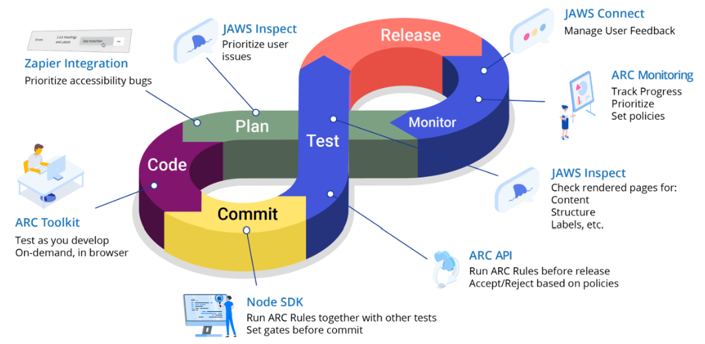
Full Spectrum Accessibility Platform
Notes:
20

Slide 21
Conclusion
Digital products and services sold or provided in the European Union will need to meet EAA requirements by June 28, 2025
Organizations need to act now to ensure they have capacity and capability to meet requirements
Key recommendations:
  Adopt EN 301549 and WCAG 2.2 Level AA as technical guidance
  Combine automated and manual accessibility testing to identify issues to be addressed
  Involve disabled people throughout the product/service development and testing lifecycle
  Document accessibility features of the product or service

Slide 22
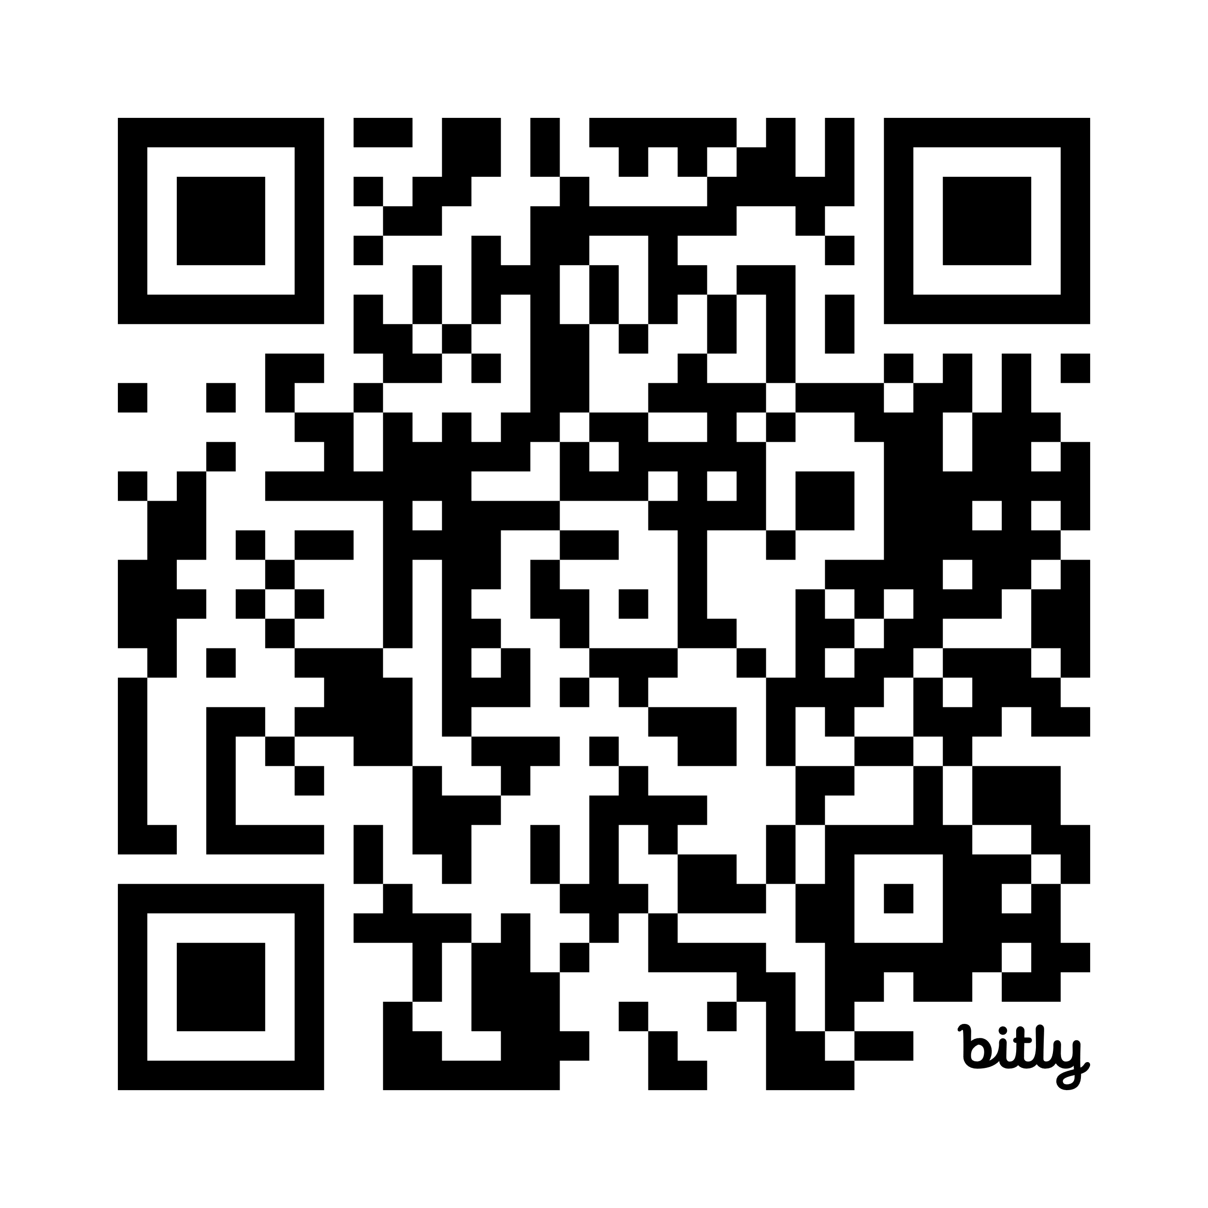
Questions?
Download TPGi’s Guide to the EAA: https://bit.ly/EaaGuide
Your Accessibility Partner
Contact us:
+1 (877) 775-9474 | info@tpgi.com | Speak with an expert

