Slide 1
Ramping Up Your Accessibility Testing:
A Beginner's Guide
Gigi Etienne
Accessibility Engineer, TPGi
Notes:
Hi, I’m Gigi – And my talk is…

Slide 2

Why is accessibility testing important?
Notes:
I’m an accessibility engineer at TPGi and I spend my days finding accessibility issues with websites and mobile app and providing the client with solutions for these accessibility issues so they can improve the accessibility of their products.
The purpose of the talk is to share everything that I’ve learnt over the last year so you can leave today with a set of tools that you can use to help you in your accessibility work or advocacy.
Who here works in accessibility?
Leave your hand up if you work in product. Developer, designer, product manager, researchers, content writer/designer
Now put your hand up if you work as an accessibility project manager, director, lead
Finally, raise your hand if you do not work specifically with accessibility but you’re a champion, or simply are interested
Whoever you are, the goal of today is to give you a set of tools to do some basic accessibility testing that you can then use to generate change in your organization.
Let me tell you a story.
So hopefully today’s presentation will encourage you to really understand your product’s accessibility issues and to use these findings to inspire change in your organization and improve the accessibility of the product you work on.
Some people might not want to make a case, just learn how to test.
Usability testing with people with disabilities

Slide 3
The testing process
  Colors
  Resizes
  Keyboard
  Code
  Screen reader
Notes:
Not just zoom. Also magnification software.

Slide 4
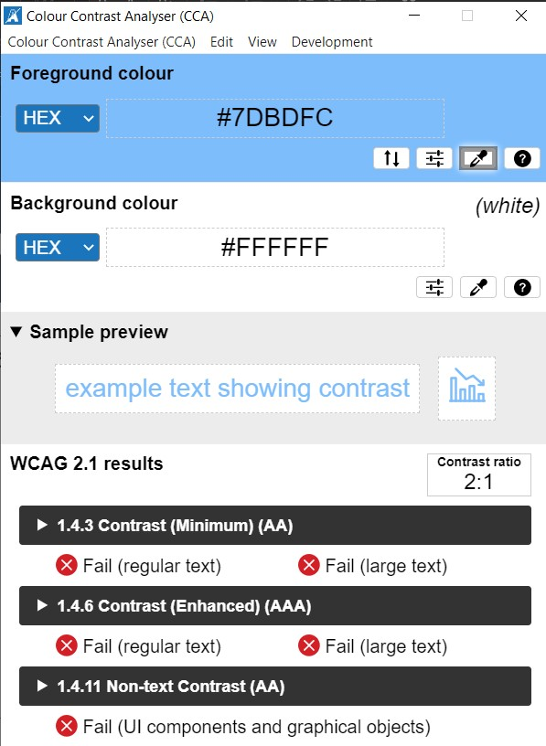
Step 1: Colors
Text contrast:
Regular size text (less than 24px or 18.5px for bold text): 4.5:1 ratio
Large size text (at least 24px or 18.5px for bold text: 3:1 ratio
Non-text contrast (focus indicators, graphical objects, etc.):
3:1 ratio
Use of color:
Color should not be used as the only way to convey information (i.e.: field in error only marked with red)
Notes:
Visual example of pass and fail

Slide 5
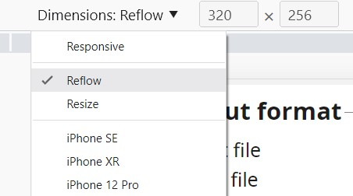
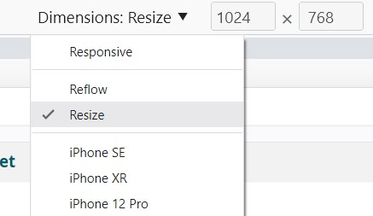
Step 2: Resizes
Reflow (resize to 320x256)
Resize (resize to 1024x768 + zoom to 200%)
Text Spacing
  line-height: 1.5 !important;
  letter-spacing: 0.12em !important;
  word-spacing: 0.16em !important;
Orientation (both portrait and landscape)

Slide 6
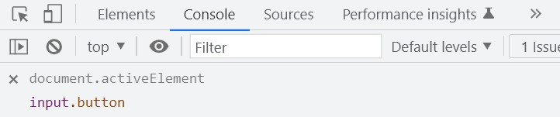
Step 3: Keyboard
Keyboard: Everything that is operable with a mouse (or by touch) should also be operable with a keyboard.
  TAB or TAB + SHIFT
No keyboard trap
Focus order
Visible focus
Tip: use document.ActiveElement
Right-click > Inspect > Console > Create Live Expression > Type: “document.ActiveElement” and enter > the focused element will appear under it > click on the element.

Slide 7
Keyboard: Reasons why element do not receive keyboard focus
<a> without an href
Non-HTML focusable element without tabindex=“0”
Element with tabindex=“-1”

Slide 8
Keyboard: Tabindex explained
tabindex=“0”
  Includes an element in the natural tab order
  Useful for: non-HTML focusable elements such as <div> or <span>
  Risks: make non-interactive elements focusable
tabindex=“1”
  Avoid using
tabindex=“-1”
  Gives programmatic focus but isn’t included in the tab order, i.e. modal dialogs, comboboxes, error messages

Slide 9
Step 4: Code
  Headings
  Lists
  Images
  Labelling
  Grouping controls
  Programmatic association
  Error messages

Slide 10
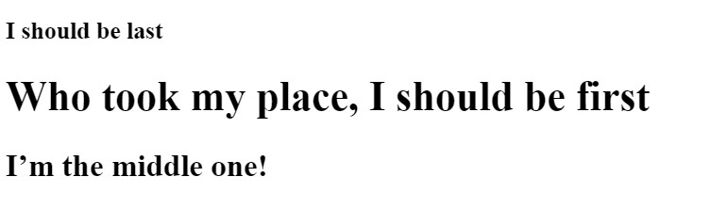
Code: headings
<h1>This is a heading</h1>
<strong>This should be a heading, but it's not</strong>
<h3>This is also a heading</h3>
<h3>I should be last</h3>
<h1>Who took my place, I should be first</h1>
<h2>I’m the middle one!</h2>
Notes:
Add visual help

Slide 11
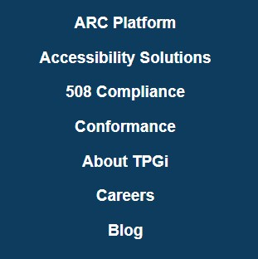
Code: lists
<ul>
<li><a href="https://www.tpgi.com/arc-platform/">ARC Platform</a></li>
<li><a href="https://www.tpgi.com/accessibility-solutions/">Accessibility Solutions</a></li>
<li><a href="https://www.tpgi.com/508-compliance/">508 Compliance</a></li>
<li><a href="https://www.tpgi.com/conformance-wcag-section-508-ada/"></a></li>
<li><a href="https://www.tpgi.com/about/">About TPGi</a></li>Conformance
<li><a href="https://www.tpgi.com/careers/">Careers</a></li>
<li><a href="https://www.tpgi.com/blog/">Blog</a></li>
</ul>
Notes:
Add an ordered list example too.

Slide 12
Code: images
<img src="..." alt="TPGi">
<img src="..." alt="">
ff
Notes:
Show example of a decorative image and one that is informative

Slide 13
Code: labelling
<a href="https://test.com" aria-label=“Facebook">
<span>Twitter</span>
</a>
<button aria-label="Blue" aria-labelledby="color">Red</button>
<span id="color">Yellow</span>
Notes:
Have a link for resources for labelling hierarchy

Slide 14


Code: grouping controls
Not grouped:
<div>
<input type="checkbox" name="newsletter" id="check_1">
<label for="check_1">The weekly newsletter</label>
</div>
<div>
<input type="checkbox" name="newsletter" id="check_2">
<label for="check_2">The weekly newsletter</label>
</div>
Grouped:
<fieldset>
<legend>I want to receive</legend>
<div>
<input type="checkbox" name="newsletter" id="check_1">
<label for="check_1">The weekly newsletter</label>
</div>
[…]
</fieldset>
ff

Slide 15
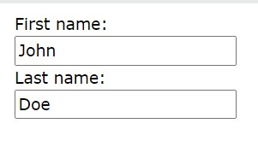
Code: programmatic association
  <div>
  <input type=“text" id=“first_name">
  <label for=“first_name">First name:</label>
  </div>
  <div>
  <input type=“text" id=“last_name">
  <label for=“last_name">Last name:</label>
  </div>
ff

Slide 16
Code: error messages
<label for="address">Address</label>
<input type="text" id="address" aria-invalid="true" aria-describedby="address-error">
<span id="address-error">Error: please enter a valid address</span>
ff

Slide 17
Step 5: Screen readers
JAWS + Chrome
NVDA + Firefox
VoiceOver + Safari (iOS devices)
TalkBack + Chrome (Android devices)

Slide 18
Screen readers (what we already know)
Are decorative images not announced? Informative images have the right alt text?
List announced as lists?
Headings announced as headings?
Element has the right role (input field, checkbox, button, etc.) and state (checked, not checked).
Element has an accessible name? Does it match the visual label?
Are the input field and the label properly associated?
Error messages associated?

Slide 19
Screen readers (what we don’t know yet)
Any visually hidden content announced to screen readers?
Is the content announced by the screen reader as it is presented visually?
Are new dynamic visual information (i.e. status messages) announced to screen reader users?
Notes:
Gif for a status message

Slide 20
Conclusion
Colors
Resizes
Keyboard
Code
Screen readers
Now, let’s build a more accessible world together!

Slide 21
WCAG Checklist
Colors
  1.4.3 Text Contrast
  1.4.11 Non-text contrast
  1.4.1 Use of Color
Resizes
  1.4.4 Resize
  1.4.10 Reflow
  1.4.12 Text spacing
  1.3.4 Orientation
Keyboard
  2.1.1 Keyboard
  2.1.2 Keyboard trap
  2.4.3 Focus Order
  2.4.7 Visible focus
Code
  1.1.1 Non-text content (images)
  1.3.1 Info and Relationships (lists and headings)
  4.1.2 Name, Role, Value (labelling, error messages)
  2.5.3 Label in Name (Labelling)
  1.3.1 Info and Relationships (grouping controls)
Screen readers
  1.3.2 Meaningful sequence
  4.1.2 Name, Role, Value

Slide 22

Questions

