Slide 1

Digital Accessibility Legal Update
Kristina Launey
Partner, Seyfarth Shaw LLP
Ashley Jenkins
Associate, Seyfarth Shaw LLP
www.adatitleiii.com

Slide 2
Legal Disclaimer
This presentation has been prepared by Seyfarth Shaw LLP for informational purposes only. The material discussed during this webinar should not be construed as legal advice or a legal opinion on any specific facts or circumstances. The content is intended for general information purposes only, and you are urged to consult a lawyer concerning your own situation and any specific legal questions you may have.

Slide 3
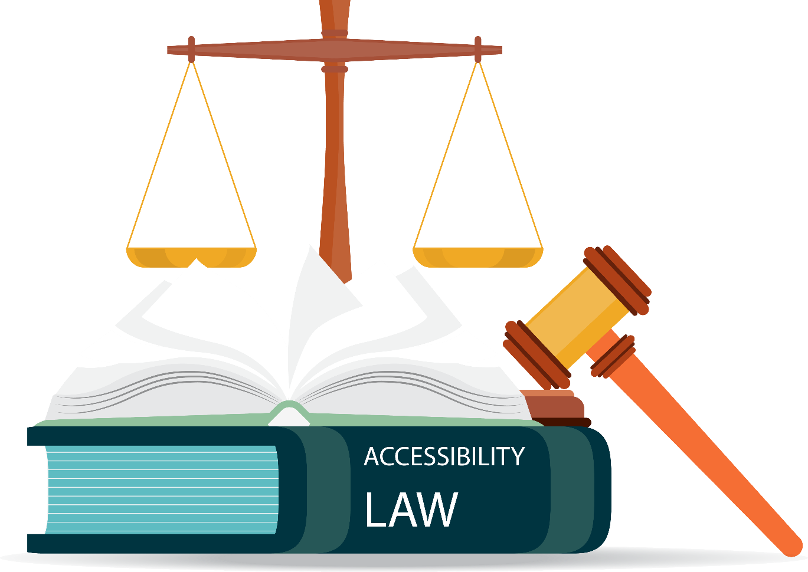
Agenda
Legal Overview
What is an accessible website?
ADA Title III Website Lawsuit Data
Key Lawsuits and Settlements
Strategies for Avoiding & Defending Legal Actions
Typical Roadmap to Accessibility

Slide 4
Legal Overview: What Laws May Require Accessible Technology
ADA Title II: State & Local Governmental Entities
ADA Title III: Public Accommodations
Section 504 Rehabilitation Act: Recipients of Federal Funding
Section 508 Rehabilitation Act: Technology sold to federal agencies may need to be Section 508 compliant under contract.
State Non-discrimination Laws: Public Accommodations
Air Carrier Access Act: Requires primary websites of airline carriers to conform to WCAG 2.0 AA.
ACA Section 1557, Medicare Regulations: Healthcare

Slide 5
ADA
Background
The Americans with Disabilities Act (ADA) is a federal civil rights law that prohibits discrimination against individuals with disabilities.
Signed into law by President George H.W. Bush on 7/26/90.
Covers five key areas:
  Employment (Title I)
  State and Local Government Activities (Title II)
  Public Transportation (Title II)
  Public Accommodations (Title III)
  Telecommunications (Title IV)
  *** Today’s focus = Title III

Slide 6
ADA Background
Under Title III of the ADA, public accommodations must:
  have facilities that are accessible to individuals with disabilities (i.e., members of the public);
  make reasonable modifications to policies, practices, and procedures when necessary to ensure that individuals with disabilities have equal access to public accommodations’ goods, services, facilities, privileges, advantages, and accommodations; and
  ensure effective communication with individuals with disabilities by providing them auxiliary aids and services (including “accessible electronic information technology”) at no additional charge.
Remedies:
  Private party: Injunctive relief, attorneys’ fees & costs (possible damages/penalties under state corollary laws)
  DOJ Action: Penalties $115,231 for a first violation and $230,464 for a subsequent violation (as of 2/12/24); injunctive relief, damages

Slide 7
ADA Background: A Public Accommodation is:
Private & Affects commerce
Falls within at least one of the following 12 categories:
  1) Places of lodging (e.g., inns, hotels, motels)
  2) Establishments serving food or drink (e.g., restaurants and bars);
  3) Places of exhibition or entertainment (e.g., motion picture houses, theaters, concert halls, stadiums);
  4) Places of public gathering (e.g., auditoriums, convention centers, lecture halls);
  5) Sales or rental establishments (e.g., bakeries, grocery stores, hardware stores, shopping centers);
  6) Service establishments (e.g., laundromats, dry-cleaners, banks, barber shops, beauty shops, travel services, shoe repair services, funeral parlors, gas stations, offices of accountants or lawyers, pharmacies, insurance offices, professional offices of health care providers, hospitals);
  7) Public transportation terminals, depots, or stations (not including facilities relating to air transportation);
  8) Places of public display or collection (e.g., museums, libraries, galleries);
  9) Places of recreation (e.g., parks, zoos, amusement parks);
  10) Places of education (e.g., nursery schools, elementary, secondary, undergraduate, or postgraduate private schools);
  11) Social service center establishments (e.g., day care centers, senior citizen centers, homeless shelters, food banks, adoption agencies); and
  12) Places of exercise or recreation (e.g., gymnasiums, health spas, bowling alleys, golf courses).
Must it be a physical place? 9th, 11th, 3d Cir. say yes; 1st Cir. says no.

Slide 8

What is an “accessible” website?
One that can be used by people with various types of disabilities
Blind: Screen reader compatibility
  Alternative text for images
  Properly labeled form fields
  Proper use of headings
  Keyboard-only access
  Audio descriptions for videos
Low Vision: Color contrast, text resizing
Deaf or Hard of Hearing: Captions for audio content
Mobility: Keyboard-only access; ability to slow down or turn off time outs
Epilepsy: No flashing content
Color Blind: Color not used as sole method of conveying information

Slide 9
Web Content Accessibility Guidelines (WCAG)
Published by private group of experts, W3C
  Adopted WCAG 2.1 in June 2018
    Adds 17 Success Criteria to WCAG 2.0
    Mobile Apps, Low Vision, Cognitive Impairments
  Issued WCAG 2.2 October 2023
    Adds 9 new success criteria to 2.1
    Removes 1
    86 total success criteria
Not a legal standard under Title III of the ADA

Slide 10
Legal Overview: DOJ Position & (In)Action Over the Years
2010-2016: 2010 ANPRM pending
2017: Withdrew website accessibility rulemaking begun in 2010
2018: Response to congressional letter
  ADA covers websites
  There is “flexibility” in how to comply
    “Absent the adoption of specific technical requirements for websites through rulemaking, public accommodations have flexibility in how to comply with the ADA’s general requirements of nondiscrimination and effective communication. Accordingly, noncompliance with a voluntary technical standard for website accessibility does not necessarily indicate noncompliance with the ADA.”
  2022/2023: Websites and Software Accessibility Act in Congress

Slide 11
Legal Overview: DOJ Position & (In)Action Over the Years (cont.)
Feb. 2022: Advocacy groups published “Joint Letter to Enforce Accessibility Standards” asking DOJ to “adopt enforceable online accessibility standards by the end of the current Administration.”
March 2022: Biden DOJ issued Guidance regarding website accessibility
June 2022: 12 Senators sent DOJ a letter: “critical [that DOJ] restart rulemaking”
February 2023: DOJ released 1st report on compliance with Section 508 in 10 years, showing many federal agencies not complying with 508’s web accessibility mandate.
May 2023: DOJ and DOE OCR issued letter informing colleges of enforcement activities under Title II and Section 504 (e.g., Nov. 2022 DOJ – UC Berkeley Consent Decree)
August 2023: DOJ published NNPRM regarding website accessibility regulations for state and local governments under Title II of the ADA. Comments closed Oct 2023.

Slide 12
Some States are Stepping In
    California: AB 1757
      would effectively make WCAG 2.1 Level AA the required standard for the websites and mobile apps of “business establishments” covered by the Unruh Civil Rights Act.
      would allow individuals with disabilities as well as business establishments to sue third party developers that create noncompliant websites and mobile apps.
        See Bashin v. Conduent lawsuit & Dec. 2023 settlement
    Kansas: Act Against Abusive Website Access Litigation
      Effective July 1, 2023, will allow Kansas businesses to sue ADA plaintiffs and their counsel to recover legal fees, as well as potentially punitive damages, for “abusive” website accessibility litigation commenced in any jurisdiction.

Slide 13
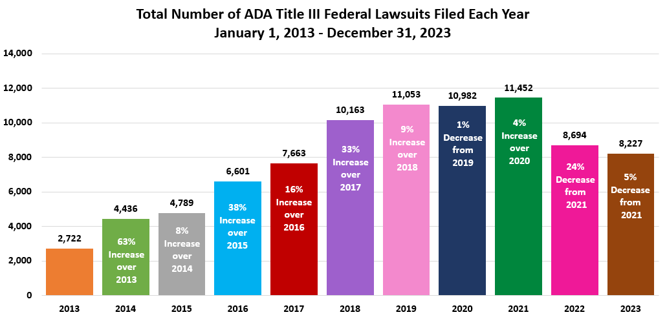
ADA Title III Accessibility Lawsuit Numbers (All Bases)

Slide 14
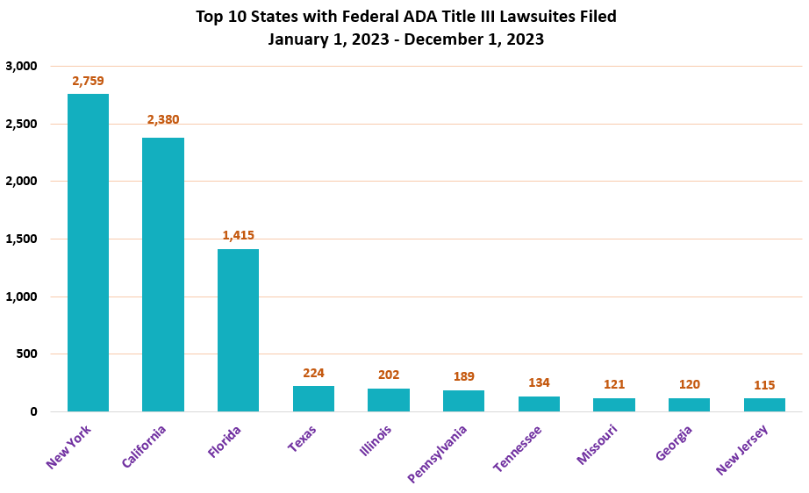
ADA Title III Lawsuit Numbers (All Bases) – Top 10 States

Slide 15
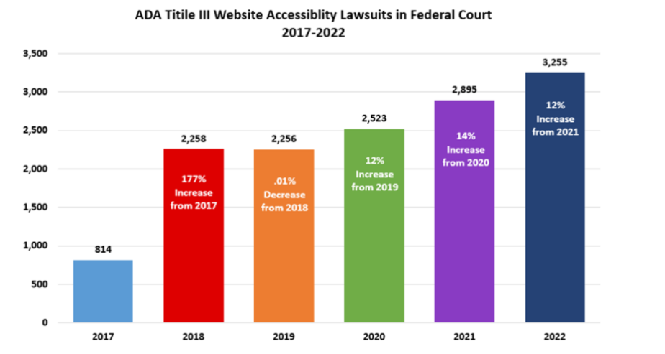
ADA Title III Website Accessibility Lawsuit Numbers (2022)

Slide 16
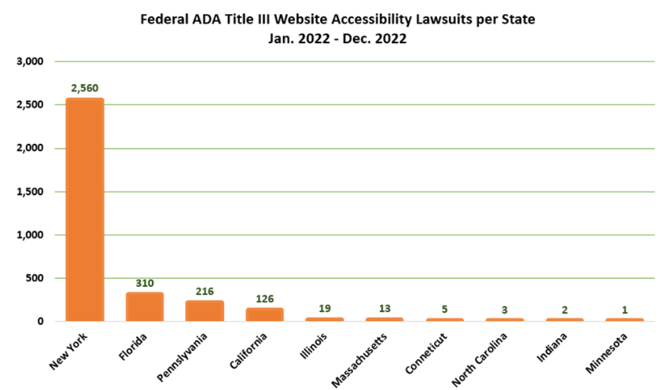
ADA Title III Web Lawsuits by State: Top 10 in 2022

Slide 17
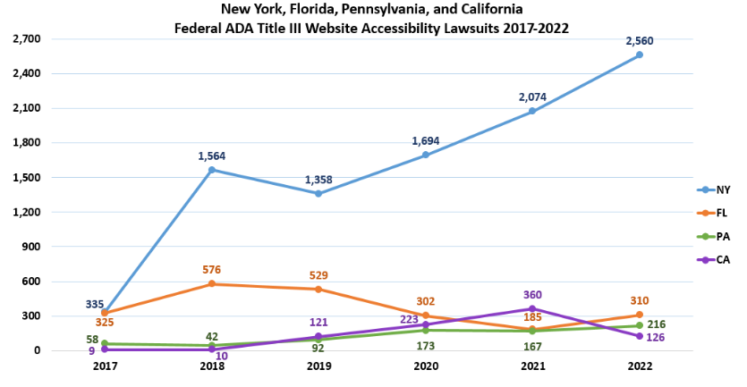
ADA Title III Web Lawsuits by State: Top 3 2017-2022

Slide 18
Title III Website Litigation: Themes
(1) Are web-only businesses are covered public accommodations? Federal Circuits disagree.
  9th Circuit & 11th Circuit: Web-only businesses not covered.
    9th Circuit follows “nexus” test (as do CA State Courts – Cot’n Wash)
    11th Circuit (in Winn-Dixie**) said barrier on website must prevent access to goods/services at physical location
  1st Circuit: Business does not have to have a physical location serving customers to be covered; district courts have applied this precedent to cover web-only businesses.
Prior settlement promising to make website accessible is not a bar to subsequent suit; but a consent decree can be (Hanyzkiewicz v. Allegiance Retail Services, NY 2023)
Being in the process of making your website accessible usually does not moot case.
If the plaintiff can’t ever use the services of the business whose website is inaccessible, case may be dismissed for lack of standing.
** See below discussion on Winn-Dixie.

Slide 19
2023 “Big Case” - Serial Plaintiff Tester Standing
No need to have desire to patronize business to have standing to sue
  Laufer v. Acheson (1st Cir, 2022) (US 2023) - US S. Ct. rendered case moot
  - watch Langer v. Kisor (9th Cir.) in 2024
  Laufer v. Arpan (11th Cir. 2022)
  Laufer v. Naranda Hotels (4th Cir. 2023)
Encountering a barrier on a website or at a location is not enough; there must be downstream consequences
  Laufer v. Mann Hospitality (5th Cir. 2021)
  Laufer v. Looper (10th Cir. 2022)
  Harty v. West Point Realty (2d Cir. 2022)
2023: NY federal trial courts dismissed multiple cases on standing grounds
  Must assert a concrete and particularized injury

Slide 20
Title III Website Litigation: Key Cases & Themes
Robles v. Dominos Pizza LLC (9th Cir. 2019)
Lawsuit alleged website and mobile app not accessible to the blind.
Federal trial court granted early dispositive motion on due process and primary jurisdiction grounds.
9th Circuit reversed & remanded, finding:
  ADA applies to websites & mobile apps that have nexus to physical place.
  Rejected due process/primary jurisdiction arguments - Domino’s had notice of the general requirements under ADA Title III.
  Telephone service as an alternative could not be decided on a motion to dismiss.
Domino’s appealed to US Supreme Court; declined to review (October 7, 2019).
On remand, partial summary judgment granted to Robles on the website, with judge finding that website is not fully accessible to plaintiff because future order can’t be placed using a screen reader.
Settled in June 2022

Slide 21
Title III Website Litigation: Key Cases & Themes
The Winn Dixie Saga
Gil v. Winn Dixie (SDFL 2017, 11th Cir 2022)
  Bench trial verdict for plaintiff, Court issued 3-year injunction:
    Accessible website by 12/1/17(WCAG 2.0 AA)
    Annual training for employees on website accessibility
    Require third party content to be accessible
    Adopt web accessibility policy by 12/1/17
    Fees/costs totaling $105,271 awarded to plaintiff
  April 2021: 11th Circuit overturned trial court decision
    found the website barriers in question did not prevent the plaintiff from accessing the goods and services offered at the retailer’s stores
  May 2021: Gil filed petition for rehearing en banc
  December 28, 2021: 11th Circuit dismissed appeal as moot because the website was made accessible, and remanded case to trial court to dismiss as moot
  January 18, 2022: Winn-Dixie filed a petition for rehearing by the en banc panel
  January 25, 2022: 11th Circuit recalled the mandate and began processing the petition for rehearing
  March 2, 2022: 11th Circuit denied petition for reconsideration of dismissal order

Slide 22
Title III Website Litigation: California Unruh Act
Thurston v. Midvale Corp d/b/a Whisper Lounge (CA State court 2018, aff’d 9/3/2019)
  Appeals Court affirmed summary judgment against restaurant on grounds inaccessible website discriminates against blind customer under Unruh Act.
  Ordered restaurant conform website with the WCAG Level 2.0 AA (App. Ct. found this not overbroad or uncertain) & Pay $4,000 statutory damages.
  App. Ct. held:
    Websites with physical nexus are subject to ADA Title III.
    Third party content: “appellant offers no legal support for its theory that it cannot be liable for ADA discrimination if hires someone else to do the discrimination.”
    Telephone and email not alternate effective communication because only available during restaurant hours of operation.
Thurston v. Omni Hotels (CA State court, aff’d 9/9/21)
  Blind plaintiff alleged hotel website not accessible, in violation of Unruh Act.
  The jury found no intent, resulting in a verdict for the hotel.
  Appeals Court affirmed, finding that intent must be proven.

Slide 23
Title III Website Litigation: Key Cases & Themes (cont.)
DOT v. Scandinavian Airline System
DOT regulations under the Air Carrier Access Act (ACAA) required airlines to bring their websites into compliance with WCAG 2.0 Level AA by 2016.
SAS built a secondary “assistive” site that met WCAG 2.0 guidelines.
  DOT brought an action against SAS, challenging the use of a second website.
SAS agreed to make its primary website accessible and to pay up to $200,000.
Separate but equal prohibited by ACAA
  Separate is never equal
  Increased costs from maintaining multiple sites
  Forgotten “separate” sites fall out of accessibility
  Good design is accessible
Take care with “widget” or “overlay” products: e.g., Murphy v. Eyebobs, LLC. (W.D. Pa. 2021)

Slide 24
Title III Website Litigation: Physical Nexus
11th Circuit:
  Haynes v. Dunkin Donuts (11th Cir. 2018 unpub.): Reversed district court dismissal of case because Plaintiff sufficiently alleged that the barriers on the website prevented him from accessing the services available in a physical store.
  Lucius v. ILOV305I, LLC (S.D. FL 2022):
    ADA violated because even though the website is not a PPA, it restricts Plaintiff’s ability to access the goods, services, privileges of Defendant’s physical restaurant, operating as an intangible barrier to a PPA.
      See also Ariza v. Coffee Beanery (S.D. FL Nov. 2022)
    “Although Gil [v. Winn-Dixie] is no longer law, I find this reasoning [that public accommodations are limited to actual, physical places] persuasive and adopt it here.”
    As long as a website operates as an intangible barrier to a physical establishment that is a place of public accommodation, a plaintiff can state a claim for violation of the ADA.
    Ordered website be made accessible to and usable by visually impaired individuals to the full extent required by Title III of the ADA, including auxiliary aids, and maintain and update the website so it remains accessible, no later than January 6, 2023.
California State & Federal (9th Cir.) Courts
  Websites are not “public accommodations” covered by Title III of the ADA
  Martinez v. Cot’n Wash, Inc. (Cal. Ct. App. 2022, CA Sup Ct Cert Denied Nov. 9, 2022)
    Licea v. PTC Therapeutics (LA Sup. Ct. Dec. 20, 2022), lawsuit dismissed based on Martinez
  Martinez v. San Diego County Credit Union (Ca. Ct. App. 2020)
  Robles v. Domino’s (9th Cir. 2019)

Slide 25

Typical Roadmap to Accessibility
Technical Manual Review
Reporting
Monitoring
User Experience
Training
Accessibility Statement, Policy, Procedure
  VPATs

Slide 26
Technical Manual Review
Manual Review (the most complete way to find variances to the WCAG guidelines)
Scoping is important:
Complete Scopes Reduce Risk
  Critical user flows
  Representative Components
Interacting with the website using assistive technology and the means used by people with disabilities.
  Screen Readers
  Screen Magnifiers
  Keyboard Only
  Without Sound

Slide 27
Reporting
Metrics to prioritize
  Severity
  Difficulty to remediate
  Who is affected
Remediation best practices
  Direct advice
  Knowledge base
  Help Desk
Multiple formats to fit different stakeholders
  Dashboards
  CSV
  Distributable
  Executive Summery

Slide 28
Monitoring
Low-cost, low-effort way to track:
  Progress during remediation
  Regression during remediation
  Ongoing conformance.
Automated testing:
  Finds a subset of errors:
    30 – 40% of the failures to the guidelines
    On average represents 60 – 70% of errors on a site

Slide 29
User Experience
Focused on user experience vs. all variance to the guidelines
Insuring flow can be navigated
Testing from Engineers with Disabilities
Testing with People with Disabilities

Slide 30
Training
Role Based
eLearning
Instructor Led

Slide 31
VPATs
Standard Reporting to communicate the level of conformance to guidelines from the Information Technology Industry Council (ITI):
  VPAT 2.5 508: Section 508
  VPAT 2.5 EU: EN 301 549
  VPAT 2.5 WCAG: WCAG 2.0, 2.1, 2.2
  VPAT 2.5 INT: all three
Must be created flowing a full manual technical review with a complete scope.
Error-only retests create risk

Slide 32





Accessibility Maturity Model
Level 3
Optimized
Level 2
Defined
Level 1
Reactive
ROI
Core competencies & Activities
Level 1: Reactive
Level 2: Defined
Level 3: Optimized
Access to Knowledge
Manual Audit and Verification
Scheduled Domain Monitoring
Actioning on ARC Analytics
Access to On-demand Accessibility expertise (Consulting / Help Desk)
Role-based Training
Design Reviews (Shift Left)
Executive Sponsorship/Champion
Enterprise Level ARC Subscription
Integration in CICD pipeline (API)
JI with Automated QA Testing
User Research with People with Disabilities
Notes:
32

Slide 33
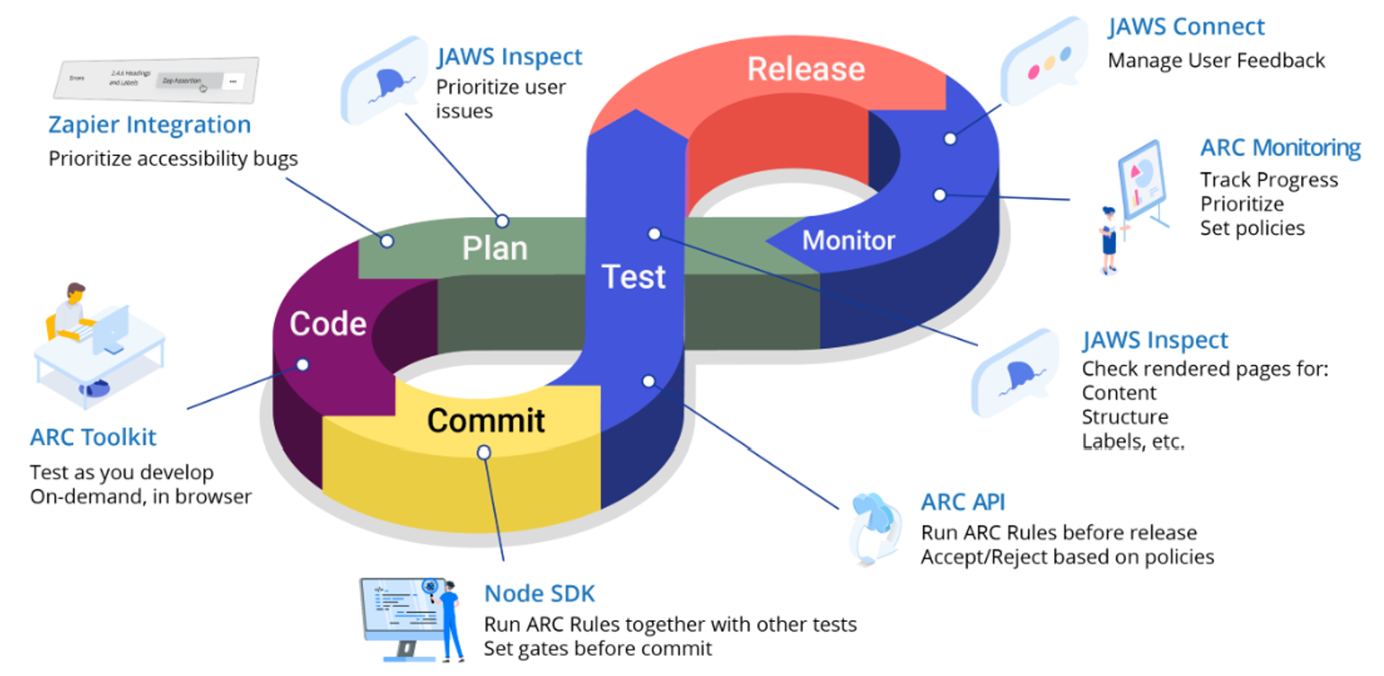
Full Spectrum Accessibility Platform
Notes:
33

Slide 34
Questions?
klauney@seyfarth.com
asjenkins@seyfarth.com
www.adatitleiii.com

