Slide 1
Client-Driven Success: Unpacking Cvent’s Accessibility Journey
Jennifer Law, PMP
Engagement Manager at TPGi
Mark Miller
Director of Sales at TPGi
Stephen Cutchins
Senior Manager – Accessibility

Slide 2
Agenda
How Cvent’s client-driven approach helped uncover and solve accessibility challenges.
The impact of setting a clear “definition of done” to ensure products meet accessibility standards.
Why accessibility improvements lead to higher retention and a more engaged audience
The importance of partnerships

Slide 3
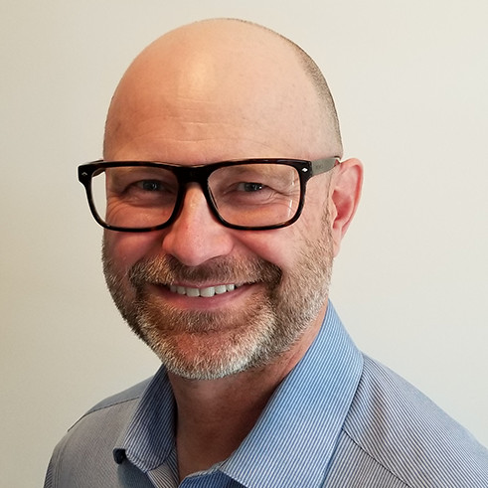
Stephen Cutchins
20+ years digital accessibility
Senior Manager, Accessibility at Cvent
Clients are mostly event planners, marketers, and members of hospitality.
Family history of People with Disabilities

Slide 4

Jennifer Law, PMP
Project Manager with TPGi for 3 years

Slide 5

Mark Miller
Sales Director
12 years with TPGi
Member, W3C‘s WAI Accessible Platform Architectures Working Group Accessibility Maturity Model Task Force

Slide 6
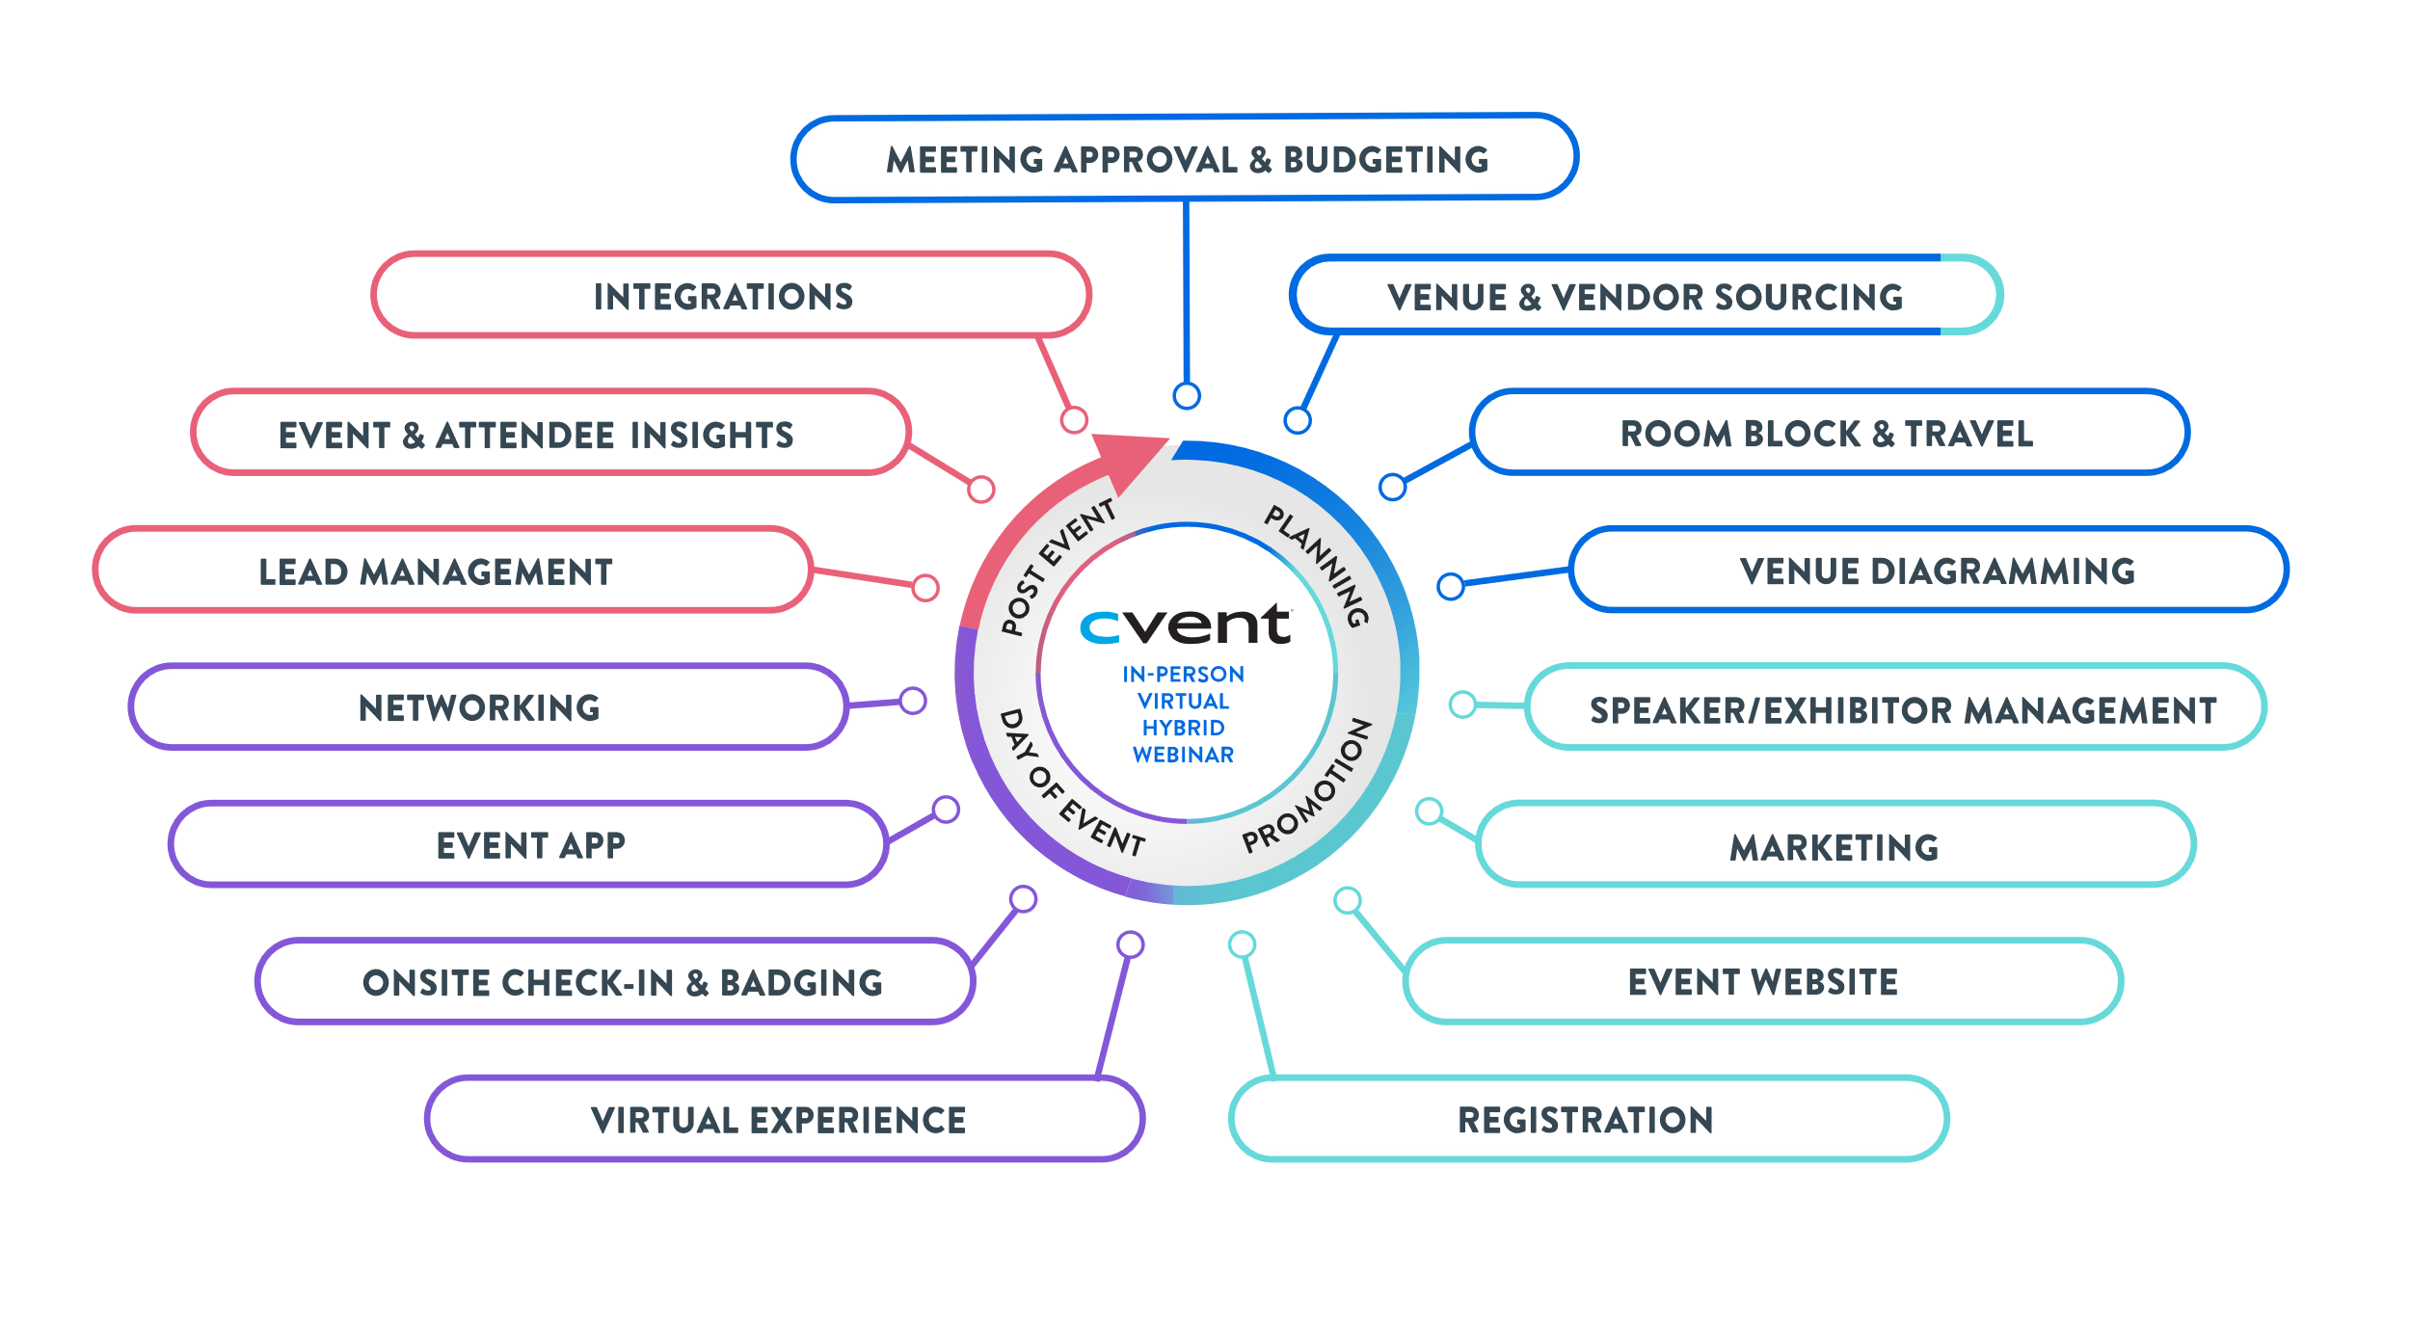
Cvent’s Complete Event Management Platform

Slide 7








A Proven Event Tech Partner and Leader
25+Years
217,000+
7.4 Million+
EXPERIENCE in the MEETINGS and EVENTS INDUSTRY
USERS GLOBALLY
EVENTS MANAGED since 1999
24,000+
87%
1,700+
TOTAL CUSTOMERS ACROSS ALL INDUSTRIES
OF THE FORTUNE 100
4,200+ Associations/Non-Profits
1,000+ Higher Education Institutions
1,900+ Third-Party Planners
TECHNOLOGY STAFF WORLDWIDE

Slide 8
Best Practices
Integration into product development for the dev teams to ensure products designed for all
Definition of Done
VPATs as a tool

Slide 9
Champions of Accessibility
Cvent clients organize events designed to include everyone
Internal Task Force
Internal accessibility knowledge resources for design, dev and production

Slide 10
Partnerships
Voice of the Customer
Commitment to accessibility: 20 manual audits, including nearly 800 components
Third party VPATs from a trusted source
Continuous loop communication with clients to determine what is needed

Slide 11
Partnership and Accessibility Maturity
Current Partnership
Future Partnership

