Slide 1

Pieces of an Accessibility Audit:
What's in an Accessible Name?
Wes Estes
Accessibility Engineer TPGi

Slide 2
What is an Accessible Name?
“The accessible name is the name of a user interface element. Each platform accessibility API provides the accessible name property. The value of the accessible name may be derived from a visible (e.g., the visible text on a button) or invisible (e.g., the text alternative that describes an icon) property of the user interface element.”
Accessible Name and Description Computation 1.2
W3C Working Draft 02 August 2024

Slide 3
What needs an Accessible Name?
Needed to describe elements on the page with certain roles, e.g.:
  Buttons
  Links
  Images (meaningful)
  Tables
  Dialogs
  Form inputs (text, radio, checkbox, select, textarea)
  Tabs/tabpanels
  Comboboxes/listboxes
Doesn’t apply to generic elements, such as:
  Divs
  Spans
  Paragraphs
  …unless it has a specified role
Notes:
This brings us to the first of two key concept for understanding the Accessible Name. No matter what your content LOOKS like on the screen, or how it’s styled and positioned with CSS; it ultimately translates to a series of text, potentially with some interactive or meaningful elements at certain points. This translation is referred to as the Accessibility API, and any of those interactive elements you may encounter need to have an appropriate Accessible Name to describe it to assistive technology (AT). How you code your content ultimately determines how accessible the resulting Accessibility API is or isn’t. Even if it “looks right” visually to a sighted user, it may not make sense or be accurate programmatically.

Slide 4
How to know what the Accessible Name is:
View the Accessibility panel in DevTools
Listen to the content with a screen reader
Display the Accessible Names of elements for speech input
Find missing/incorrectly applied Accessible Names with scanning tools like ARC Toolkit
Notes:
We’re going to focus on using the Accessibility panel in DevTools today, which everyone should have access to and many of you already have some familiarity with I suspect.
Note: Scanning tools will find missing names or references to missing ids but won’t tell you if a name that’s present makes any sense. They can tell you if the Accessible Name doesn’t contain the visible label, however.

Slide 5
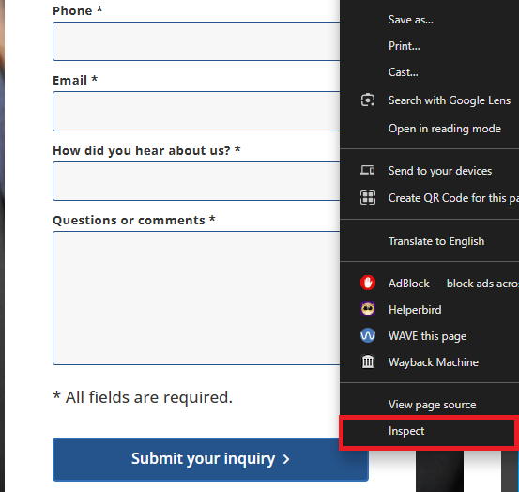
Inspect an element with DevTools:
Use DevTools to view all the technical aspects of each element, use any of these options to open DevTools:
  Right click element and Inspect
  Press F12
  Press CTRL + SHIFT + C (Windows)
  Press CMD + OPTION + C (Mac)

Slide 6
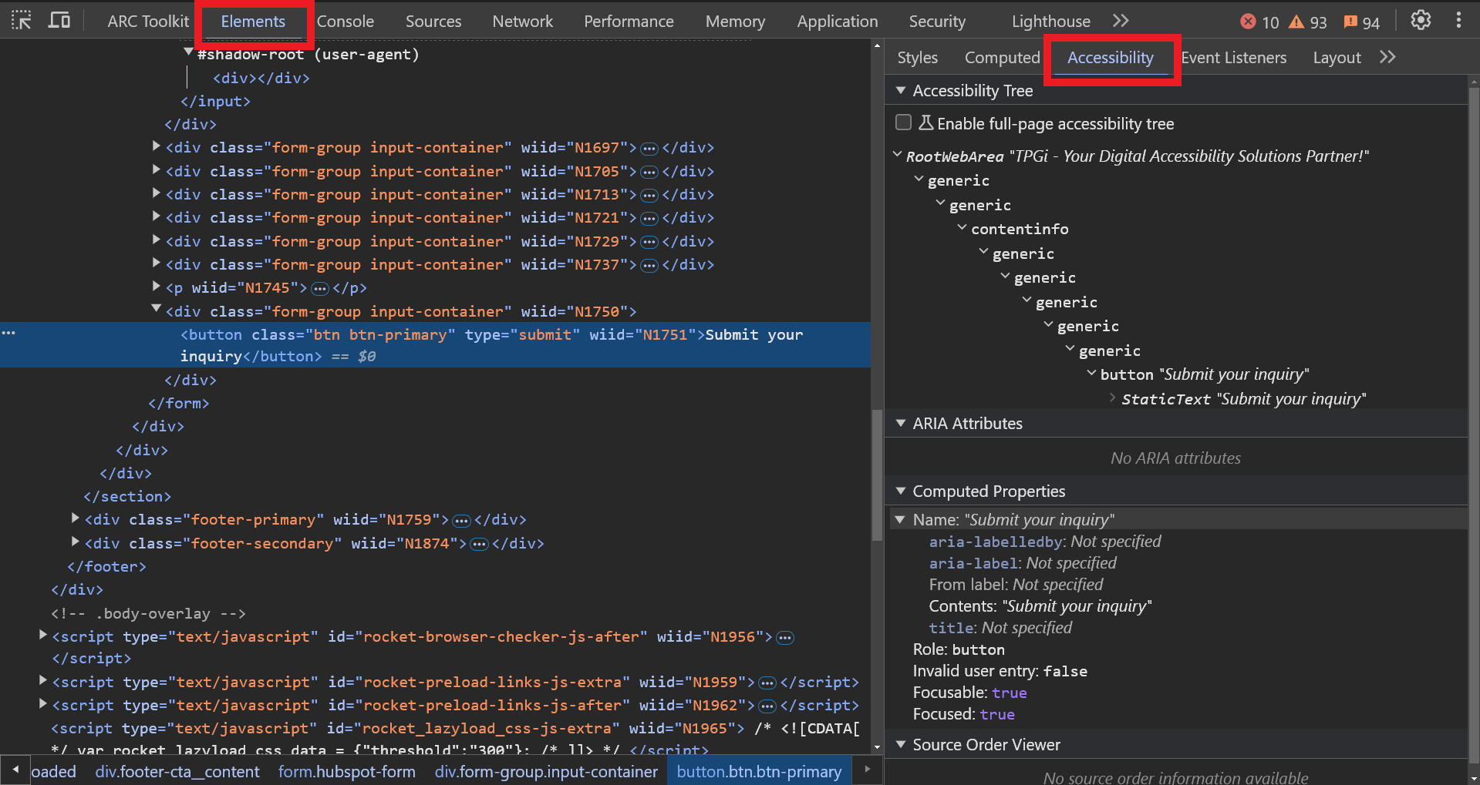
The Accessibility Panel in DevTools:

Slide 7
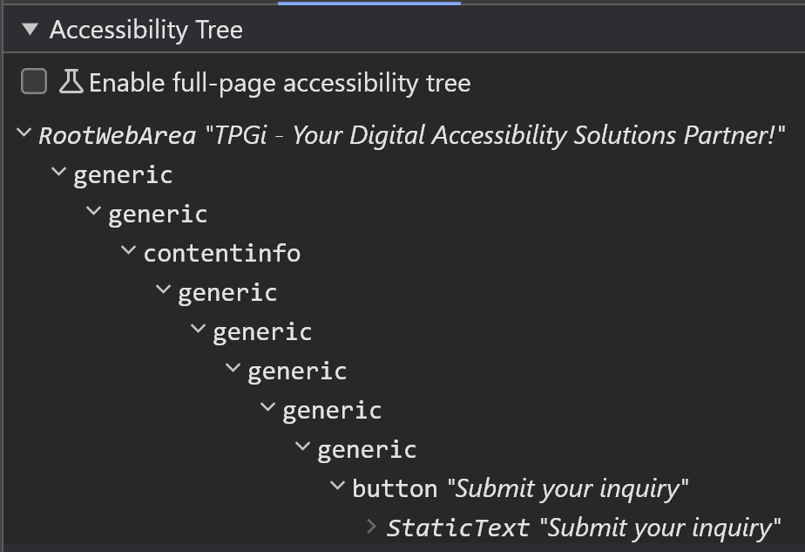
The Accessibility Tree:
Shows the accessible element structure of the page:
  Helps confirm logical structure
  Shows how content is arranged
Notes:
Mention there is also a whole section on ARIA Attributes as well, but today we’re going to focus on the Computed Properties panel.

Slide 8
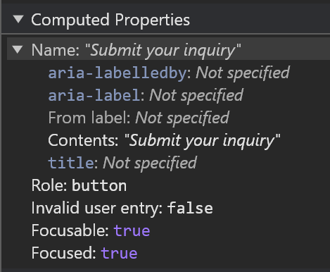
The Computed Properties panel:
Shows various accessibility properties of elements on the page, such as:
  Accessible Name
  Role
  aria-describedby
  Other ARIA attributes
  Statuses (focusable, dismissible, checked)
Notes:
The properties displayed will vary based on the element type being inspected but will always include a Role and Accessible Name.

Slide 9
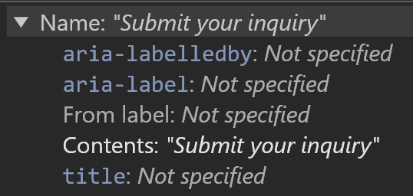
The Computed Accessible Name:
The Accessible Name is computed based on a hierarchy of potential sources, e.g.:
  aria-labelledby
  aria-label
  From label
  alt
  Contents
  title
Notes:
This is the second key concept to understanding the Accessible Name. The Accessible Name differs from most other attributes because it is a calculated value versus an assigned value, which can cause some confusion. The Accessible Name is not set in stone by simply applying a value to a particular element attribute like most other properties. Since the naming can come from multiple sources or be intentionally modified, we need a hierarchy to determine what naming source takes precedence over others.

Slide 10
Why is the Accessible Name important?
Provides users of assistive technology a description of the element they are currently focused on or interacting with
When no accessible name is provided, screen reader users only hear the role but no description of what it is, even if visible text may be present
Speech input users navigate by speaking the accessible name
Generic, insufficiently descriptive or repeated accessible names can confuse users or make navigation difficult

Slide 11
WCAG success criteria that apply to the Accessible Name:
4.1.2 – Name, Role, Value
1.3.1 – Info and Relationships
2.5.3 – Label in Name
1.1.1 – Non-text Content
3.3.2 – Labels or Instructions
2.4.4 – Link Purpose (in context)

Slide 12
Modifying or updating an Accessible Name?
Ideally the Accessible Name should come from real text present on the page, like a visible label and/or visually hidden text
For elements without visible text, ARIA can be used to provide the Accessible Name by referencing other elements on the page using aria-labelledby with id references, or directly using aria-label
The title attribute provides an Accessible Name for iframes, but should otherwise generally be avoided in preference to other methods; as it’s the least reliable for assistive technology and the browser-based tooltips it creates have accessibility issues
For more details on what to consider when crafting a good Accessible Name, reference these recent articles:
  Good Intentions, Poor Context by Doug Abrams, Senior Accessibility Engineer TPGi
  Context is king: long live the king! by Ian Lloyd, Principal Accessibility Engineer TPGi
Notes:
Note: Real text is beneficial for localization translations, as well as upkeep when using references with aria-labelledby versus direct modifications with aria-label that may need to be independently changed with every content update.
Note: The title attribute causes a browser-based tooltip popup that work only for mouse users, not keyboard or touch. It can also get announced separately by screen readers, creating a redundant or otherwise verbose output.

Slide 13

Example 1: Button with Accessible Name from Contents
Computed Properties:
Name: "Submit your inquiry"
  aria-labelledby: Not specified
  aria-label: Not specified
  From label: Not specified
  Contents: "Submit your inquiry"
  title: Not specified
Role: button
Invalid user entry: false
Focusable: true
Focused: true
Code:
<button
  type="submit">
  Submit your inquiry
</button>

Slide 14
Example 2: Button with Accessible Name from aria-label
Computed Properties:
Name: "Go!"
  aria-labelledby: Not specified
  aria-label: "Go!"
  From label: Not specified
  Contents: "Submit your inquiry"
  title: Not specified
Role: button
Invalid user entry: false
Focusable: true
Focused: true
Code:
<button
  type="submit"
  aria-label="Go!">
  Submit your inquiry
</button>
Notes:
Fails 2.5.3 – Label in Name

Slide 15

Example 3: Button with no Accessible Name
Computed Properties:
Name: ""
  aria-labelledby: Not specified
  aria-label: Not specified
  From label: Not specified
  Contents: Not specified
  title: Not specified
Role: button
Invalid user entry: false
Focusable: true
Code:
<button
  type="submit" >
  <span
    class="fas fa-search"
    aria-hidden="true">
  </span>
</button>
Notes:
Fails 4.1.2 – Name, Role, Value

Slide 16
Example 4: Button with Accessible Name from aria-label
Computed Properties:
Name: "Submit Search"
  aria-labelledby: Not specified
  aria-label: "Submit Search"
  From label: Not specified
  Contents: Not specified
  title: Not specified
Role: button
Invalid user entry: false
Focusable: true
Code:
<button
  type="submit"
  aria-label="Submit Search">
  <span
    class="fas fa-search"
    aria-hidden="true">
  </span>
</button>

Slide 17
Example 5: Button with Accessible Name from child image
Computed Properties:
Name: "Search"
  aria-labelledby: Not specified
  aria-label: Not specified
  From label: Not specified
  Contents: "Search"
  title: Not specified
Role: button
Invalid user entry: false
Focusable: true
Code:
<button
  type="submit" >
  <span
    class="fas fa-search"
    aria-label="Search"
    role="img">
  </span>
</button>

Slide 18
Example 6: Button with Accessible Name from aria-label
Computed Properties:
Name: "Submit Search"
  aria-labelledby: Not specified
  aria-label: "Submit Search"
  From label: Not specified
  Contents: "Search"
  title: Not specified
Role: button
Invalid user entry: false
Focusable: true
Code:
<button
  type="submit"
  aria-label="Submit Search">
  <span
    class="fas fa-search"
    aria-label="Search"
    role="img">
  </span>
</button>

Slide 19

Example 7: Link with Accessible Name from visually-hidden text
Computed Properties:
Name: "Read More about your accessibility partner"
  aria-labelledby: Not specified
  aria-label: Not specified
  Contents: "Read More about your accessibility partner"
  title: Not specified
Role: link
Focusable: true
Focused: true
url: "https://www.tpgi.com/..."
Code:
<a
  class="btn"
  href="https://www.tpgi.com/...">
  Read More
  <span
    class="screen-reader-text">
    about your accessibility partner
  </span>
</a>

Slide 20

Example 8: Link with Accessible Name from image alt text
Computed Properties:
Name: "TPGi"
  aria-labelledby: Not specified
  aria-label: Not specified
  Contents: "TPGi"
  title: Not specified
Role: link
Focusable: true
Focused: true
url: "https://www.tpgi.com/"
Code:
<a href="https://www.tpgi.com">
  <img
  src=“logo.svg"
  alt="TPGi">
</a>

Slide 21

Example 9: Form field with Accessible Name from label
Computed Properties:
Name: “First Name"
  aria-labelledby: Not specified
  aria-label: Not specified
  From label (for= attribute): label.form_label "First Name "
  title: Not specified
Role: textbox
Focusable: true
Focused: true
Required: true
Code:
<label for="firstname">
  First Name
  <span aria-hidden="true">*</span>
</label>
<input id="firstname"
  name="firstname"
  …>

Slide 22
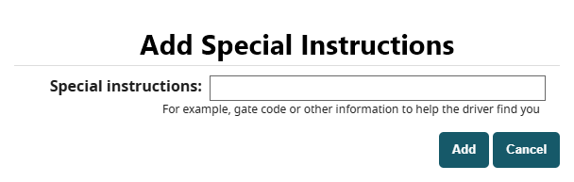
Example 10: Dialog with Accessible Name from aria-labelledby reference
Computed Properties:
Name: "Add Special Instructions"
  aria-labelledby:
    h2#dialog1_label.dialog_label"Add Special Instructions"
  aria-label: Not specified
  title: Not specified
Role: dialog
modal: true
Code:
<div id="dialog1"
  role="dialog"
  aria-labelledby="dialog1_label"
  aria-modal="true">
  <h2 id="dialog1_label">
    Add Special Instructions
  </h2>
  ...
</div>

Slide 23
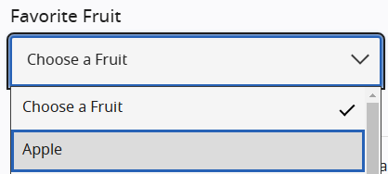
Example 11: Combobox w/ Listbox and Accessible Name from aria-labelledby
Computed Properties:
Name: "Favorite Fruit"
  aria-labelledby:
    div#combo1-label.combo-label"Favorite Fruit"
  aria-label: Not specified
  title: Not specified
Value: "Choose a Fruit"
Role: combobox
Focusable: true
Focused: true
hasPopup: listbox
Required: false
Expanded: true
Code:
<div id="combo1-label">
  Favorite Fruit
</div>
<div id="combo1"
  role="combobox"
  aria-labelledby="combo1-label"
  …>
  Choose a Fruit
</div>
<div id="listbox1"
  role="listbox"
  aria-labelledby="combo1-label"
  …>
  ...
</div>
Notes:
Point out that both the combobox and listbox point to the same id and have the same Accessible Name but different Roles.

Slide 24

Example 12: Button with Accessible Name from recursive aria-labelledby reference
Computed Properties:
Name: "Read More about Your accessibility partner"
  aria-labelledby:
    button#control1.btn.btn-primary"Read More about"
    h2#heading1.h1.footer-cta__heading"Your accessibility partner"
  aria-label: Not specified
  From label: Not specified
  Contents: Not specified
  title: Not specified
Role: button
Invalid user entry: false
Focusable: true
Code:
<h2 id="heading1">
  Your accessibility partner
</h2>
<button id=“control1"
  type="submit"
  aria-labelledby="control1 heading1">
  Read More
  <span
    class="screen-reader-text">
    about
  </span>
</button>

Slide 25
Summary:
The Accessible Name gives context to interactive or meaningful elements
The Accessibility API is translated based on how your code is structured programmatically, not how it looks visually
The Accessible Name is a calculated value based on a hierarchy of potential naming sources
You can view the calculated Accessible Name of an element in the DevTools Elements tab, under the Accessibility panel

Slide 26

Questions?
Thank you so much for joining us today!
This concludes today’s session on:
Pieces of an Accessibility Audit – What’s in an Accessible Name,
by Wes Estes, Accessibility Engineer TPGi.
For more information on creating good Accessible Names, please reference these recent articles:
  Good Intentions, Poor Context
  by Doug Abrams, Senior Accessibility Engineer TPGi
  Context is king: long live the king!
  by Ian Lloyd, Principal Accessibility Engineer TPGi

