Slide 1

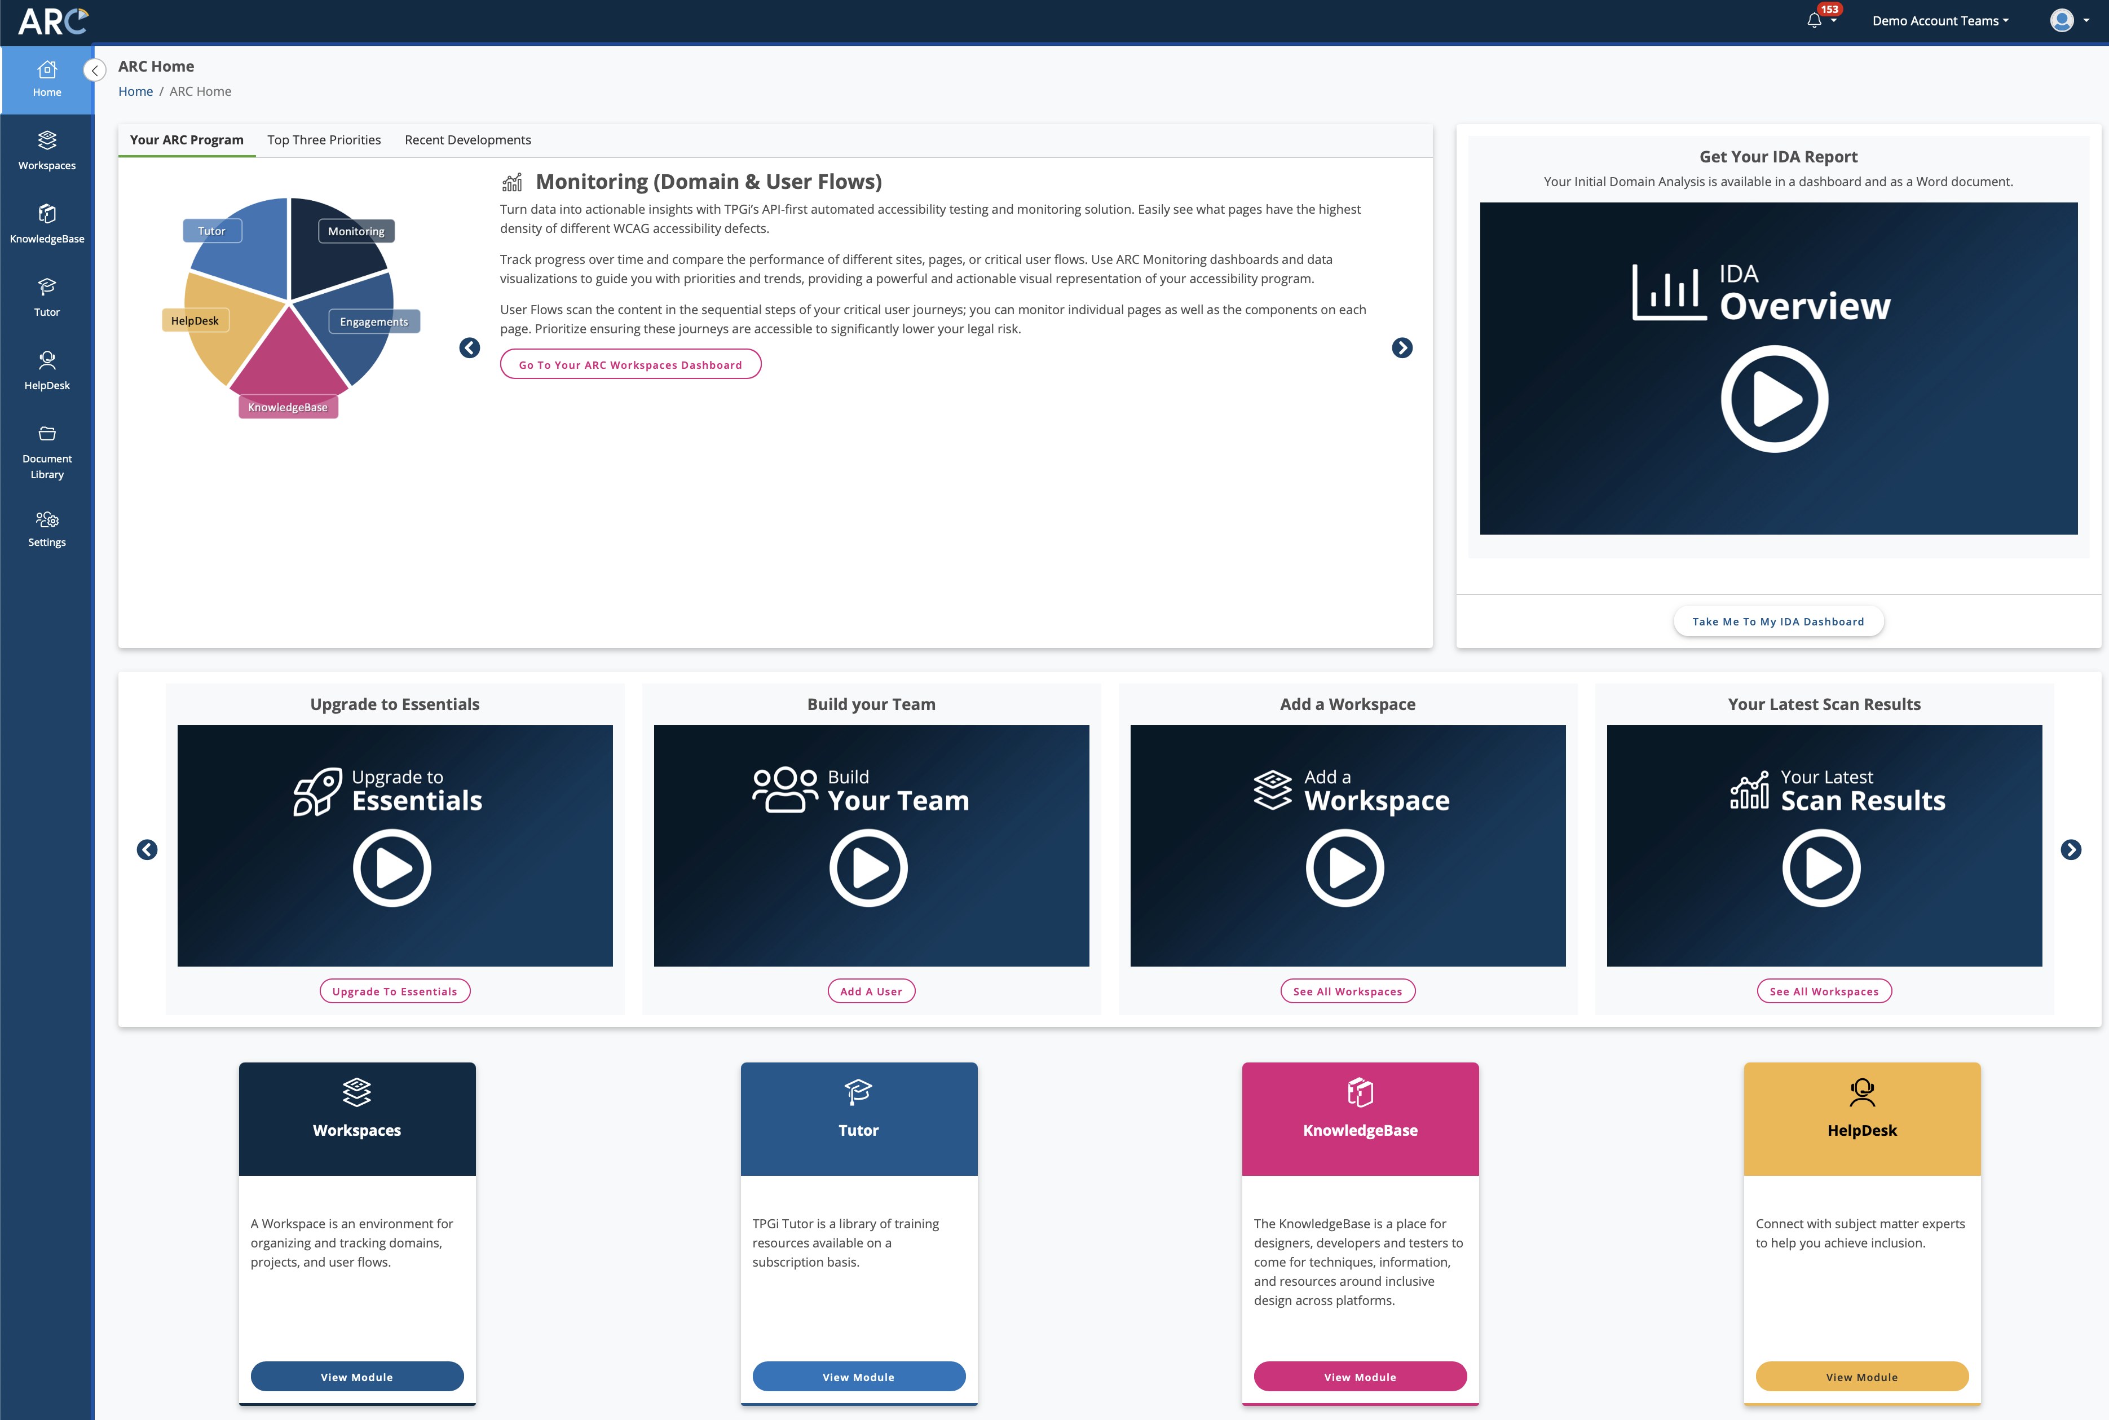

Using Screen Reader Testing Tools to Evaluate the Accessibility of a User Journey - Part 1
Charlie Pike
Director, Platform Success
cpike@tpgi.com

Slide 2
Agenda
Introduction
JAWS Inspect
When and how to test with JAWS
User Journeys
User Journeys with JAWS testing
Demonstration
Q&A

Slide 3
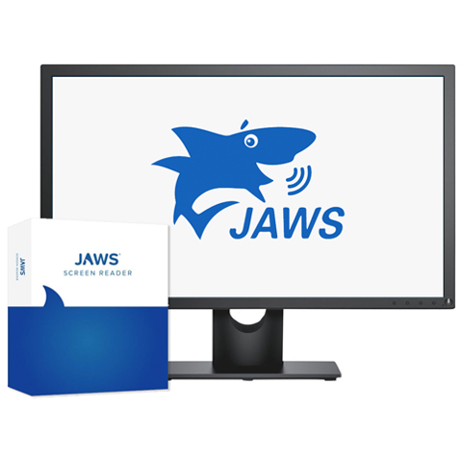
What is JAWS?
Job Access with Speech
World’s most popular Windows screen reader
Enables a blind or visually impaired user to read the text that is displayed on the computer screen with a speech synthesizer or braille display

Slide 4
Why test with JAWS?
Test compatibility with screen readers
Evaluate the user experience
Go past guidelines to grasp accessibility
User challenges are easy to understand
It may be technically accessible, but is it usable?

Slide 5

JAWS Inspect
JAWS Inspect vastly simplifies accessibility and JAWS compatibility testing. Without the distraction of speech or the complex feature set of the end-user product, Inspect uses transcripts of JAWS output to help diagnose issues and share them easily across quality control and compliance systems.

Slide 6
Benefits
Simplifies JAWS use for testers
Text transcript of JAWS output for use in bug tracking and compliance programs
Helps with the identification of issues
Rapid rollout with limited training required
Demonstrates impact of accessibility on users

Slide 7

Further Benefits
A clear visual illustration of what JAWS users experience on your site
No need for accessibility expertise to read and understand reports

Slide 8
When and How to Test with JAWS

Slide 9
Peeling the Onion
Domain Scans
User Flows
AT Testing
User Feedback
User Research
Manual Expert Audits

Slide 10
User Journeys

Slide 11
Why User Journeys
User centered design
Better identify user needs.
Build useful software and websites

Slide 12
User Journeys in JAWS Testing
Focus on core tasks
Task completion and efficiency, not compliance
Cross-section of UI and content

Slide 13
Building User Journeys

Slide 14

Personas
“The right technology lets me do anything.”
Background
Goals/Motivations
Pain Points
Technologies
Ability: Blind since birth with some light perception
Aptitude: Skilled technology user
Attitude: Digital native, early adopter, persists until she gets it
Assistive Technology: Screen reader, audio note-taker, Braille display
Victoria Aquino
38 years old
College graduate, legal training courses
Shares an apartment with a friend
Paralegal, reviews cases and writes case summaries
Laptop, braille display,
iPhone
Pain Points
Unclear navigation
Lack of useful descriptions for products and images

Slide 15
User Journeys in UX Design
1 Add Uses and Assign Roles
User Activity
List core tasks to perform
Capture functionality
Create new role
Invite a new user
Associate user with role
View list of roles
View list of users
View list of roles by user
Edit role
Edit user
View list of users by role
Archive/Unarchive role
Archive/Unarchive user
Delete role
Delete user
Reset password
Forgot password

Slide 16
Sample User Journey

Slide 17
User Journey for JAWS Testing
Victoria Aquino
Scenario: Victoria needs to buy new sneakers for her son. She is price sensitive but prefers sites that provide detailed information about their products
Expectations:
Large range, easy to browse
Ability to compare brands
Clear pricing
Stages | Browses the site |  | Evaluates Products |  | Pays
Activities | Checks out deals | Browses categories | Selects product | Adds product to cart | Completes checkout process
Actions | Browse home page Select Shop Sale Browse Sale Item | Select ‘Men’ from Shop menu Browse ‘Men’ Category Filter results | Choose ‘Sneaker’ Browse images Read Description | Select size, color and quantity Add to cart | Fill out ‘check out’ step 1 Complete ‘check out’ step 2 Pay and complete checkout
Notes

Slide 18

Thank You
Thank You!
Charlie Pike
cpike@tpgi.com

