Slide 1

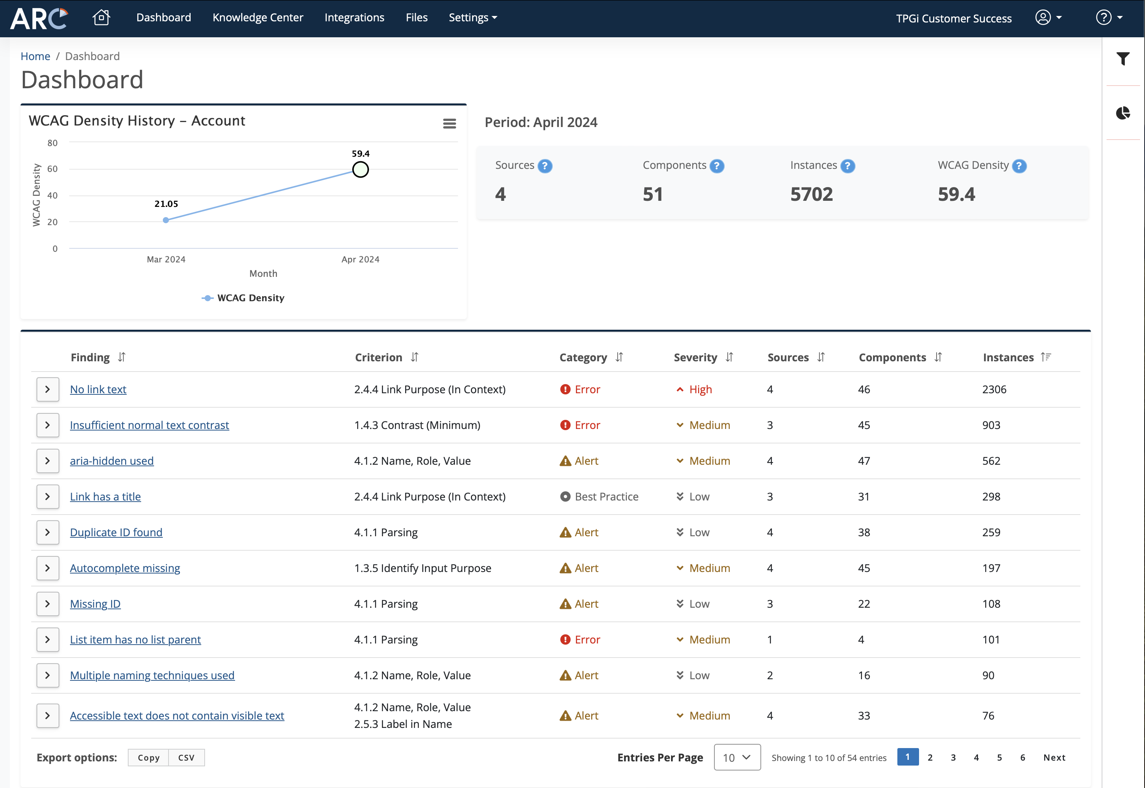

The Three Step Accessibility Program
Charlie Pike
Director, Platform Success
cpike@tpgi.com

Slide 2
Agenda
Overview
Discover
Solve
Manage
Demo
Q&A

Slide 3
The Analysis Onion
Domain Scans
User Flows
AT Testing
User Feedback
User Research
Manual Expert Audits

Slide 4
Discover

Slide 5
Domain Monitoring
Accessibility scanning:
  Websites
  Web applications

Slide 6
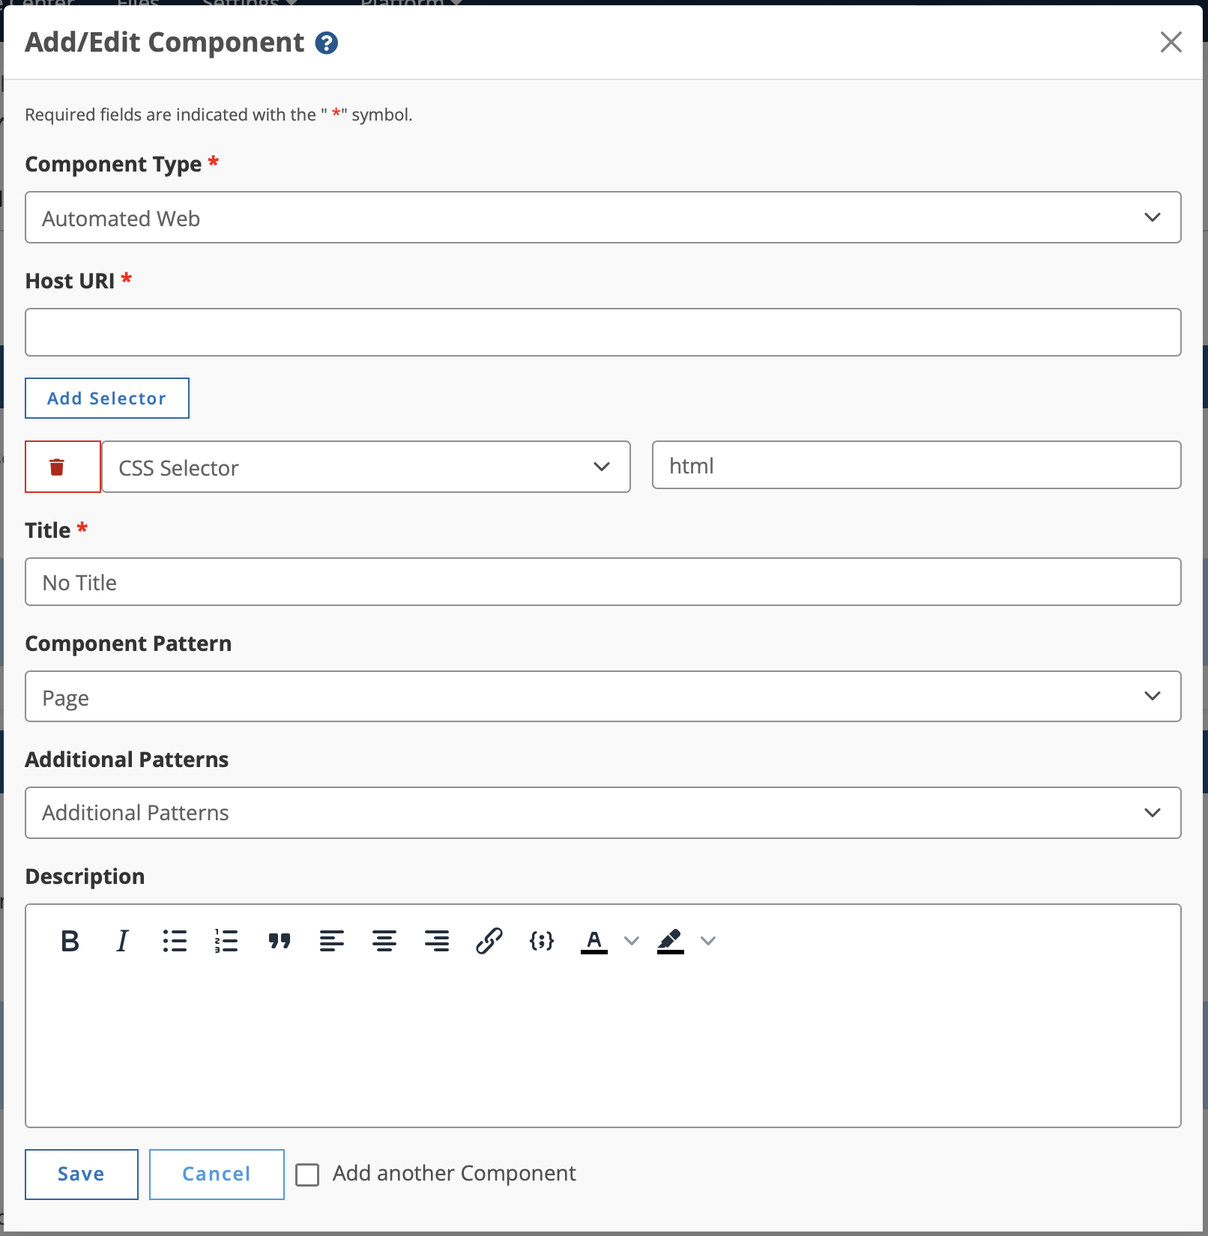
User Flow Monitoring
Accessibility scanning:
  Interactive tasks
  Components

Slide 7
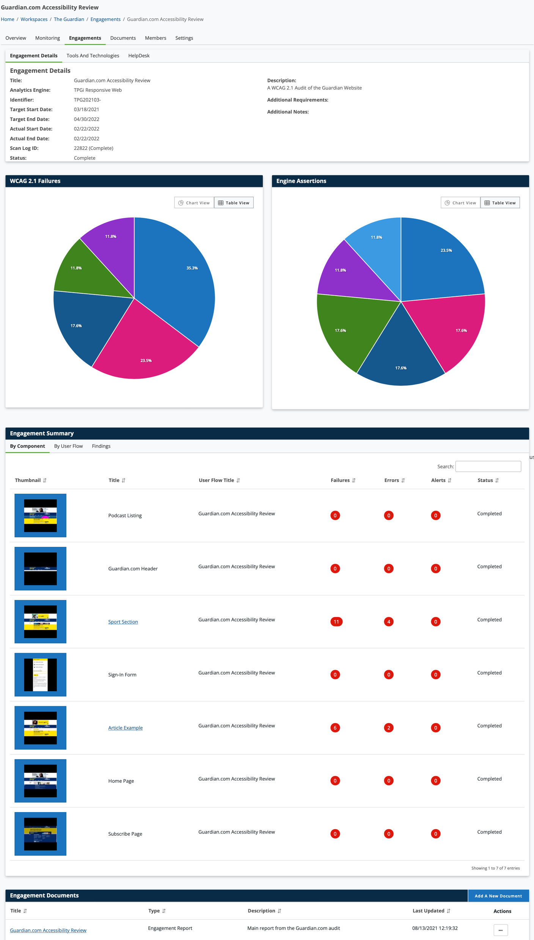
Engagements
Manual Expert Testing
Full WCAG and Section 508 compliance testing

Slide 8
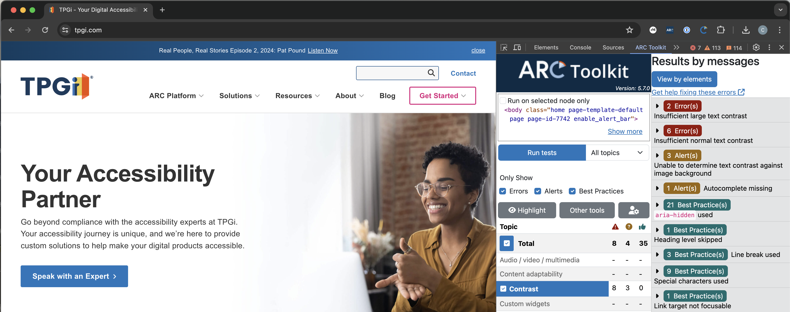
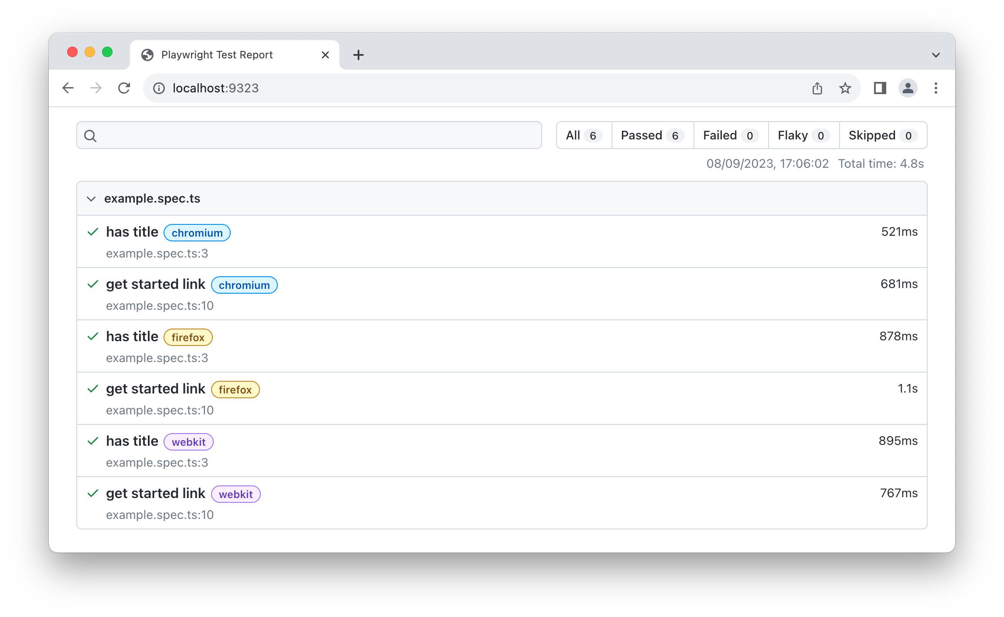
Developer Testing
Integrate ARC Rules with development environment
Automated CI/CD tests
Introduce accessibility gradually

Slide 9

AT Testing: JAWS Inspect
Dedicated JAWS testing tool
Transcripts of JAWS speech for easy sharing and reporting
Quick to learn and rollout

Slide 10
Solve

Slide 11
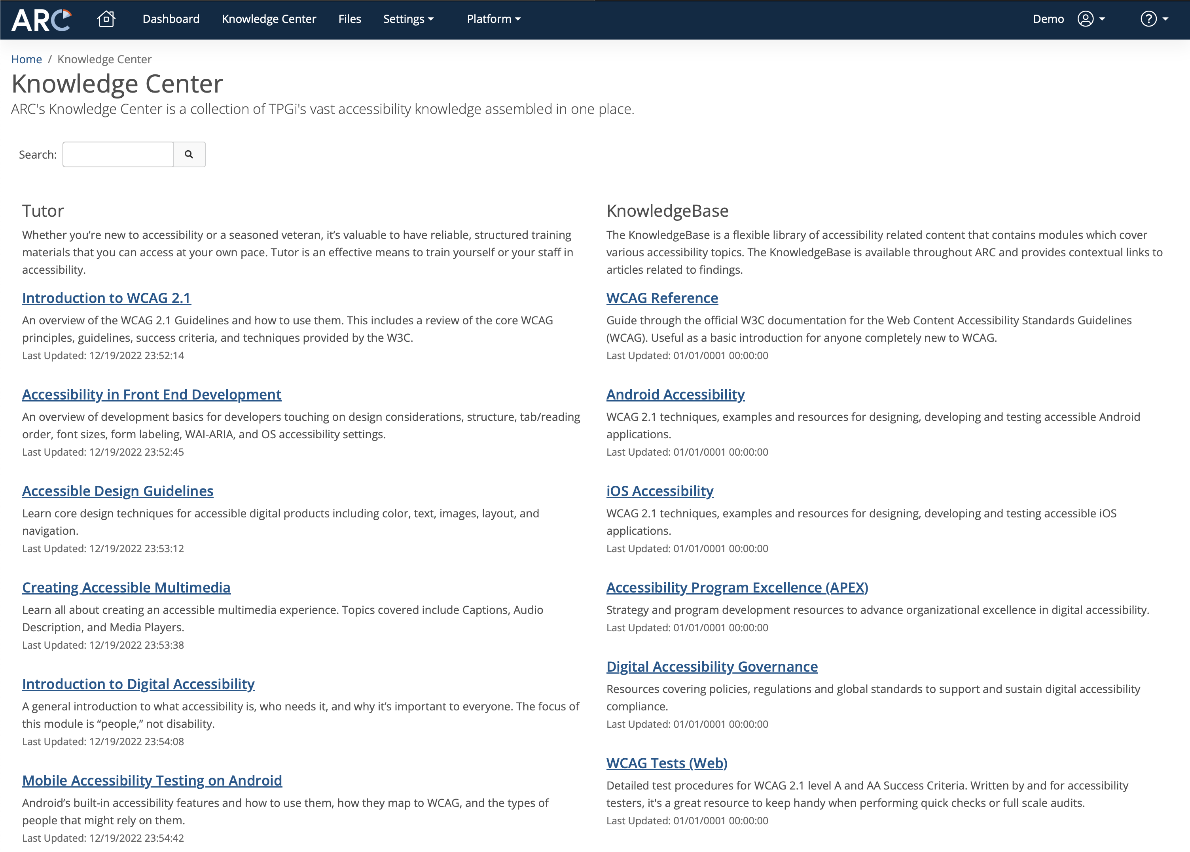
Knowledge Center
Exhaustive source of accessibility guidance
Content available in context throughout platform
Maintained by dedicated team

Slide 12
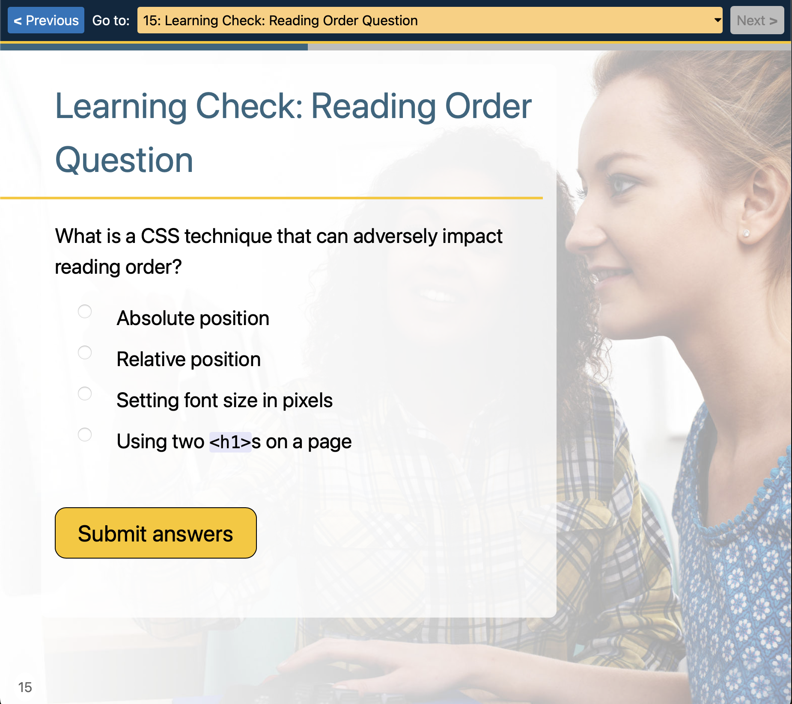
Tutor
Interactive training in all accessibility topics
Beginner to advanced
Integrate into LMS using SCORM

Slide 13
Manage

Slide 14
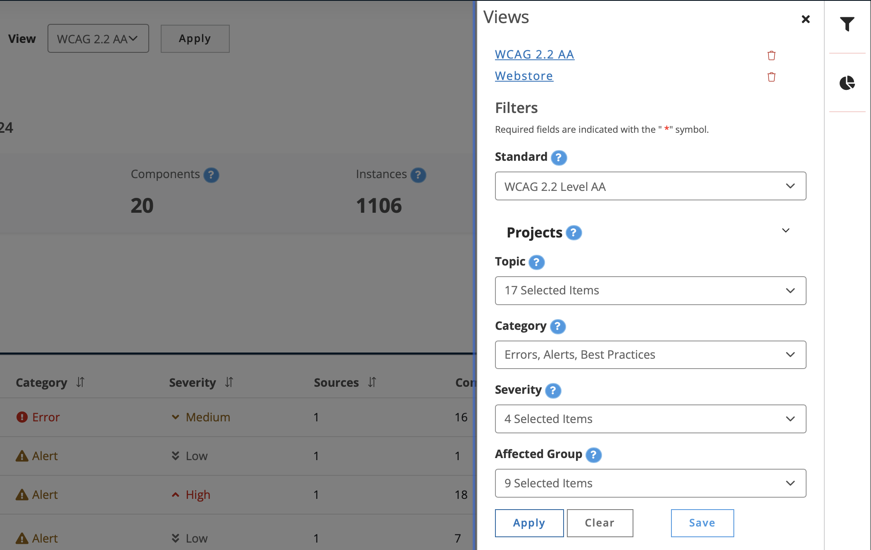
Reporting
Save Custom Views
Rapidly build out dashboards

Slide 15
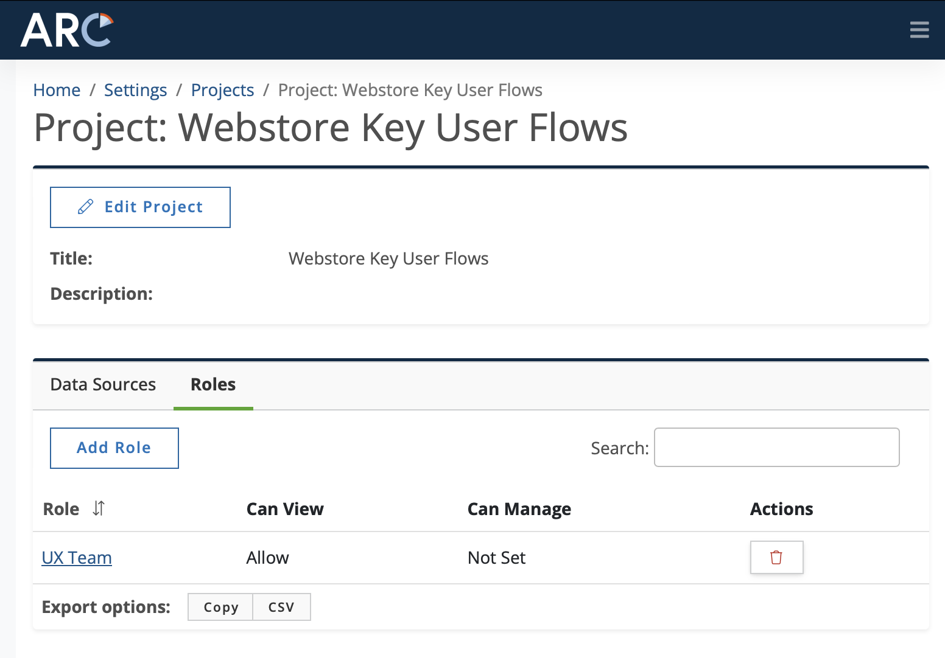
Projects and Roles
Organize your data into Projects
Create custom roles and apply access and views

Slide 16
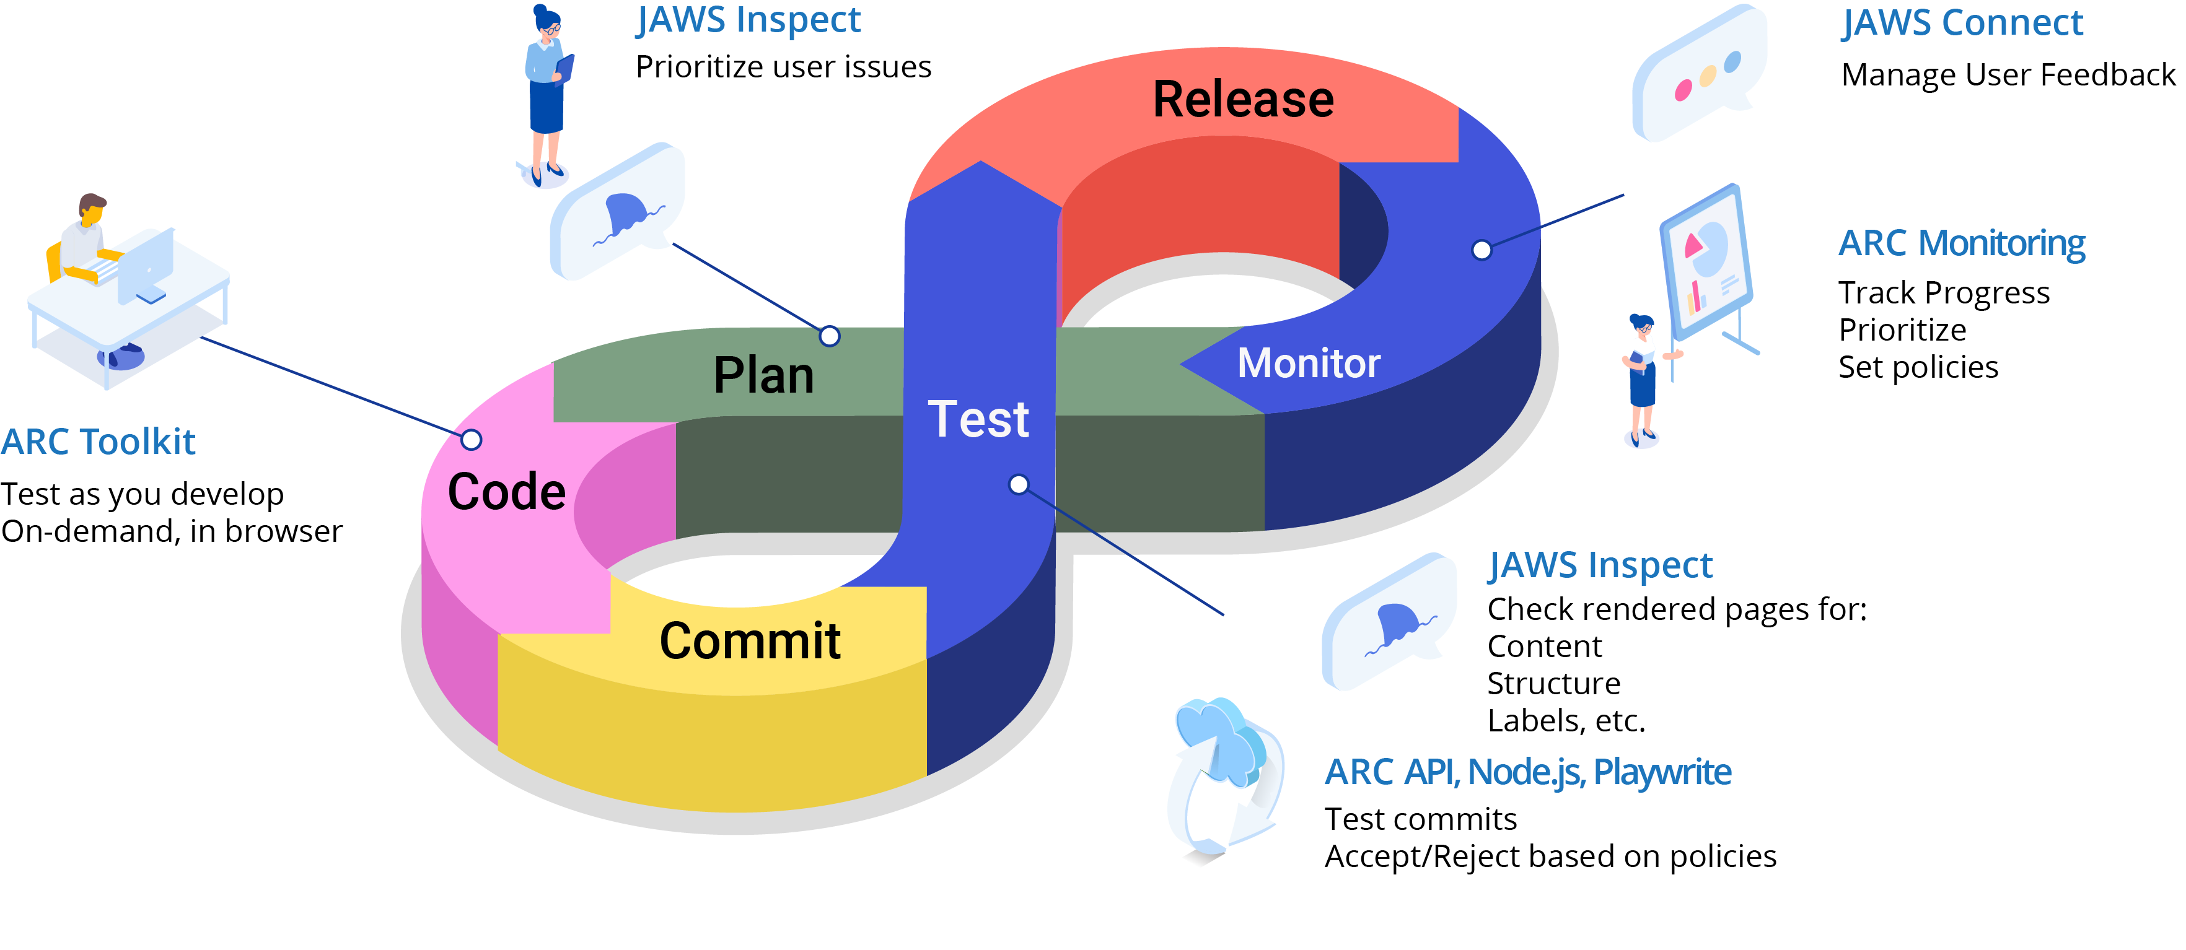
Accessibility Assembly Line

Slide 17

Questions

Slide 18

Thank You
Thank You!
Charlie Pike
cpike@tpgi.com

