Slide 1

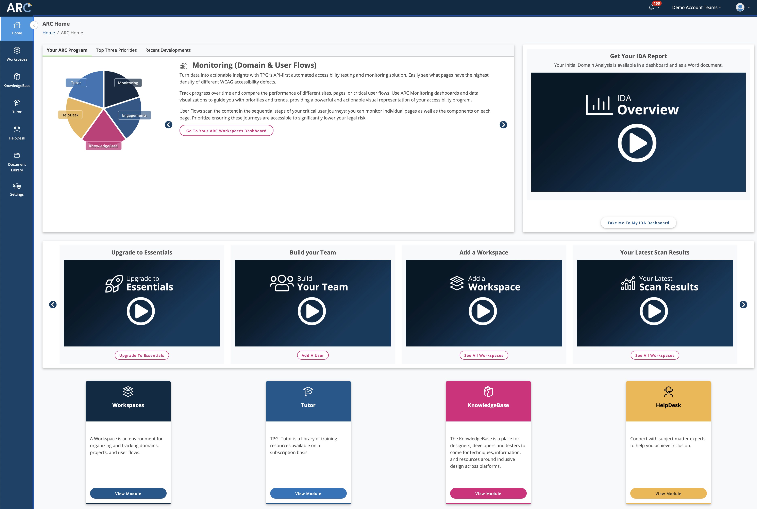

User Centred Testing with User Journeys
Charlie Pike
Director, Platform Success
cpike@tpgi.com

Slide 2
Agenda
Introduction
Why User Journeys
Building User Journeys
Testing with User Journeys
Demonstration
Q&A

Slide 3
User Journeys

Slide 4
Why User Journeys
User centered design
Better identify user needs.
Build useful software and websites

Slide 5
User Journeys in Accessibility Testing
Focus on core tasks
Task completion and efficiency, not compliance
Cross-section of UI and content

Slide 6
Building User Journeys

Slide 7

Personas
“The right technology lets me do anything.”
Background
Goals/Motivations
Pain Points
Technologies
Ability: Blind since birth with some light perception
Aptitude: Skilled technology user
Attitude: Digital native, early adopter, persists until she gets it
Assistive Technology: Screen reader, audio note-taker, Braille display
Victoria Aquino
38 years old
College graduate, legal training courses
Shares an apartment with a friend
Paralegal, reviews cases and writes case summaries
Laptop, braille display,
iPhone
Pain Points
Unclear navigation
Lack of useful descriptions for products and images

Slide 8
User Journeys in UX Design
1 Add Uses and Assign Roles
User Activity
List core tasks to perform
Capture functionality
Create new role
Invite a new user
Associate user with role
View list of roles
View list of users
View list of roles by user
Edit role
Edit user
View list of users by role
Archive/Unarchive role
Archive/Unarchive user
Delete role
Delete user
Reset password
Forgot password

Slide 9
Sample User Journey

Slide 10
User Journey for JAWS Testing
Victoria Aquino
Scenario: Victoria needs to buy new sneakers for her son. She is price sensitive but prefers sites that provide detailed information about their products
Expectations:
Large range, easy to browse
Ability to compare brands
Clear pricing
Stages | Browses the site |  | Evaluates Products |  | Pays
Activities | Checks out deals | Browses categories | Selects product | Adds product to cart | Completes checkout process
Actions | Browse home page Select Shop Sale Browse Sale Item | Select ‘Men’ from Shop menu Browse ‘Men’ Category Filter results | Choose ‘Sneaker’ Browse images Read Description | Select size, color and quantity Add to cart | Fill out ‘check out’ step 1 Complete ‘check out’ step 2 Pay and complete checkout
Notes

Slide 11
Testing User Journeys

Slide 12
Peeling the Onion
Domain Scans
User Flows
AT Testing
User Feedback
User Research
Manual Expert Audits

Slide 13
When and How to Test
Test Type | Crawl/Scan | JAWS Inspect / AT | Toolkit | Compliance Audit | User Research
Delivery | Automated | Manual | Automated & Manual | Manual (some automated) | Manual
Roles | Accessibility Team Product Manager | QA UX Dev | QA UX Content Authors Dev | Accessibility Team Accessibility Consultants | Accessibility Team Accessibility Consultants
Frequency | Monthly (or based on release schedule) | Each release (where there are UI changes) | Constant | Yearly or when issues identified | Redesigns As needed

Slide 14
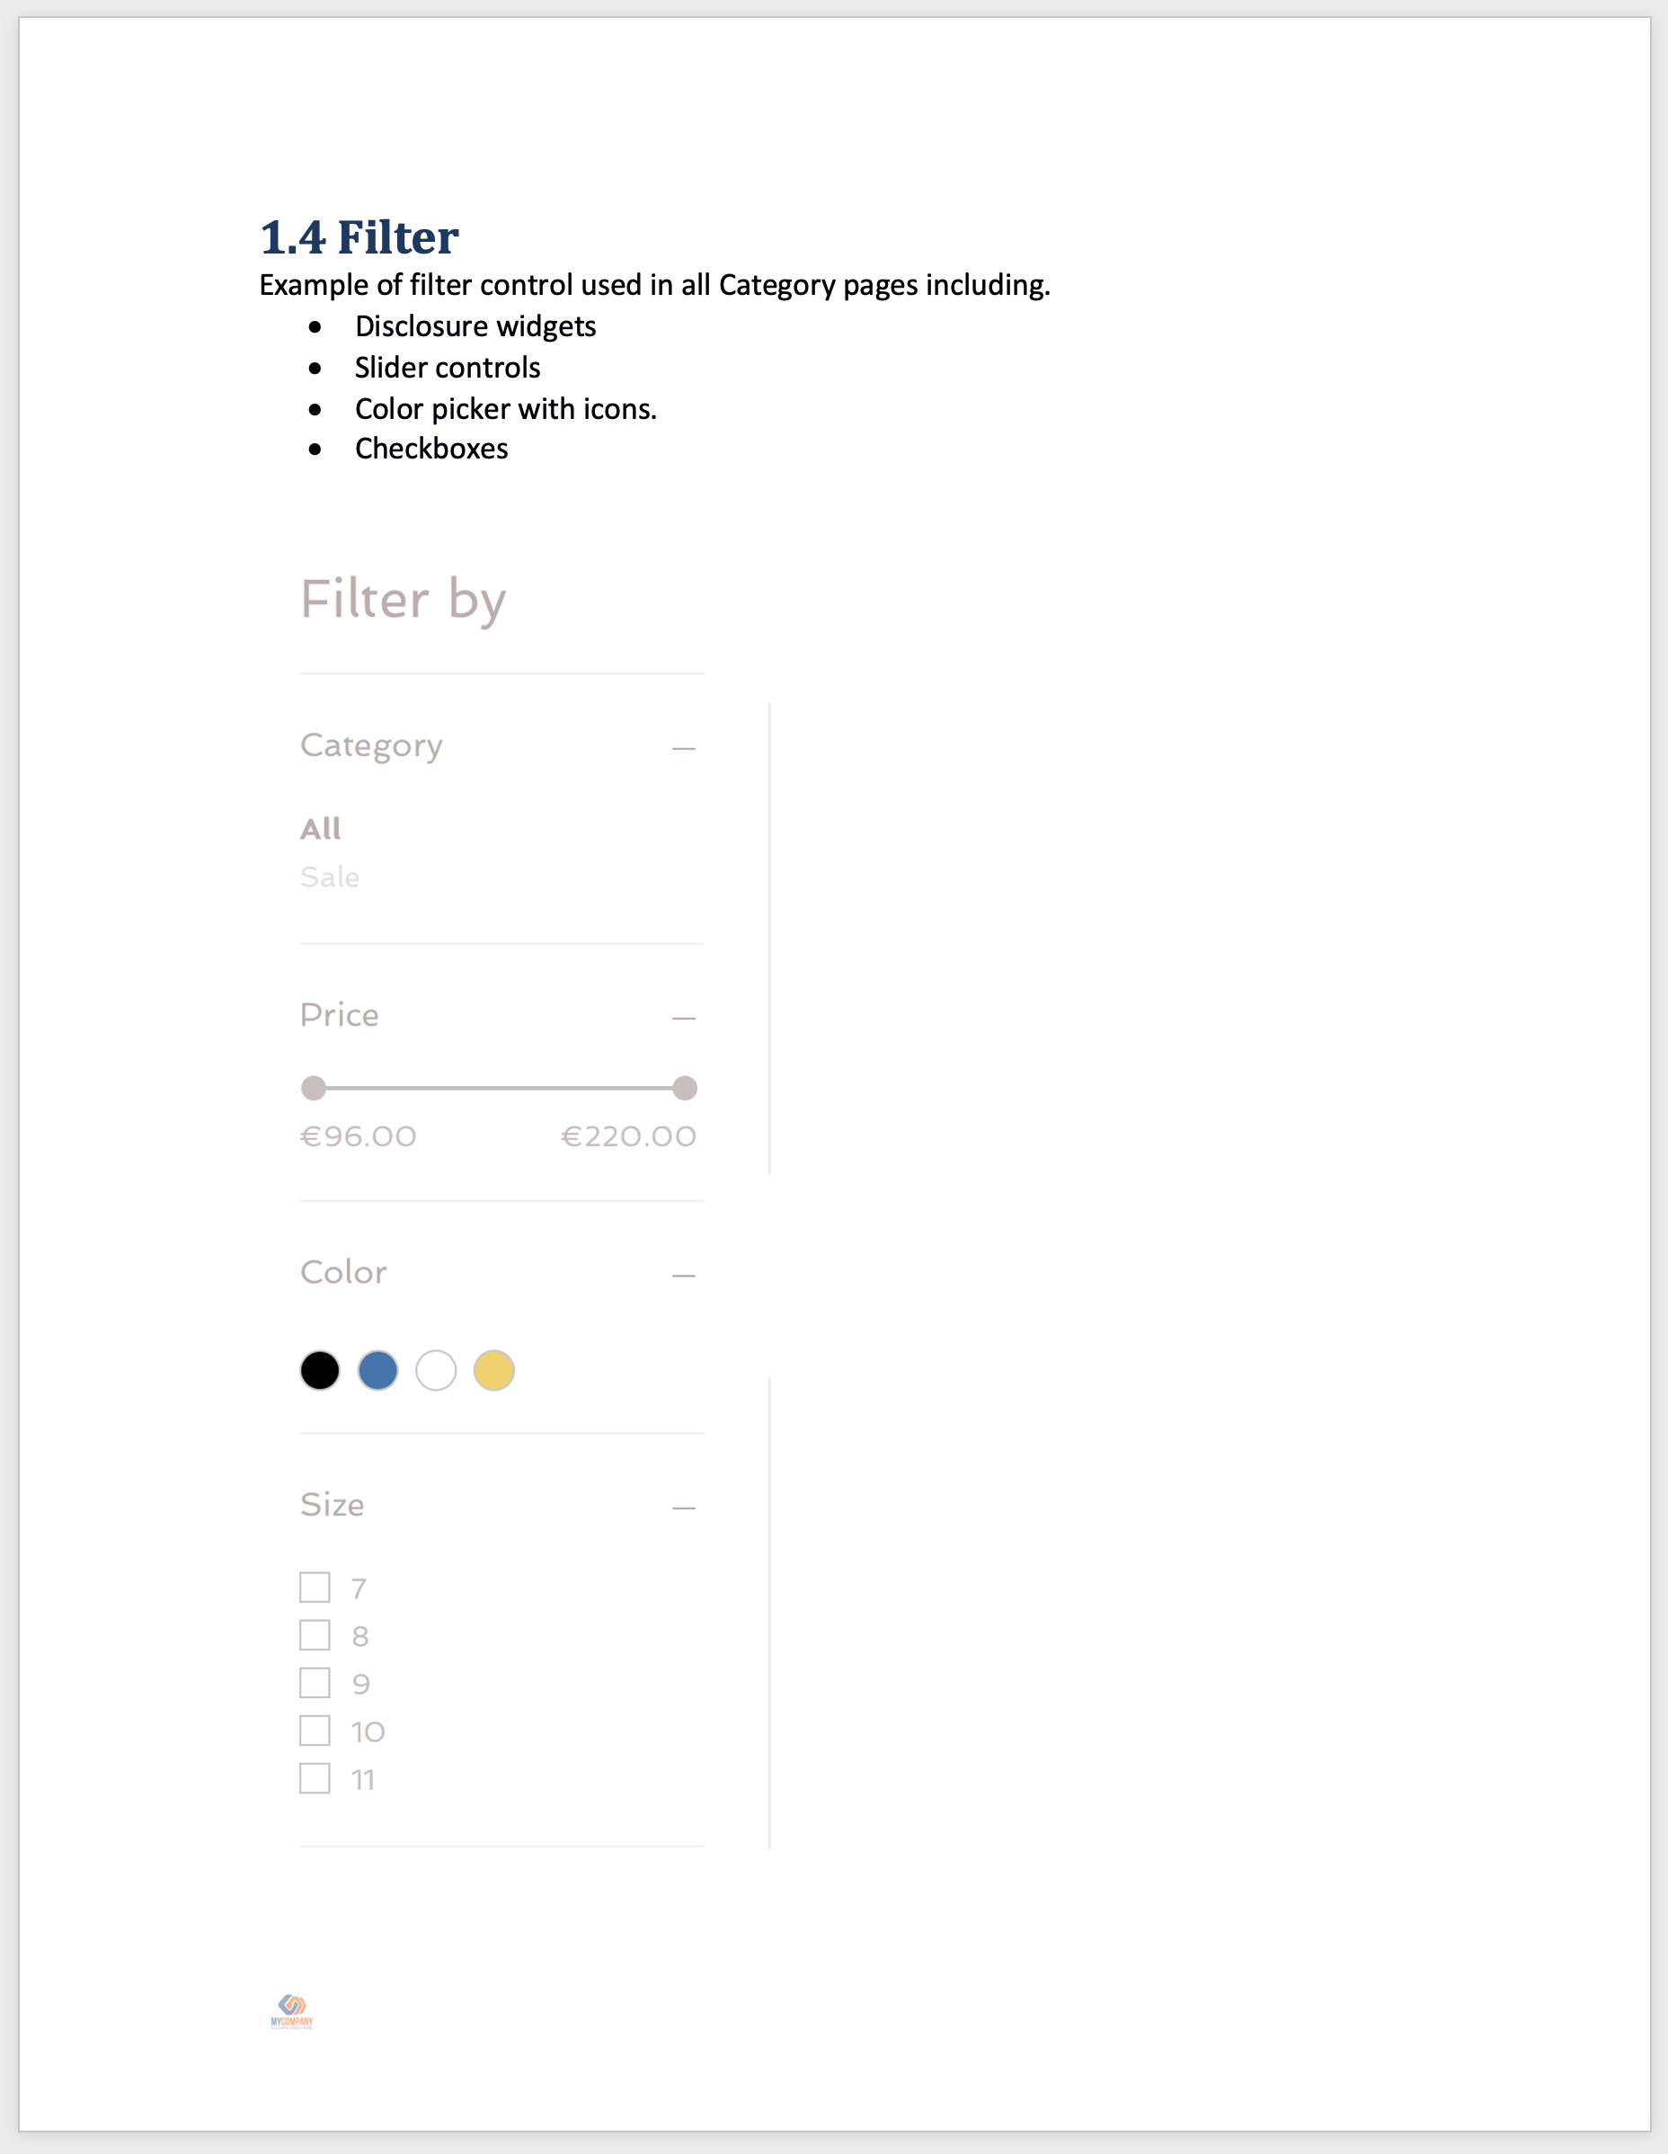
Test Plans
Define purpose of each sample
Ongoing test set
Task focus

Slide 15

JAWS Inspect
JAWS Inspect vastly simplifies accessibility and JAWS compatibility testing. Without the distraction of speech or the complex feature set of the end-user product, Inspect uses transcripts of JAWS output to help diagnose issues and share them easily across quality control and compliance systems.

Slide 16
Benefits
Simplifies JAWS use for testers
Text transcript of JAWS output for use in bug tracking and compliance programs
Helps with the identification of issues
Rapid rollout with limited training required
Demonstrates impact of accessibility on users

Slide 17

Thank You
Thank You!
Charlie Pike
cpike@tpgi.com

