Slide 1
What AI Can Do For (and To) Web Accessibility
Ricky Onsman, Hans Hillen
Notes:
Welcome everyone, and thanks for attending our webinar “What AI Can Do For and To Web Accessibility”. This is the talk that Ricky and I gave earlier this year at the CSUN 24 conference. We’re presenting this as a pre-recorded session, as timezone constraints prevented us from doing the session live.

Slide 2
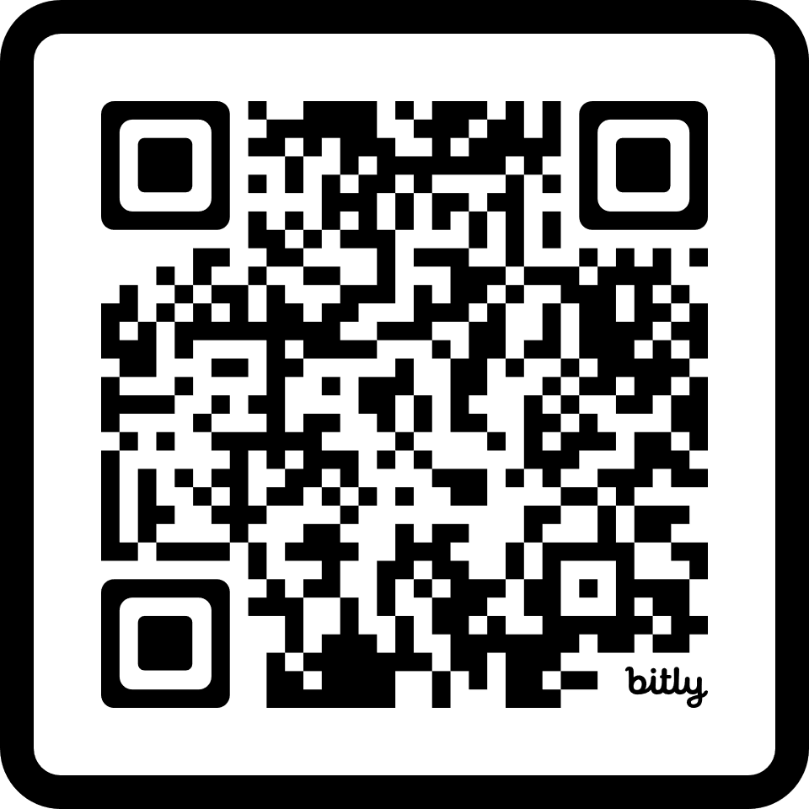
Slide deck
Find these slides at https://bit.ly/tpgi24ai, or scan this QR code (direct download)
Notes:
If you want to follow along with the slides today, there’s a QR code to scan on the screen, or you can go directly to bit.ly/tpgi24ai. This is all lower case, and the numbers are actual number characters. bit.ly/tpgi24ai. The slides will also be available through the details of this webinar.

Slide 3
In this session:
AI & existing accessibility support
AI and overlays
AI generated captions
AI generated alt text
AI in personal lives of people with disabilities
Computer vision
Personalized output
AI as recruiter
AI making content accessible
Pros and cons
Notes:
In this session, we’re going to talk about the potential effects of AI on web accessibility, and people with disabilities in general.
First we’ll look at how AI has been transforming existing accessibility technology, using overlays, captions, and alt text as examples.
Next we’ll talk about how AI can directly affect the personal lives of people with disabilities, and we’ll focus on computer vision, personalized output, and recruiting.
Then we’ll finish by looking at the possibilities of using AI to create accessible content.

Slide 4
About the TPGi Knowledge Center
Hans Hillen
Director of Knowledge Center
Ricky Onsman
Technical Content Writer
James Edwards
Technical consultant
?
Content Lead
Keep an eye on www.tpgi.com/business/careers/
Notes:
But first, let’s quickly introduce ourselves.
We’re both with the TPGi Knowledge Center team, and as such we’re responsible for maintaining and improving accessibility-related knowledge and content within TPGi.
My name is Hans Hillen, and I’m the Team Director.
My co-presenter today is Ricky Onsman, who is a senior Technical Content Writer for the Knowledge Center.
The other KC member is James Edwards, who is our technical consultant and is responsible for our design patterns and WCAG 2.2 specific content, amongst other things.
Speaking of recruiting, we will start looking for the fourth member of the TPGi Knowledge Center. We’ll be looking for someone who is fluent in everything accessibility, a good technical writer, and comfortable with writing nodejs and front end code. If that sounds interesting to you, keep an eye on our careers page at www.tpgi.com/business/careers/.

Slide 5
AI & existing accessibility support

Slide 6
AI definition
“Artificial Intelligence (AI) refers to the development of computer systems that can perform tasks that typically require human intelligence.”
– ChatGPT
Notes:
We’re not going to go into detailed explanations of what is or isn’t AI - including whether it actually exists.
For our purposes, Artificial Intelligence (AI) refers to the development of computer systems that can perform tasks that typically require human intelligence.

Slide 7
AI technologies
Machine Learning uses structured data and algorithms to imitate the way humans learn
Natural Language Processing allows computers to engage with humans in conversational language
Large Language Models work off very large datasets to produce content humans can comprehend
Computer Vision enables computers to analyze, recognize and describe images in human terms
Deep Learning can learn from unstructured data, increasing scale, depth and complexity
Notes:
AI can take many different forms, some of which we’ll be exploring today. Some of the AI technologies that will come up in our discussions today include:
Machine Learning uses structured data and algorithms to imitate the way humans learn
Natural Language Processing allows computers to engage with humans in conversational language
Large Language Models work off very large datasets to produce content humans can comprehend
Computer Vision enables computers to analyze, recognize and describe images in human terms
Deep Learning can learn from unstructured data, increasing scale, depth and complexity
As an example, ChatGPT uses Machine Learning, Large Language Models and Natural Language Processing to respond to prompts from humans in a conversational way.

Slide 8
Technology enhanced by AI
Automatic Captioning
Automatic Alt Text
ChatBots
Predictive Text
User Interface Customization
Text-to-Speech
Speech-to-Text
Overlays
Notes:
These technologies are used, often in combination, in various tools and functionalities.
Where needed, we’ll explain these terms as they come up in the examples we’ll be looking at today, which include:
Automatic Captioning Automatic Alt Text Chatbots Predictive Text UI Customization Text-to-Speech Speech-to-Text Overlays
Let’s start with the digital elephant in the virtual room: overlays
This talk was always going to have elements of the good, the bad, and the ugly, so let’s start with – by reputation, at least – the ugly.

Slide 9
Overlays and AI

Slide 10
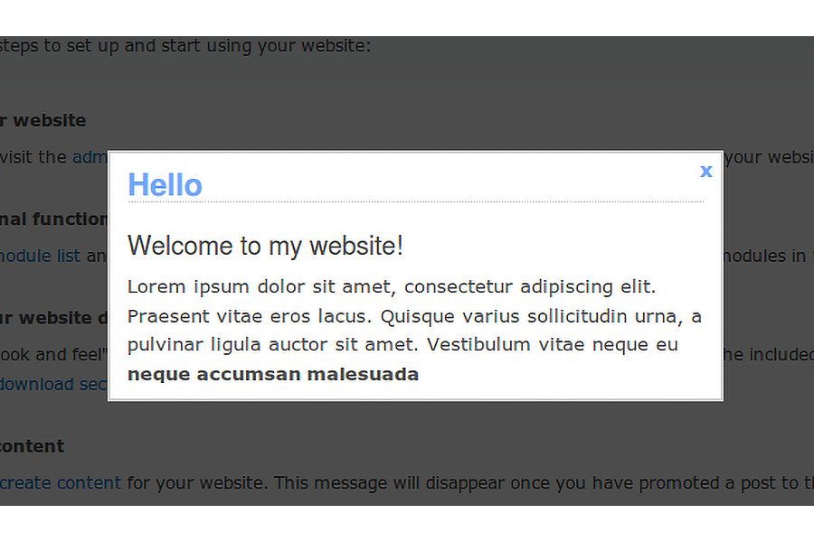
Overlays
Screenshot of a pop-up dialog
Notes:
At its most literal, an overlay is simply something laid over something else. In digital technology and web content, an overlay is a piece of software laid over a website or app to perform a specific function.
We use them all the time. Pop-up dialogs, date pickers, chat bots, and tooltips can all be overlays.
In themselves, as long as they’re accessible - keyboard operable, within the viewport, persistent, dismissible, etc. - there’s nothing inherently wrong with using overlays.

Slide 11
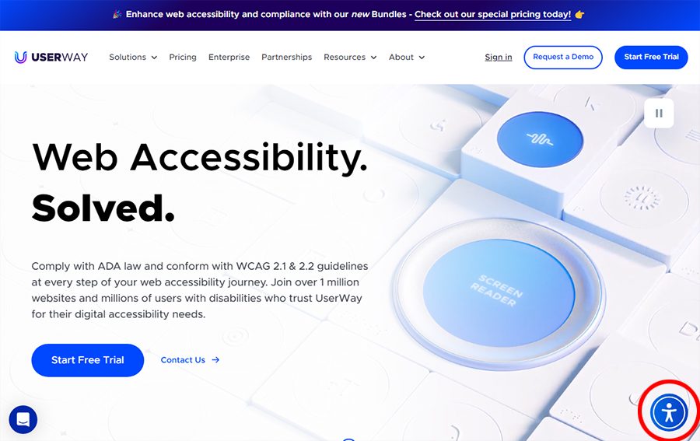
Digital Accessibility Overlays I
Screenshot of Userway home page with overlay icon highlighted
Notes:
In a digital accessibility context, however, some overlays make very specific claims, including being able to use automated tools to assess web content for WCAG conformance and then automatically implement code changes or new code that will guarantee conformance, with the site owner needing to do no more than install a widget. There are variations on this. Some overlays present an icon that the end user can activate to set a series of user preferences, some generate a report that tell the site owner what they found and what they fixed.

Slide 12
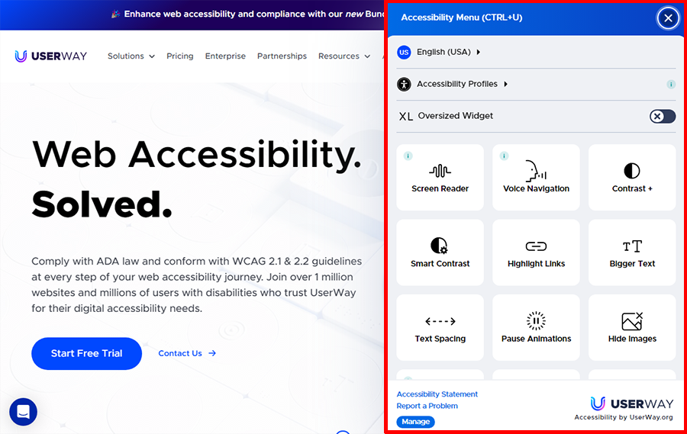
Digital Accessibility Overlays II
Screenshot of Userway home page with overlay expanded and highlighted
Notes:
They all fall under the broad title of “digital accessibility overlays” and they are what we’ll refer to as overlays for the purpose of this talk.

Slide 13
Overlay Criticisms
The modifications that overlays implement cannot guarantee full conformance with WCAG, because no automated tool can.
The modifications that overlays implement are often unreliable, ineffective, and / or create other accessibility issues than the ones they address.
The modifications that overlays make often interfere with assistive technologies and accessibility settings already in use.
The use of an overlay may create non-compliance with privacy regulations.
Notes:
There’s been a great deal of criticism directed towards overlays, which can be briefly summarized as:
The modifications that overlays implement cannot guarantee full conformance with WCAG, because no automated tool can.
The modifications that overlays implement are often unreliable, ineffective, and / or create other accessibility issues than the ones they address.
The modifications that overlays make often interfere with assistive technologies and accessibility settings already in use.
The use of an overlay may create non-compliance with privacy regulations.

Slide 14
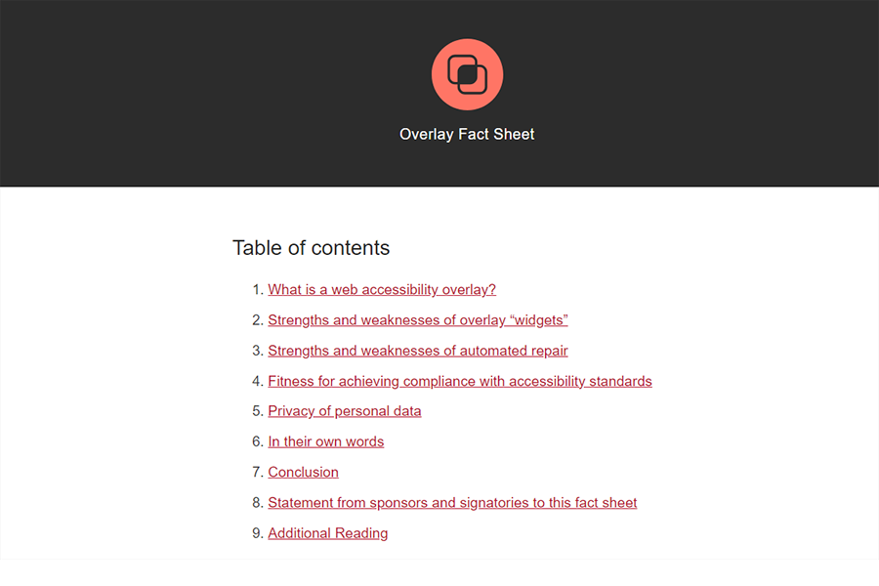
Overlay Fact Sheet
Screenshot of Overlay Fact Sheet home page
Notes:
These are serious considerations, and more detail is available at the Overlay Fact Sheet website.

Slide 15
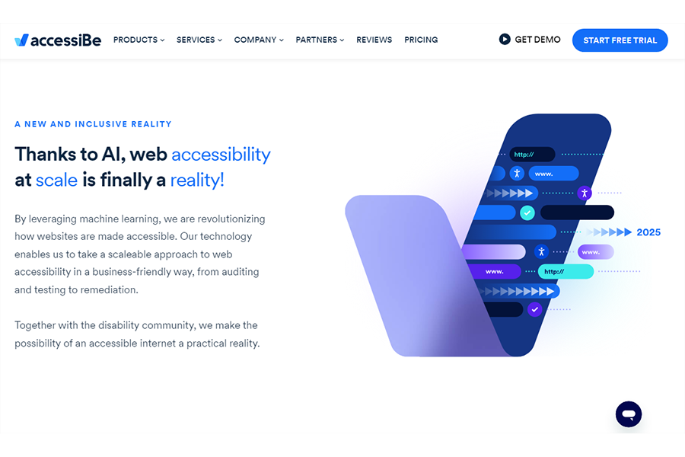
accessiBe
Screenshot of accessiBe home page
Notes:
This talk is about AI, so we’re going to focus on overlays that use - or claim to use - Artificial Intelligence. Let’s take a look at one that does go into some detail: accessiBe. The accessiBe home page tells us that “Thanks to AI, web accessibility at scale is finally a reality.”

Slide 16
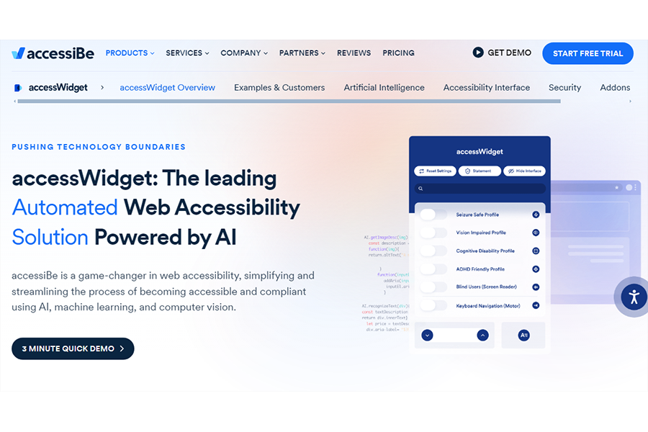
The accessiBe Claim
Screenshot of accessWidget landing page
Notes:
Its accessWidget claims to be “The leading Automated Web Accessibility Solution Powered by AI”.
“accessiBe is a game-changer in web accessibility, simplifying and streamlining the process of becoming accessible and compliant using AI, machine learning, and computer vision.”
The accessWidget product consist of two parts, one a process that operates in the background, the other a widget on the user interface that a user can configure.

Slide 17
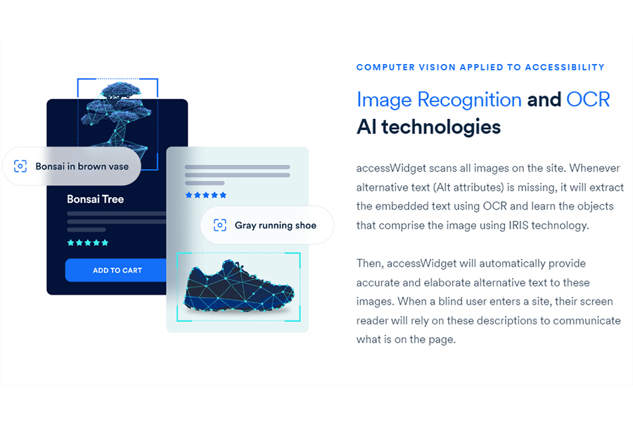
How accessiBe uses AI
Website quote on role of AI in accessWidget
Notes:
Under the heading “Computer vision applied to accessibility”, accessiBe tells us:
“accessWidget scans all images on the site. Whenever alternative text (Alt attributes) is missing, it will extract the embedded text using OCR and learn the objects that comprise the image using IRIS technology.”
OCR is Optical Character Recognition, a technology that’s been around for many years and is used in many contexts to turn images of text, such as scanned documents or on web pages, into actual text that can then be manipulated. It’s probably one of the oldest technologies that can be described as AI.
I had to dig beyond the accessiBe website to find out what “IRIS technology” is. It refers to an advanced form of Machine Vision using Deep Learning and Neural Networks to identify image content (not to be confused with “iris recognition”, which is about scanning eyeballs to authenticate identity).
Basically, IRIS is trained off a database of images that must be sufficiently representative (in other words, huge) to “interpret” and “recognize” images. How it does this is not clear, and certainly not explained by accessiBe.
“Then, accessWidget will automatically provide accurate and elaborate alternative text to these images. When a blind user enters a site, their screen reader will rely on these descriptions to communicate what is on the page.”
The claim is that “These adjustments are compatible with popular screen readers such as JAWS, NVDA, VoiceOver, and TalkBack”, a claim some dispute.

Slide 18
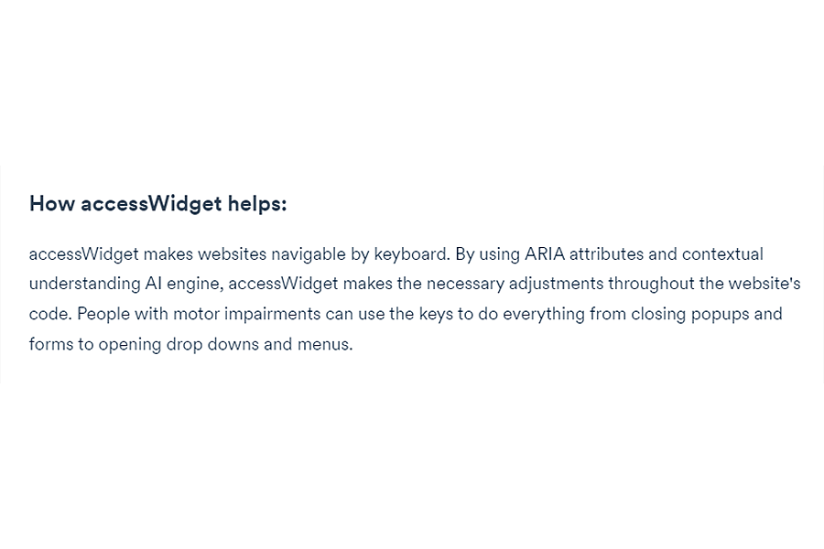
accessWidget in background
Illustration of widget
Notes:
Which specific AI technologies are used to ensure keyboard accessibility is even less clear.
“accessWidget makes websites navigable by keyboard. By using ARIA attributes and contextual understanding AI engine, accessWidget makes the necessary adjustments throughout the website’s code. People with motor impairments can use the keys to do everything from closing popups and forms to opening drop downs and menus.”
So, accessWidget uses an automated checking tool to find accessibility issues on functional elements, and then uses JavaScript to apply ARIA roles, attributes, and labels to make those elements keyboard accessible. What role AI plays in this is not specified.
With all this going on in the background, this part of accessWidget might be better described as an “underlay” rather than an overlay.

Slide 19
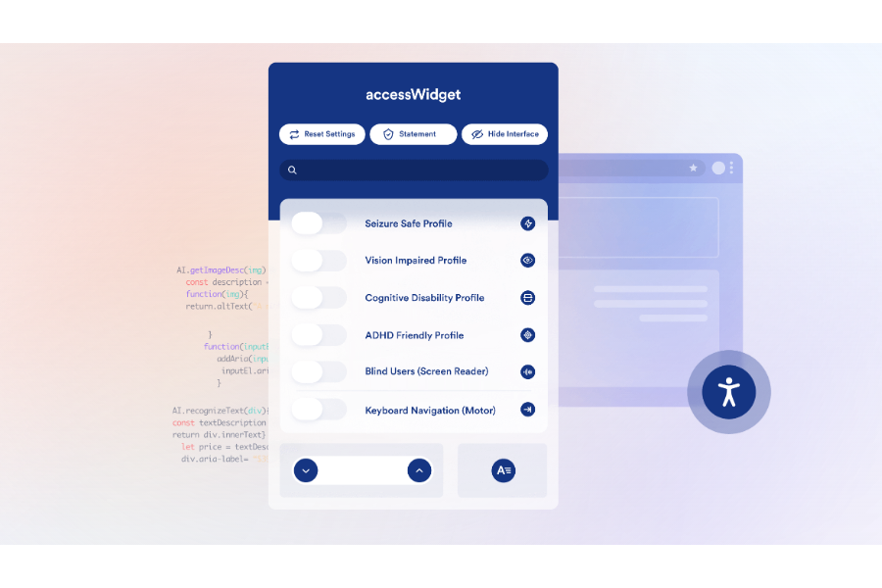
The accessWidget widget
Illustration of widget
Notes:
But there is also an overlay widget in accessWidget, which may be installed on the user interface. This has a number of generic user profiles that can be turned on and customized by the user, or turned off completely. In fact, the website owner doesn’t have to install the widget at all, and can just rely on the background process.
The accessiBe logic seems to be to use unexplained AI technologies in background, and let the user configure a relatively straightforward front end widget as they wish.
Ultimately, then, we’re left with one over-arching question regarding the use of AI in digital accessibility overlays.
“Is the claim of some overlays that the use of AI provides fully automated functionality that can identify and remediate all WCAG issues on a website, with no human intervention, valid?”
On the available evidence, the answer has to be “Not completely”, or “Not yet”, or just “No.”

Slide 20
Automatic Captioning

Slide 21
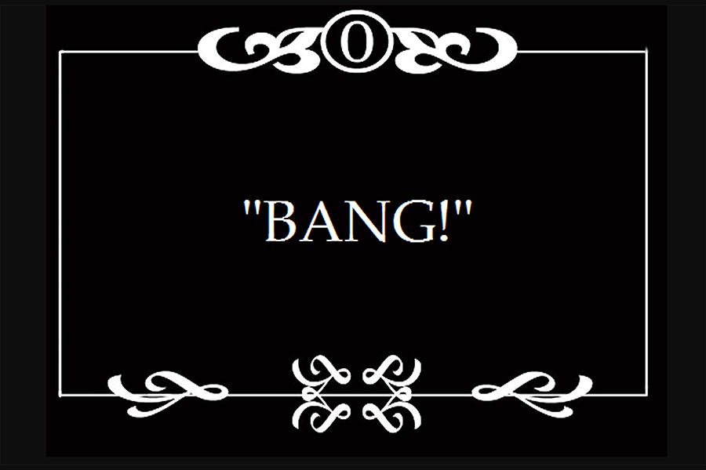
Early Captions
A silent movie caption card that says “Bang!”
Notes:
Captions have been around ever since we’ve had moving images, from caption cards used in silent movies to convey key dialog and sound effects, to the subtitling in one language of movie dialog delivered in another.

Slide 22
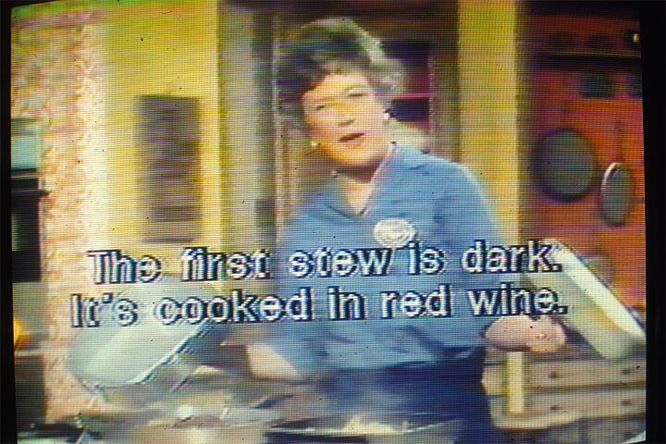
Open Captioned TV
a TV screen grab of The French Chef with captions - WGBH
Notes:
Julia Child’s cooking show The French Chef was the first TV show to trial captions in 1972. The show was recorded live in the studio and the captions were then burned on to the print afterwards, which meant they couldn’t be turned off or adjusted, what we now call open captioning.
By the 1980s, technology had advanced to making available closed captions that could be turned on and off, albeit via a relatively expensive decoder, and legislation was introduced mandating the provision of captions for pre-recorded television.

Slide 23
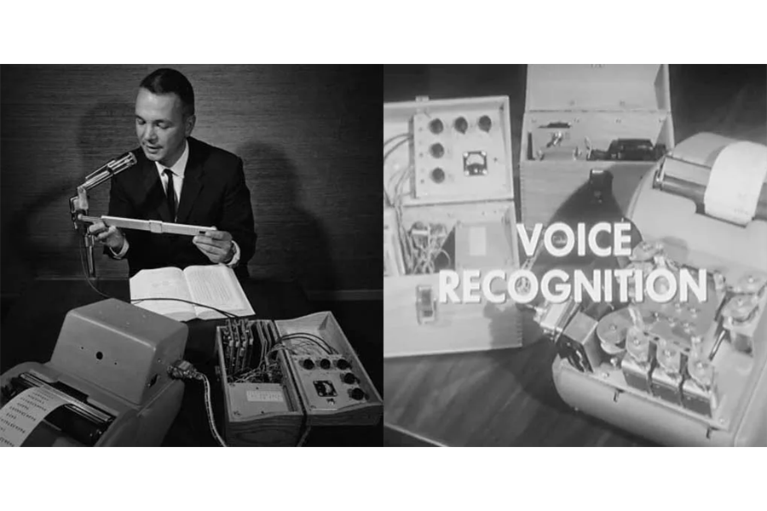
Speech Recognition I
1950s speech recording and an early transcription device - Beyond Design
Notes:
Meanwhile, speech recognition and text-to-speech models were being developed for single-speaker voice recognition with very limited vocabularies, with machines trained to recognize speech from one specific person - if they only used certain words - and render them as text.

Slide 24
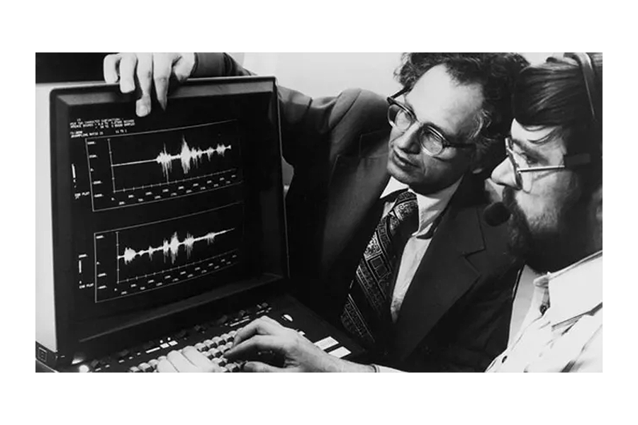
Speech Recognition II
1980s computerized speech recording - Electronic Products
Notes:
By the 1980s, though, machine vocabularies were larger than those of the average person, and had become speaker-independent. Computerization was making speech recognition much more reliable and useful.
A big breakthrough came in the 2000s when probability logic - how well a machine could guess the right word - was overtaken by Long Short-Term Memory (LSTM), a form of Deep Learning that can remember “hearing” a word from thousands of steps ago.

Slide 25
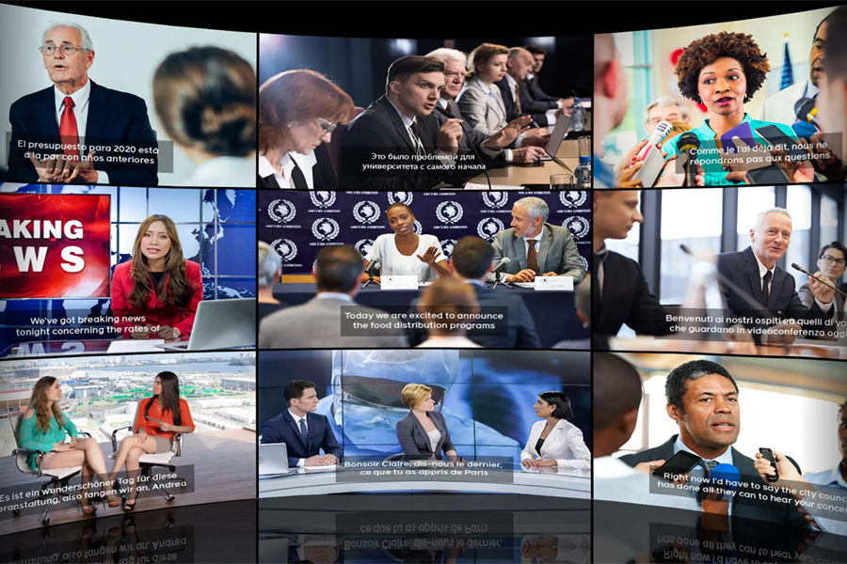
Facebook Captioning
Screenshot Facebook captioning - Meta
Notes:
Greater computing power, larger datasets and LSTM brought speech-to-text into the AI family, where it became known as Automatic Speech Recognition (ASR), the basis for automated captioning functionality currently offered by video providers like YouTube, Vimeo and Facebook, by activating a control on the user interface. AI for the win!
Well, nearly. When Google made this available on YouTube in 2009, even in its moment of automated glory, it had to admit that the quality of its auto-captioning was not always very good.

Slide 26
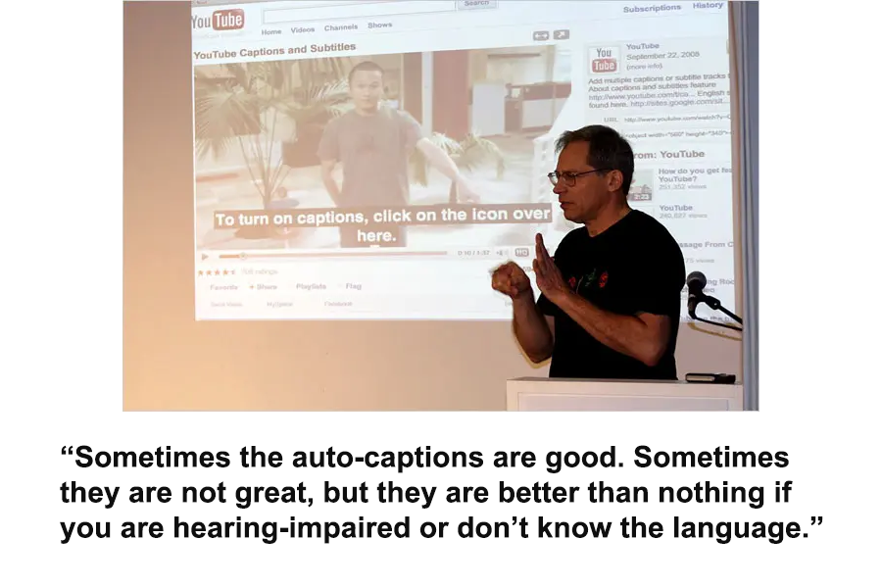
YouTube Captioning (2)
Ken Harrenstien - New York Times
Notes:
The New York Times quoted deaf Google engineer Ken Harrenstien as saying at the launch, “Sometimes the auto-captions are good. Sometimes they are not great, but they are better than nothing if you are hearing-impaired or don’t know the language.”
And there’s the rub with ASR. It isn’t very good, and it isn’t getting much better.
And let’s be clear about what we mean by “very good”.
In the 2023 State of Automatic Speech Recognition report by 3PlayMedia (a vendor of video accessibility services), no automated captioning from ten different vendors achieved a Word Error Rate of less than 6.86%. Once formatting like punctuation and capitalization was taken into account, none of the vendors had a Formatted Error Rate of less than 17.2%.
That equates to about one in six words being incorrectly captioned - at best. Some auto-captioning vendors had error rates as high as 42%.
With regard to web content, it should be noted that while standards like WCAG require the provision of captions in some contexts, they have little to say about quality, how accurately captions convey dialog.
In television contexts, though, the FCC is much more specific, requiring 99% accuracy. If that standard was included in WCAG, no web pages with auto-captioned videos would conform. In some ways, AI has made some captioning issues worse. Where earlier forms of automated captioning might admit something is “indecipherable”, AI-powered ASR tends to supply something, even if it is wildly inaccurate.

Slide 27
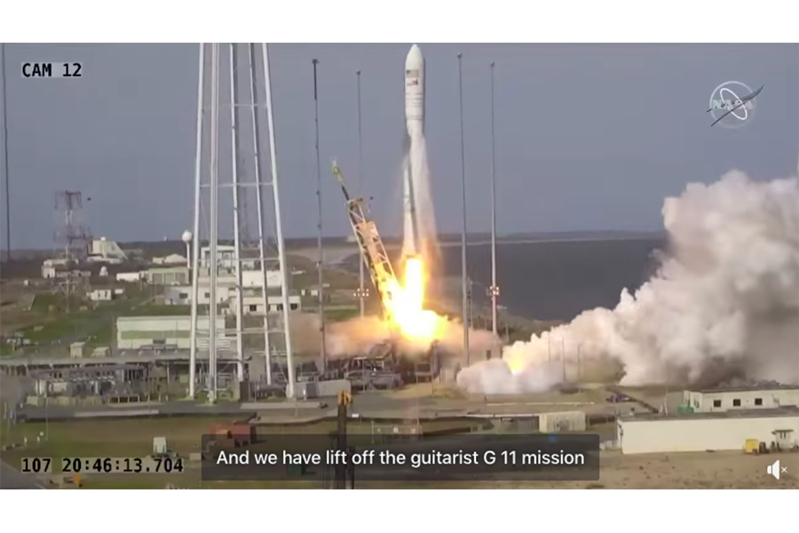
Rocket Launch I
Screenshot of video of NASA rocket launch with Facebook Captioning - Mashable
Notes:
The caption here says, “And we have lift off the guitarist G 11 mission”. What was said was, “And we have lift off of the Antares NG-11 mission.” It’s entirely possible that some of the current barriers to greater accuracy, such as that ASR engines respond better to a single voice rather than multiple voices, will be overcome but probably not in the very near future.
In the meantime, to get decent captioning, a user has to upload the video, download the automatically generated captions file, edit it for accuracy, and re-upload it. Or pay a commercial service to do it.
It’s interesting that a major provider like Rev.com has developed an automated captioning service alongside its manual service, but concedes that the manual service is much more accurate.

Slide 28
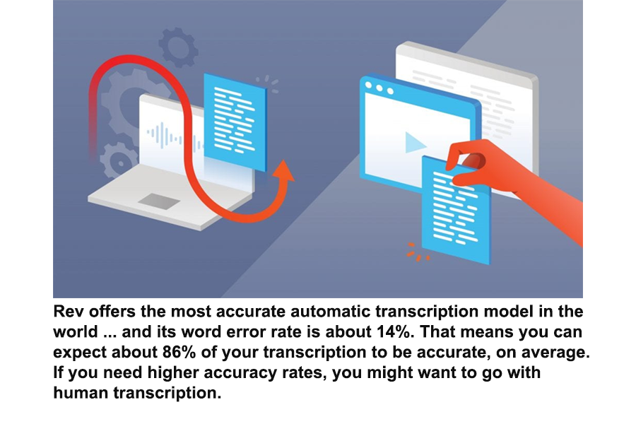
Automatic v. Human
Quote from Rev - Rev
Notes:
“Rev offers the most accurate automatic transcription model in the world … and its word error rate is about 14%. That means you can expect about 86% of your transcription to be accurate, on average. If you need higher accuracy rates, you might want to go with human transcription.”
For the foreseeable future, like many forms of AI-powered functionality, a human touch is needed to ensure captioning accuracy.

Slide 29
AI and Alt Text

Slide 30
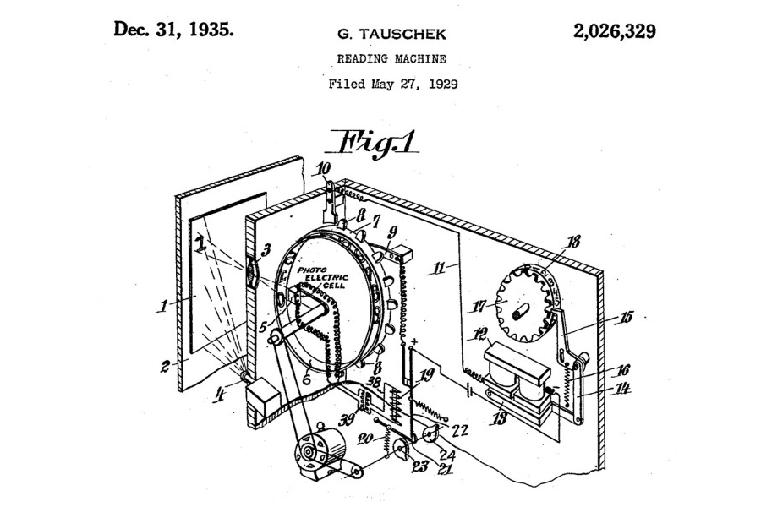
AI alt text history I
Drawing of 1935 patent application for reading machine – Veryfi
Notes:
Using machines to analyze and report on the content of images is not at all new.
OCR was an outcome of pre-World War I experiments with telegraphy and creating reading devices for the blind.
One of these projects developed the capacity to read printed characters and convert them into telegraphic code.
Another used a handheld scanner that produced a range of audio tones that corresponded to different characters printed on a page.

Slide 31
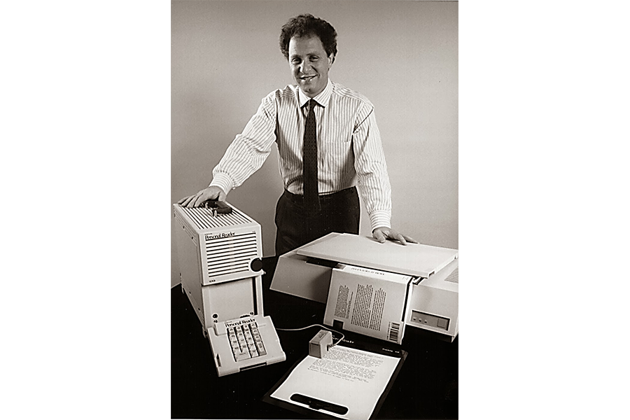
AI alt text history II
Ray Kurzweil and his reader – Pedersen Recovery
Notes:
It was Ray Kurzweil in the 1970s who created the breakthrough technology that enabled a machine to read out text content to blind people, combining a flatbed scanner with synthesized text-to-speech.

Slide 32
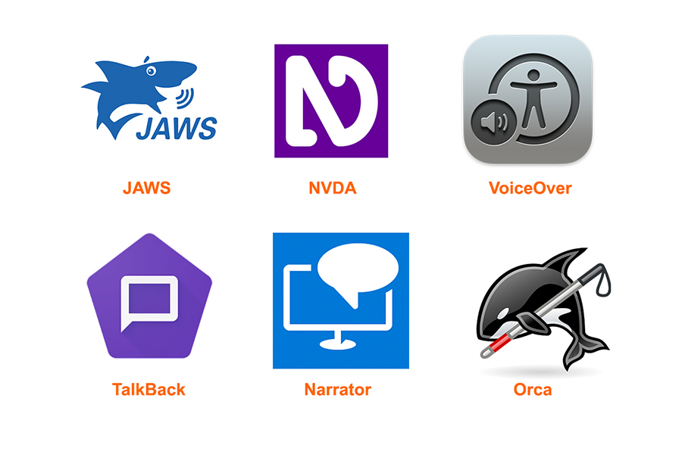
AI alt text history III
Logos of JAWS, NVDA, VoiceOver, TalkBack, Narrator, and Orca screen readers
Notes:
Nowadays, as well as being used in dozens of applications that require translating a picture of text into text, OCR is a core part of screen reader technology. It’s not generally thought of as AI, but it does fall into that part of the AI family known as text-to-speech.
And that’s why alt text is important. Screen readers read out text, whether that’s visible text on a web page or hidden text describing an image. They can use OCR to read out images of text (with varying levels of accuracy), but without that visibly hidden alternative text, screen readers don’t describe other images - yet.
Back in the 1970s, some of that same OCR technology was being used to develop Computer Vision (CV), a technological way of analyzing and reporting on the content of a much wider range of images than just text.
It was very much seen as part of the nascent development of AI, automating tasks associated with the human visual system.

Slide 33
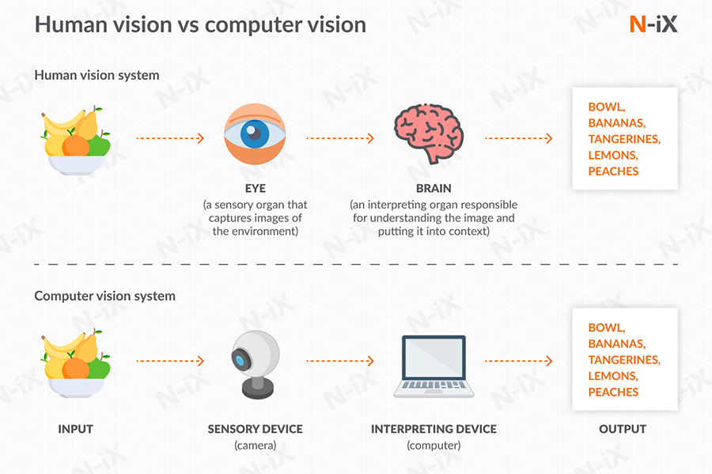
Computer vision I
Comparison of human and computer visual systems – N-ix
Notes:
Many of the algorithms developed then are still in use today, such as the ability to discern edges, implied structure, the labeling of lines, and motion estimation in videos.

Slide 34
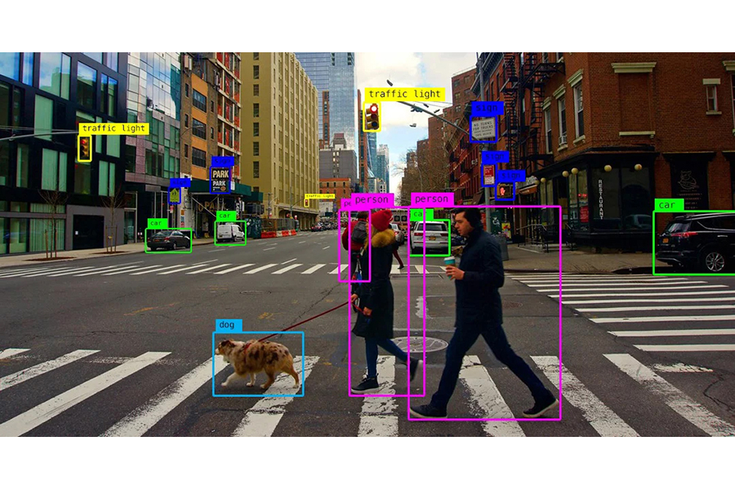
Computer vision II
Example of computer vision image labeling – Algotive
Notes:
As more sophisticated algorithms developed, the massive recent increases in datasets and the processing power to analyze them has led to Machine Learning and Deep Learning techniques being applied to Computer Vision to produce truly remarkable advances in image recognition and description.
So, CV + ML + DL should equal great alt text, right?
Well, we all realize it’s not that simple.
Producing text that describes an image in an automated, mechanical way is not the whole story of what makes good alternative text for accessibility purposes.

Slide 35
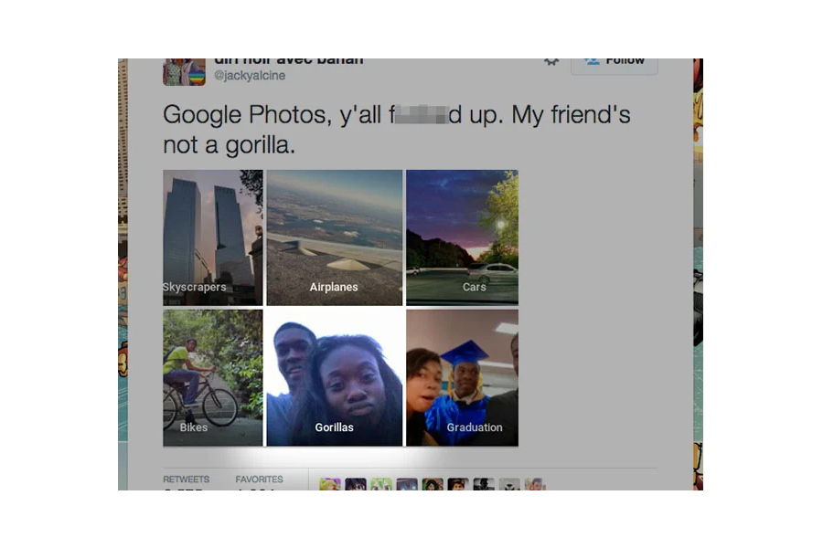
Auto tagging I
Screenshot of offensive Google autotagging – Peta Pixels
Notes:
Early efforts revealed limitations in datasets that made machines produce text that was neither accurate nor appropriate. In 2015, Google Photos was rightly criticized for offensive auto-tagging of photos of African Americans.
But larger datasets and better analysis are improving that greatly.
The frontier we now face is context. Isolating an image from the context of its web content does not produce good alt text.

Slide 36
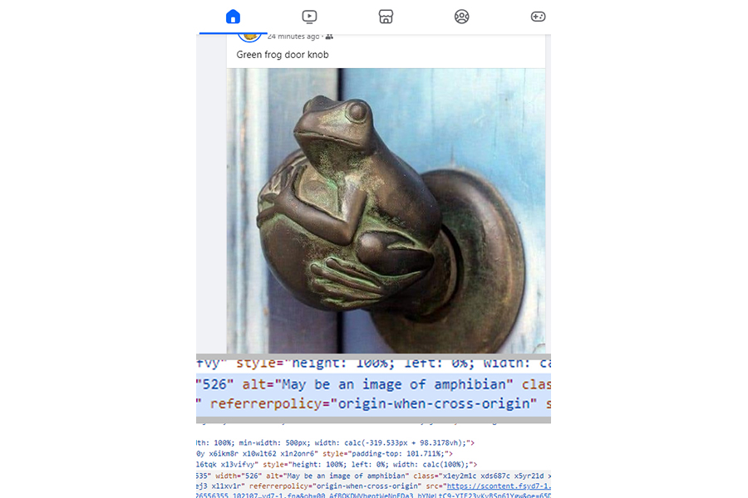
Auto tagging II
Door knob in the shape of a frog – Facebook
Notes:
With this image, Facebook’s alt text generator ignored the text of a message: “Green frog door knob”, and concluded that this “May be an image of amphibian”, which is not untrue but doesn’t tell a screen reader user that it’s a door knob in the shape of a frog.

Slide 37
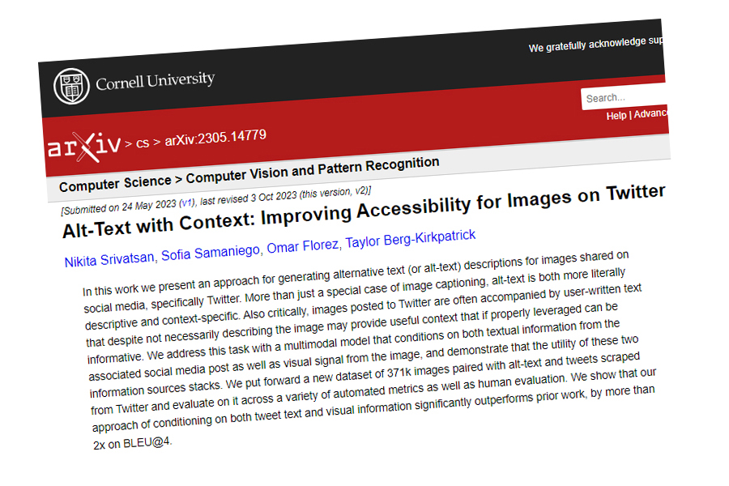
Context I
Screenshot of academic abstract - Cornell University
Notes:
However, there are currently underway projects to teach machines to analyze surrounding text and other images on a web page (or social media post) and generate alternative text for a screen reader that equates to that which would be added by a human.
With the kinds of technologies we’re talking about, this is by no means an insurmountable task.

Slide 38
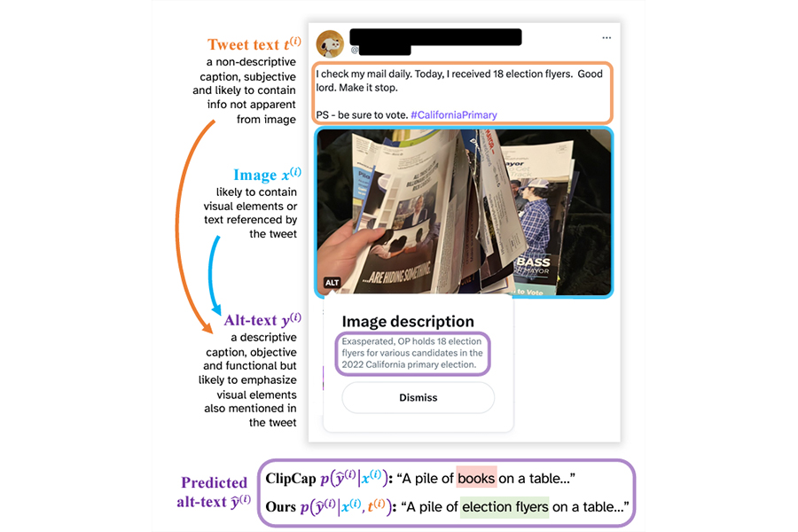
Context II
Screenshot of text generation logic - Cornell University
Notes:
This slide shows the analysis of a social media post that says “I check my mail daily. Today, I received 18 election flyers. Good lord. Make it stop. PS - be sure to vote. Hashtag California Primary”, with a photo of a hand holding multiple election flyers.
Logic flows for deciding on the image content are then described, resulting in automatically generated alt text, “Exasperated OP holds 18 election flyers for various candidates in the 2022 California primary election”. The AI has correctly assessed image-relevant content to include in the alt text from the tweet text, including what “election flyers” means, what the hashtag refers to and the tone of the tweet.
In fact, it’s not unreasonable to expect that some AI alt text generators are already better at this than human beings. Anyone who’s audited more than a few websites knows that human-generated alt text is often variable at best.

Slide 39
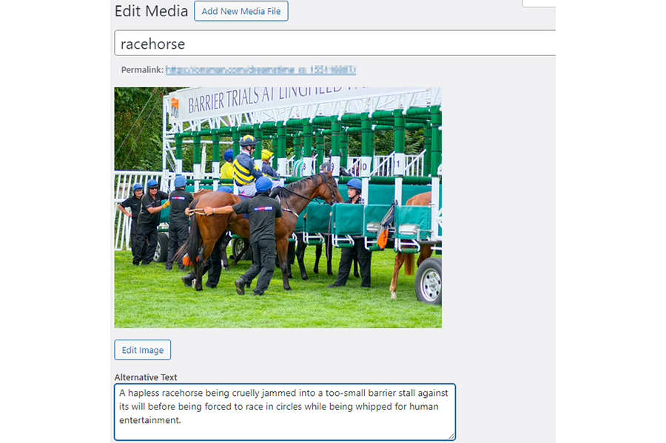
Human alt text
Racehorse entering a barrier stall
Notes:
For the alt text of this photo of a racehorse entering the barrier before a race, a human wrote:
“A hapless racehorse being cruelly jammed into a too-small barrier stall against its will before being forced to race in circles while being whipped for human entertainment.”
This alt text was written for a sports news portal, not for a site protesting cruelty to animals.
In many ways, a machine working off a massive dataset may be better placed than a human to analyze an image’s context and choose a description that fits the purpose of the web content.

Slide 40
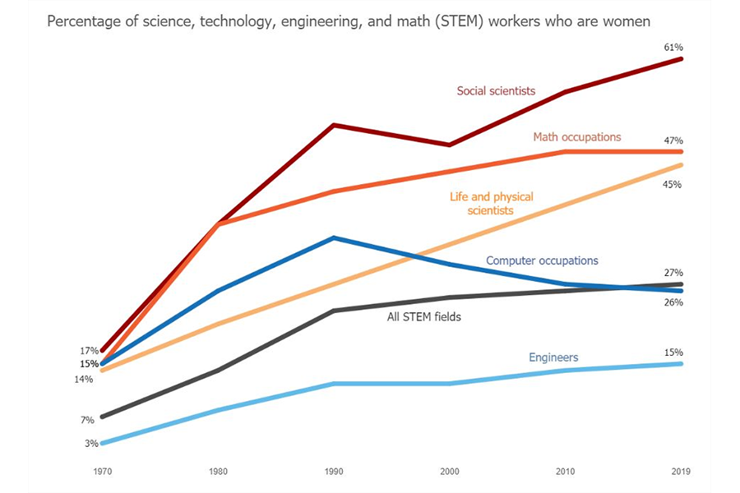
Complex images
Graph showing percentage of women in STEM jobs
Notes:
This extends to complex images, diagrams and illustrations. Charts and graphs visualize not just data, but relationships between data. That’s their purpose, to show at a glance what might otherwise not be very apparent from a table of numbers.
AI alt text generators can already describe these relationships, working off the original tabular data used to generate the images to create alt text such as “the percentage of female STEM workers rose 20% between 1970 and 2019, with the greatest increases in social science and math occupations”.
I do have a caveat. There is a current generation of AI-powered alt generators that focus on search engine optimization rather than accessibility. Keyword stuffing is, of course, just a reflection of how many humans currently regard alt text - AI just automates it.
Nevertheless, there’s no reason purpose-specific AI tools can’t be used now to analyze an image and its context to calculate appropriate alt text. However, what if AI could be used to generate not just alt text it thinks is “right”, but alt text that it calculates to meet the needs of each user - every user, in every context.
That’s where AI is going, and where this talk is going next.

Slide 41
AI in personal lives of people with disabilities
Notes:
In the next section, lets look at a few examples of how AI can directly affect the daily lives of people with disabilities today.

Slide 42
Examples of AI as personal disability aid
Generative voice AI
Synthetic speech, but more natural and ‘human sounding’
Text to speech, speech to speech
AI powered hearing aids
AI powered limbs
Computer vision
Personalized AI responses
Notes:
There are plenty of examples out there. For example, generative voice AI provides a more human and natural sounding form of synthetic speech. This is useful for text to speech solutions like professional sounding book narrations. It can also be used for speech to speech solutions, providing a personal voice to people who have lost, or are losing, their own voice.
There’s AI powered hearing aids, which can filter out irrelevant background noise in a more intelligent way, or AI powered artificial limbs that allow for more natural and intuitive control over the prosthetic.
But the two examples I would like to spend a bit more time on in this talk are computer vision and personalized AI responses.

Slide 43
Computer vision as disability aid
Describes pictures to people who are blind or have low vision, and allow them to ask follow up questions.
Why is it a game changer?
‘perfect alt’: does not exist.
you will never know what every single user needs or wants to know about your image
Let user decide:
level of detail
Specific interests
follow up questions / corrections
Notes:
So let’s start with computer vision. To simplify Ricky’s definition from earlier, computer vision basically attempts to make sense of an image in the way a human would, and describe that image to a person who can’t see it.
So why is computer vision as a disability aid such a game changer? It’s because in the end, the perfect alt text does not exist. You will never know what every single individual consuming your content needs or wants to know about your image.
Rather than us trying to think of every detail to describe an image with, or using auto-tagging to do that for us, why not let the user decide how detailed they want their image description to be, what specific aspects of the image they’re interested in, and what follow up questions they might have about it? With computer vision this is possible, and that’s why it’s a game changer. It’s like having the longdesc attribute back, and having somebody else write its contents for you!

Slide 44
Be My AI
Part of Be My Eyes app
Uses ChatGPT4’s computer vision
Describe images from anywhere, not just camera:
Photos app
Messaging app
Website (iOS VO: double tab long press > ‘Share’ > ‘Describe with Be My Eyes’)
Ask follow up questions
Share chat transcript
Notes:
Let’s have a closer look at an app feature that specifically uses computer vision to aid blind and low vision users: Be My AI. One thing that I really like about it, and what some of its users might not be aware of, is that it doesn’t limit you to just describe pictures taken on the spot with your device’s camera. You can send images to be described with Be My AI from any app that lets you open a ‘share’ menu for images. This includes web page images in Safari.
Another great feature is that after you ask Be My AI questions about your image, you can then create a link to your chat log to share what you learned with others who might need the information.

Slide 45
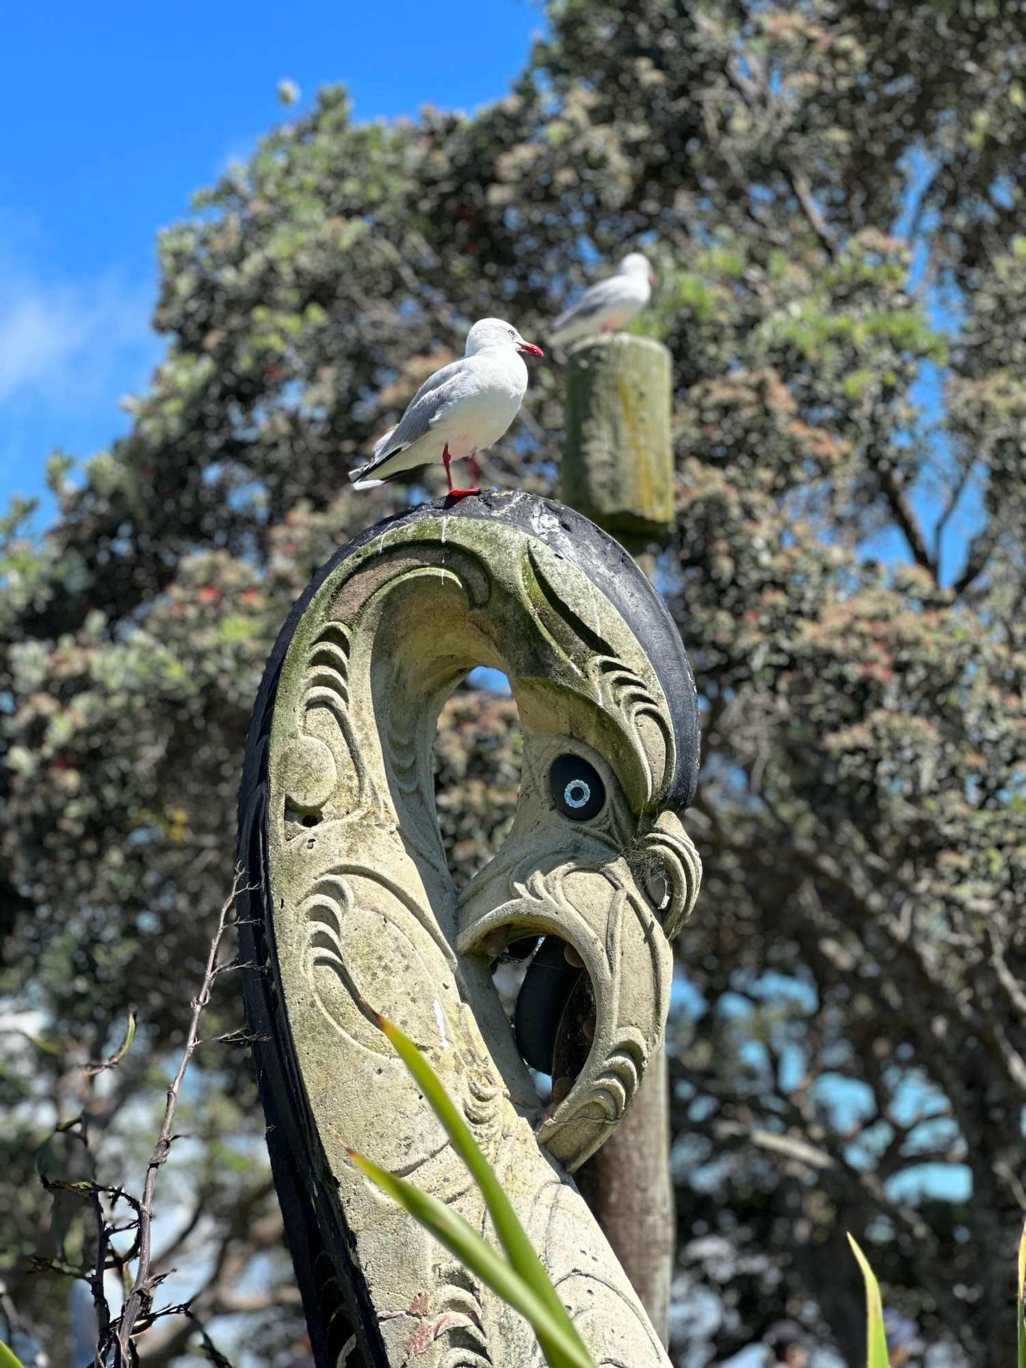
Computer vision example: Learning more about an image
“The picture shows a clear blue sky with a few trees in the background. In the foreground, there is an ornate, weathered stone carving resembling a Māori design, with a circular hole in the middle and a spiral pattern around it.
Perched on top of the carving is a white bird with grey wings and a red beak, possibly a seagull. Behind it, on a similar stone post, is another similar bird.” (chat log)
Seagull perched on a Pouwhenua
Notes:
Here’s a basic example of using Be My AI to learn more about an image. If I had to provide an alt text for this photo, I might describe it as “seagull perched on top of a pouwhenua”. For those of you who don’t live in New Zealand, a pouwhenua is a type of marker post that is used in Māori culture, used to mark important boundaries or places of significance.
And Be my AI describes it really well:
“The picture shows a clear blue sky with a few trees in the background. In the foreground, there is an ornate, weathered stone carving resembling a Maori design, with a circular hole in the middle and a spiral pattern around it.
Perched on top of the carving is a white bird with grey wings and a red beak, possibly a seagull. Behind it, on a similar stone post, is another similar bird.” end quote.
You’ll notice it provides a decent amount of detail, without going overboard. It was able to answer my follow up questions, which I’ve linked to on this slide, perfectly. It told me that this was likely a pouwhenua, and that the picture was probably taken in New Zealand. Perfect!

Slide 46
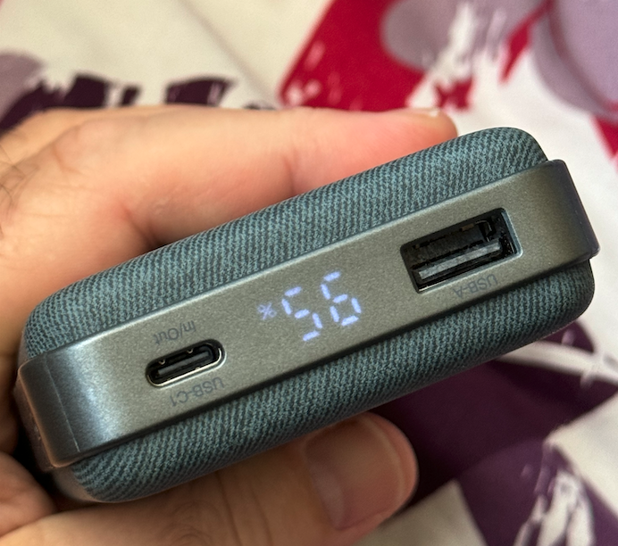
Computer vision example: getting it wrong
“How much battery percentage do I have left on my power bank?”
Notes:
For the next example, let's play a little game, and see if you are smarter than an AI. For anybody who is close enough to see the screen, imagine if a blind person showed you this photo of a power bank, and asked you how much battery percentage they had left. What would you answer? Feel free to shout out.
If you said 56%, you are just as wrong as every AI chat system I tried this with, because the power bank in this photo is actually being held upside down, and the real answer is 95%.
This goes to show that AIs can and will get things wrong, which makes them a less than ideal choice for advice on potentially dangerous subjects, such as medicine labels or safety instructions.

Slide 47
Computer vision in screen readers
PictureSmart AI for JAWS
Added in March 2024 release
Descriptions provided by ChatGPT4 and Gemini
Choose short or long description
Follow up questions feature coming soon
NVDA addons, such as AI Content Describer
Requires Open AI API key and payment
Notes:
On desktop, you can actually make use of computer vision directly from within your screen reader.
For JAWS, the recent March 2024 release added a new feature called Picture Smart AI, which allows you to request a detailed description for any image on your PC, including images on web pages. The descriptions are provided by both ChatGPT4 and Google Gemini, and from what I understand there is going to be an update that will also allow you to ask follow up questions.
There’s similar functionality available for NVDA users, although it’s not built into the screen reader like with JAWS. You’ll have install an NVDA addon such as ‘AI Content Describer’, and provide your own Open AI API key that requires payment for ChatGPT4 output.

Slide 48
Personalized responses
Notes:
The other AI benefit I wanted to mention is the ability to adapt and personalize responses.

Slide 49
We learn in different ways
Content should adapt to us rather than vice versa
AI lets us personalize how information is presented to us
simplify language,
summarize it,
spend more time on certain presumed knowledge,
and so on.
Notes:
We are all different, and learn in different ways. But the content that we learn from generally comes to us in a fixed format. We have to adapt to it, when it really should be the other way around; content should adapt to our needs and preferences. With AI, it’s possible to transform and deliver information in a simplified format that works best for the person requesting it.

Slide 50
Example: simplifying WCAG
Me: “Can you explain WCAG success criterion 2.5.1?”
ChatGPT: “… The main requirement is that all functionality that uses multipoint or path-based gestures for operation can also be operated with a single pointer without a path-based gesture…” etc.
Me: “Can you explain it using less complex terminology, to someone who is confused by the term ‘pointer gestures’”
ChatGPT: “… Imagine you’re on a website or using an app. Sometimes, you need to do things like spread two fingers apart on the screen to zoom in, or swipe with your finger to move through pictures. These are called”complex gestures” because they need specific finger movements or more than one finger.
But what if someone finds it hard to make these gestures? Maybe they can’t move their fingers that way, or they only have one hand available. This is where the rule comes in. It says that websites and apps should let people do the same things without needing those complex gestures. For example…” – Chat log
Notes:
Let’s try this with something that could really benefit from simplification: WCAG.
I asked ChatGPT to explain WCAG success criterion 2.5.1. which as you all know is the ‘focus obscured’ one. Again I have linked to the chat transcript on the slide.
It described the SC very well, with that WCAG style and jargon that we all know and love. Here’s a quote:
“… The main requirement is that all functionality that uses multipoint or path-based gestures for operation can also be operated with a single pointer without a path-based gesture…” etc.
This is fine if you know your WCAG stuff, but not everyone is going to get this immediately. So my follow up question was: “can you explain it using less complex terminology, to someone who is confused by the term ‘pointer gestures’”
And the response was:
“… Imagine you’re on a website or using an app. Sometimes, you need to do things like spread two fingers apart on the screen to zoom in, or swipe with your finger to move through pictures. These are called”complex gestures” because they need specific finger movements or more than one finger.
But what if someone finds it hard to make these gestures? Maybe they can’t move their fingers that way, or they only have one hand available. This is where the rule comes in. It says that websites and apps should let people do the same things without needing those complex gestures.” end quote.
I really like this simplified explanation, and it shows that getting the same answer in different formats can really make a big difference.

Slide 51
AI as recruiter
Notes:
Another way that AI currently affects the daily lives of people with disabilities is through the job recruiting process.

Slide 52
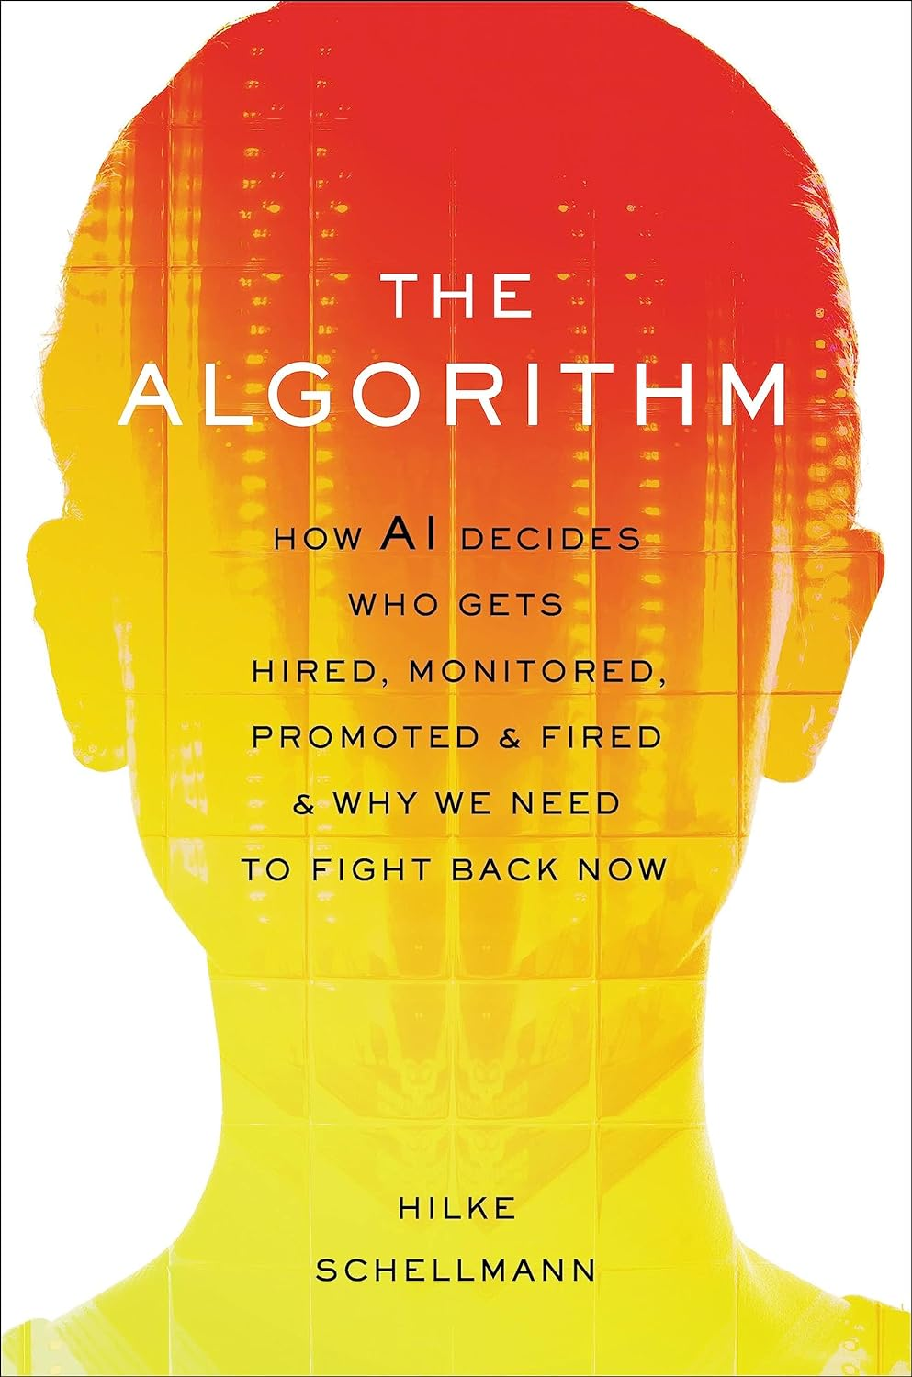
AI in recruiting procedures
Recommended reading: The Algorithm, by Hilke Schellmann
Notes:
If you want to learn more about this topic, I can strongly recommend the book ‘the Algorithm’, by Hilke Schellmann. She describes how it’s more and more common these days for AI to handle the initial stages of the online application process, and how this can put people with disabilities at risk of being significantly disadvantaged.

Slide 53
AI in recruiting procedures: risks for people with disabilities
1: General patterns vs. individual variances (one-size-fits-all approach)
2: Negative scores for disability-related factors
3: AI technology as ‘black box’
Notes:
Let’s look at some of those risks:
First of all, AI algorithms are good at recognizing general patterns rather than individual variances, and are often trained on large datasets representing average or typical behaviors. They may even be trained specifically on previously ‘high performing’ employees, a category in which people with disabilities will likely be underrepresented.
Secondly, disability-related factors can lead to negative scores, for example when applicants are required to do performance based tasks or play games involving reaction time. In addition, an AI algorithm might track an applicant’s speech or facial patterns during an interview, and unintentionally penalize patterns specific to disabilities.
Third, AI technology can easily be viewed as a ‘black box’ by the company that uses it. If AI recruiting tools are not transparent about how they assess candidates, it is difficult for employers to understand why certain applicants are rejected.

Slide 54
Using AI to create accessible content
Notes:
For the last segment, let’s talk about what AI can do for the creation of accessible content.

Slide 55
AI as accessibility ‘expert’
Most GPT chat flavors will handle basic accessibility related requests well
ChatGPT ‘passed’ my job interview
Ask it to:
explain accessibility concepts
find accessibility issues in your code and recommend fixes
Write accessible code
test plans
testing bookmarklets
JAWS scripts
etc.
Notes:
Can AI replace an experienced accessibility consultant? I would say that it can definitely perform some our tasks very well, if you know what to ask for and what to expect.
I thought it would be interesting to do a little Turing test with ChatGPT, and fed it the questions of the technical interview I used to hold with TPGi applicants. Some of these questions are quite tricky, involving code snippets, meant to trip up people who lack practical experience. I wanted to see if I would ‘hire’ ChatGPT if it was a person, purely based on its answers.
To my surprise, it pretty much answered much all of them perfectly, no matter the format or trickiness of the question.
So you can ask it to explain accessibility concepts, to find accessibility issues in your code, recommend fixes, and write accessible code. But you can also have it create things like accessibility test plans, bookmarklets, JAWS scripts, etc.
Wait a minute, that sounds a lot like all of our jobs!

Slide 56
GitHub Copilot: what can it do?
Article: Prompting GitHub Copilot Chat to become your personal AI assistant for accessibility
Answer questions
Explain what selected code does
Fix selected code
Recommend new code
Learn from your coding habits and project context
Notes:
Another popular AI tool that can help with accessible web development is GitHub Copilot. We don’t have enough time in this session to cover all its features, but I recommend reading the GitHub article called “Prompting GitHub Copilot Chat to become your personal AI assistant for accessibility”. I’ve linked to it here in the slide.
Suffice it to say that GitHub Copilot can do a lot of what ChatGPT can do: it will answer accessibility questions, and recommend, explain, or fix accessible code.
Where Copilot really stands out in my opinion is how well it integrates with your projects and development environment. Where ChatGPT requires you to submit isolated requests, Copilot learns from your project structure and coding style while you’re creating and editing that code. I’ve been using it a lot during the last few months, and have found a great time saver and teaching tool for during development.

Slide 57
Why you shouldn’t fully outsource accessibility to an AI
Most code out there is not accessible, so how could a model trained on it be?
Good for smoothing over small knowledge gaps, not big ones
Mistakes hard to catch due to eloquence and (over)confidence of response
Human expertise still needed, or you’ll crash
Notes:
But of course it’s not al perfect, far from it. We know that AI can and will get things wrong, and that it will confabulate. Accessibility is not exempt in this regard, and why would it be? Most of the code out there is inaccessible to varying degrees, so a model trained on it will inherit those flaws as well.
I think services like ChatGPT and Copilot are great for smoothing over small knowledge gaps, provided you have enough understanding about a subject and its context. Once those knowledge gaps become too deep and wide to be smoothed over, once you basically start outsourcing accessibility to the AI without learning anything about accessibility concepts yourself, you’re likely to get stuck fairly quick.
This is because you won’t be able to gauge or verify whether the responses you’re getting make common sense within the context of what you are trying to do. This is a problem with AI in general. The responses always appear well written, researched, and authoritative, which makes it a lot harder to recognize when it’s spouting absolute nonsense, unless you have the expertise to do so.
And this is something you’ll hear in every other AI talk: the need for the ‘human in the loop’. The copilot should never become the pilot, and human expertise will always be needed to keep the AI in check.
Without that, you’ll waste a lot of time trouble shooting the AI’s concoctions before you realize that your copilot actually already crashed the plane a while back. This is especially true for accessibility, where an incorrect approach can go unnoticed much easier and for much longer than with generic coding mistakes.
And that is why I’m not worried about my job just yet.

Slide 58
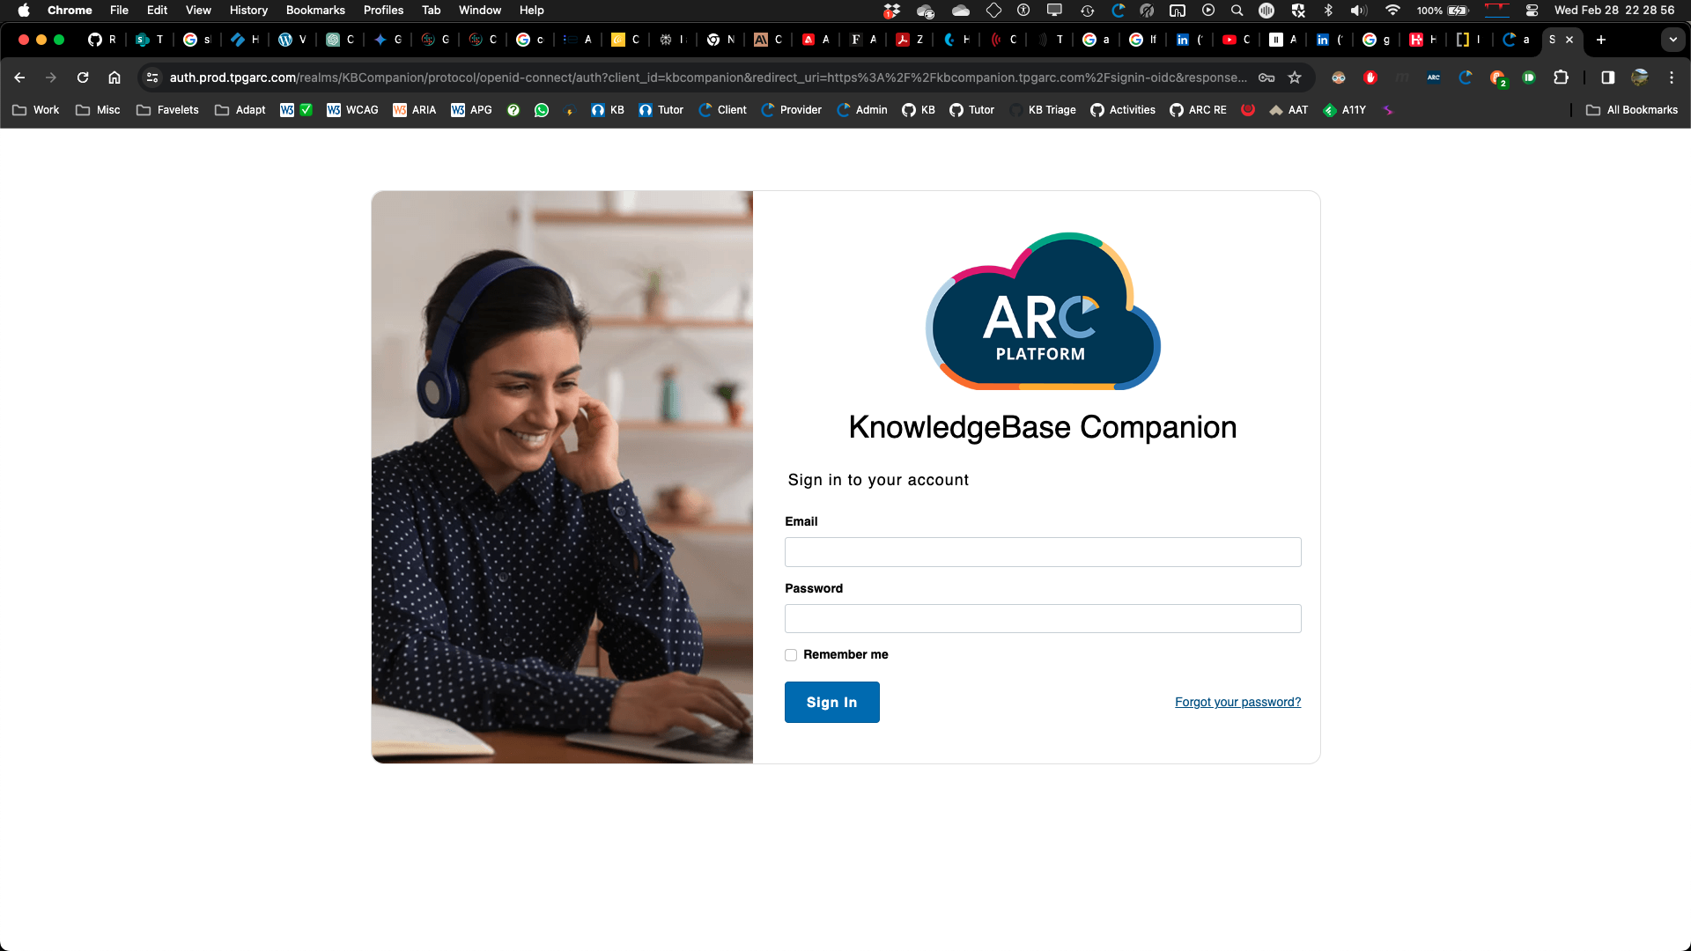
(Almost) everyone is experimenting with AI. So is TPGi
We’re exploring,
Looking into possibilities:
Wealth of data for training: knowledge base, Tutor, engagement audit data, helpdesk tickets
ARC KnowledgeBase Companion
Using AI to perform automated rules and assist manual testers
Keep an eye on our technical blog: tpgi.com/blog
ARC KB Companion
Notes:
As you probably have noticed, pretty much everyone is experimenting with AI these days, and so is TPGi.
We are exploring, looking into possibilities, of which there are many. We have a wealth of data that could potentially be used for training, such as our knowledge base, Tutor training courses, engagement data and helpdesk tickets.
We’ve built our own AI model, which we call the knowledge base companion, or Chat TPGi. We’re currently testing and training internally, it’s not available publicly just yet, and won’t be until it learns how to behave.
Then there are other possibilities, like using computer vision to detect inaccessible components for our automated rules, or AI driven tools to speed up the tricky and time consuming parts of manual audits.
Like I said, we’re still exploring at this point, but if there are any developments to announce, you’ll find them on our technical blog, which you can access through tpgi.com/blog.

Slide 59
Wrap-up
Notes:
So what key points can we take home from all of this?

Slide 60
Take away points about AI in A11Y
It’s all good, it’s all bad, it’s all ugly
Can hugely improve independence for people with disabilities
Can work against PWDs through exclusion or biases inherited from training data
Can be a great teaching tool for creating accessible content in a more productive way
‘Human in the loop’ always needed
Notes:
It’s all good, it’s all bad, it’s all ugly. All the AI advancements we talked about today can be great or horrible, depending on how they are used.
AI has the potential of hugely improving independence in the daily lives of people with disabilities
It can work against PWDs through exclusion or biases inherited from training data
It can be a great teaching tool for creating accessible content in a more productive way, but only if you know what you’re doing.
There will always a need to have a ‘Human in the loop’

Slide 61
Get in touch
Ricky Onsman @onsman@aus.social
Hans Hillen: @hhillen@mastodon.social
TPGi technical blog: www.tpgi.com/technical
TPGi Knowledge Center newsletter: email knowlege@tpgi.com
Notes:
That brings us to the end of our talk. If you want to get in touch with us, feel free to reach out to us on Mastodon or use the contact details provided with this webinar, and we’ll get back to you. Check out the TPGi technical blog, and sign up for our Knowledge Center news letter by sending an empty email to knowledge@tpgi.com. Thanks for attending!

