Slide 1
Why is Web Accessibility Important?
Webinar May 16, 2023

Slide 2
What is Web Accessibility?
Accessible Website: Users with and without disabilities have equal access to the website and the knowledge of how to use it.
Assistive Technology: Software or hardware that supports users with disabilities to access technology (screen readers, magnifiers, Braille displays).
Accessibility is not limited to hardware and software.

Slide 3
Accessibility Ends with “Y” and Begins with “Why”
  If you practice accessibility for the right reasons, you get better return on accessibility (ROA).
  This term was used at the 2023 CSUN Assistive Technology Conference.
  https://www.csun.edu/cod/conference/sessions/2023/index.php/public/presentations/view/1513

Slide 4
Moral Reason for Accessibility
It’s the right thing to do.

Slide 5
Legal Reason for Accessibility
ADA and similar regulations require reasonable accommodations including web accessibility.
Companies have been sued for inaccessible websites. Read the article below.
https://www.levelaccess.com/blog/title-iii-lawsuits-10-big-companies-sued-over-website-accessibility/

Slide 6
Guessing Game!
In the chat, guess what percentage of the world population has one or more significant disabilities.
Keyboard Shortcut for Chat: Alt+H for Windows, Command+Shift+H for Mac.

Slide 7
Business Case for Accessibility
World Health Organization (WHO) estimates 16% of world population, 1.3 billion people, has one or more significant disabilities.
https://www.who.int/news-room/fact-sheets/detail/disability-and-health#:~:text=Key%20facts,earlier%20than%20those%20without%20disabilities.
If they can’t use your service, they won’t generate revenue for you (as a customer, as an employee) even if they want to.
Craig Radford’s Dealership Story
https://www.linkedin.com/pulse/when-comes-accessibility-your-organization-reactive-craig-radford/
Accessibility gives you a competitive edge.

Slide 8
Personal Story #1: Leisure

Slide 9
Personal Story #2: Personal Banking

Slide 10
Personal Story #3:Education

Slide 11
Personal Story #4:Employment

Slide 12
Reactive versus Proactive Approaches to Accessibility
Reactive: Try to fix problems once found.
Proactive: Prevent problems by making products “born accessible” (a term used by Benetech).
https://bornaccessible.benetech.org/
Reactive is more costly over time.
Proactive accessibility gives you high ROA (return on accessibility).

Slide 13
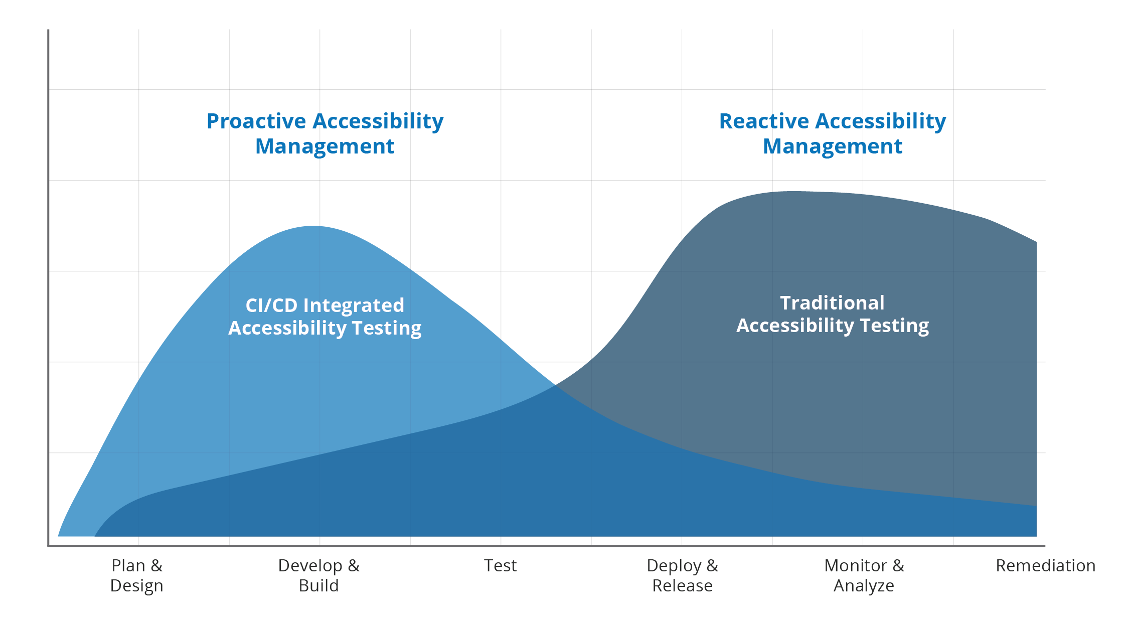
TPGI Proactive versus Reactive Chart, Retrieved from https://www.tpgi.com/arc-platform/monitoring/

Slide 14
Google Search with JAWS Demo

Slide 15
Be Part of the Solution in Less than 5 Minutes
Alt text.

Slide 16
Conclusion: How to Get a Positive Return on Accessibility
Using a proactive, “born accessible” approach:
Reduced accessibility cost because it’s integrated into regular processes.
Decreased costs of lawsuits.
Increased revenue from customers with disabilities.
Increased brand loyalty, especially if competitors are less accessible.
Increased diversity of talent by leveraging employees with disabilities.
Satisfaction of doing the right thing.
Net positive ROA.

